Slide 1
Disaster Tweet
Classification
Natural Language Processing • Machine Learning • Streamlit
Dataset
7,613
Hand-classified tweets
Final Model
81.09%
Tuned Linear SVM
F1 Score
77.85%
Final holdout test
ROC-AUC
87.09%
Final holdout test
Submitted by: Megha Parasher | Submission date: 15 Oct 2026

Slide 2
Background, Challenge & Objectives
02
Aligned with the official project brief
Background
Twitter can spread critical
information during
emergencies,
creating value for
automated real-time
disaster monitoring.
Challenge
Words such as “fire” or “flood” can be literal or metaphorical.
The model must distinguish real
disaster intent from non-disaster context.
OBJECTIVES
• Build a binary classifier for real disaster vs non-disaster tweets.
• Aim for high accuracy and precision to reduce false alarms.
• Handle slang, abbreviations and language variation.
• Create a scalable workflow suitable for real-time prediction.
NLP Project • Disaster Tweet Classification • Project Submission

Slide 3
Project Workflow
03
Four parts required by the project document
Part 1
Data Exploration
& Preparation
Part 2
Feature Engineering
& Model Selection
Part 3
Evaluation
& Validation
Part 4
Deployment with
Web Interface
→
→
→
• Our implementation also uses reusable Python modules so the notebook, validation code and Streamlit app share the same logic.
NLP Project • Disaster Tweet Classification • Project Submission

Slide 4
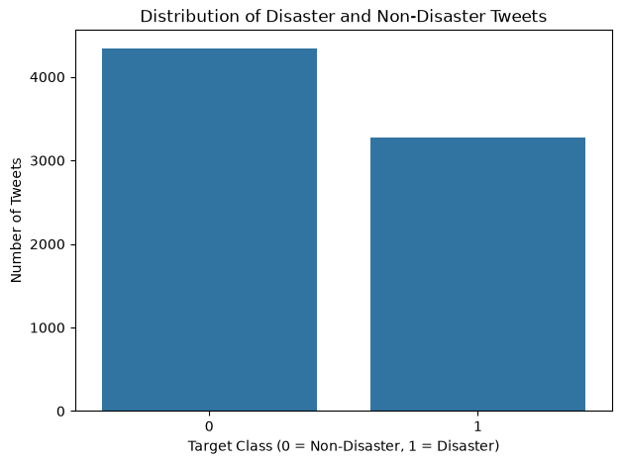
Part 1 — Data Exploration
04
Dataset structure and target distribution
Tweets
7,613
Dataset used in implementation
Non-Disaster
4,342
57.03%
Disaster
3,271
42.97%
Unique Texts
7,503
Distinct tweet texts
Columns
5
id • keyword • location • text • target
• Moderate class imbalance, but both classes have substantial representation.
• Stratified splitting was used to preserve class proportions.
• Initial checks covered shape, data types, missing values and duplicates.
NLP Project • Disaster Tweet Classification • Project Submission

Slide 5
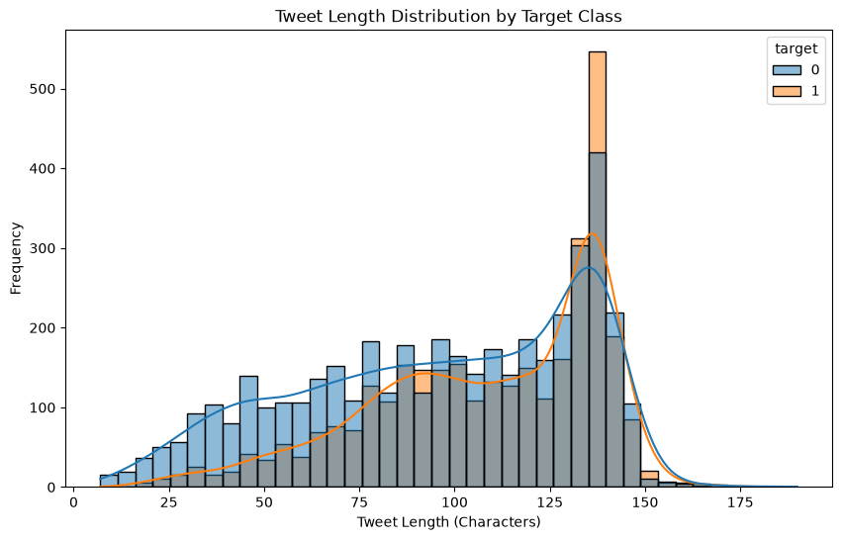
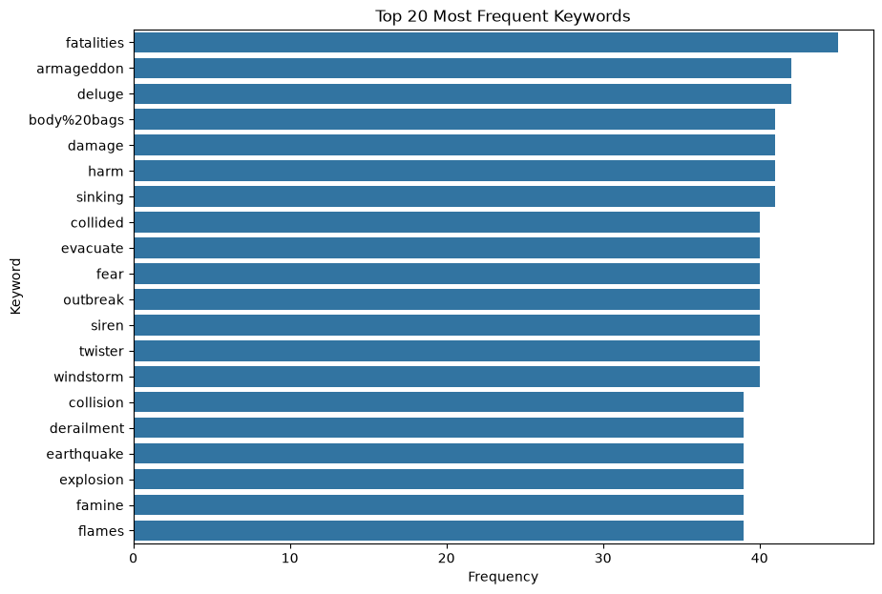
Part 1 — EDA Insights
05
Tweet length and frequent keywords
Tweet Length
Disaster tweets are more concentrated at longer lengths, but strong overlap means length
alone cannot classify reliably.
Keywords
Frequent keywords are disaster-related, yet the same vocabulary can appear in figurative or
unrelated contexts.
NLP Project • Disaster Tweet Classification • Project Submission

Slide 6
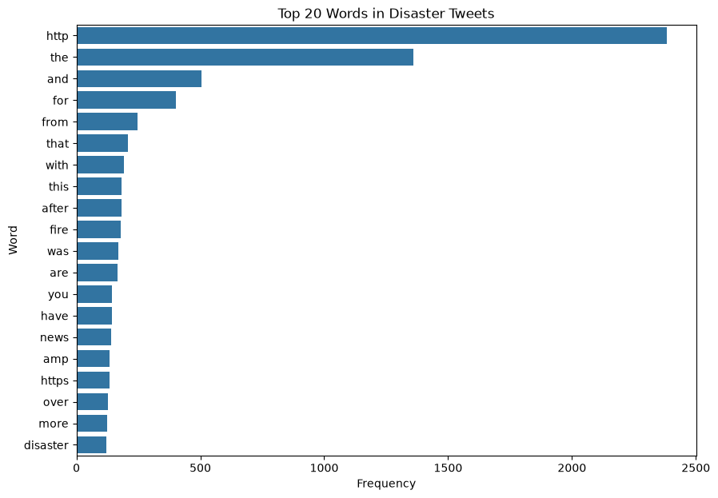
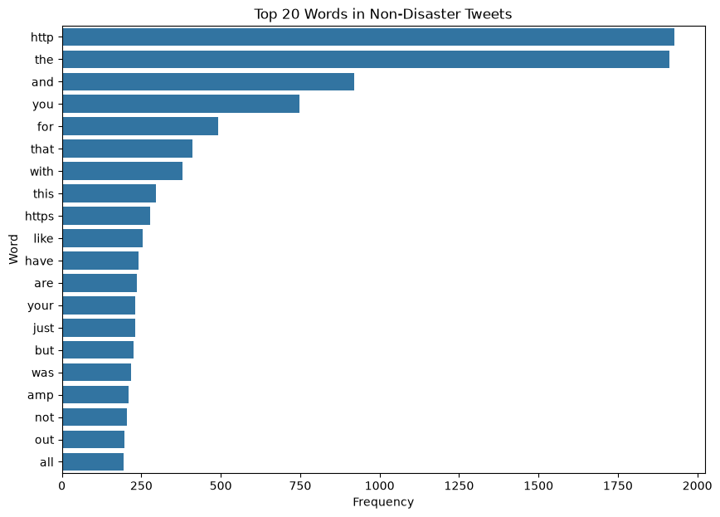
Part 1 — Data Preparation
06
Cleaning noisy social-media text before feature extraction
Missing Values
keyword/location filled;
required text/target
retained
Text Cleaning
lowercase • URLs • HTML
• mentions • special
characters
Token Processing
stop word removal +
lemmatization
Target
0 = Non-Disaster
1 = Disaster
Split
stratified train/test split
NLP Project • Disaster Tweet Classification • Project Submission

Slide 7
Part 2 — Feature Engineering
07
Text representation plus supporting tweet-level features
TF-IDF
Primary text representation. Tuned
final pipeline uses unigrams + bigrams.
Sentiment
Text Blob polarity was explored as an
additional feature.
Tweet Features
Length, word count, hashtags, mentions, URLs, ! and ?
counts.
Important Methodology
TF-IDF was fitted only on training data. For cross-validation and Grid SearchCV, TF-IDF stayed inside each Scikit-learn Pipeline so every fold
learned vocabulary independently and avoided leakage.
NLP Project • Disaster Tweet Classification • Project Submission

Slide 8
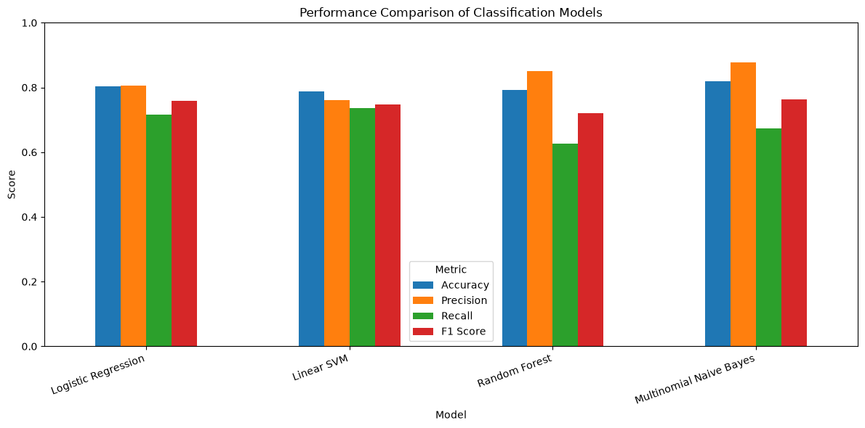
Part 2 — Model Selection & Training
08
Candidate models were compared before tuning
• Logistic Regression: strong balanced baseline.
• Linear SVM: strong recall and well suited to sparse TF-IDF features.
• Random Forest: high precision but lower recall.
• Multinomial Naive Bayes: best initial accuracy and precision.
NLP Project • Disaster Tweet Classification • Project Submission

Slide 9
Part 3 — Initial Model Evaluation
09
Accuracy, precision, recall and F1-score
Model
Accuracy
Precision
Recall
F1
Logistic Regression
80.37%
80.55%
71.56%
75.79%
Linear SVM
78.73%
76.03%
73.70%
74.84%
Random Forest
79.19%
85.03%
62.54%
72.07%
Multinomial NB
82.01%
87.85%
67.43%
76.30%
• Naive Bayes led the initial evaluation in accuracy, precision and F1.
• Linear SVM had the highest initial recall.
• These initial results were followed by leakage-safe cross-validation and hyperparameter tuning before final model selection.
NLP Project • Disaster Tweet Classification • Project Submission

Slide 10
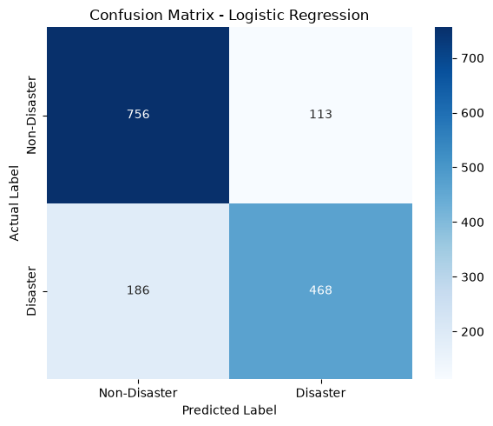
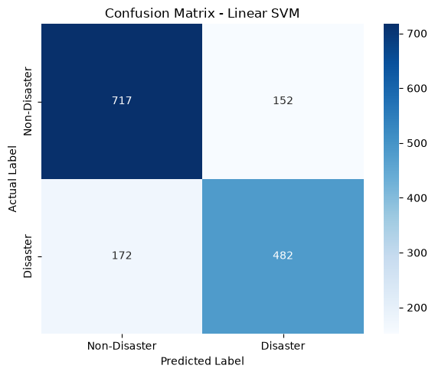
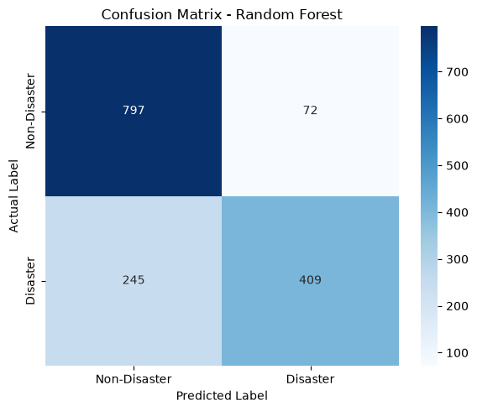
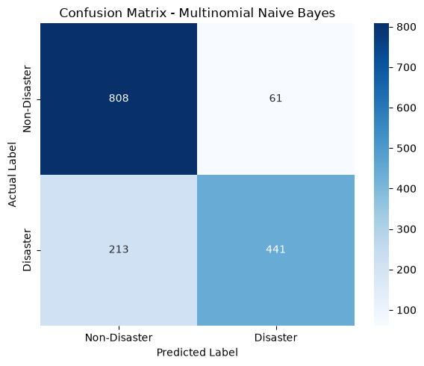
Part 3 — Confusion Matrices
10
Initial models showed different false-positive / false-negative trade-offs
Logistic Regression
TN 756 • FP 113 • FN 186 • TP 468
Linear SVM
TN 717 • FP 152 • FN 172 • TP 482
Random Forest
TN 797 • FP 72 • FN 245 • TP 409
Naive Bayes
TN 808 • FP 61 • FN 213 • TP 441
• Random Forest and Naive Bayes were conservative about predicting disasters; Linear SVM captured more actual disasters but initially produced more false positives.
NLP Project • Disaster Tweet Classification • Project Submission

Slide 11
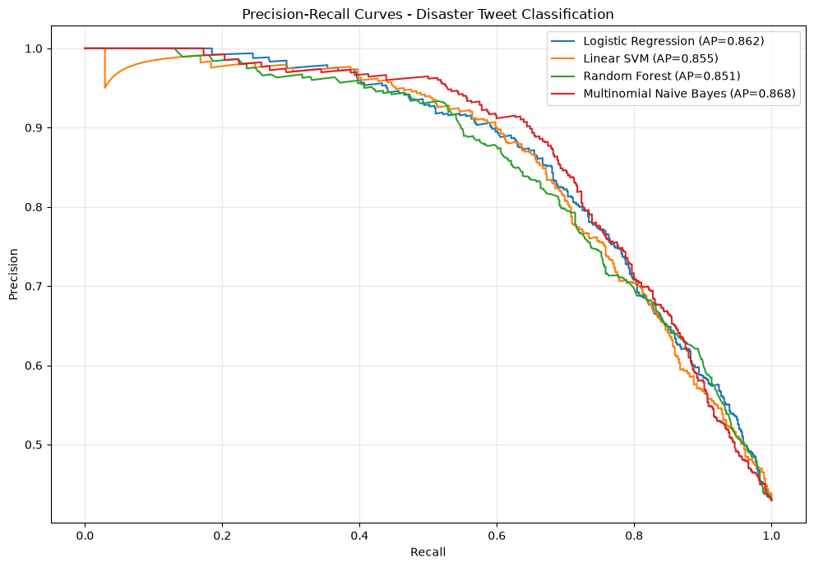
Part 3 — Precision–Recall Analysis
11
All four initial models achieved Average Precision above 0.85
Naive Bayes
0.868
Highest initial AP
Logistic Regression
0.862
Very close second
Linear SVM
0.855
Strong balance
Random Forest
0.851
Competitive result
NLP Project • Disaster Tweet Classification • Project Submission

Slide 12
Part 3 — Validation & Hyperparameter Tuning
12
5-fold Stratified CV + GridSearchCV on training data
Logistic Regression
CV F1 75.29%
Best: C=0.5 • class_weight=balanced
• bigrams
Multinomial NB
CV F1 75.11%
Best: alpha=1.0 • fit_prior=False
• unigrams
Linear SVM
CV F1 75.29%
Best: C=0.1 • class_weight=balanced
• bigrams
Model
Train F1
Validation F1
F1 Std
Gap
Logistic Regression
85.22%
75.29%
1.64%
9.93 pp
Multinomial NB
85.19%
75.11%
1.76%
10.08 pp
Linear SVM
87.03%
75.29%
1.63%
11.74 pp
NLP Project • Disaster Tweet Classification • Project Submission

Slide 13
Part 3 — Final Holdout Results
13
The tuned Linear SVM was selected for deployment
Accuracy
81.09%
Unseen holdout set
Precision
78.33%
Unseen holdout set
Recall
77.37%
Unseen holdout set
F1 Score
77.85%
Unseen holdout set
ROC-AUC
87.09%
Unseen holdout set
Model
Accuracy
Precision
Recall
F1
ROC-AUC
Tuned Logistic Regression
80.89%
78.05%
77.22%
77.63%
86.98%
Tuned Multinomial NB
79.51%
77.23%
74.16%
75.66%
86.41%
Tuned Linear SVM
81.09%
78.33%
77.37%
77.85%
87.09%
FINAL MODEL
Tuned TF-IDF + Linear SVM
NLP Project • Disaster Tweet Classification • Project Submission

Slide 14
Part 3 — Error Analysis
14
The main remaining challenge is contextual understanding
False Positives
140
Non-Disaster predicted as
Disaster
False Negatives
148
Disaster predicted as
Non-Disaster
Total Errors
288
Holdout set
Correct Predictions
81.09%
1,235 of 1,523
WHY FALSE POSITIVES?
WHY FALSE NEGATIVES?
• Words such as bomb, earthquake, wreck, spill and detonation used figuratively, humorously or technically.
• Keyword presence can be strong even when no real disaster is reported.
• Indirect wording, abbreviations, noisy text and limited context.
• TF-IDF learns statistical patterns but not deeper semantics, sarcasm or ambiguity.
NLP Project • Disaster Tweet Classification • Project Submission

Slide 15
Part 4 — Deployment & Modular Architecture
15
Saved model + reusable prediction pipeline + dynamic Streamlit interface
data_loader.py
Load dataset
preprocessing.py
Clean & normalize text
feature_engineering.py
Create features
model_training.py
Train models
evaluation.py
Metrics & plots
validation.py
CV + tuning
model_persistence.py
Save/load model
prediction.py
Inference logic
Streamlit Dashboard
Tweet input
live prediction
model performance
error analysis
Deployment Status
Interactive app completed locally.
Cloud/server deployment is the remaining production
step.
Serialized Model
models/disaster_tweet_svm_pipeline.pkl
NLP Project • Disaster Tweet Classification • Project Submission

Slide 16
Streamlit Dashboard — Overview
Interactive web interface for real-time prediction and project exploration
• Colourful multi-page interface
• Reusable prediction module
• Immediate classification feedback
• Performance and error-analysis views
🏠 Home
🔎 Live Prediction
📊 Model Performance
🧪 Error Analysis
📘 Project Details
Disaster Tweet Classification
AI-powered classification of tweets into Disaster / Non-Disaster
Welcome
Enter a tweet, view the prediction, inspect model performance and explore error analysis.
Final Model
81.09%
Tuned Linear SVM
F1 Score
77.85%
Holdout test
ROC-AUC
87.09%
Holdout test
NLP Project • Disaster Tweet Classification • Project Submission

Slide 17
Streamlit Dashboard — Live Prediction
The deployed pipeline cleans the input and predicts with the saved Linear SVM
• Input is cleaned with the same preprocessing module used during model development.
• The saved pipeline is loaded from the models folder.
• The dashboard returns a clear Disaster / Non-Disaster result in real time.
🏠 Home
🔎 Live Prediction
📊 Model Performance
🧪 Error Analysis
📘 Project Details
Live Tweet Prediction
Paste or type a tweet below
Emergency crews are responding to severe flooding
Predict
Prediction: DISASTER
Processed text: emergency crew responding severe flooding
NLP Project • Disaster Tweet Classification • Project Submission

Slide 18
Streamlit Dashboard — Analytics & Error Analysis
The interface also communicates model quality, not just predictions
• Model Performance page presents key evaluation results.
• Error Analysis page highlights false positives and false negatives.
• Project Details page explains the workflow and model used.
• This makes the app useful for both prediction and project demonstration.
🏠 Home
🔎 Live Prediction
📊 Model Performance
🧪 Error Analysis
📘 Project Details
Model Performance
Final tuned model metrics and error-analysis summary
Accuracy
81.09%
Holdout
Precision
78.33%
Holdout
Recall
77.37%
Holdout
False Positives
140
Non-Disaster → Disaster
False Negatives
148
Disaster → Non-Disaster
NLP Project • Disaster Tweet Classification • Project Submission

Slide 19
Final Recommendation
Recommended model and deployment approach based on the project results
Recommended Model
Linear SVM
Use the tuned TF-IDF + Linear SVM
pipeline as the final classifier because it
achieved the strongest overall holdout
performance.
Why This Model
Best final accuracy (81.09%),
F1 (77.85%) and ROC-AUC (87.09%)
, with a balanced precision–recall
profile.
Recommended Deployment
Keep preprocessing and prediction in
reusable src modules, serialize the full
pipeline, and serve it through the
Streamlit dashboard.
• For future production use, test on larger and more diverse tweet data and consider transformer-based NLP for stronger contextual understanding.
NLP Project • Disaster Tweet Classification • Project Submission

Slide 20
Conclusion
The project meets the core NLP, machine-learning, validation and interface goals
• Built an end-to-end NLP pipeline for classifying real disaster and non-disaster tweets.
• Completed data exploration, cleaning, feature engineering, model comparison, cross-validation and hyperparameter tuning.
• Selected tuned Linear SVM after final unseen holdout evaluation.
• Achieved 81.09% accuracy, 77.85% F1-score and 87.09% ROC-AUC.
• Performed qualitative error analysis to identify context, metaphor and ambiguity as major remaining challenges.
• Converted notebook experimentation into reusable Python modules and an interactive Streamlit application.
PROJECT OUTCOME
A complete workflow from raw social-media text → validated model → interactive application
NLP Project • Disaster Tweet Classification • Project Submission

Slide 21
Key Takeaways
What this project taught us:
1. Preprocessing Matters
Cleaning URLs, noise and common words improves the
quality of NLP features.
2. Validation Matters
Leakage-safe cross-validation gives a more trustworthy
estimate than one split.
3. Context Is Hard
A keyword can signal a disaster or be metaphorical;
statistical text models do not fully understand meaning.
4. Deployment Matters
A useful ML project must move beyond the notebook into
reusable code and a practical interface.
CORE MESSAGE
Good NLP performance comes from the complete workflow—not only from choosing an algorithm.
NLP Project • Disaster Tweet Classification • Project Submission

Slide 22
Thank You

