Slide 1

Supplier Selection Process using AHP

Slide 2

AGENDA
INTRODUCTION & PROBLEM STATEMENT
Dataset Details
Detail Analysis
Interpretive structural modelling (ISM)
Analytic Hierarchy Process (AHP)
Interpretive Ranking Process (IRP)
Result
Conclusion
Acknowledgement

Slide 3

INTRODUCTION & PROBLEM STATEMENT
To increase flexibility in today's global marketplace it is needed to remain competitive and respond to rapidly changing markets. From that point of view, supplier selection represents one of the most important functions to be performed by the purchasing department.
The search for new suppliers is a priority for the most companies in order to upgrade the variety of their products range. This is essentially due to two main reasons. At first, more generally products life circle is very short (2–4 years) and new models must often be developed by using completely renewed material or with new technologies. Second, more industries are historically, a labour-intensive sector. These aspects are expressed through a complex pattern of demand for material and labour.
Today with this presentation we will do supplier selection using the Interpretive structural modelling (ISM) and Analytic Hierarchy Process (AHP). AHP provides a framework for making effective decisions in complex decision situations (vendor selection), helps to simplify and accelerate the natural process of decision making.

Slide 4

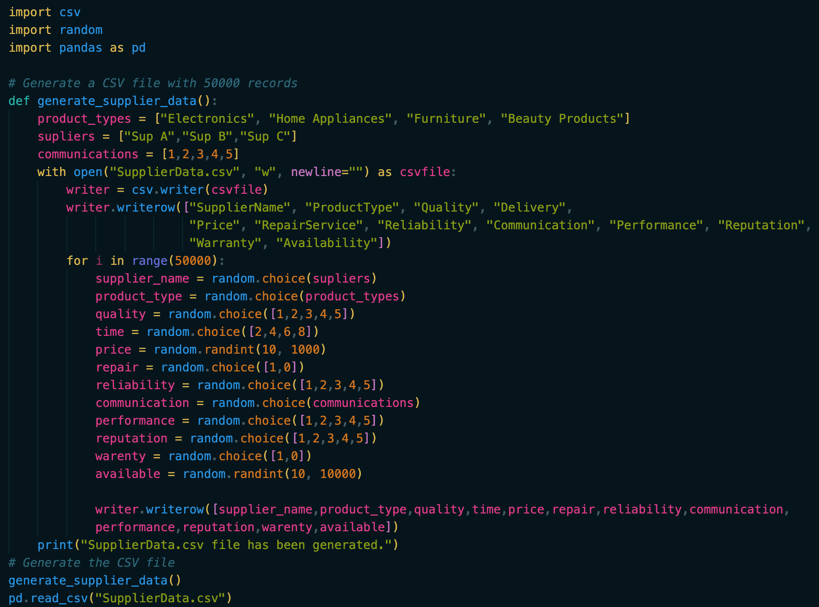
Dataset Details
Created a simple supplier dataset using python script

Slide 5
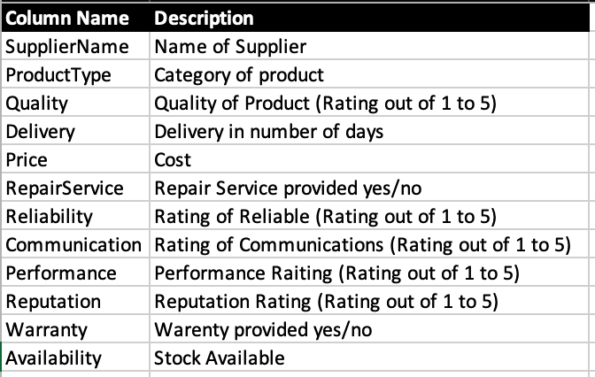
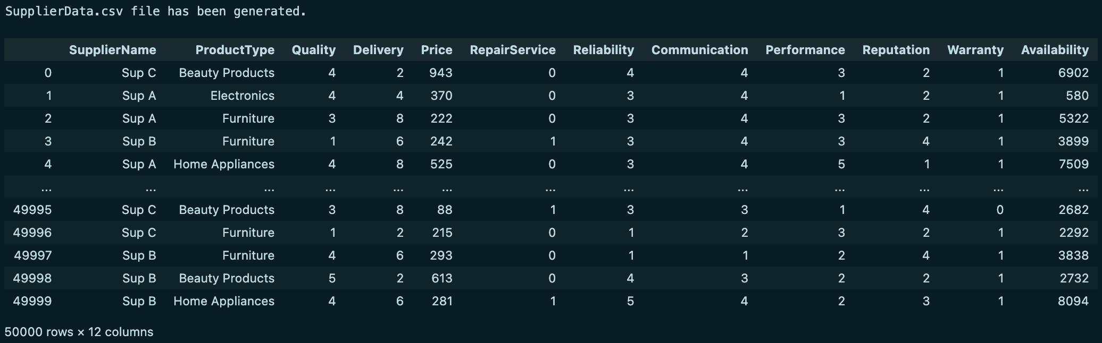
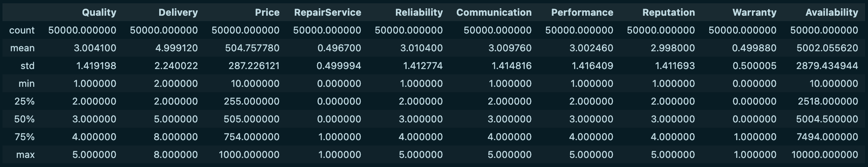
Dataset Details
Here are the few details of dataset.

Slide 6

Detail Analysis
Selecting the suppliers who can meet consumers’ demand for higher-quality service or products may bring some initial costs, but it will pay off over time through consistent, high-grade materials. However, the process to find the ideal supplier is often not easy and requires expert and scientific approach.
Today with this study we will try to illustrate researches which are carried out on large number of logistics and production companies in order to consider the complexity and the problems of the supplier selection and the distribution network, their elements and action of the subsystem according to the defined criteria.
To do this we will take the help of below mentioned methods
Interpretive structural modelling (ISM)
Analytic Hierarchy Process (AHP)
Interpretive Ranking Process (IRP)

Slide 7

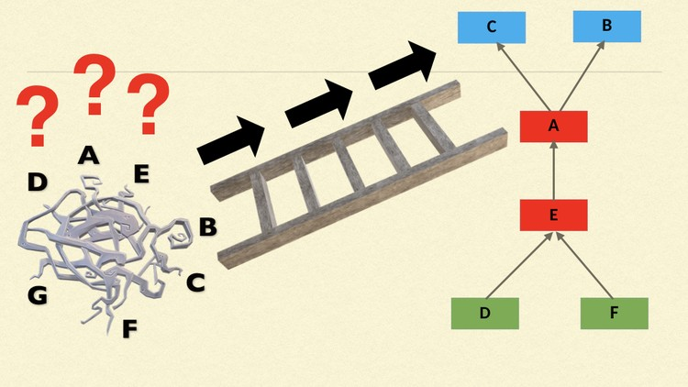
Interpretive structural modelling (ISM)
Interpretive structural modelling (ISM) is a well-established methodology for identifying relationships among specific items, which define a problem or an issue. This approach has been increasingly used by various researchers to represent the interrelationships among various elements related to the issue. ISM approach starts with an identification of variables, which are relevant to the problem or issue. Then a contextually relevant subordinate relation is chosen. Having decided the contextual relation, a structural self-interaction matrix (SSIM) is developed based on pairwise comparison of variables. After this, SSIM is converted into a reachability matrix (RM) and its transitivity is checked. Once transitivity embedding is complete, a matrix model is obtained. Then, the partitioning of the elements and an extraction of the structural model called ISM is derived. In this paper, key concept of ISM approach is discussed in detail.

Slide 8

Interpretive structural modelling (ISM)
Today we will use ISM to identify the most important driving Criteria which should be considered for decision making.
Steps involved in using ISM for supplier selection are -
Identification of Criteria
Formation of Structured-Self Interaction Matrix (SSIM). Below abbreviations are used to create the matrix -
Reachability matrix is developed from the SSIM and the matrix is checked for transitivity.
Level Partitioning is done to Identify the level of each Criterion
Formation of an Interpretive Structural Model
Formation of a MICMAC Analysis Graph and identify which are the most important Driving Criteria and Linkage Criteria.

Slide 9
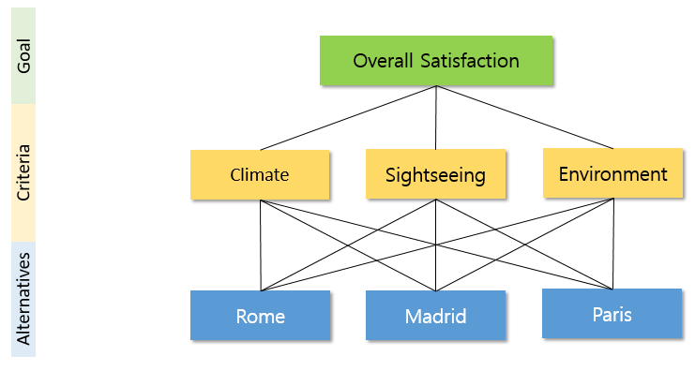
Analytic Hierarchy Process (AHP)
Developed in 1970, AHP (Analytic Hierarchy Process) is a decision-making framework that helps individuals or groups systematically analyze and prioritize multiple criteria and alternatives to make informed decisions.
AHP has 3 components: 1 Goal: Representing the ultimate objective 2 Criteria: These are different factors which are relevant to the decision (Sub-criteria further break down the criteria) and 3 Alternatives: that are the options being considered.

Slide 10
Analytic Hierarchy Process (AHP)
Step 1: To select the best supplier from the available pool, we used Interpretive Structural Modelling (ISM) to identify and rank the most relevant set of criteria called Hierarchical Structure of Evaluation
Step 2: We then develop a Pairwise Comparison Matrix by asking decision-makers to assess the relative importance of elements – at first within the set of criteria and then for the alternatives. Pros: 1 Comparative judgement is better for two elements at a time than all elements at once. 2 Quantifiable and Flexible inputs that can be revised

Slide 11
Analytic Hierarchy Process (AHP)
Step 3: Calculating the Consistency Ratio (CR) provides a check for inconsistencies in decision-makers judgement (threshold 10%). Pros: 1 Enhance reliability and validity of Pairwise Matrix 2 Confirms Principle of Transitivity
Step 4: Final step of creating the Priority Weights Matrix indicate the relative importance of elements within each level. This is calculated using Eigen Vector method. The Priority matrix is normalised to determine overall ranking of alternatives

Slide 12
Interpretive Ranking Process (IRP)
Interpretive ranking process (IRP) is a multi-criteria decision making method based on paired comparison in an interpretive manner. Due to paired comparisons, the number of interpretations to be made for n ranking variables are 𝑛(𝑛−1)/2 to establish dominance with respect to each reference variable or criterion. IRP is a knowledge intensive method and thus a large number of comparisons poses a limitation on the number of rankling as well as reference variables to be considered in the design of the decision problem.

Slide 13
Interpretive Ranking Process (IRP)
Today we will use IRP to Identify the best Supplier amongst the available options based on the Criteria we got from ISM.
Below steps are followed in IRP Model -
Take the AHP Inputs we got when we created Pairwise Comparison matrix of Suppliers with respect to each Criteria.
Create the Dominance Matrix by identifying which supplier better in which criteria when compared with other Suppliers and give ranking to Suppliers based on Net Dominance.
Use same Dominance Matrix to perform Weighted-IRP. Give the weightage of Criteria calculated in AHP Model instead of Criteria name.
Add the weightage of the row and column to Dominance and Net Dominance.
Based on the Net Dominance rank the Suppliers.

Slide 14

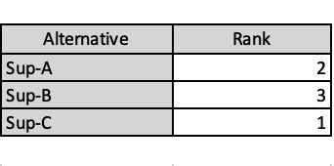
Result
In our today’s assessment we found Supplier-C is the potential Supplier and the winner of the Supplier battle between 2 other competitor (Supplier-A and Supplier-B)
As per the result of AHP Supplier C is performing best in 3 criteria, Supplier A is performing best in 2 Criteria and Supplier B is performing best in 1 Criterion

Slide 15

Conclusion
Many researchers and practitioners have focused their work on supplier selection in supply chain management area and deployed a wide range of scientific and technical techniques to enhance efficiency and flexibility of the supply networks and various approaches are available for supplier selection.
Out of those many today we have explored one of them.

Slide 16


THANK YOU

