Slide 1


TRACBOT
Chat Bot for Tractor Related Customer Queries
Problem
Name of Organization : ESCORTS LIMITED CORPORATE CENTER , FBD
Industry Mentor: Mr. Virender Garg
Faculty Mentor: Dr.Rajendra Kumar Roul
Starting Date: 2nd January 2019
Ending Date: 30th June 2019
Submitted By : Megha Arora(101690007)
Snapshots
Architecture
Technology
Project
About

Slide 2
Escorts Limited
Mr. Nikhil Nanda
CMD, Escorts Limited
The Escorts Group is an Indian engineering company that operates in the sectors of agri-machinery, construction and material handling equipment, and railway equipment. Headquartered in Faridabad, Haryana, the company was launched in 1944 and has marketing operations in more than 40 countries.
Escorts Agri Machinery was launched in 1960. The company manufactures tractors under the brand names of Farmtrac,
Powertrac and Steeltrac. The current range involves over 45 models ranging from 25HP to 80HP. The tractor division was started in 1960 with the first Escort tractors produced in 1965. In 1969, a partnership with Ford was set up to produce licensed Ford tractors for India. Ford became New Holland, which is currently part of CNH Global, which in turn is owned by the Fiat Group.
Snapshots
Technology
Problem
Architecture
Project
About

Slide 3



Problems behind choosing Chatbot
1
2
3
Customer queries were not answerable at time
Communication Between the Client and the Supplier is little difficult.
User Interation Problems were raised.
about
Snapshots
Technology
Problem
Architecture
Project

Slide 4
Why Tracbot ?
Tracbot is an Artificial intelligence Chatterbot for Agricultural Purposes that is meant to help farmers get their queries addressed by a ChatBot or a live scientist. Our application will be basically a portal to give all the useful information regarding Farmtractors. Our objective of this project is to reach out to millions of farmers of India using social media and Machine Learning.This application will work on both platforms i.e. Android as well as IOS Devices by using Expo Cli and Genymotion as an Emulator. The text -to - speech and image capturing and recognition feature will be added. It is a chatbot named TracBot which will be used to resolve customer queries related to AgriMachinery . The Technologies used will be React Native for user interface , Dialogflow which is Google platform which contains NLP modules in it, which is trained by Admin and the dataset which is required , following customer queries with answers , all will be saved using Dialogflow and for backend part , Firebase will be used which is a Google Cloud platform database which will store all the Dataset in the Database.
Snapshots
Problem
Architecture
Technology
Project
About

Slide 5
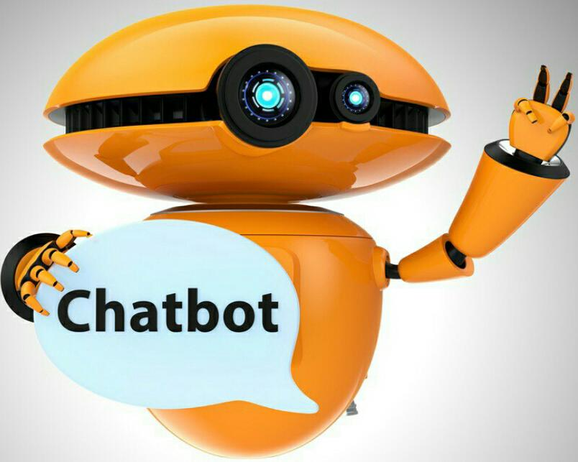



ff
Tools and Technology used
01
03
React –Native
Problem
Snapshots
Architecture
Technology
Project
About
02
Dialogflow

Slide 6
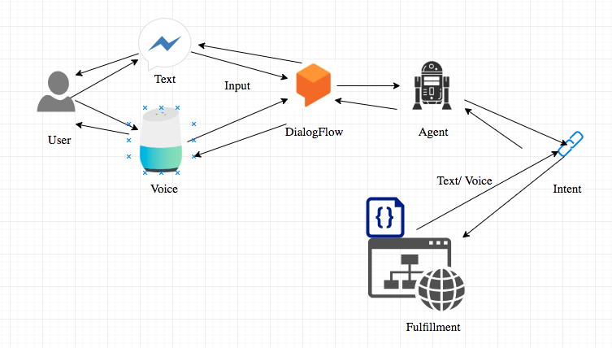
sdfffdfdfdf
Snapshots
Architectire
Problem
Technology
Project
About
Architectural Flow Diagram of Dialogflow

Slide 7
Future Scope
Snapshots
Problem
Architecture
Technology
Project
About

Slide 8





The project can have further amendments according to the requirements of the company.
These are the following features that can be added:
Some Features will be added like GPS and Image Capture Recognition feature as if any customer
want to replace any part of tractor , customer have to upload the part which has to be replaced and bot
will send this query to prescribed person.
2. User Interface can be made by adding Redux along with React Native for state management .
FUTURE SCOPE
Future Scope
Problem
Snapshots
Architecture
Technology
Project
About
8M
6M
7M
Add Some Brief Text Here to Explain
Add Some Brief Text Here to Explain
Add Some Brief Text Here to Explain
Thank you !!

