Slide 1
POWERPOINT PRESENTATION
By,
ISWARRAJ S

Slide 2
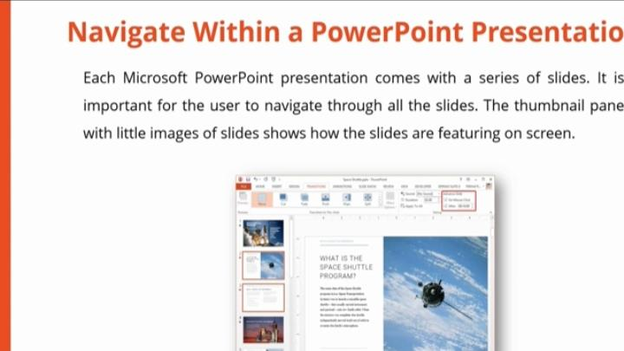
NAVIGATE WITHIN A POWERPOINT PRESENTATION
The thumbnail plane with little images of slides shows the slides are featuring on screen

Slide 3
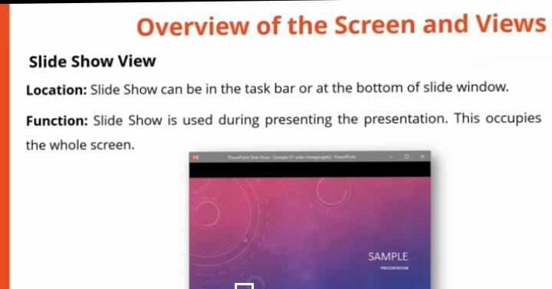
OVERVIEW OF THE SCREEN AND VIEWS
Slide show can be in the task bar or at the bottom of the slide window

Slide 4
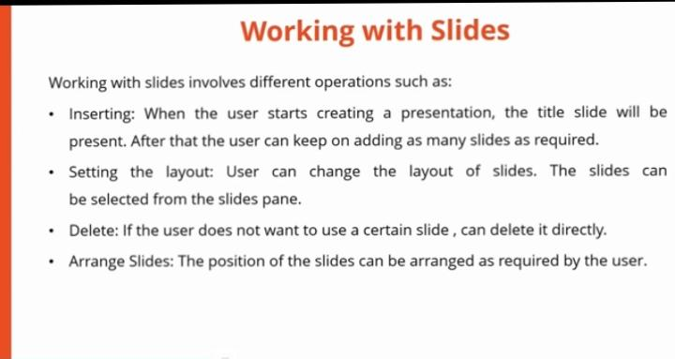
WORKING WITH SLIDES
Different operations with slides:
Inserting
Setting the layout
Delete
Arrange slides

Slide 5
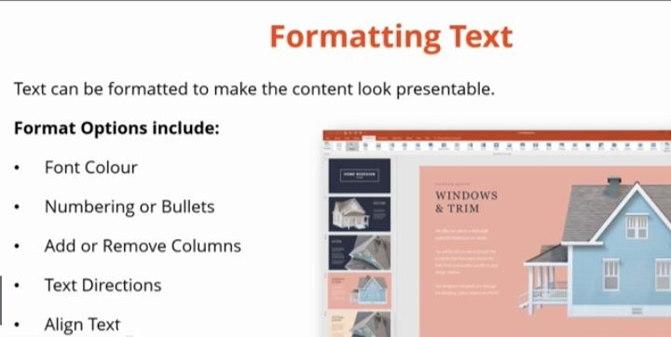
WORKING WITH TEXT IN PRESENTATION
Format options:
Font colour
Numbering or bullets
Add or remove columns
Text directions
Align text

