Slide 1

Company structure :
ISWARRAJ.S
MD&CEO
K. Shiva
Management head
Rhaul
Manager
Homesh
M3 cader
Dhaya
M3 cader
Nithish
M3 cader
Rishvanth
Asst, Man. head

Slide 2
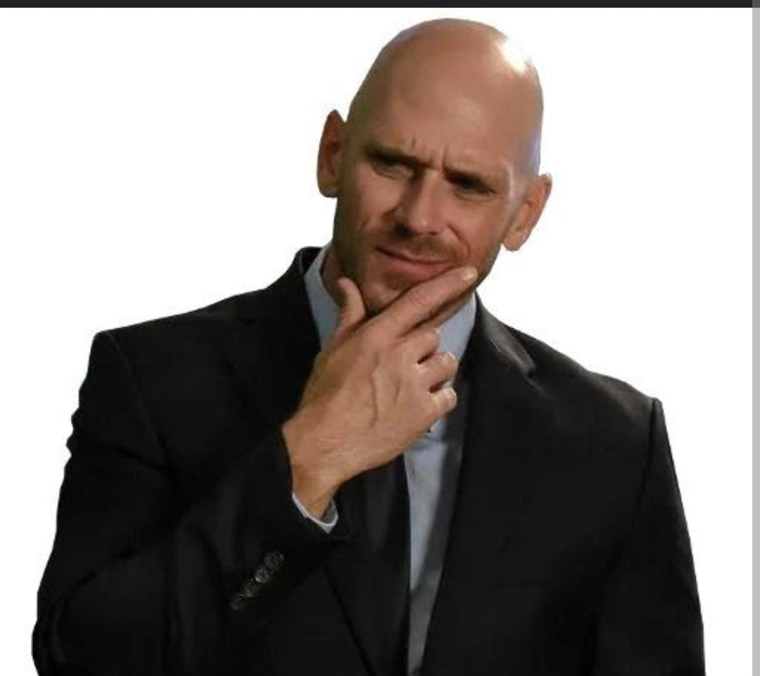
Human Resource
Human resources managers plan, coordinate, and direct the administrative functions of an organization.
They oversee the recruiting, interviewing, and hiring of new staff; consult with top executives on strategic planning; and serve as a link between an organization's management and its employees

Slide 3
Human Resource

Slide 4
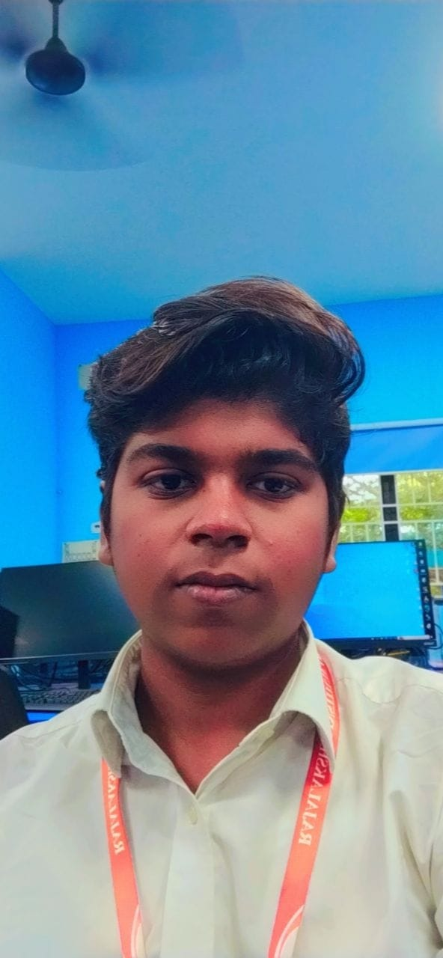
Transportation Incharge
Transport managers are responsible for directing, coordinating, planning and overseeing tasks and operations within an organisation involving transportation activities. They are required to ensure the legal requirements for road haulage are met

Slide 5
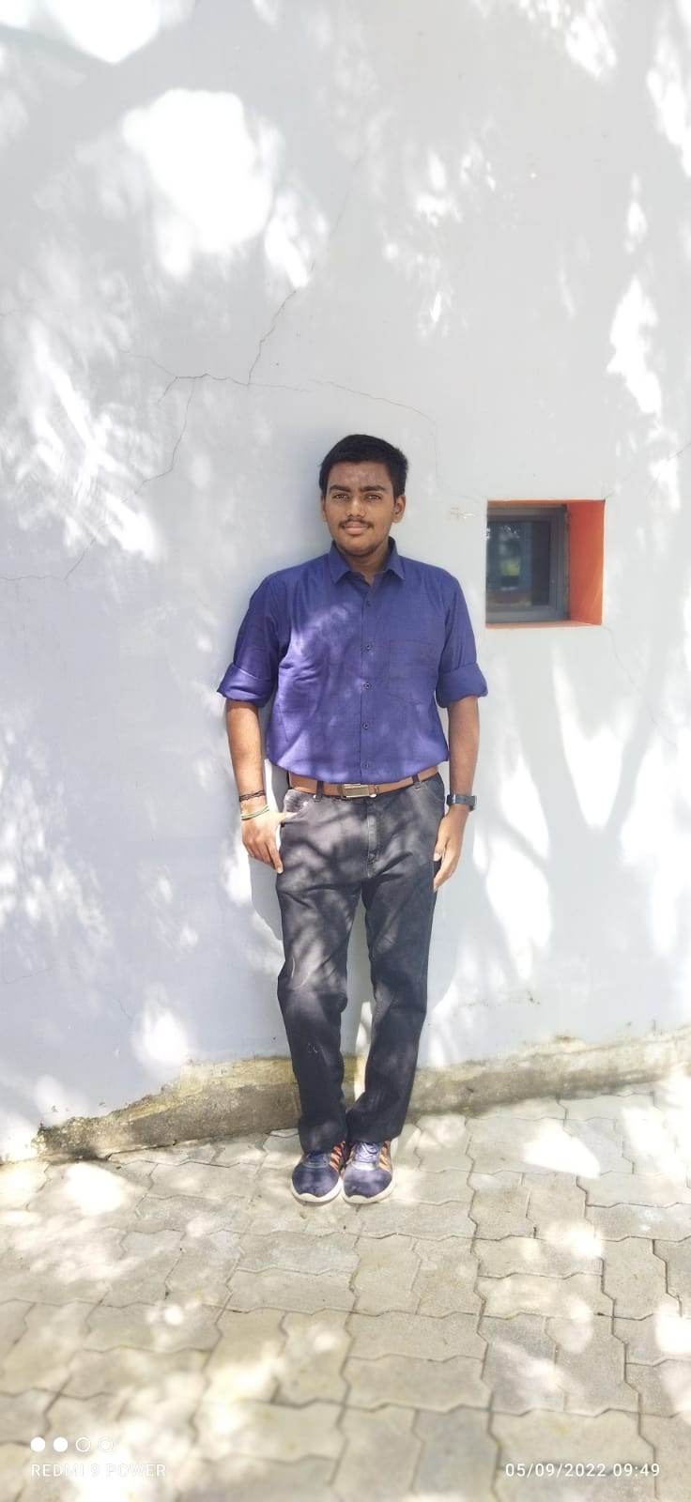
Cleaning Incharge
He/She inspects the work area cleaned by cleaners. He/She manages work schedule of cleaners and reallocate work to cover absences.
He/She ensures all cleaning equipmen
t is well maintained and is safe for use.
He/She checks on the stock level of cleaning materials and equipment

