Slide 1

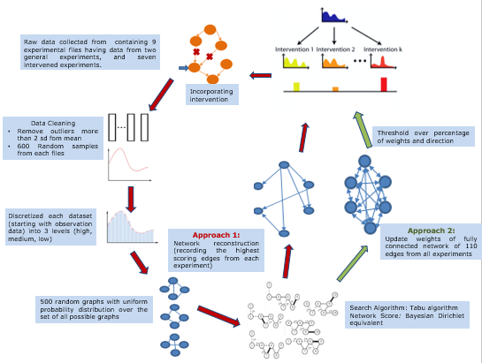
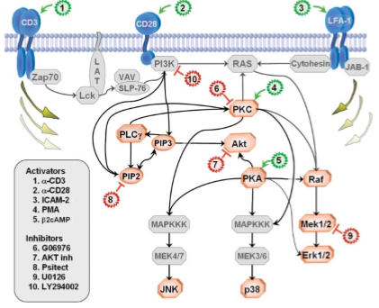
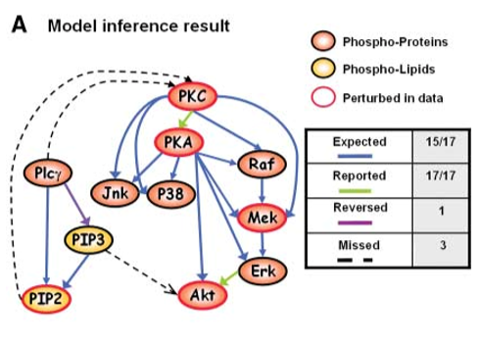

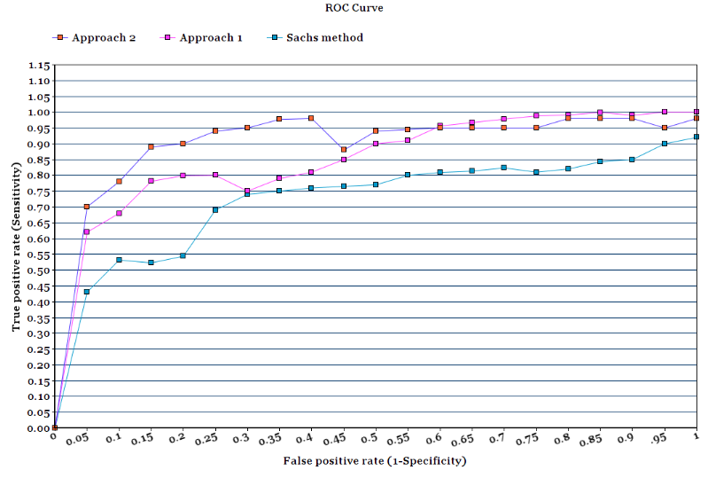


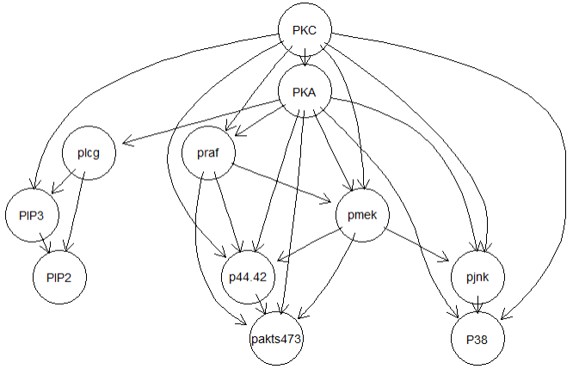

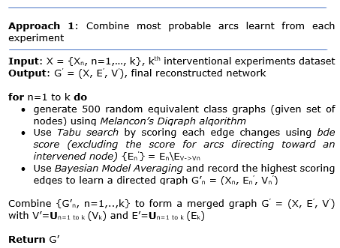
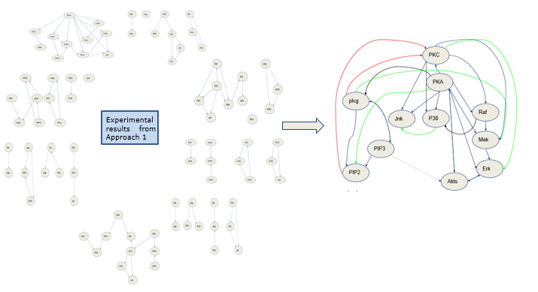


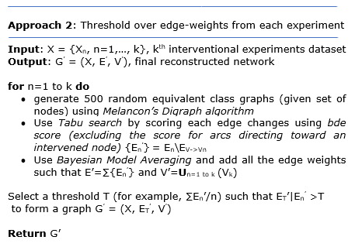
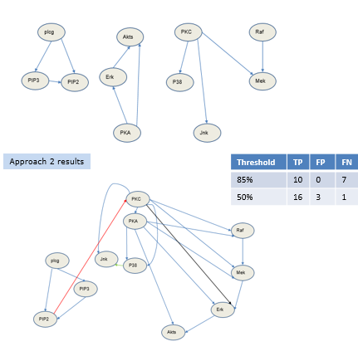
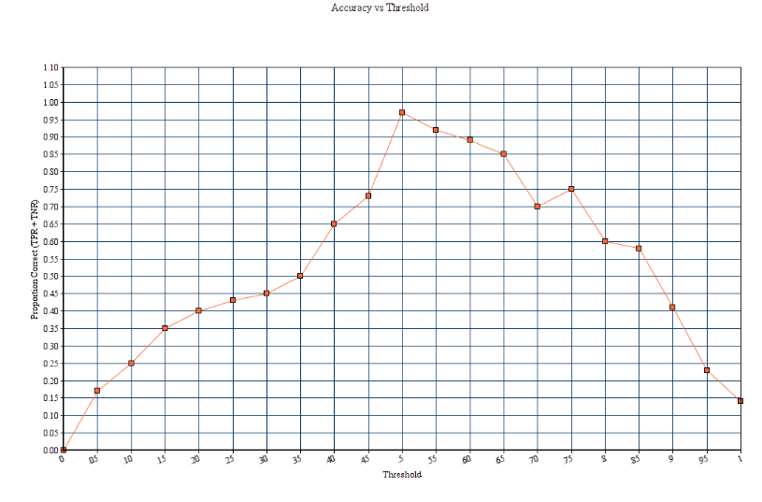

Causal Bayesian network structure learning through effects of interventions to analyze Protein signaling pathways
Meghamala Sinha; Prasad Tadepalli; Stephen Ramsey
School of Electrical Engineering and Computer Science
Oregon State University
Motivation
Approach and Method
Discussion
Living cell molecules interact with each other in a coordinated and complicated fashion to carry out important biological functions. Building a rich network of these interactions can improve recognition of diseases by providing useful mechanistic interpretations of various phenotypes. A lot of discoveries in high-throughput technologies have given rise to numerous algorithms for reverse-engineering networks from molecular observations, as they provide an efficient and systematic way of analyzing the various molecular state and interaction of a number of genes. One class of such interaction networks that has recently generated
much interest in recent years is transcriptional gene regulatory networks, which specify the set of genes that influence a given gene’s expression level. This type of pattern can be naturally modeled in a causal graph or Bayesian network. In this work, we investigate the performance of our approach by analyzing experimental data from a pollychormatic flow cytometry experiment originally presented by Sachs, Perez, Pe´er, Lauffenburger and Nolan (2005). In this particular experiment, 11 well-studied proteins were selected from the MAPK pathways for fluorescent labeling, showed in Fig 1. This pathway was then perturbed by 9 different stimuli, each targeting a different protein in the selected pathway.
The original data set is continuous data that was processed by first eliminating outliers assuming a log-scale transform. The data were then discretized using an information preserving technique and adjusted such that perturbed vertices always reflect their perturbed values.
The main aim of this work is a deep understanding of the classical work done by Sachs et al in their ground-breaking work. We have thoroughly analyzed the data set used by the authors and recreated their method.
We tried to separate each experiments instead of combining them, in order to make more extensive use of the intervention nodes and hoped to extract more information, since the perturbed nodes were intervened simultaneously changing the states of all the other nodes as well. Hence an intra-experimental method (Fig 7) made more since than inter-experimental way.
The results showed a significant improvement than the classical paper. All the expected nodes found by Sachs et al were also found by our method (Approach 1) including an additional discovery of 2 expected missed node. Most of the newly found arcs were further discovered to be true by literature survey and labelled as reported.
Approach 2 gave a lower accuracy than Approach 1, but the computation time was higher in the later. The accuracy rate for all the methods have been described in Fig 8.
Fig 1. Basic structure of MAPK pathways
Reagent | Effects
Anti-CD3/CD28 | General Perturbation
ICAM-2 | General Perturbation
b2cAMP | Activates PKA
AKT inhibitor | Inhibits AKT
U0126 | Inhibits Mek1/2
PMA | Activates PKC
G06976 | Inhibits PKC
Psitectorigenin | Inhibits PIP2
LY294002 | Activates AKT
This is necessary because some of the perturbation methods, particularly the inhibition, only affect the activity of the protein and not their phosphorolation so while the activity of the protein appears to vary, its activity is in fact controlled. After pre-processing, 500 data sets are generated. Each data set consists of 600 cells sampled from each of the 9 experiments. Simulated annealing was used to obtain an optimal DAG
Fig 2. Summary of the 9 experimental stimuli and their effect on the proteins
from each of the data sets. Thus, after 500 simulated annealing runs, they now have a set of 500 DAGs each with an associated score. To estimate the marginal feature probabilities, Bootstrap samples are generated from this data set according to their scores.
Fig 3. Results from Sachs et al experiment.
Introduction
Observation
X
X
X
Y
Z
Y
Z
Y
Z
Intervention
X
X
X
Y
Z
Y
Z
Y
Z
Fig 4. Observation vs Intervention
Fig 7. Flowchart of our work
Experiments
Result from our closest implementation of the Sachs et al method as described in their supplementary material.
Significance of interventions for causal discovery in biological networks:
Given a directed acyclic graph over a set of variables , an edge X → Y encodes a causal influence of X on Y
For data containing only passive observations of the underlying system, the causal structure is only identifiable up to Markov equivalence classes, it can be claimed as an association
To overcome this limitation, intervention experiments, in which some variables are controlled to take specific values, can be used to guarantee full identifiability, so given intervention on X, X → Y implies X to be a causal parent of Y
Living cells and molecules of organisms incorporates a lot of such relationship, which remain intractable
We apply Bayesian causal reconstruction methods over Sachs et al data to analyze the various aspect of intervention in causality.
True Positive | 17
False Positive | 8
False Negative | 0
A Significant Improvement !!!
New Arcs found :
P38 -> pjnk (reported in PCViz)
Plcg -> pmek (reported in PCViz)
P44.4 -> PKC (reported in PCViz)
Praf -> P38
PKA-> plcg
Pip2->PKA (reported in PubMed)
Fig 8. Performance analysis of all the methods
References
Sachs, K., Perez, O., Pe'er, D., Lauffenburger, D. A., & Nolan, G. P. (2005). Causal protein-signaling networks derived from multiparameter single-cell data. Science, 308(5721), 523-529.
Cho, H., Berger, B., & Peng, J. (2016). Reconstructing causal biological networks through active learning. PloS one, 11(3), e0150611
He, Y., & Geng, Z. (2016). Causal Network Learning from Multiple Interventions of Unknown Manipulated Targets. arXiv preprint arXiv:1610.08611
Hagmayer, Y., Sloman, S. A., Lagnado, D. A., & Waldmann, M. R. (2007). Causal reasoning through intervention. Causal learning: Psychology, philosophy, and computation, 86-100
Ellis, B., & Wong, W. H. (2008). Learning causal Bayesian network structures from experimental data. Journal of the American Statistical Association, 103(482), 778-789.
Druzdzel, M. J., & Díez, F. J. (2003). Combining knowledge from different sources in causal probabilistic models. Journal of Machine Learning Research, 4(Jul), 295-316.
Pearl, J. (2009). Causality. Cambridge university press.
Scutari, M., & Denis, J. B. (2014). Bayesian networks: with examples in R. CRC press.
Pubmed : https://www.ncbi.nlm.nih.gov/pubmed/
PCViz: http://www.pathwaycommons.org/pcviz/
Fig 5. Our algorithm for Approach 1
Select an appropriate
threshold for sensitivity vs specificity tradeoff !!!
best threshold found
Fig 6. Our algorithm for Approach 2
<your name>
<your organization>
Email:
Website:
Phone:
Contact:
Meghamala Sinha
Graduate Student (CS)
Email: sinham@oregonstate.edu
1148 Kelley Engineering Center, 2500 NW Monroe Ave, Corvallis, OR 97331

