Slide 1
Scotbank group 8
Let’s get those budgets approvedddd

Slide 2
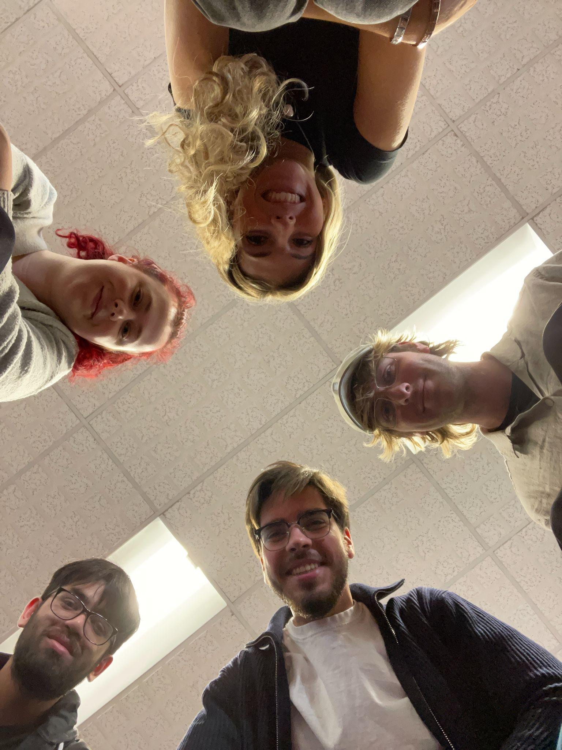
Meet the team
Megan - DB wizard
Luke - login page pro
Hashim - lifesaver
Katie - transactions magician
Nick - Product owner

Slide 3
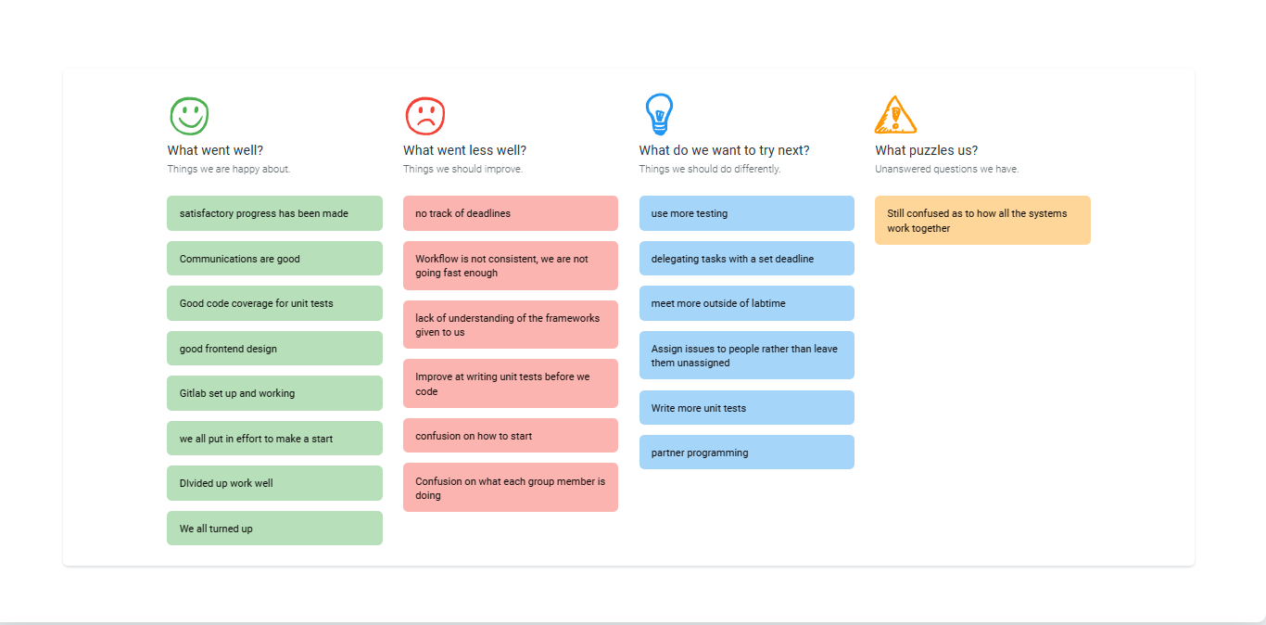
Retros!

Slide 4
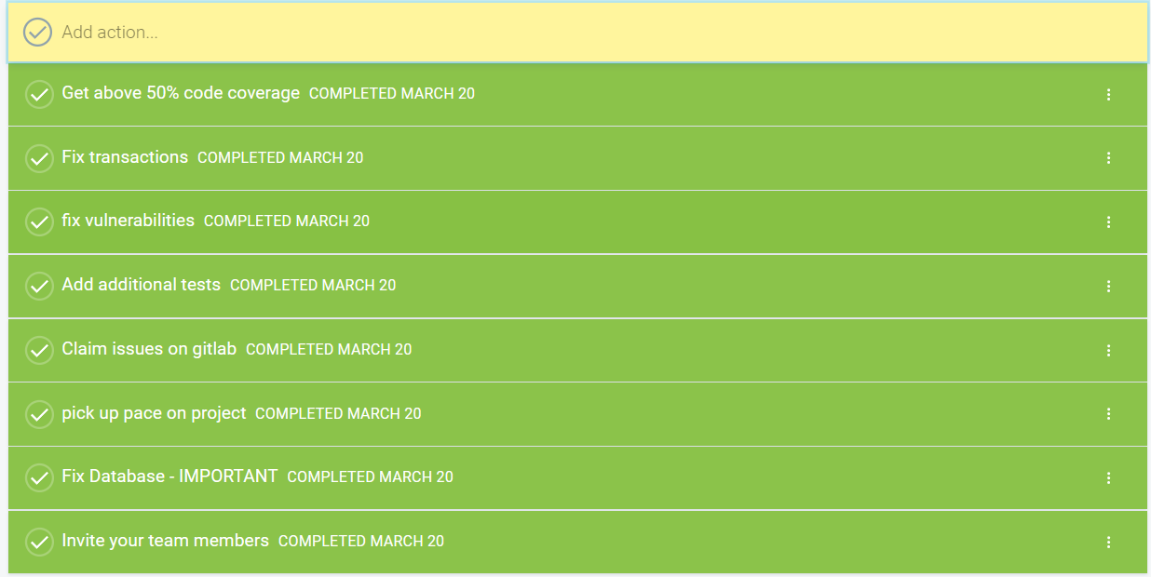
Actions?

Slide 5
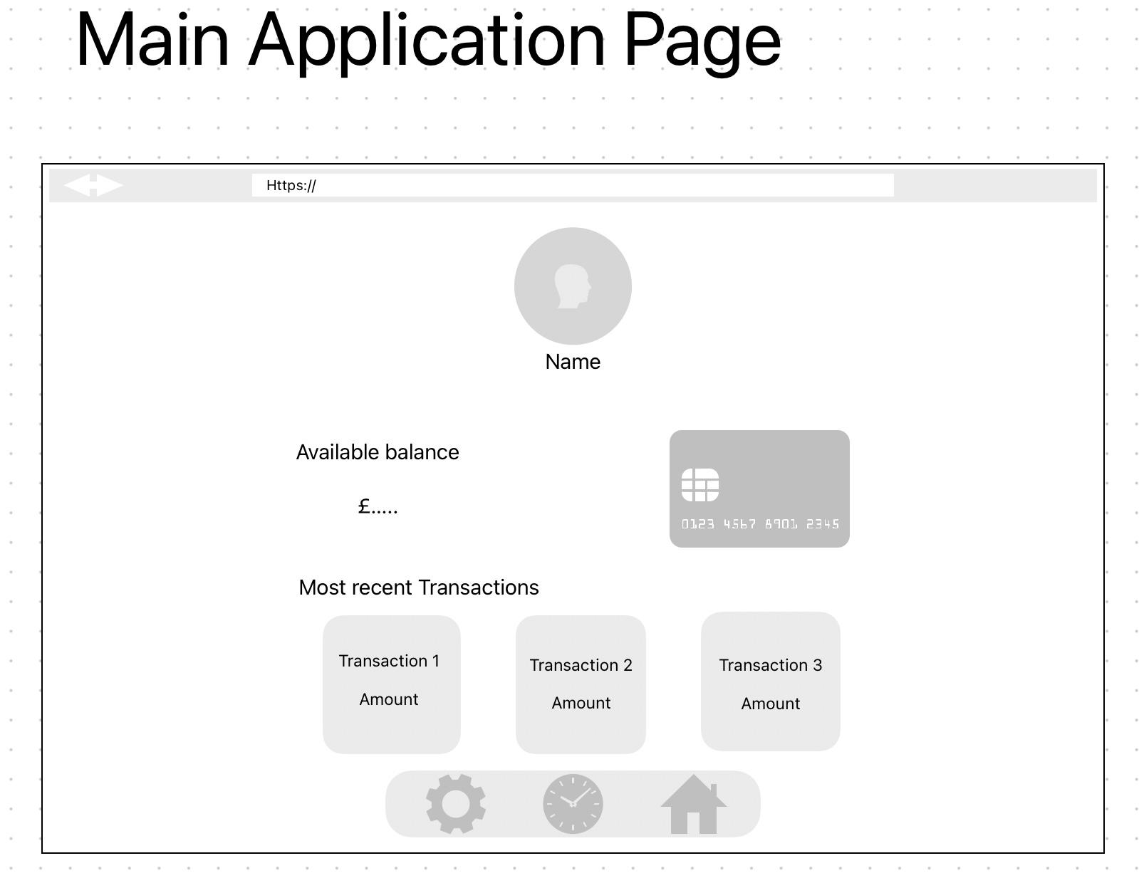
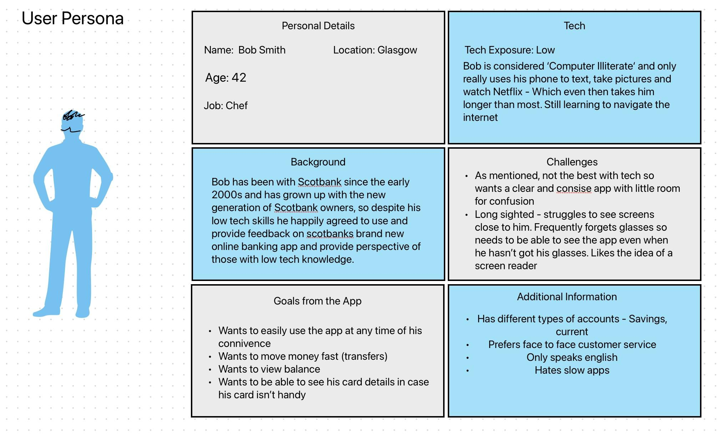
User persona+ wireframes

Slide 6

Demo time

Slide 7
Deployment strategy
Hybrid
Partial migration
Use courses to close off the learning gaps in the team

