Slide 1

Team Name :
Team Details
VULTURE VIRTUE
Nisha Agarwal
[Team Leader]
Megha Thakur
[Team Member]

Slide 2
Problem Statement
Gen Z user engagement : Building engagement constructs that create virality and enabling habit creation among Gen Z .
Gen Z's decreasing attention span and constant need for stimulation to stay engaged.
The app's content-heavy design makes it less interactive.
There is a lack of stimulating features that encourage users to return to the app regularly.

Slide 3


Solution 1
Introducing an Open chat box for User Interaction
Introducing an open chatbox like tool where user can post like
"Hey lovely people! There's an evening party next week. The weather will be humid with a temperature of 32 degrees Celsius. The mood is easy breezy. Any outfit suggestions?"
https://www.myntra.com/dresses/stylecast/stylecast-white-square-neck-puff-sleeves-maxi-dress/26022872/buy
https://www.myntra.com/heels/colo/colo-open-toe-wedge-heels/27534114/buy
what about this flowy maxi dress and these wedges.
Thank you for the amazing suggestion.

Slide 4
An open chat box will give Fashion savy users a Space To Interact.
User will get their Fashionable Solutions to their always existing to “I have nothing to wear” problem.
And If the product is bought from the link given by user, Then they will also get Myntra Score.
Which they can use to get benefit on further orders.
This tool can become a safe space for fashion enthusiasts and can also become a Trend Setting Hub, with the creative interactions.

Slide 5
Solution 2
Addition of short length and interactive content
Short-form content is highly popular among Gen Z, as it keeps them engaged and encourages repeated use of the app.
Content created by other users, such as reviews, unboxings, and testimonials, is seen as more authentic and trustworthy

Slide 6
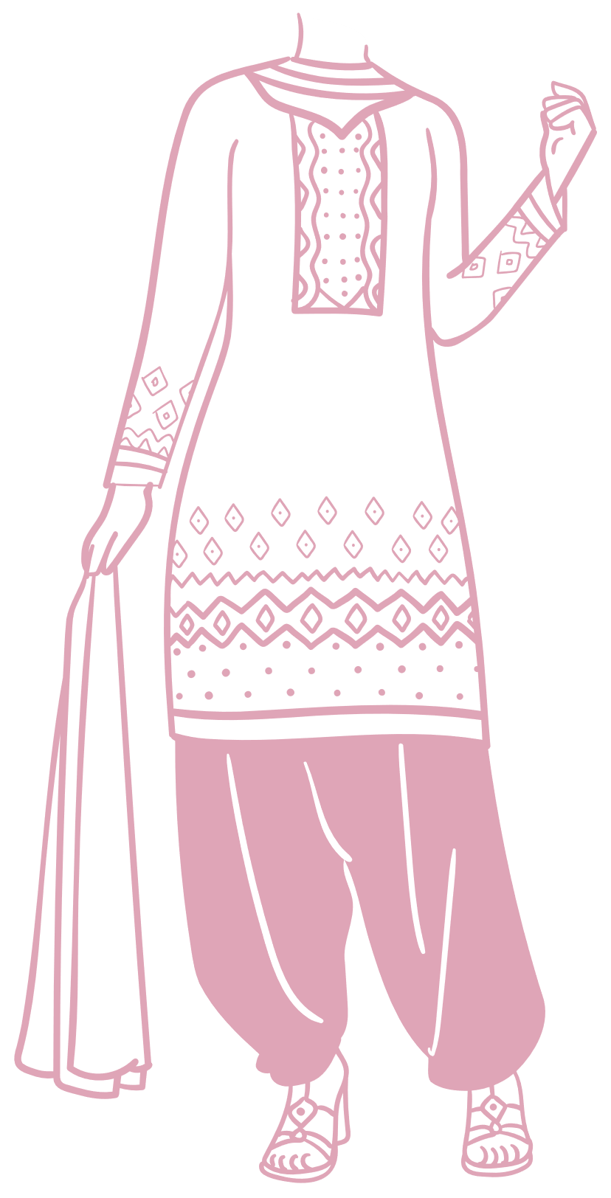




Benefits
Myntra
Quick Consumption
Frequent Visits
Addictive Nature

