Slide 1
www.auto-grid.com

Slide 2
EDNA FCI Data Exploratory
June 8, 2017

Slide 3
Purpose
Explore the data format/quality of newly found FCI data (from EDNA) and compare them with old FCI data
Data sent on June 8 2017 to fpl-ftp.autogridsystems.com
Folder name: EDNA_TEST
Three sample files:
COUNTRY_CLUB.805933.FCI.593302B.FAULT.B_PH.csv
'MIAMI_SHORES.803434.FCI.343703B.I_FAULT.B_PH.csv
'NORMANDY_BEACH.801038.FCI.103210B.IN_SCAN.B_PH.csv
Overall Insights:
For sample data:
A lot of repeated readings
One of the time stamp is out of normal time range ('1/1/0001 12:00:00 AM’)
FCI I_FAULT (most important reading) all has value of zero

Slide 4
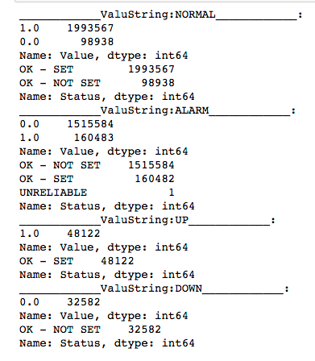
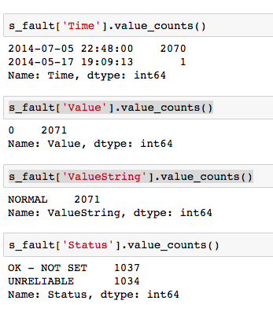
FAULT 2012 – 2017 (Old)
FAULT EDNA_TEST (NEW)

Slide 5
Insights for FCI FAULT old data vs sample data
Proportion of unreliable to reliable is way higher in sample data (almost 50%, 50%), the old data has 1 unreliable reading per around 1.6 million reading
Sample data only has normal reading with almost all of them having identical timestamps (2070 reading having the same time stamp)

Slide 6
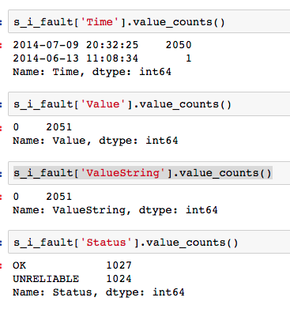
I_FAULT EDNA_TEST(NEW)
Proportion of unreliable to reliable is way higher in sample data (almost 50%, 50%) (way higher than old data)
Repeated timestamps
All of the values are zero

Slide 7
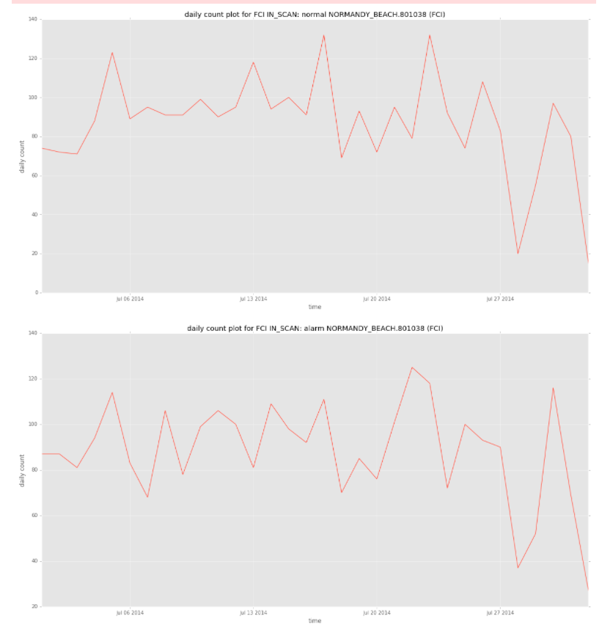
IN_SCAN EDNA_TEST(NEW)
Sample data looks relatively normal
With minimal repeating timestamps
Need more data to make sure quality is ok

