Slide 1
Design of a Moore Sequential Circuit
Outputs depend only on the present state.
Easier to design and debug than Mealy machines, but often contain more states than equivalent Mealy machines.
No outputs occur during the transition.
Cannot respond to an input until the active edge of the clock occurs; this is in contrast to a Mealy circuit.

Slide 2
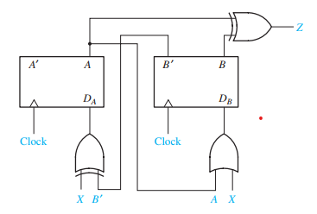
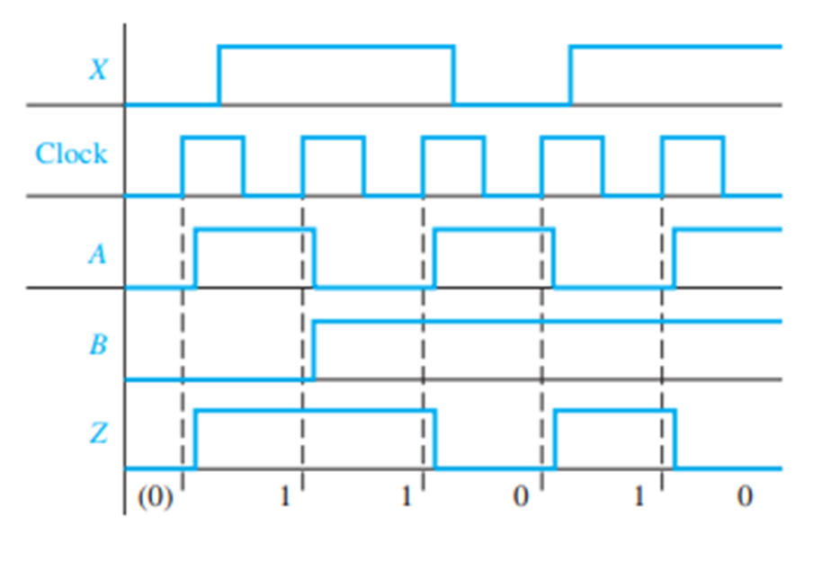
Moore Sequential Circuit

Slide 3
Note : For the Moore circuit, the output which results from application of a given input does not appear until after the active clock edge; therefore, the output sequence is displaced in time with respect to the input sequence.

Slide 4
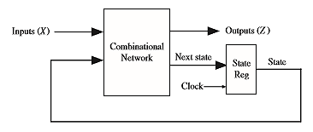
Mealy Sequential Circuit Design
Mealy: the outputs depend on both the present state and the present inputs.
Consists of: combinational circuit, which generates the outputs and the next state, and a state register, which holds the present state. State register is usually comprised of D flip-flops.

Slide 5
Mealy Sequential Circuit Design (continued)
Steps required to design a sequential circuit:
1. Determine the required relationship between the input and output sequences. Find a state graph and state table.
2. Reduce the table to a minimum number of states.
3. If the reduced table has m states ,n flip-flops are needed. Use either the encoded state assignment technique or the one‑hot assignment technique.
4. Form the transition table.
5. Plot next‑state maps and input maps for each flip‑flop and derive the flip‑flop input equations. Derive the output functions.
6. Realize the flip‑flop input equations and the output equations using the available logic gates.
7. Check design.
1-5

Slide 6
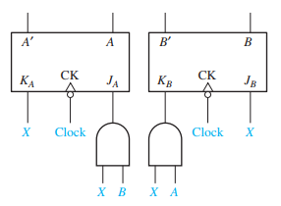
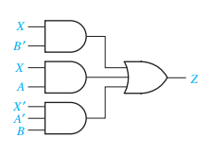
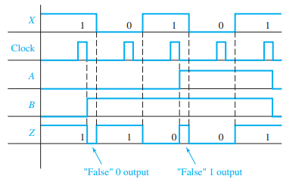
Mealy Sequential Circuit

Slide 7
After the circuit has changed state and before the input is changed, the output may temporarily assume an incorrect value, which we call a false output. As indicated on the timing chart, this false value arises when the circuit has assumed a new state but the old input associated with the previous state is still present.
For the Mealy circuit, the output which corresponds to a given input appears shortly after the application of that input. Because the correct output appears before the active clock edge, the output sequence is not displaced in time with respect to the input sequence as was the case for the Moore circuit.

Slide 8
State Graphs
The state table specifies the next state and output of a sequential circuit in terms of its present state and input. The following method can be used to construct the state table:
Determine the flip-flop input equations and the output equations from the circuit.
2. Derive the next-state equation for each flip-flop from its input equations, using
one of the following relations:
D flip-flop Q+ = D
T flip-flop Q+ = T ⊕ Q
S-R flip-flop Q+ = S + R’ Q
J-K flip-flop Q+ = JQ’+ K’ Q
3. Plot a next-state map for each flip-flop.
4. Combine these maps to form the state table. Such a state table, which gives the
next state of the flip-flops as a function of their present state and the circuit
inputs, is frequently referred to as a transition table.

Slide 9
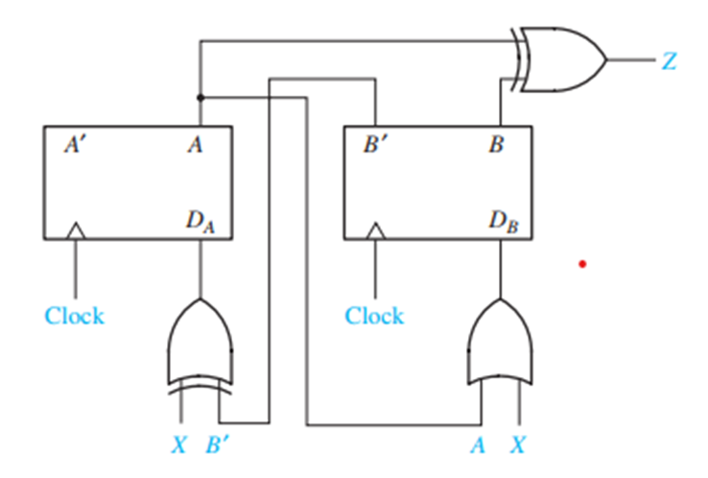
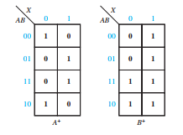
The flip-flop input equations and output equation are
DA = X ⊕ B’ DB= X + A Z= A ⊕ B
2. The next-state equations for the flip-flops are
A+ = X ⊕ B’ B+ = X+ A
3. The corresponding maps are

Slide 10

Combining these maps yields the transition table in Table which gives the next state of both flip-flops (A+, B+) as a function of the present state and input.
The output function Z is then added to the table. In this example, the output depends only on the present state of the flip-flops and not on the input, so only a single output column is required.
Moore State Tables
Using Table we can construct the timing chart

Slide 11
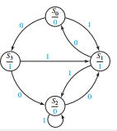

Slide 12
Construct the state table and graph for the Mealy machine of

Slide 13

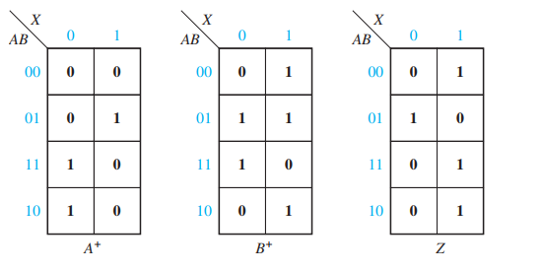

Slide 14
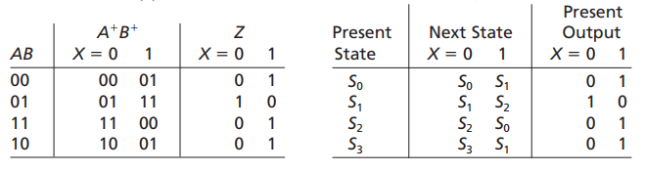
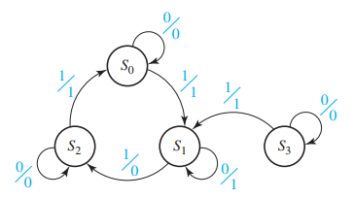
Mealy State Tables
Mealy State Graph

Slide 15
Tristate Logic and Busses
Tristate buffers: gates with a high‑impedance state (hi‑Z) in addition to high and low logic states. The high‑impedance state is equivalent to an open circuit.
Use tristate buffers when connecting multiple gate outputs to the same wire or channel.
Can be used to aid in data transfers between registers.
Tristate buffers are either inverting or non-inverting.

Slide 16
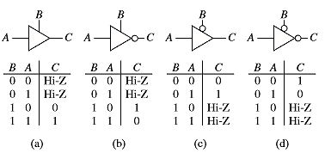
Tristate Logic and Busses (continued)
4 kinds of Tristate buffers:

Slide 17
Sequential Circuit Timing
The correct functioning of sequential circuits involves several timing issues:
Propagation Delay or Clock-to-Q delay: small amount of time that elapses from the time the clock changes to the time the Q output changes.
Setup Time (t_{su)}: amount of time the D input is stable before the active edge of the clock.
Hold time (t_{h}): amount of time the D input is stable after the active edge of the clock.

Slide 18
Sequential Circuit Timing (continued)
Timing Conditions: Maximum clock frequency for a sequential circuit depends on several factors:
Clock period must be long enough.
Propagation delays and setup and hold times create complications in timing.
Static timing analysis (STA) is a method of validating the timing performance of a design by checking all possible paths for timing violations under worst‑case conditions.

Slide 19
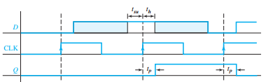
Setup and Hold Times for an Edge-Triggered D Flip-Flop

Slide 20
Sequential Circuit Timing (continued)
Timing paths in a synchronous digital system can be classified into 4 types:
I. Register to register paths (i.e., flip‑flop to flip‑flop).
II. Primary input to register paths (i.e., input to flip‑flop).
III. Register to primary output paths (i.e., flip‑flop to output).
IV. Input to output paths (i.e., no flip‑flop).

Slide 21
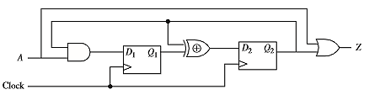
Sequential Circuit Timing (continued)
Question: Identify the static timing paths in the following circuit:
1-21

Slide 22
Sequential Circuit Timing (continued)
Answer: there are six static timing paths in this circuit:
I. From A to D₁ (primary input to flip‑flop)
II. From D₁ to D₂ including the XOR (flip‑flop to flip‑flop)
III. From D₂ via XOR to D₂ (flip‑flop to flip‑flop)
IV. From D₂ to D₁ via AND (flip‑flop to flip‑flop) V. From D₂ to Z via the OR gate (flip‑flop to output)
VI. From A to Z via the OR gate (input to output)

Slide 23
Sequential Circuit Timing (continued)
Timing Rules for Flip-Flop to Flip-Flop Paths:
1. Setup time rule for flip-flop to flip-flop path: Clock period should be long enough to satisfy flip-flop setup time.
2. Hold-time rule for flip-flop to flip-flop path: Minimum circuit delays should be long enough to satisfy flip-flop hold time.
3. Setup time rule for input to flip-flop path: External input changes to the circuit should satisfy flip-flop setup time.
4 Hold-time rule for input to flip-flop path: External input changes to the circuit should satisfy flip-flop hold times.

Slide 24
Sequential Circuit Timing (continued)
Synchronous design vs. asynchronous design:
Synchronous circuits are more reliable than asynchronous circuits.
Synchronous design philosophy makes design and debugging easier as compared with asynchronous.
Synchronous designs consume more power than asynchronous designs because of the power consumed in the clock distribution network.
Asynchronous designs can reduce power consumption, but it is very difficult to get timing issues under control.
Hence, despite their high power consumption, designers favor synchronous designs.

Slide 25
Sequential Circuit Timing (continued)
Timing Rules (continued)for Circuits with Skew:
5. For a positive skew:
6.
Clock skew: total time difference in clock signal arrival between 2 points in the clock network.
Positive skew: the capturing flip‑flop gets the clock delayed with reference to the launching flip‑flop. Positive skew is good for setup time, but it is bad for hold time.
Negative skew: the launching flip‑flop gets the clock delayed with reference to the capturing flip‑flop. Negative skew is good for hold time, but it is bad for setup time.

Slide 26
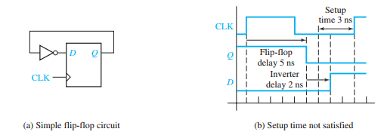
Suppose the inverter has a propagation delay of 2 ns, and suppose the flip-flop has a propagation delay of 5 ns and a setup time of 3 ns. (The hold time does not affect this calculation.) Suppose, that the clock period is 9 ns, i.e., 9 ns is the time between successive active edges

Slide 27
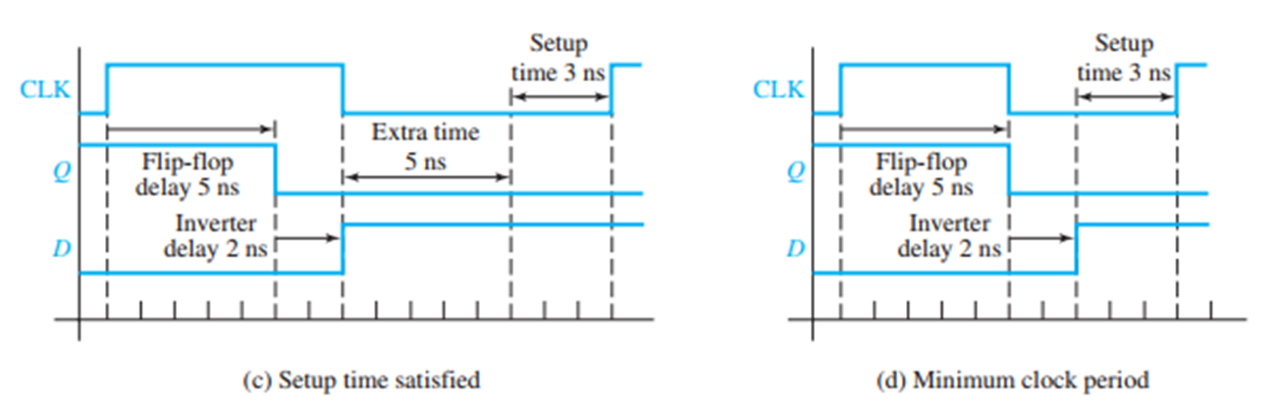
Suppose instead that the clock period were 15 ns. Again, the input to the flip-flop will change 7 ns after the rising edge. However, because the clock is slower, this is 8 ns before the next rising edge. Therefore, the flip-flop will work properly.

Slide 28
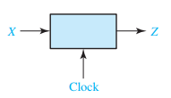
Design of a Sequence Detector
To illustrate the design of a clocked Mealy sequential circuit, we will design a sequence detector.
Sequence Detector to be Designed
The circuit will examine a string of 0’s and 1’s applied to the X input and generate an
output Z 1 only when a prescribed input sequence occurs. It will be assumed that the
input X can only change between clock pulses. Specifically, we will design the circuit
so that any input sequence ending in 101 will produce an output Z 1 coincident with
the last 1. The circuit does not reset when a 1 output occurs. A typical input sequence and the corresponding output sequence are

Slide 29
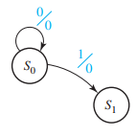
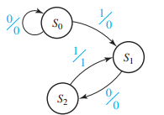
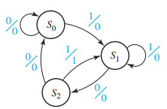
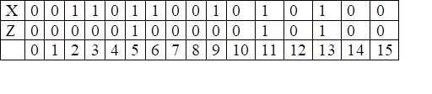
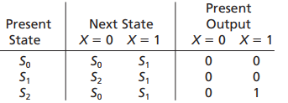
we do not know how many flip-flops will be required, so we will designate the
circuit states as S0, S1. The labels on the graph are of the form X/Z.
state table

Slide 30
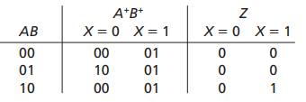
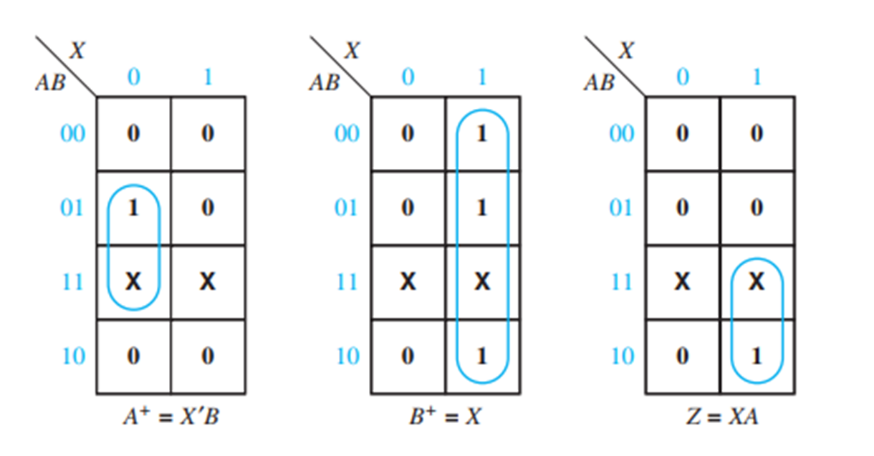
One flip-flop can have only two states, two flip-flops are needed to represent the three states. Designate the two flip-flops as A and B.
Let flip-flop states A=0 and B=0 correspond to circuit state S0;
A=0 and B=1 correspond to S1;
and A=1 and B=0 correspond to circuit state S2.

Slide 31
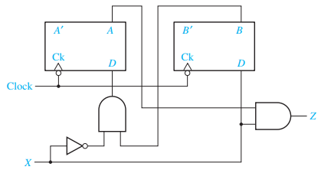
DA=A+ = X’ B , DB=B+= X, Z=AX

Slide 32
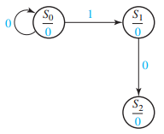
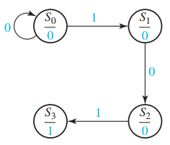
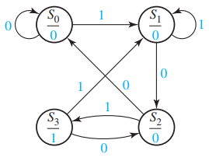
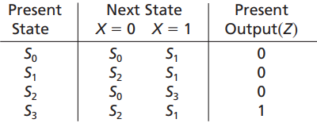
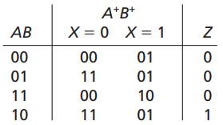
Moore machine is similar to that used for a Mealy machine, except that the output is written with the state instead of with the transition between states.
Z AB’ .

Slide 33
Practice for:
Design of Mealy and Moore Sq. Ckt.
Analysis of Mealy and Moore Sq. Ckt to get the state graph.

