Slide 1
Delays in Verilog
Types of Delays:
Inertial delay
Transport delay
Net delay

Slide 2
Delays in Verilog (continued)
Inertial delay: intended to model gates and other devices that do not propagate short pulses from the input to the output.
An input pulse that is shorter than the delay of the assignment does not propagate to the output. This feature is called inertial delay.
If a gate has an ideal inertial delay T, in addition to delaying the input signals by time T, any pulse with a width less than T is rejected.
For example, if a gate has an inertial delay of 5 ns, a pulse width 5ns would pass through, but a pulse of width 4.999 ns would be rejected.

Slide 3
Delays in Verilog (continued)
Transport delay: is intended to model the delay introduced by wiring; it simply delays an input signal by the specified delay time.
In order to model this delay, a delay value must be specified on the right-hand side of the statement.

Slide 4
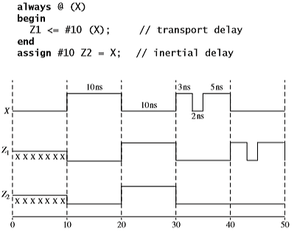
Delays in Verilog (continued)
Example of inertial and transport delays:

Slide 5
Delays in Verilog (continued)
The delay in the statement Z1 <= #10 X; is called intra-assignment delay. The expression on the right hand side is evaluated but not assigned to Z1 until the delay has elapsed (also called delayed assignment).
In a statement like #10 Z1 <= X; the delay of #10 elapses first and then the expression is evaluated and assigned to Z1 (also called delayed evaluation).

Slide 6
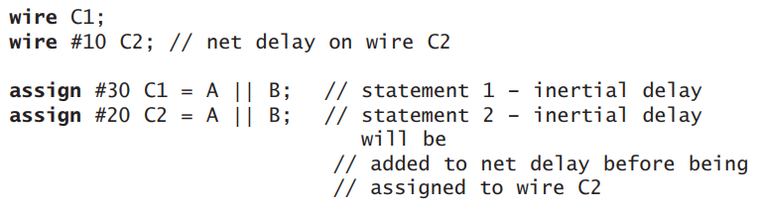
Delays in Verilog (continued)
Net delay: refers to the time it takes from any driver on the net to change value to the time when the net value is updated and propagated further.
The wire C2 has a net delay of 10 ns, C1 has a no delay.

Slide 7
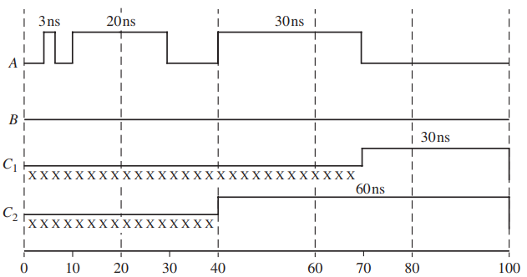
Delays in Verilog (continued)
There are inertial delays of 30ns for C1 in statement 1 and 20ns for C 2 in statement 2, typically representative of gate delays. After statement 2 processes its delay of 20 ns, the net delay of 10 ns is added to it. Figure indicates the difference between C1 and C2. C1 rejects all narrow pulses less than 30ns, whereas C2 rejects only pulses less than 20 units.

Slide 8
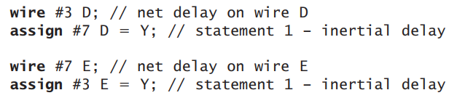
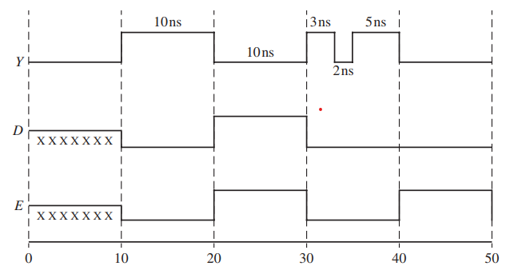
Delays in Verilog (continued)

Slide 9
Delays in Verilog (continued)
The assign statement for D works with a 7ns inertial delay and rejects any pulse below 7ns.
Hence D rejects the 3ns, 2ns and 5ns pulses in Y. The 3ns net delay from the wire statement is added to the signal that comes out from the assign statement.
In the case of E, pulses below 3 ns are rejected. Hence the 3 ns pulse in Y passes through the assign statement for E, the 2 ns pulse is rejected and the 5ns pulse is accepted. Hence the 3 ns and 5 ns pulses get combined in the absence of the 2ns pulse to yield output on E appears as a big 10ns pulse.

Slide 10
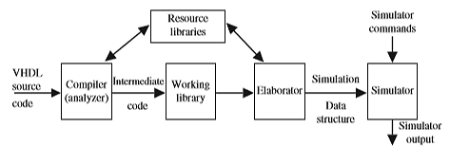
Compilation, Simulation, and Synthesis of Verilog Code
Three phases in the simulation of Verilog code: analysis (compilation), elaboration, and simulation:
Compilation, Elaboration, and Simulation of Verilog Code

Slide 11
Compilation, Simulation, and Synthesis of Verilog Code (continued)
Analysis (compilation): check source code; if a syntax or semantic error occurs, then the compiler gives error message. Checks references to libraries.
Elaboration: creates a hierarchy of module instances, propagates parameters among modules, makes drivers, and constructs a design hierarchy.
Simulation: consists of an initialization phase and actual simulation. The initialization phase is used to give an initial value to the signal. Events are kept on an event queue, ordered by simulation time.
Events can occur at different times. In order to keep track of the events and to make sure they are processed in the correct order, the events are kept on an event queue, ordered by simulation time.

Slide 12
Compilation, Simulation, and Synthesis of Verilog Code (continued)
Verilog event queue is divided into five regions:
1. Active event region: events that occur at the current simulation time.
2. Inactive event region: events that occur at the current simulation time but that shall be processed after all the active events are processed.
3. Non-blocking assign update region: events that have been evaluated during some previous simulation time but that shall be assigned at this simulation time after all the active and inactive events are processed.
4. Monitor event region: events that shall be processed after all the active, inactive, and non-blocking assign update events are processed.
5. Future event region: events that occur at some future simulation time are in this region.

Slide 13
When each Verilog statement is processed, events are added to the various queue regions according to the following convention for each type of statement: i. Continuous assignment—evaluate RHS and add to active region as an active update event. ii. Procedural continuous assign—evaluate RHS and add to active region as an update event. iii. Blocking assignment with delay—compute RHS and put into future event region for time after delay. iv. Blocking assignment with no delay—compute RHS and put into inactive region for current time. v. Non-blocking assignment with no delay—compute RHS and schedule as non-blocking assign update event for current time if zero delay. vi. Non-blocking assignment with delay—compute RHS and schedule as nonblocking assign update event for future time if zero delay. vii. $monitor and $strobe system tasks—create monitor events for these system tasks. (These events are continuously reenabled in every successive time step.)

Slide 14
Compilation, Simulation, and Synthesis of Verilog Code (continued)
Processing of all the active events is called a simulation cycle; for each cycle these ordered actions are performed:
1. Process all active update events.
2. Activate all inactive events for that time.
3. Activate all non-blocking assign update events and process them.
4. Activate all monitor events and process them.
5. Advance time to the next event time and repeat from step 1.

Slide 15
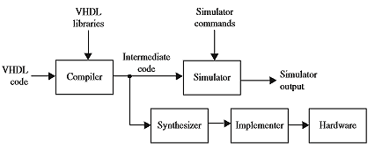
Compilation, Simulation, and Synthesis of Verilog Code (continued)
Simulation and synthesis process:
A netlist is a list of required components and their interconnections.
Most important uses of Verilog is to synthesize or automatically create hardware from a Verilog description. The synthesis software for Verilog translates the Verilog code to a circuit description that specifies the needed components and the connections between the components.

Slide 16
Verilog Data Types and Operators
Two main groups of data types:
Variable:
An abstraction of a data storage element.
Stores a value from one assignment to the next. An assignment statement in a procedure acts as a trigger that changes the value in the data storage element.
Examples: reg, time, integer, real, real-time.
Net:
Represent physical connections between structural entities, such as gates.
Generally, it does not store values. Instead, value is determined by the values of its drivers.
Examples: wire, tri, wand, wor.

Slide 17
Verilog Data Types and Operators (continued)
Bitwise and Logical Operators:
Operator type | Operator symbols | Operation performed
Bitwise | ~ | Bitwise NOT (1's complement)
 | & | Bitwise AND
 | | | Bitwise OR
 | ^ | Bitwise XOR
 | ~^ or ^~ | Bitwise XNOR
Logical | ! | NOT
 | && | AND
 | || | OR

Slide 18
Verilog Data Types and Operators (continued)
Reduction and shift operators:
Operator type | Operator symbols | Operation performed
Reduction | & | Reduction AND
 | ~& | Reduction NAND
 | | | Reduction OR
 | ~| | Reduction NOR
 | ^ | Reduction XOR
 | ~^ or ^~ | Reduction XNOR
Shift | >> | Logical right shift
 | << | Logical left shift
 | >>> | Arithmetic right shift
 | <<< | Arithmetic left shift

Slide 19
Verilog Data Types and Operators (continued)
Relational, logical and bitwise operators:
Operator type | Operator symbols | Operation performed
Relational | > | Greater than
 | < | Less than
 | >= | Greater than or equal to
 | <= | Less than or equal to
Logical and bitwise | == | Logical equality
 | != | Logical inequality
 | === | Case equality
 | !== | Case inequality

Slide 20
Verilog Data Types and Operators (continued)
Arithmetic, concatenation, replication, conditional operators:
Operator type | Operator symbols | Operation performed
Arithmetic | + | Addition
 | - | Subtraction
 | - | 2's complement
 | * | Multiplication
 | / | Division
 | ** | Exponentiation
Concatenation | { } | Concatenation
Replication | {{}} | Replicate value m for n times
Conditional | ? : | Conditional

