Slide 1
Modeling Registers and Counters Using Verilog Always Statements (continued)
What is the hardware obtained if the following code is synthesized?
module reg31 (Q1,Q2,Q3,A,CLK);
input A;
input CLK;
output Q1,Q2,Q3;
reg Q1,Q2,Q3;
always @(posedge CLK)
begin
Q1 = A; // statement 1
Q2 = Q1; // statement 2
Q3 = Q2; // statement 3
end
endmodule
A single flip-flop
Modern synthesis tools will generate a single flip-flop with input A when this code is synthesized. The outputs Q1, Q2, and Q3 can all be connected to the output of the same flip-flop. If the synthesizer does not have good optimization algorithms, it might generate three parallel flip-flops, each with the same input A but with outputs Q1, Q2, and Q3, respectively.

Slide 2
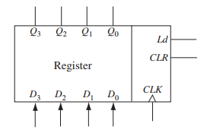

Modeling Registers and Counters Using Verilog Always Statements (continued)
Register with Synchronous Clear and Load

Slide 3
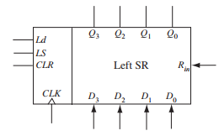
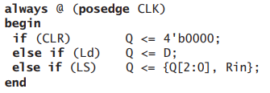
Modeling Registers and Counters Using Verilog Always Statements (continued)
Left-Shift Register with Synchronous Clear and Load

Slide 4
Modeling Registers and Counters Using Verilog Always Statements (continued)
The following are important coding practices while writing synthesizable Verilog for sequential hardware:
1. Use an edge-triggered clock in the sensitivity list using the posedge or negedge keywords.
2. Use non-blocking assignments: use “<=” inside always blocks.
3. Do not mix blocking and non-blocking statements in an always block.
4. Do not make assignments to the same variable from more than one always block.
5. Avoid unwanted latches by assigning a value to combinational output signals in every possible execution path in the always block.

Slide 5
Constants
There are three different ways to define constant values:
`define: used to define a number or an expression for a meaningful string.
`define constant_name constant_value
Example:
`define wordsize 16
reg [1:`wordsize] data;
parameter: used to define constants that should not be changed.
parameter constant_name = constant_value;
Example:
parameter msb = 15; // defines msb as a constant value 15
parameter [31:0] decim = 1'b1; // value converted to 32 bits

Slide 6
Constants (continued)
Third way to define constant values:
Localparam: similar to parameter; used to define constants that should not be changed.
localparam constant_name = constant_value;

Slide 7
Arrays
Key feature of VLSI circuits is the repeated use of similar structures. Arrays in Verilog can be used while modeling the repetition.
Verilog arrays can be used to create memory arrays and specify the values to be stored in these arrays.
In order to use an array, one must declare the array upper and lower bound.
Two options to declare the array bounds:
First option: the array bounds are declared between the variable type (reg or net) and the variable name, and the array bound means the number of bits for the declared variable.

Slide 8
Arrays (continued)
Example:
reg [7:0] eight_bit_register;
The register variable eight_bit_register can store one byte (eight bits) of information. The 8-bit register can be initialized to hold the value 00000001 using the following statement: eight_bit_register = 8'b00000001;

Slide 9
Arrays (continued)
Second option: array bounds can be declared after the name of the array.
Example:
reg rega [1:n]; // This is an array of n 1-bit registers
reg [1:n] regb; // This is an n-bit register

Slide 10
Arrays (continued)
We can define multiple 8-bit registers in one array declaration. In this case, additional upper and lower bound(s) must be declared after the name of the array. In the example that follows, 16 registers are declared; each register can store onebyte (8-bit) vector information.
reg [7:0] eight_bit_register_array [15:0];
This array can be initialized as follows: eight_bit_register_array[15] = 8'b00001100; eight_bit_register_array[14] = 8'b00000000; . . . . . . . . eight_bit_register_array[1] = 8'b11001100; eight_bit_register_array[0] = 8'b00010001;

Slide 11
Arrays (continued)
Arrays can be created of various data types. Arrays of wires and integers can be declared as follows:
wire wire_array[5:0]; // declares an array of 6 wires
integer inta[1:64]; // declares an array of 64 integer values

Slide 12
Arrays (continued)
Matrices:
Multidimensional array types may also be defined with two or more dimensions.
The following example defines a 2-dimensional array variable in an initial statement, which is a matrix of integers with four rows and three columns with 8-bit elements:
Example:
reg [7:0] matrixA [0:3][0:2] = { { 1, 2, 3},
{ 4, 5, 6},
{ 7, 8, 9},
{10, 11, 12}};
The array element matrixA[3][1] references the element in the fourth row and second column, which has a value of 11.

Slide 13
Arrays (continued)
Look-Up Table Method Using Arrays and Parameters:
The array construct together with parameter can be used to create look-up tables which can be used to create combinational circuits using the ROM or Look-up Table (LUT) method.

Slide 14
Loops in Verilog
Loops:
Activity occurring in a repetitive way.
Statements are sequential.
Kinds of loop statements: for, while, repeat.
Form for a loop:
for (initial_statement; expression; incremental_statement) begin
sequential statement(s);
end

Slide 15
Loops in Verilog
The following example is of initializing an array variable, eight_bit_register_array, using a for loop.
reg [7:0] register A [15:0]; for (i=0; i<16; i=i+1) begin register A[i] = 8'b00000000; end

Slide 16
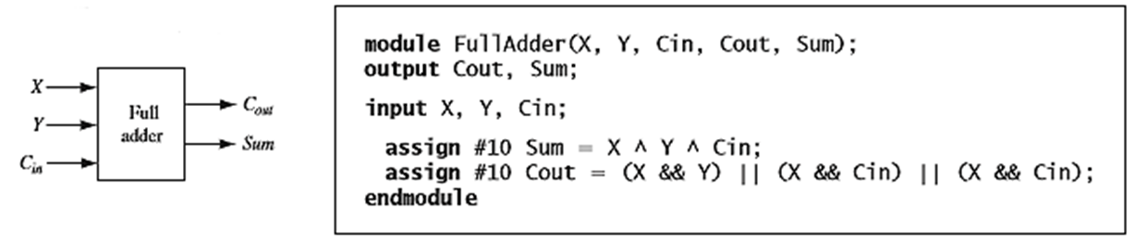
Loops in Verilog
For loop example: 4-bit adder
for (i=0; i<4; i=i+1)
begin
Cout = (A[i] && B[i]) || (A[i] && Cin) || (B[i] && Cin);
sum[i] = A[i] ^ B[i] ^ Cin;
Cin = Cout;
end

Slide 17
Loops in Verilog (continued)
While loop: a condition is tested before each iteration. It is used mainly for simulation.
While loop has the form:
while condition
begin
sequential statements;
end

Slide 18
Loops in Verilog (continued)
While loop example:
`define MAX 100
module counter_100;
integer count;
initial begin
count = 0;
while (count < `MAX)
begin
count = count + 1;
end // while
$display("number = %d ", count);
end // initial begin
endmodule

Slide 19
Loops in Verilog (continued)
Repeat loop: repeats the sequential statement(s) for specified times. The number of repetitions is set by a constant value or a logical expression.
Repeat loop example:
repeat ( 8 )
begin
x = x + 1;
y = y + 2;
end

Slide 20
Testing a Verilog Model
A model has to be tested and validated before it can be successfully used.
A test bench is a piece of Verilog code that can provide input combinations to test a Verilog model for the system under test.
Test benches are frequently used during simulation to provide sequences of inputs to the circuit or Verilog model under test.

Slide 21
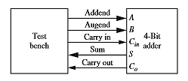
Testing a Verilog Model (continued)
Test bench for testing a 4-bit binary adder:

Slide 22
Testing a Verilog Model (continued)
System tasks used to observe outputs:
$display: outputs/prints values exactly where it is executed. Adds a new line character to the end of its output.
$write: works the same as $display, but does not add a new line character to the end of its output as $display does.
$strobe: displays at the very end of the current simulation time unit.
$monitor: displays every time one of its parameters changes.

Slide 23
A Few Things to Remember
Verilog is typically written for the following three reasons:
1. To design hardware (i.e., to model and synthesize hardware).
2. To model hardware (i.e., to create simulation models that are not necessarily synthesizeable).
3. To verify hardware (i.e., to test designs).

Slide 24
The following are illegal in all models: assign a <= b; // statement 1 assign a <= #10 b; // statement 2 assign a = #10 b; // statement 3
The assign statement is to be used with ‘=’, not with ‘<=’. Hence the first two statements are illegal. Statement 3 uses delayed assignment, which cannot be done with the assign statement. No delay can be specified on the right side of a continuous assign statement. Hence statement 3 is illegal.

Slide 25
The following are legal. assign a = b; \\ Statement 4 assign #10 a = b; \\ Statement 5
Statement 4 is a concurrent statement. It executes concurrently to all other concurrent assign statements and always blocks. Statement 5 behaves with the inertial type of delay.

Slide 26
A Few Things to Remember
Some strategies that can be followed for models:
Do not use initial blocks.
Do not use delays. Delays are ignored during synthesis.
If possible, use concurrent assignments (assign) to design combinational logic.
It is possible to use procedural assignments (always blocks) to design either combinational logic or sequential logic.
When procedural assignments (always blocks) are used for combinational logic, use blocking assignments (e.g., ‘=’).
When procedural assignments (always block) are used for sequential logic, use non-blocking assignments (e.g., ‘<=’).

Slide 27
A Few Things to Remember (continued)
Strategies (continued):
Do not mix blocking and non-blocking statements in an always block.
Do not make assignments to the same variable from more than one always block.
Avoid unwanted latches by assigning a value to combinational output signals in every possible execution path in the always block.

Slide 28
A Few Things to Remember (continued)
To model hardware, a few points to remember:
If delays are not to be modeled, use blocking assignments for combinational logic and non-blocking assignments for sequential logic.
In blocking assignments with no delay specification, the new values are assigned immediately without any delta delays. However, in non-blocking assignments with no delay specification, the change is scheduled to occur after a delta time.
For combinational logic with inertial delays, use delayed evaluation blocking statements.
For combinational logic with transport delays, use delayed assignment non-blocking assignments.

Slide 29
A Few Things to Remember (continued)
Modeling hardware points (continued):
For sequential logic with delays, use delayed assignment non-blocking assignments.
Use inertial delays if pulse-rejection behavior is required.
Do not make assignments to the same variable from more than one always block.

Slide 30
A Few Things to Remember (continued)
To verify hardware, a few points to remember:
Although all types of assignment statements can be used in verification models, use blocking assignments if possible.
When delays are used, pay attention to inertial behavior.
Use initial blocks to hard code test stimulus values.
Use parameters for creating constants so test benches can easily be modified.
Be aware of the differences between $display, $strobe and $monitor so that wrong conclusions are not made about correctly working circuits.

Slide 31
We have seen how to use Verilog to model combinational logic and sequential machines. Since Verilog is a hardware description language, it differs from an ordinary programming language in several ways. Most importantly, Verilog statements execute concurrently, since they must model real hardware in which the components are all in operation at the same time. Statements within an always block execute sequentially, but the always blocks themselves operate concurrently.

Slide 32
Summary
Steps in design: state the problem, design requirements, develop specs, design formulation, design entry, simulation, logic synthesis, post synthesis simulation, mapping, placement, and routing.
Verilog models combinational circuits by what are called concurrent statements or continuous assignments.
Data Types: Reg (register) and wire
Words such as and, or, and always are reserved words (or keywords).

Slide 33
Summary (continued)
Module: a basic building block that declares the input and output signals and specifies the internal operation of the module.
The two types of assignments are: continuous and procedural.
Two types of sequential statements: signal assignment statements and if statements.
Types of Delays: inertial delay, transport delay, and net delay.

Slide 34
Summary (continued)
The three phases in the simulation of Verilog code are: analysis (compilation), elaboration, and simulation.
Two main data types: variable and net.
A multiplexer is a combinational circuit and can be modeled using: a conditional operator with assign statement, a case statement or if-else statement.

Slide 35
Summary (continued)
There are important coding practices while writing synthesizeable Verilog for combinational hardware.
Statements within an always block execute sequentially, but the always blocks themselves operate concurrently.
3 Models are: structural, behavioral, and data Flow (Register Transfer Language).

Slide 36
Summary (continued)
Modeling a sequential machine, 3 approaches: use two always blocks to represent the two parts of the circuit, use a data flow approach, or use a structural model.
There are three different ways to define constant values: `define, parameter, and localparam.
Verilog arrays can be used to create memory arrays and specify the values to be stored in these arrays.
Kinds of loop statements: for, while, repeat.
Be aware of the differences between $display, $strobe and $monitor.

Slide 37
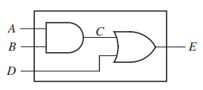
module two_gates (A, B, D, E);
output E;
input A, B, D;
wire C;
assign C = A && B; // concurrent
assign E = C || D; // statements
endmodule

Slide 38
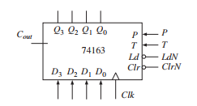
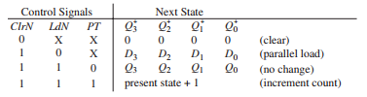
This counter has four control inputs—ClrN, LdN, P, and T. Both P and T are used to enable the counting function. While P is an actual enable signal to the 4-bit generic counter, T is used for a carry connection signal when cascading multiple counters.

Slide 39
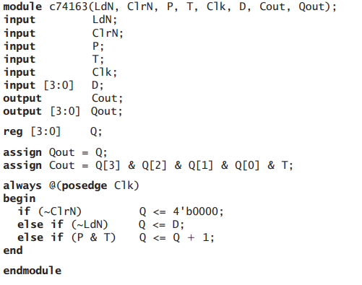

Slide 40
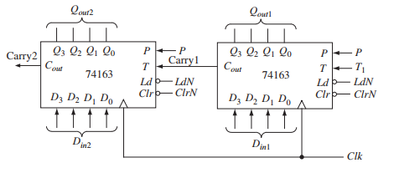

Slide 41
