Slide 1
3:8 decoder using case
module decoder ( input [2:0] a, output reg [7:0] y);
always @(*)
case (a)
3’b000: y <= 8’b00000001;
3’b001: y <= 8’b00000010;
3’b010: y <= 8’b00000100;
3’b011: y <= 8’b00001000;
3’b100: y <= 8’b00010000;
3’b101: y <= 8’b00100000;
3’b110: y <= 8’b01000000;
3’b111: y <= 8’b10000000;
endcase
endmodule

Slide 2
What device does the following Verilog code represent?
always @(CLK, Clr, Set) begin if(Clr == 1'b1) Q <= 1'b0; else if(Set == 1'b1) Q <= 1'b1; else if(CLK == 1'b0) Q <= D; else begin end end

Slide 3
In the following Verilog process A, B, C, and D are all registers that have a value of 0 at time=10 ns. If E changes from 0 to 1 at time = 20ns, specify the time(s) at which each signal will change and the value to which it will change. List these changes in chronological order.
always begin wait(E); A <= #5 1; B <= A + 1; C <= #10 B; D <= #3 B; A <= #15 A + 5; B <= B + 7; end

Slide 4
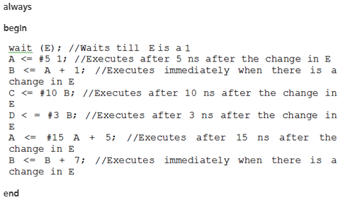

Slide 5
reg [7:0] C; reg signed [7:0] D; reg signed [7:0] A = 8'hD5;
evaluate i. C = A >> 4 ii. C = A >>> 4 iii. C = A << 4 iv. C = A <<< 4 v. D = A >> 4 vi. D = A >>> 4 vii. D = A << 4 viii. D = A <<< 4
A= 11010101

Slide 6
Assume D1=0, D2=5, and D1 changes to 1 at time=10 ns. What are the values of D1 and D2 after the following code has been executed once? Do the values of D1 and D2 swap?
always @ (D1)
begin
D2 <= D1;
D1 <= D2;
End

Slide 7
If A 5 101, B 5 011, and C 5 010, what are the values of the following statements? Assume A, B, and C are of reg type. Assume as many bits as necessary for the result.
(a) {A,B} | {B,C} (b) A >> 2 (c) A >>> 2 (d) {A,(~B)} == 111110 (e) A | B & C

Slide 8
Which system?
module Question(input wire CLK, output reg [31:0] OUT);
initial
OUT <= 0;
always @(posedge CLK)
OUT <= OUT + 1;
endmodule

Slide 9
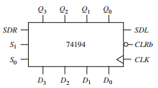
A description of a 74194 4-bit bidirectional shift register follows. The CLRb input is asynchronous and active low and overrides all the other control inputs. All other state changes occur following the rising edge of the clock. If the control inputs S1 = S0 = 1, the register is loaded in parallel. If S1 = 1 and S0 = 0, the register is shifted right and SDR (serial data right) is shifted into Q3. If S1 = 0
and S0 = 1, the register is shifted left and SDL is shifted into Q0. If S1 = S0 = 0, no action occurs

Slide 10
Down Counter
`define TICK #2
module downCntr(clk, reset, Q);
input clk, reset;
output [3:0] Q;
reg [3:0] Q;
always @ (posedge clk)
begin
if (~reset) begin
Q <= `TICK Q-1;
end
end
always @ (posedge reset)
begin
Q <= 4'b0000;
end
endmodule

