Slide 1
Objectives
Introduction
Brief Overview of Programmable Logic Devices
Simple Programmable Logic Devices (SPLDs)
Read-only memories (ROMs)
Programmable Logic Arrays (PLAs)
Programmable Array Logic (PAL)
Programmable Logic Devices (PLDs)/Generic Array Logic (GAL)
Complex Programmable Logic Devices (CPLDs)
Field-Programmable Gate Arrays (FPGAs)
Organization
Programming Technologies
Programmable Logic Block Architectures
Programmable Interconnects
Programmable I/O Blocks
Dedicated Specialized Components
Applications
Design Flow
Summary

Slide 2
Introduction
If one can put several of building blocks into an integrated circuit (IC) and provide the user with mechanisms to modify the configuration, one can implement almost any circuit within a chip. This is the general principle of programmable logic devices.
Use of programmable logic devices in digital design allows the implementation of complex logic functions, which require many gates and flip-flops, on a single IC chip.
Programmable logic devices to be discussed:
Simple programmable logic devices (SPLDs)
Complex programmable logic devices (CPLDs)
Field-programmable gate arrays (FPGAs)

Slide 3
Briefs of Programmable Logic Devices
Programmable logic comes in different types:
1. Devices that can be programmed only once (irreversible programming process is used)
.Factory programmable Examples: mask-programmable gate array (MPGA) and read-only memory (ROM).
2. Devices that can be reprogrammed many times.
Field programmable
Examples: simple programmable logic device (SPLD), complex programmable logic device (CPLD), and field programmable gate array (FPGA).

Slide 4
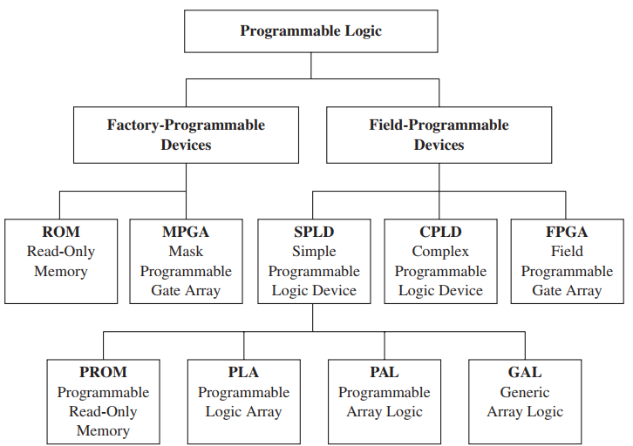
Briefs of Programmable Logic Devices (continued)
(continued)

Slide 5
Briefs of Programmable Logic Devices (continued)
Simple programmable logic devices:
Programmable Logic Arrays (PLAs):
There is a programmable AND array and a programmable OR array, allowing users to implement combinational functions in two levels of gates.
Programmable Array Logic (PAL):
A special case of a PLA, in that the OR array is fixed and only the AND array is programmable.
Many PAL also contain flip-flops.
PLAs and PALs were popular in the 1970s and 1980s due to ease of design.

Slide 6
Briefs of Programmable Logic Devices (continued)
The early programmable devices allowed only one-time programming.
In the early days, erasure of programmable logic used ultraviolet light. With ultraviolet light, erasing the configuration of a device meant removing the device from the circuit and placing it in an ultraviolet environment.
Hence, in-circuit erasure was not possible. Ultraviolet erasers were slow; typically 10 or 15 minutes were required to perform erasures.
Then electrically erasable technology came along.

Slide 7
Briefs of Programmable Logic Devices (continued)
Simple programmable logic devices:
Programmable Logic Devices (PLDs)/Generic Array Logic (GAL):
Flash erasable/reprogrammable PALs.
Contain macroblocks with arrays of gates, multiplexers, flip-flops, or other standard building blocks. Several of these macroblocks appear in a PLD.
Lattice Semiconductor created similar devices with easy programmability and called their line of devices GALs (generic array logic)

Slide 8
Briefs of Programmable Logic Devices (continued)
Complex Programmable Logic Devices (CPLDs):
Have more integration capability than SPLDs.
Come in sizes ranging from 500 to 16,000 gates.
Multiple PLDs into the same chip.

Slide 9
Briefs of Programmable Logic Devices (continued)
Field-Programmable Gate Arrays (FPGAs)
During late 1980s, Xilinx started using static RAM storage elements to hold configuration information.
Larger and more complex blocks containing static RAMs and multiplexers.
With improved technology over past 15 years, now can contain more than 5 million gates.

Slide 10
Briefs of Programmable Logic Devices (continued)
Field-Programmable Gate Arrays (FPGAs)
During late 1980s, Xilinx started using static RAM storage elements to hold configuration information.
Larger and more complex blocks containing static RAMs and multiplexers.
With improved technology over past 15 years, now can contain more than 5 million gates.

Slide 11
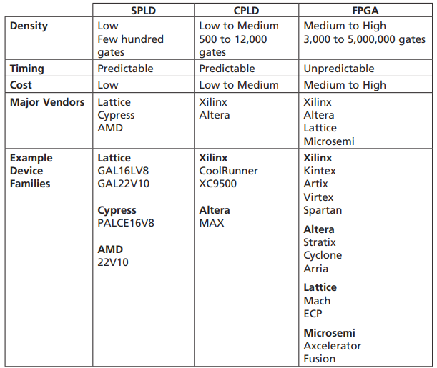
Briefs of Programmable Logic Devices (continued)
Comparison of devices:

Slide 12
Simple Programmable Logic Devices (SPLDs): Introduction
Simple Programmable Logic Devices (SPLDs):
Read-only memories (ROMs)
Programmable Logic Arrays (PLAs)
Programmable Array Logic (PAL)
Programmable Logic Devices (PLDs)/Generic Array Logic (GAL)

Slide 13
SPLDs: Read only memories (ROMs)
Array of semiconductor devices that are interconnected to store an array of binary data.
Once data is stored in the ROM, it can be read out but it cannot be changed.
Outputs can be looked up: Look-Up Table (LUT).
Basic types: mask-programmable ROMs, user-programmable ROMs (PROMs), erasable programmable ROMs (EPROMs), electrically erasable and programmable ROMs (EEPROMs), and flash memories.

Slide 14
SPLDs: ROMs (continued)
Types:
Mask-programmable ROM: data array is permanently stored at the time of manufacture.
PROMs: one-time programmable.
EPROMs: use a special charge-storage mechanism to enable or disable the switching elements in the memory array. Can be erased using ultraviolet light.
EEPROMs: similar to EPROM except that erasure is done using electrical pulses. Can be erased and reprogrammed a limited number of times.
Flash memories: similar to EEPROMs, except that use a different charge-storage mechanism. Usually have built-in programming and erasure capability.

Slide 15
SPLDs: ROMs (continued)
A ROM that has n input lines and m output lines contains an array of 2^{n} words, and each word is m bits long.
A 2^{n} x m ROM can realize m functions of n variables since it can store a truth table with 2^{n} rows and m columns.
Typical sizes for commercially available ROMs: 32 words x 4 bits to 512K words x 8 bits, or larger.

Slide 16
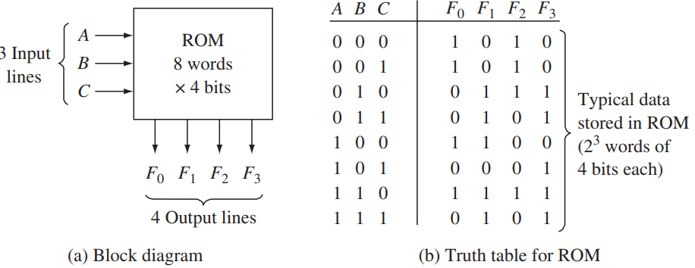
SPLDs: ROMs (continued)
Each of the output patterns that is stored in the ROM is called a word. Each input combination serves as an address,
ROM with n inputs and m outputs:
An 8-Word X 4-Bit ROM

Slide 17
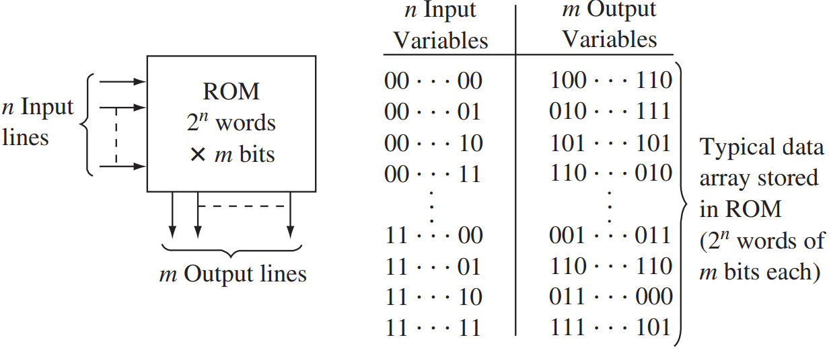
Read-Only Memory with n Inputs and m Outputs

Slide 18
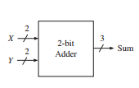
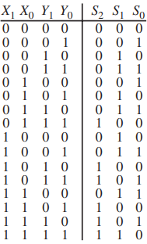
2-bit adder can be implemented with a 16 X 3 ROM.
Block Diagram and Truth Table of a 2-Bit Adder

Slide 19
SPLDs: ROMs (continued)
Question:
Compute the size of the ROM required to implement an 8-to-3 priority encoder.

Slide 20
SPLDs: ROMs (continued)
Answer:
The 8-to-3 priority encoder has 8 inputs and 4 outputs. Hence, it needs a 2⁸ x 4 bit ROM.

Slide 21
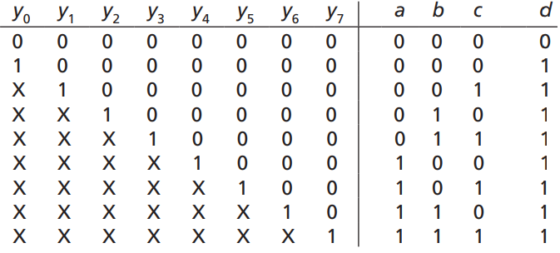
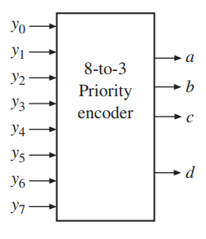
An additional output d is used to indicate invalid outputs

