Slide 1
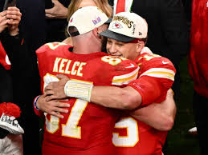
Sprint 4
Team 5

Slide 2
What We Did
Added a Memory Game
Improved Graphics for Snake Game and Air Hockey
Added Code Linting
Bug Fixes and more

Slide 3
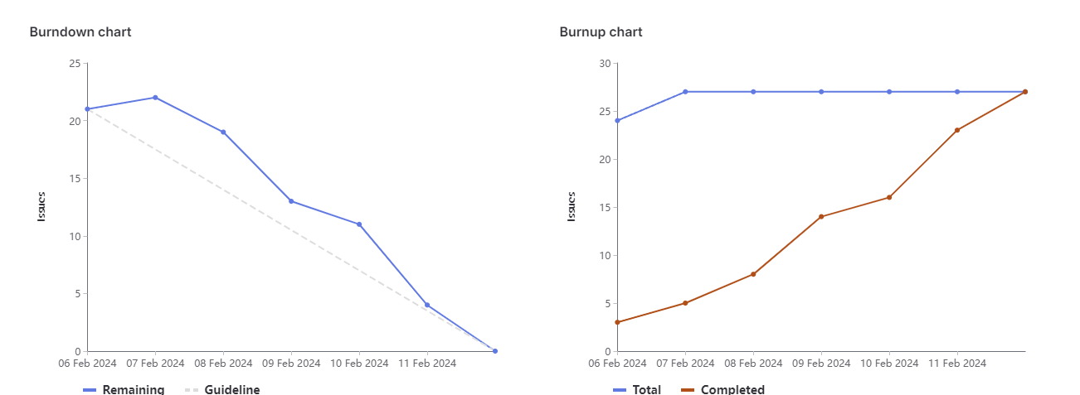
Sprint 4 burndown chart

Slide 4
Joudi
Worked on improving snake game graphics
Added scoring functionality
A bunch of small tasks like debugging and other sprint lead responsibilities
Weight: 13

Slide 5
Brandon
Created the memory game
Created the leaderboard for air hockey

Slide 6
Jacob
Updated opponent code for Air Hockey
Air Hockey bug fixes
WebGL research for future games
Total Weight: 9

Slide 7
Jose
CI/CD Pipeline:
Code Linters
Testing games
Organized stages
Helped with debugging and fixing errors caught by pipeline, updated some documentation
Weight: 15

Slide 8
Manmeet
Air Hockey Bug Fixes
Error fixing in CI/CD pipeline
Weight: 7

Slide 9
Megh
Remove password from login and removed the register popup
Added a way to end the game, a score limit
Found ways to pass in username to different pages, to snake game page - used session storage.
Weight = 13

Slide 10
Abdullah
Frontend Testing - Match Game
Frontend Testing - Snake
Add code linting for CI/CD pipeline
Weight: 12

Slide 11
What didn’t go so well
A few too many issues
Duplicate issue created

Slide 12
What did go well
Good communication
Good Pacing
Good Collaboration
Issues Were Closed Upon Completion

Slide 13
Changes for next sprint?
Double Checking issues
More thorough weight estimation discussion

Slide 14
Demo
Home Page : https://cis4250w24-05.socs.uoguelph.ca/
Match Game: https://cis4250w24-05.socs.uoguelph.ca/match
Snake Game: https://cis4250w24-05.socs.uoguelph.ca/snake
Air Hockey: https://cis4250w24-05.socs.uoguelph.ca/airhockey

