Slide 1
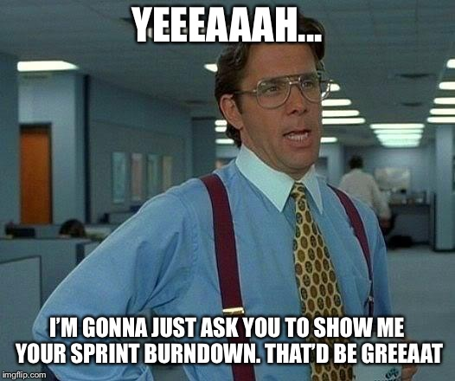
Sprint 4
Team 5

Slide 2
What We Did
Implemented the Word Puzzle Game
Creating secret page
Adding different ways to figure out the secret letters in each separate game
Leaderboard functionality for Match Game
Created more test cases for our games
Fixed any outlying bugs in our games
Linting consistency

Slide 3
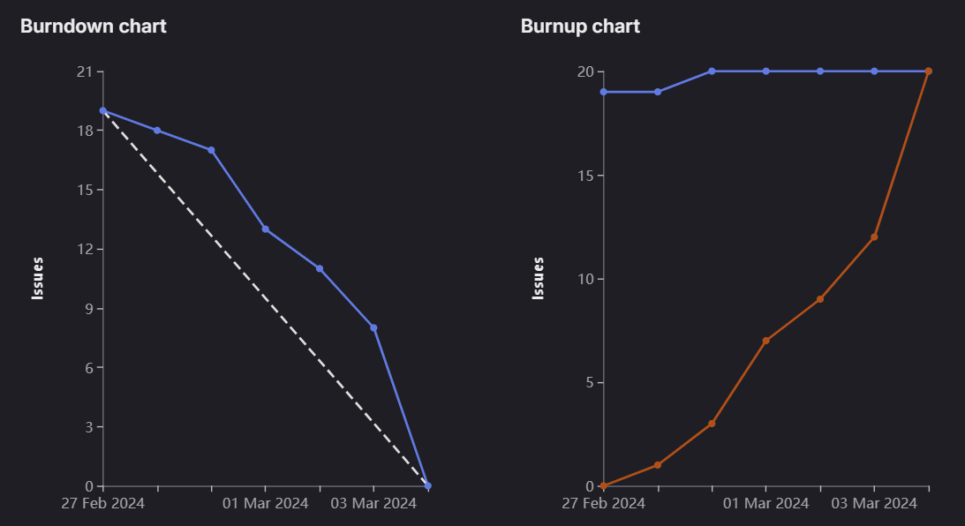
Sprint 4 burndown chart

Slide 4
Abdullah (Sprint Lead)
Word Puzzle Game Design - Match Game
Frontend Testing
Hockey Game
Snake Game
Fixed code for Linting consistency
Ensured everything was running smoothly

Slide 5
Joudi
Added Leaderboard Functionality for Air Hockey
Added Leaderboard Functionality for Match Game
Front End Testing Leaderboard
Weight: 11

Slide 6
Brandon
Helped brainstorm ideas for getting to the secret page
Added ‘secret’ page
Added hint/secret to find in the snake game
Total Weight: 12

Slide 7
Jacob
Added mobile functionality for Air Hockey (Touch Functionality)
Fixed Bug Issues for Air Hockey
Frontend Testing for Air Hockey
Frontend Testing for Match Game
Total Weight: 12

Slide 8
Jose
Contributed to design of puzzle
Implemented the clue to secret page in air hockey game
Updated documentation for Sprint 5
Total Weight: 11

Slide 9
Manmeet
Helped brainstorm ideas for getting to the secret page
Updated Test Cases and fixed the bugs
Reviewed and Updated Puzzle Word Documentation.
Total Weight : 10

Slide 10
Megh
Added mobile functionality for snake game (Touch Functionality)
Updated about us page to include contact information for each member.
Added the how to play for the match game.
Updated nav bars on all the different pages
Total Weight: 12

Slide 11
What didn’t go so well
A few too little issues for everyone to divide equally
Issues were not closed right after completing them

Slide 12
What did go well
Good communication
Good Pacing
Good Collaboration

Slide 13
Changes for next sprint?
Double Checking issues
More thorough weight estimation discussion

Slide 14
Demo
Home Page : https://cis4250w24-05.socs.uoguelph.ca/
Match Game: https://cis4250w24-05.socs.uoguelph.ca/match
Snake Game: https://cis4250w24-05.socs.uoguelph.ca/snake
Air Hockey: https://cis4250w24-05.socs.uoguelph.ca/airhockey

