Slide 1
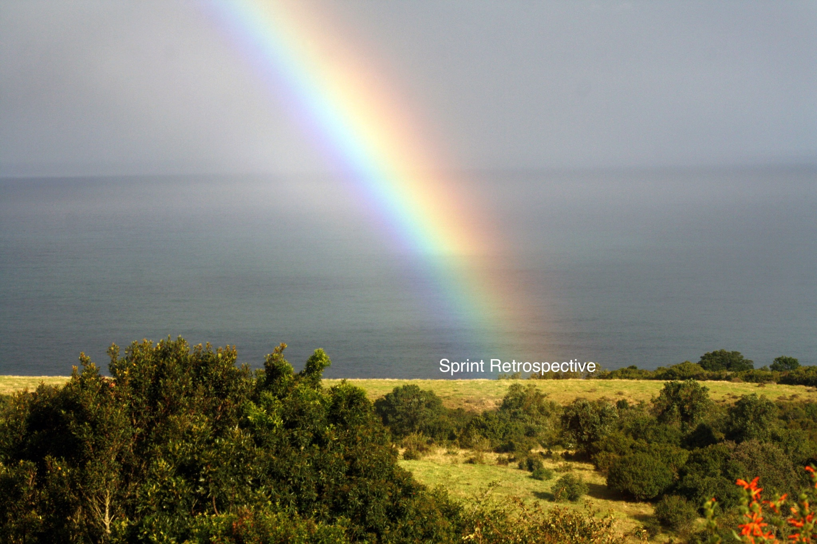
Sprint 7
Team 5

Slide 2
Summary of accomplishments
Added 2 new games to arcade
Farkle - Dice Game
BlackJack - Card Game
Improved previous games
Increased Difficulty
More seamless gameplay
Added indicators for actions performed in games
Testing/Error Fixes/Documentation
Updated Site to reflect new changes

Slide 3
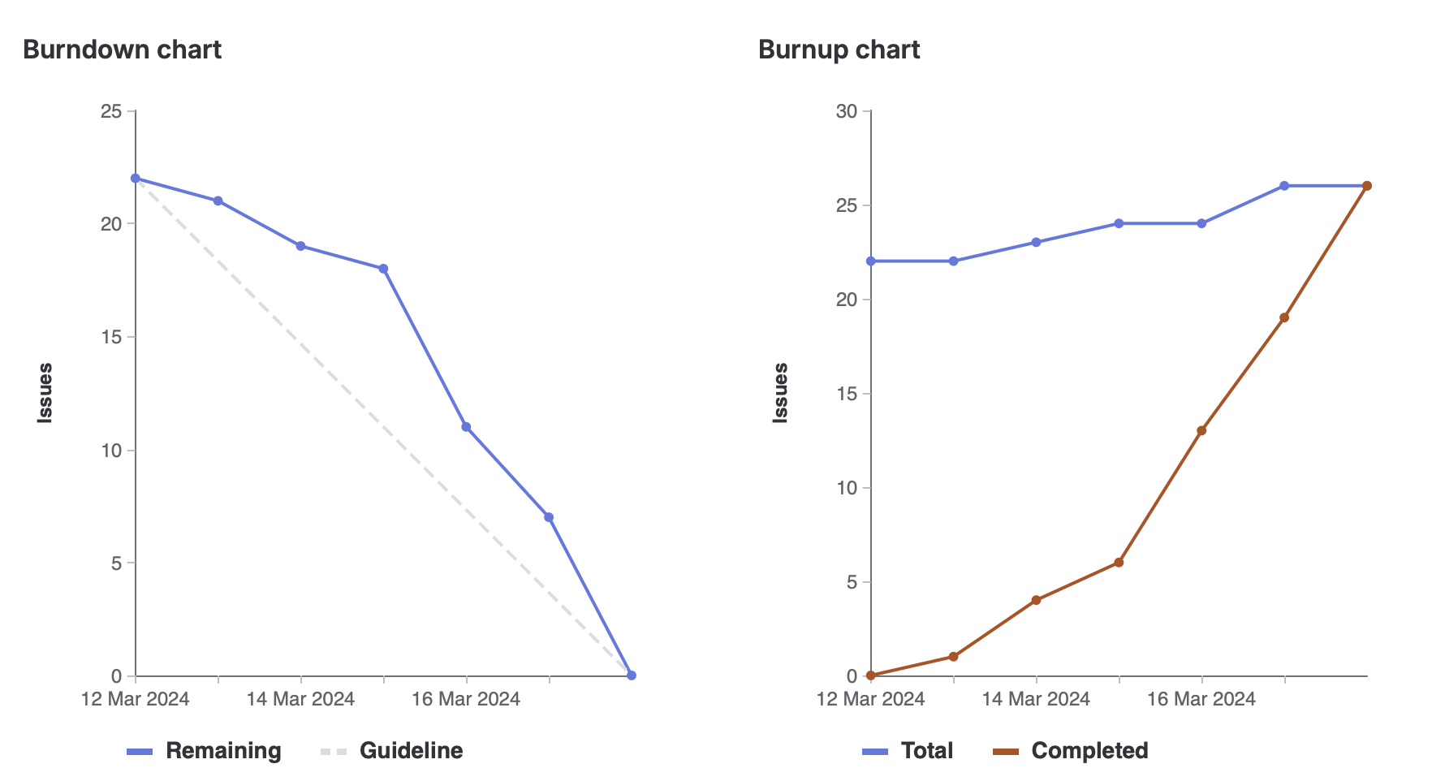
Sprint 7 burndown chart

Slide 4
Megh
Frontend for blackjack game (Added delay when someone scores)
Improving on gameplay for air hockey
How to play for blackjack
Total Weight: 12

Slide 5
Jacob
Designing and beginning implementation of Blackjack game
Add Blackjack documentation to Wiki
Weight: 12

Slide 6
Brandon
Implemented Dice/Farkle game
Upped the difficulty of the match game
Weight: 12

Slide 7
Joudi
Updated Snake Game
Various small items (updating leaderboard, add how to play for farkle, wiki update)
Weight: 11

Slide 8
Manmeet
Did Testing for the new added games
Updated The Documentation.
Weight - 8

Slide 9
Jose (Sprint Lead)
Did testing for the new games
Added documentation
Weight: 12

Slide 10
Abdullah
Doing Testing for the new games
Fixing linting errors
Weight: 12

Slide 11
What didn’t go so well
Issues were created later than preferred.
Work on sprint began later than anticipated.

Slide 12
What did go well
Team organized itself very well amongst tasks.
Constant communication regarding progress.

Slide 13
Changes for next sprint?
Establishing a more rigid schedule, specifically for starting work.
Gaining a better understanding of what tasks may need to be completed.

Slide 14
Demo
Home Page : https://cis4250w24-05.socs.uoguelph.ca/
Match Game: https://cis4250w24-05.socs.uoguelph.ca/match
Snake Game: https://cis4250w24-05.socs.uoguelph.ca/snake
Air Hockey: https://cis4250w24-05.socs.uoguelph.ca/airhockey
BlackJack: https://cis4250w24-05.socs.uoguelph.ca/blackjack
Farkle: https://cis4250w24-05.socs.uoguelph.ca/dice

