Slide 1
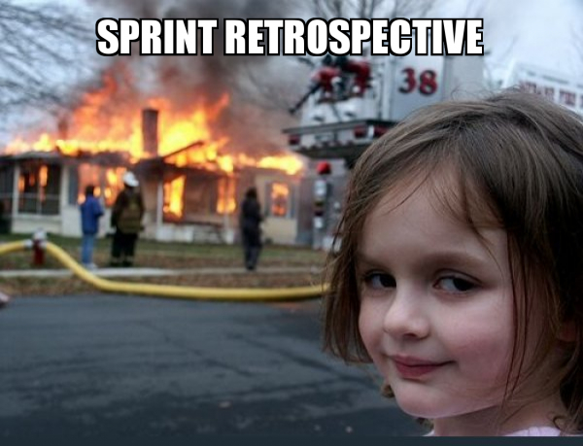
Sprint 2
Team 5

Slide 2
Summary of accomplishments
Added frontend and backend for logging in.
Added frontend and backend for snake game.
Fully completed CI/CD Pipeline.
Added a games menu to the main page.

Slide 3
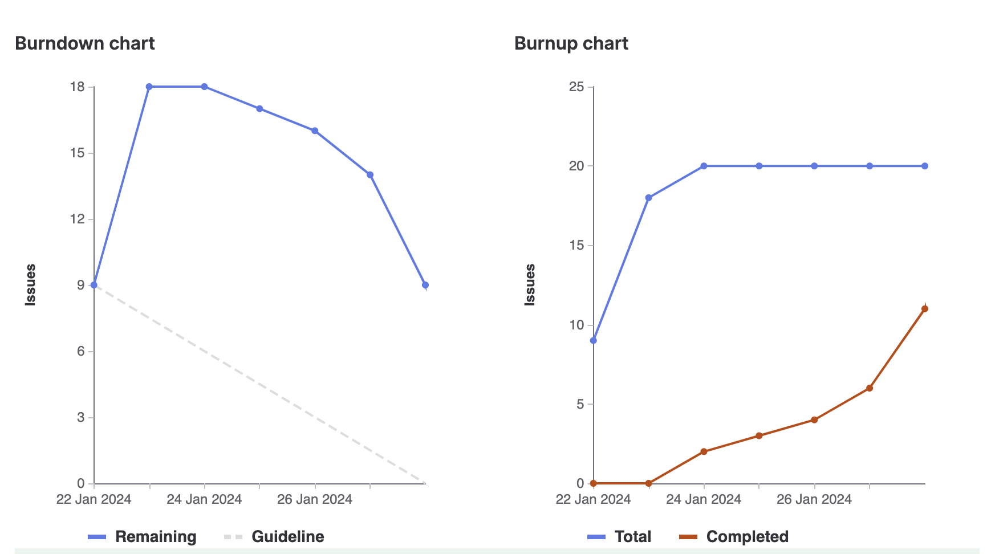
Sprint 1 burndown chart

Slide 4
Megh
Worked on frontend for login
Created retrospective slides
Created the readme for sprint 2
Created an uninstall script
Total Weight: 13

Slide 5
Jacob
Developed Snake Game logic
Created Design Document for Snake Game
Tested Web Server on Google Chrome, Safari, Mozilla Firefox, and Opera GX
Weight: 12

Slide 6
Brandon
Updated the landing page with a ‘games menu’ that can be added upon in the future
Updated the production site to remove the trailing .php
Moved the repo on the VM to somewhere more accessible
Weight: 12

Slide 7
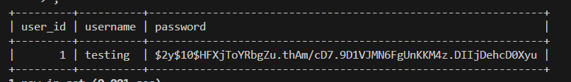
Joudi
Largest task: setting up mysql db
Second largest task: creating login backend
Weight 12:

Slide 8
Manmeet
Helped to implement the CI/CD pipeline, specifically with deployment.
Helped in test cases
Added QA Notes
Created Retro
Weight: 11

Slide 9
Jose
Helped to implement the CI/CD pipeline, specifically with deployment.
Added test cases for the website
Weight: 12

Slide 10
Abdullah
Created the Frontend page for the Snake Game
Implemented the functionality of a Restart button
Added the How To Play page
Created additional test cases for the Snake Game
Fixed up About Me page
Weight: 12

Slide 11
What didn’t go so well
Weight estimations for some tasks were off, which led to a worse burndown chart
We got a lot of the stuff done at the end of the sprint, everyone was rushing to get stuff done.

Slide 12
What did go well
We had our sprint planning earlier in the week, which allowed for a better start to the sprint
We had enough issues to create for everyone this time around, so everyone had enough to do.
We had good communication with one another, ensuring no merge conflicts.

Slide 13
Changes for next sprint?
More communication within the team, make sure everyone has what they need to complete tasks
Try to come up with more accurate weight estimations.
Try to complete tasks earlier on in the sprint period.

Slide 14
Demo
Demo updated landing page (https://cis4250w24-05.socs.uoguelph.ca/)
Demo snake game page (https://cis4250w24-05.socs.uoguelph.ca/snake.php)
CI/CD Pipeline (https://gitlab.socs.uoguelph.ca/cis4250_w24/team_5/-/pipelines)

