Slide 1
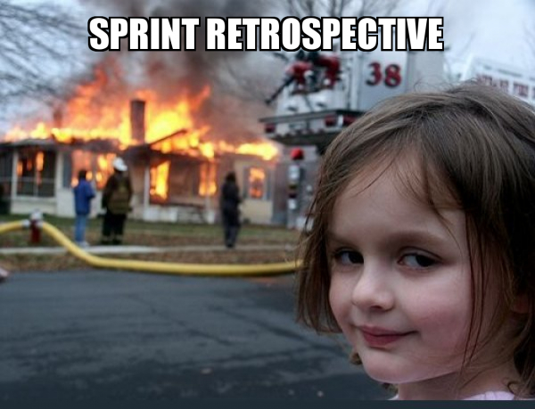
Sprint 6
Team 5

Slide 2
Summary of accomplishments
Connected the Teams
Fixed the Hockey Game and Snake Game
Added new Secret Puzzle

Slide 3
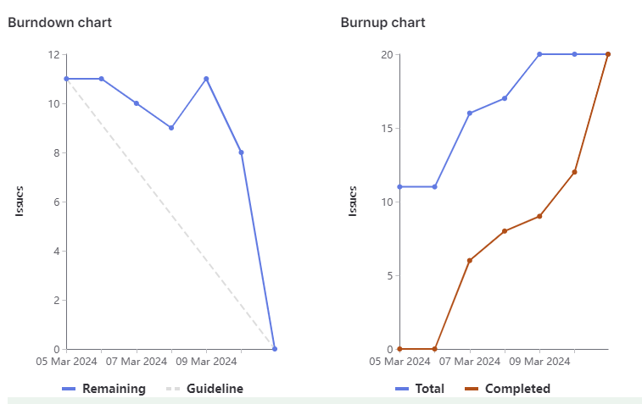
Sprint 6 burndown chart

Slide 4
Megh
Updated the snake game so that there is a short pause between the game being loaded and starting
Fixed the hockey game starting bug, where the game started before play game was clicked
Documentation for mystery/secret game.
Total Weight: 12

Slide 5
Jacob
Updated Air Hockey Graphics/Physics
User Testing Secret Game
Secret Game Brainstorming/planning
Weight: 9

Slide 6
Brandon
Made it more clear when the user got the match game correct
Added secrets to the leaderboard and to the login button
Updated snake game to return part of the secret URL for the next team
Weight: 12

Slide 7
Joudi
Largest task: updating documentation
Second largest: brainstorming hidden game ideas
Weight: 8

Slide 8
Manmeet
Connected Team 4 and Team 6 stories
Brainstormed Ideas for new Puzzle
Fixed bugs and updated documentation.
Total Weight: 12

Slide 9
Jose
Contributed to adding clues/hints for secret game and connecting it with other teams.
Updated games to reflect mystery theme.
Total Weight: 12

Slide 10
Abdullah

Slide 11
What didn’t go so well
There were less issues to create but later on it was fixed
Team 4 took a little longer time to respond which made the sprint to start little late

Slide 12
What did go well
Everything well went all the issues were resolved.
Everyone put their effort and went everything good.

Slide 13
Changes for next sprint?
More Communication and trying to solving the issues early.
Trying to come up with accurate task weightage.

Slide 14
Demo
Home Page : https://cis4250w24-05.socs.uoguelph.ca/
Match Game: https://cis4250w24-05.socs.uoguelph.ca/match
Snake Game: https://cis4250w24-05.socs.uoguelph.ca/snake
Air Hockey: https://cis4250w24-05.socs.uoguelph.ca/airhockey

