Slide 1
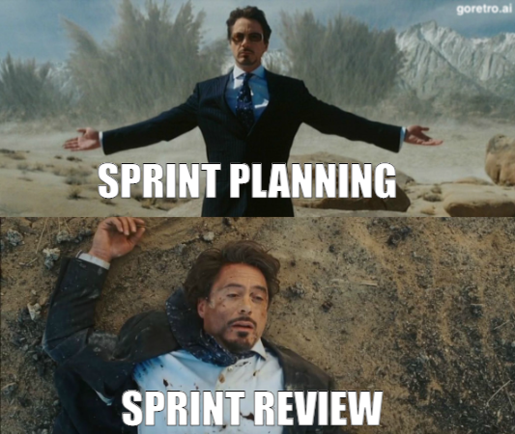
Sprint 1
Team 5

Slide 2
Summary of accomplishments
Setup and styled landing page
Setup and styled about us page
Everyone added their about us section
Was able to access the production environment(VM)

Slide 3
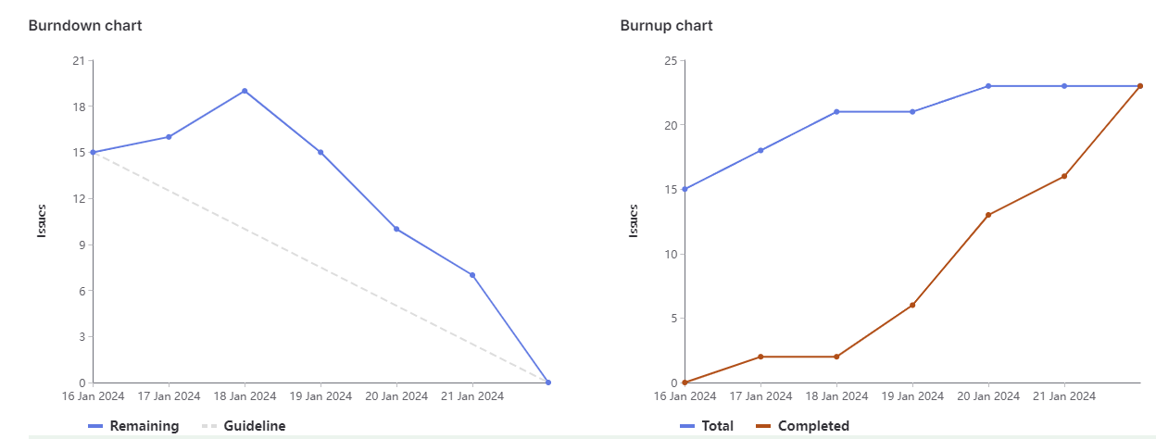
Sprint 1 burndown chart
Will add on sat night

Slide 4
Brandon
Helped get everyone up to speed on what everyone needed to do and helped answer questions regarding setting up local developer environment and logging into the VM
Created and styled initial landing page
Weight: 12

Slide 5
Jacob
Created About Me Snippet
Worked with Megh and Joudi to brainstorm Game Ideas
Manually updated VM with sprint1 branch
Weight: 12

Slide 6
Jose
Researched and helped setup the beginning of the Pipeline by adding a testing framework that can test our site.
Creating the README and adding information as it relates to this sprint
Weight: 14

Slide 7
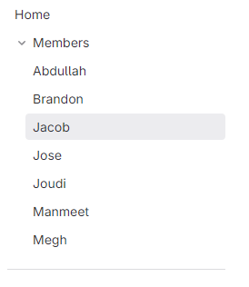
Joudi
Largest contribution: create about me page
Second largest contribution: create wiki on gitlab
Weight : 12

Slide 8
Manmeet
Created “About Me” snippet
Helped in the CI/CD pipeline
Research for deployment part.
Weight - 12

Slide 9
Megh
Created About Me Snippet
Researched Game Ideas for next sprint
Created an install script, that installs git on the vm, along with cloning the gitlab repo automatically.
Weight: 12

Slide 10
Abdullah
Created About Us Home Page
Created the About Me Snippet
Helped create the CI/CD Pipeline + Research
Created a test case for the pipeline
Weight: 12

Slide 11
What didn’t go so well
We had a team meeting late this week
Had a hard time creating enough task for everyone
Some of the tickets weren’t closed as they were finished which skewed the burndown/up charts

Slide 12
What did go well
Everyone was pretty independent, people assigned to the task didn’t need to ask other members for help, for the most part so everyone could focus on their own tasks
Most of the tasks were done in a reasonable timeframe and didn’t prevent other tasks that relied on them from being able to be completed.

Slide 13
Changes for next sprint?
Have the weekly meeting earlier
Close tickets as you complete them
Try to break down larger task into smaller ones

Slide 14
Demo
Demo landing page (https://cis4250w24-05.socs.uoguelph.ca/)
Demo about us page (https://cis4250w24-05.socs.uoguelph.ca/about.php)
Demo basic tests (https://gitlab.socs.uoguelph.ca/cis4250_w24/team_5/-/pipelines)

