Slide 1
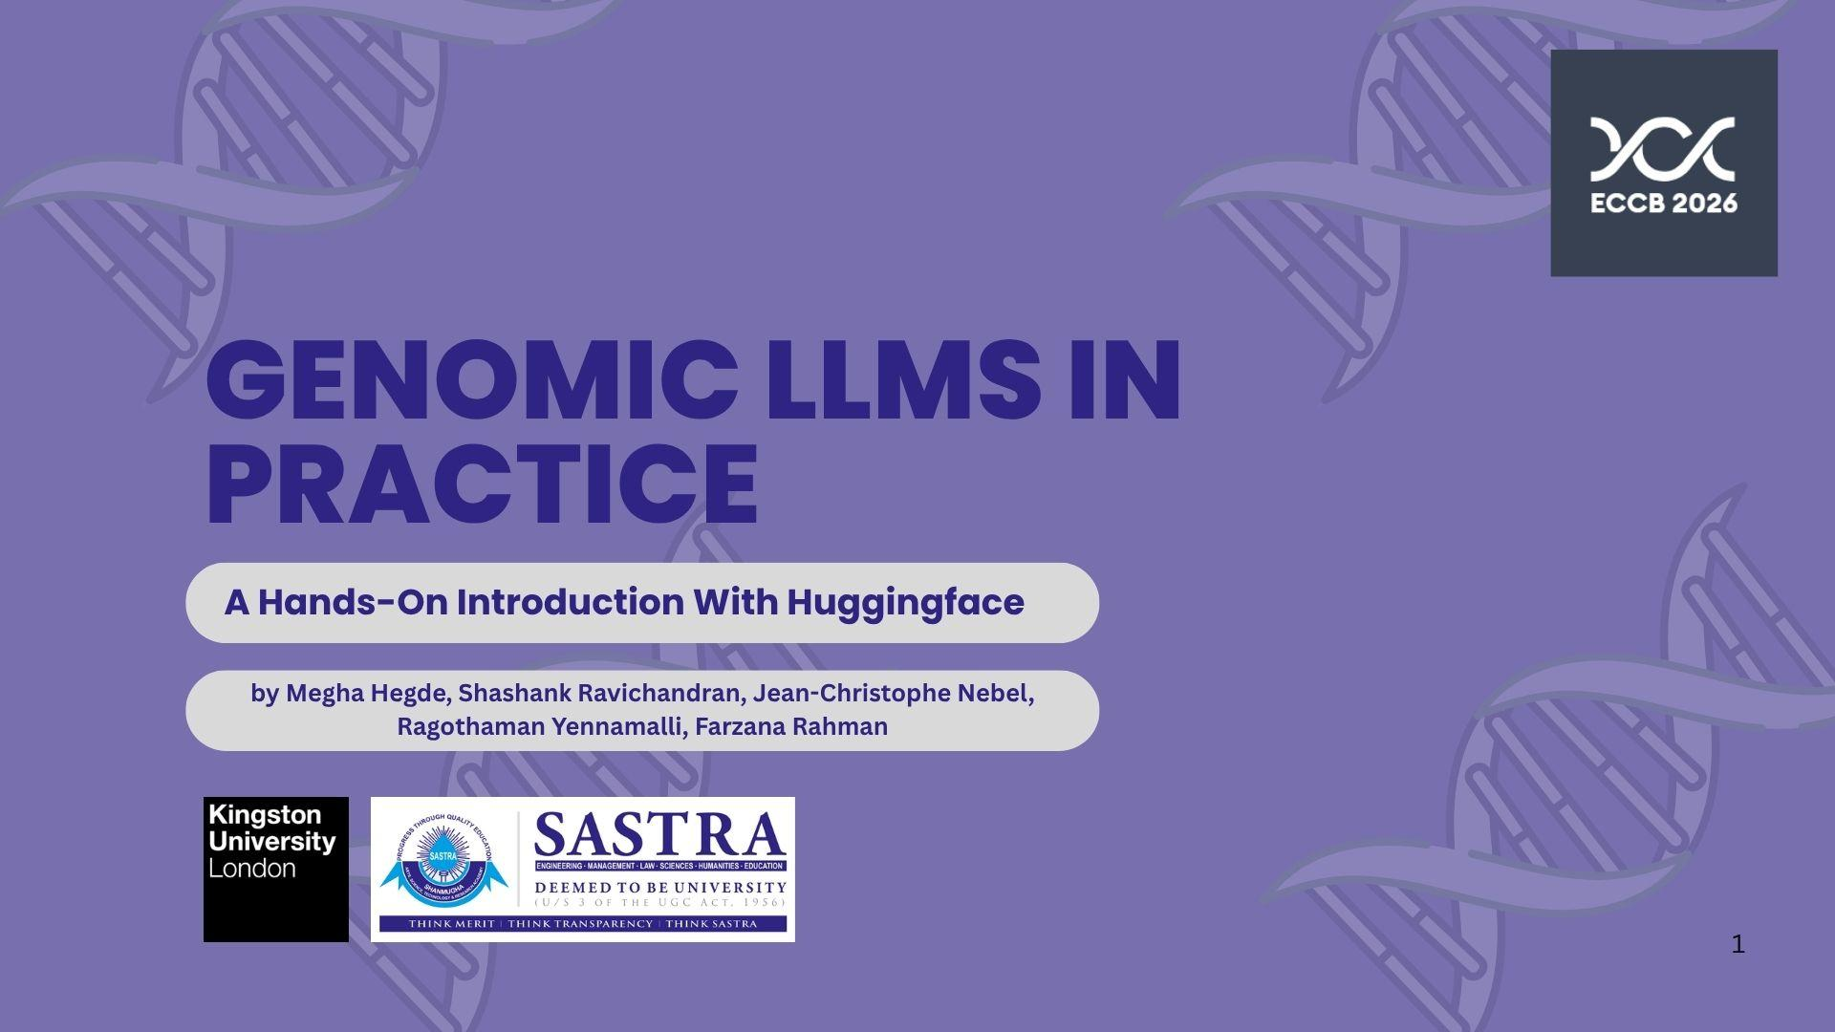

Slide 2


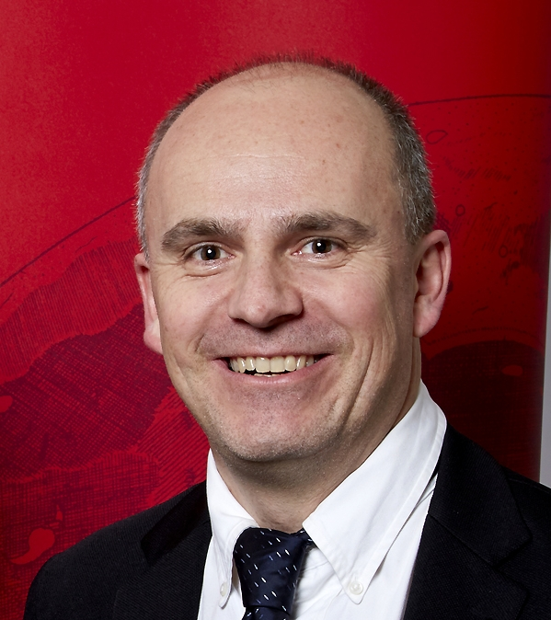
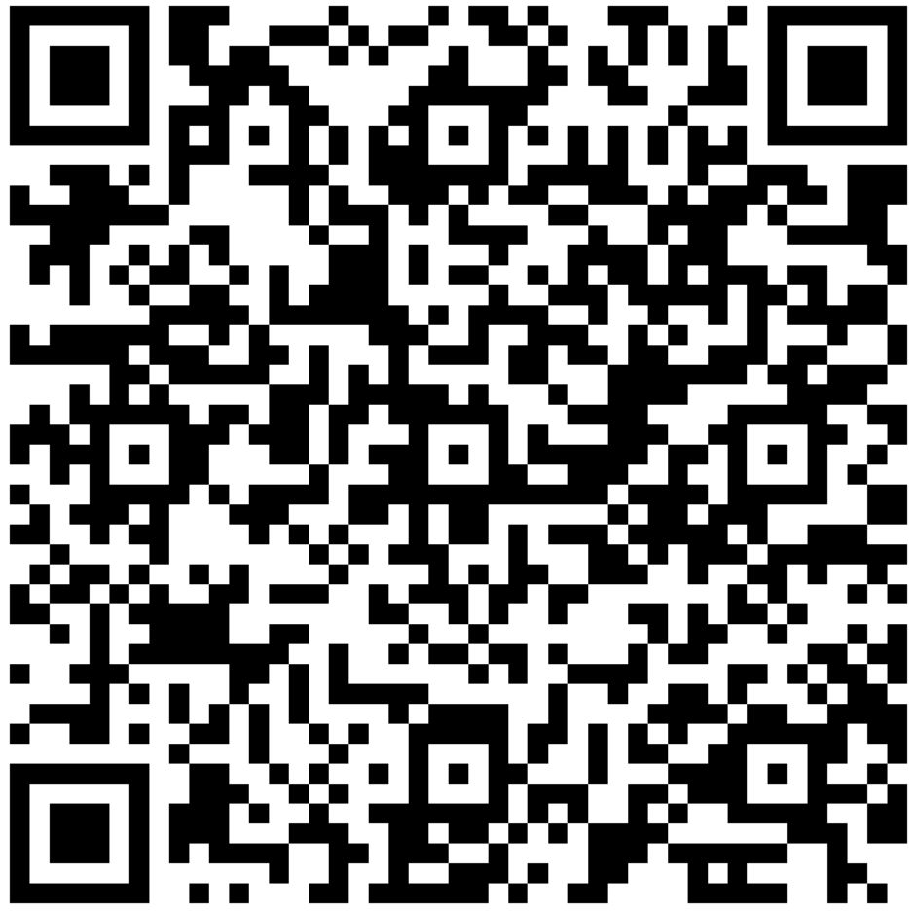
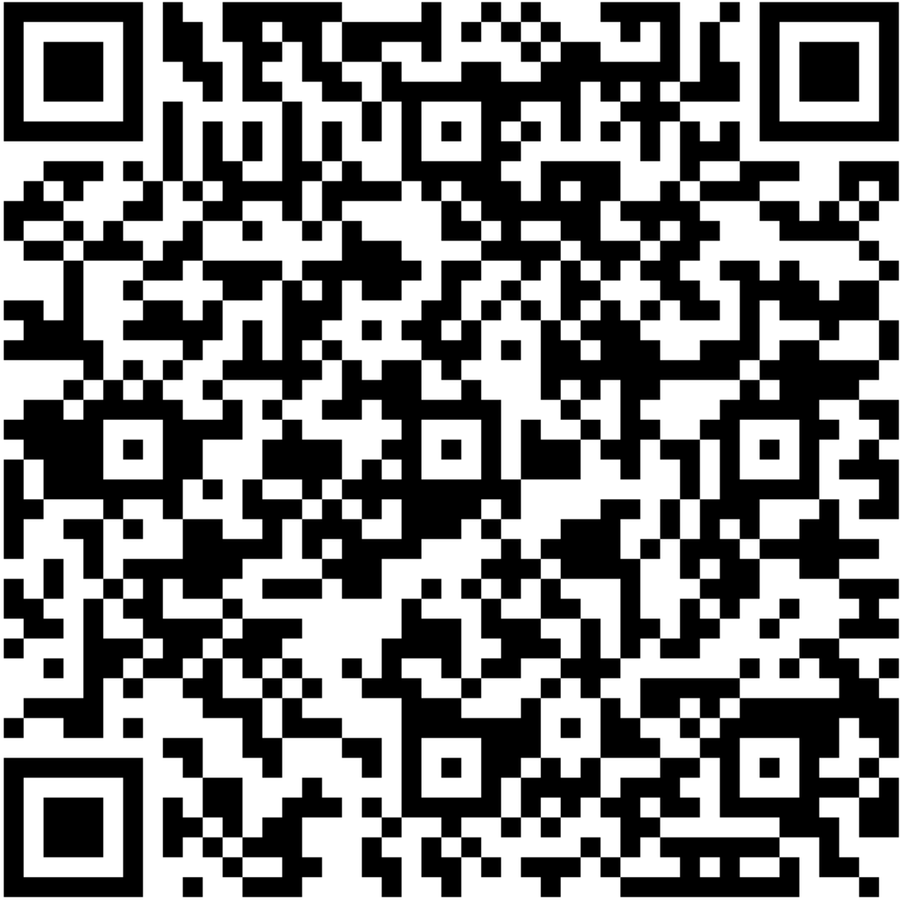
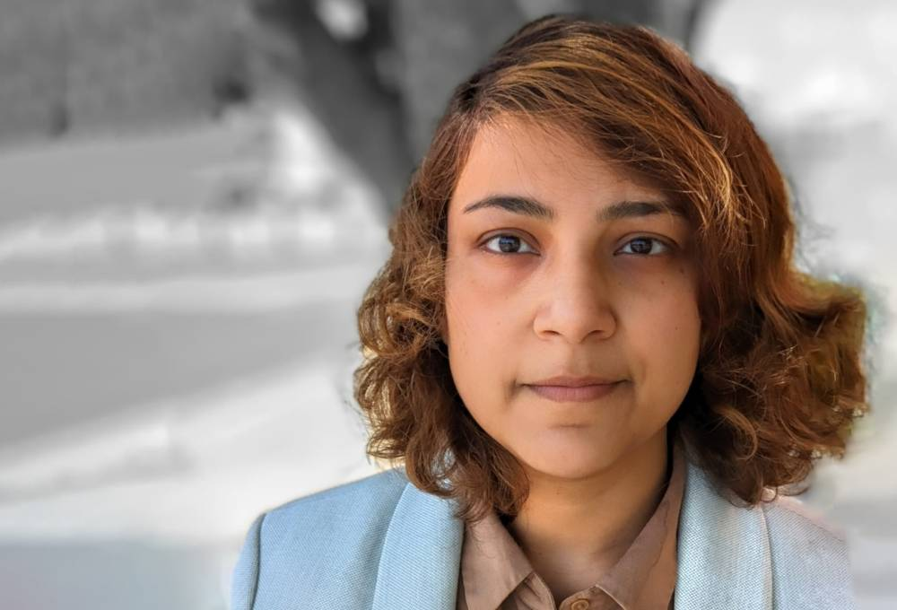
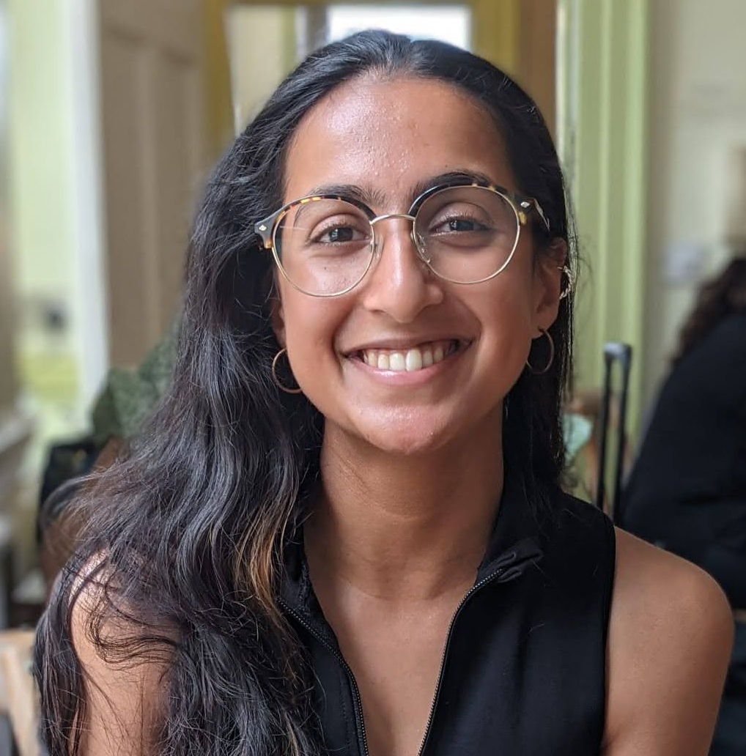
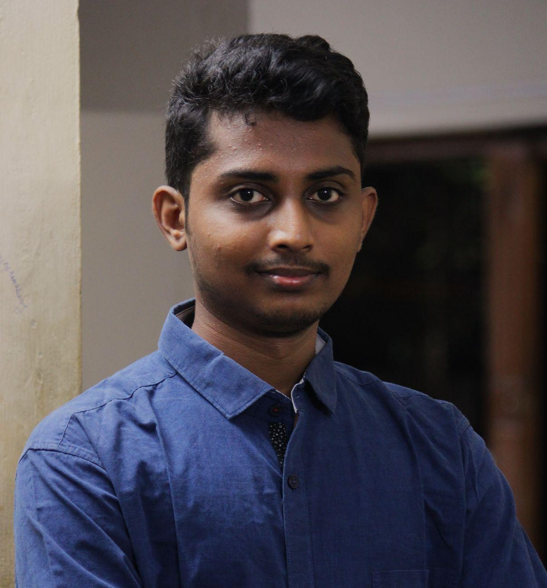



Organizing team
Ragothaman M. Yennamalli, Ph.D.
Associate Professor
School of Computational and Integrative Sciences
Jawaharlal Nehru University
India
Jean-Christophe A Nebel, Ph.D
Professor of Computer Science
Director of Research & Enterprise
School of Computer
Science and Mathematics
Kingston University
London
UK
Farzana Rahman, Ph.D.
Assistant Professor
Applied Computer Science (Data Science)
Faculty of ECE
Kingston University London
UK
Megha (Meg) Hegde PhD Researcher Faculty of ECE Kingston University London
UK
Shashank Ravichandran
Senior Software Engineer
Incedo Technology Solutions Ltd.
India

Slide 3
Aims & Learning Outcomes
Understand and implement genomic sequence representation using large language models, including DNA tokenisation strategies (k-mers and byte-pair encoding) and transformer architectures such as DNABERT.
Develop and fine-tune genomic LLM pipelines in Python, using PyTorch and Hugging Face to preprocess data, train models, and evaluate performance on tasks such as enhancer classification and splice-site prediction.
Apply and integrate pretrained genomic models into real-world genomics workflows, interpreting model outputs for biological insight.

Slide 4
Schedule
Time | Session Type | Session Title
09:00-09:05 | Overview | Introduction to the session
09:05-10:00 | Lecture | Introduction to Genomic LLMs
10:00-10:30 | Guided Hands-On | Introduction to Hugging Face for Genomic LLMs
10:30-10:45 | Coffee Break
10:45-11:15 | Lecture | Training Genomic LLMs
11:15-12:45 | Guided Hands-On | Training Genomic LLMs Using PyTorch and the Hugging Face Trainer API
12:45-13:45 | Lunch Break
13:45-14:15 | Guided Hands-On | Training Genomic LLMs Using PyTorch and the Hugging Face Trainer API (contd.)
14:15-14:30 | Briefing | Introduction to Workshop
14:30-15:15 | Workshop | Workshop: Try It Yourself
15:15-15:30 | Coffee Break
15:30-17:15 | Workshop | Workshop: Try It Yourself (contd.)
17:15-17:30 | Discussion | Recap & Reflection

