Slide 1
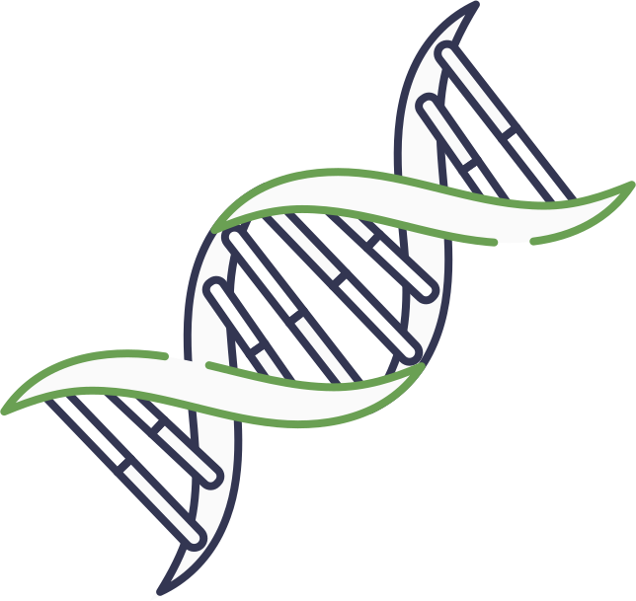



GENOMIC LLMS IN PRACTICE
A Hands-On Introduction With Huggingface
by Megha Hegde, Shashank Ravichandran, Jean-Christophe Nebel, Ragothaman Yennamalli, Farzana Rahman
1

Slide 2
HOW DOES GLLM TRAINING WORK?
Stage 1: Pretraining (self-supervised)
ACTGACTGACTGACTG
Untrained LLM
Pretrained LLM
ACTGACTGACTGACTG
ACTGACTGACTGACTG
ACTGACTGACTGACTG
ACTGACTGACTGACTG
Large corpus of unlabelled genomic sequences
e.g., DNA sequences from the Human Reference Genome
Stage 2: Fine-tuning (supervised)
Sequence | Label
ACTGACTGACTGACTG | 0
ACTGACTGCCTGACTG | 1
Pretrained LLM
Fine-tuned LLM
Task-specific data and labels, e.g., variant sequence and pathogenicity label
2

Slide 3
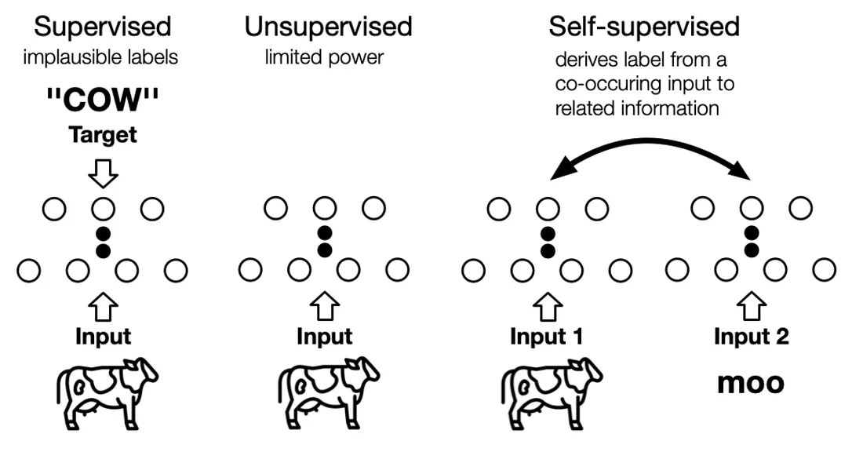
REFRESHER: TYPES OF ML TRAINING
3
Image source: https://tzuruey.medium.com/neurips-day-7-self-supervised-learning-workshop-5ec57ce5eab1

Slide 4
LLM PRETRAINING PARADIGMS
Masked Language Modelling (MLM)
Some % of tokens in each DNA sequence are masked
The model is trained to predict the missing tokens
Usually used in encoder-only Transformers
gLLM examples: DNABERT-2, Nucleotide Transformer
During pretraining, the model learns foundational contextual information
Predict this token based on the tokens on either side
<ACTG> <ACTG> <[MASK]> <ACTG>
Next Token Prediction (NTP)
The model is trained to predict the next token based on the previous tokens
Usually used in decoder-only Transformers
Mainly used in models that generate synthetic DNA/protein sequences, e.g., Evo2
Predict the next token based on the preceding tokens
<ACTG> <ACTG> <ACTG> ...?
4

Slide 5
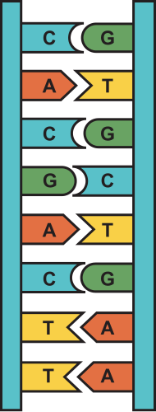
WHY MLM FOR GLLMS?
Incorporates bidirectional context
Best for learning patterns and syntax among genomic sequences
Allows the model to identify genomic motifs and signals depending on both upstream and downstream context
PRETRAINING DATA
Single species genome
E.g., Human reference genome (current assembly GRCh38)
Multi-species genomes
Large corpus of sequences from the genomes of different species
Can improve the model’s ability to generalise
Hegde, M. et al. (2025) Bioinformatics and Biology Insights
Shu, L. et al. (2026) Briefings in Bioinformatics
Dalla-Torre, H., et al. (2025) Nature
5

Slide 6
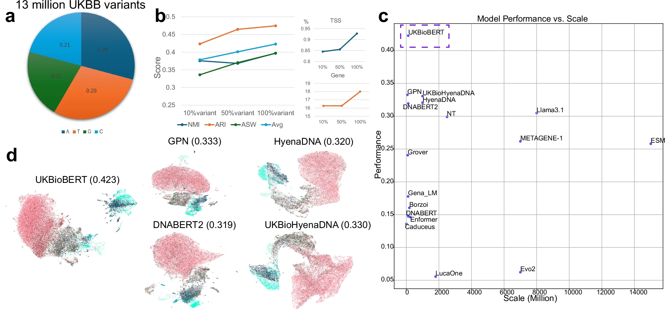
GLM EMBEDDINGS
Embeddings are the model’s internal representation of the input sequences as vectors of numbers
They capture information and context about the sequences, that can be used in downstream tasks
The embeddings are usually extracted from the last layer. At this stage, the hidden state represents a culmination of all the model's computations, and provides the most informative context.
Here, sequence embeddings from some state-of-the-art genomic LLMs are visualised using uniform manifold approximation and projection (UMAP), coloured by gene types
Protein-encoding genes are coloured in pink
The models with the most informative embeddings are those which have clear separation between clusters
https://huggingface.co/spaces/hesamation/primer-llm-embedding
Liu, T. et al, (2026), npj Artificial Intelligence
6

Slide 7
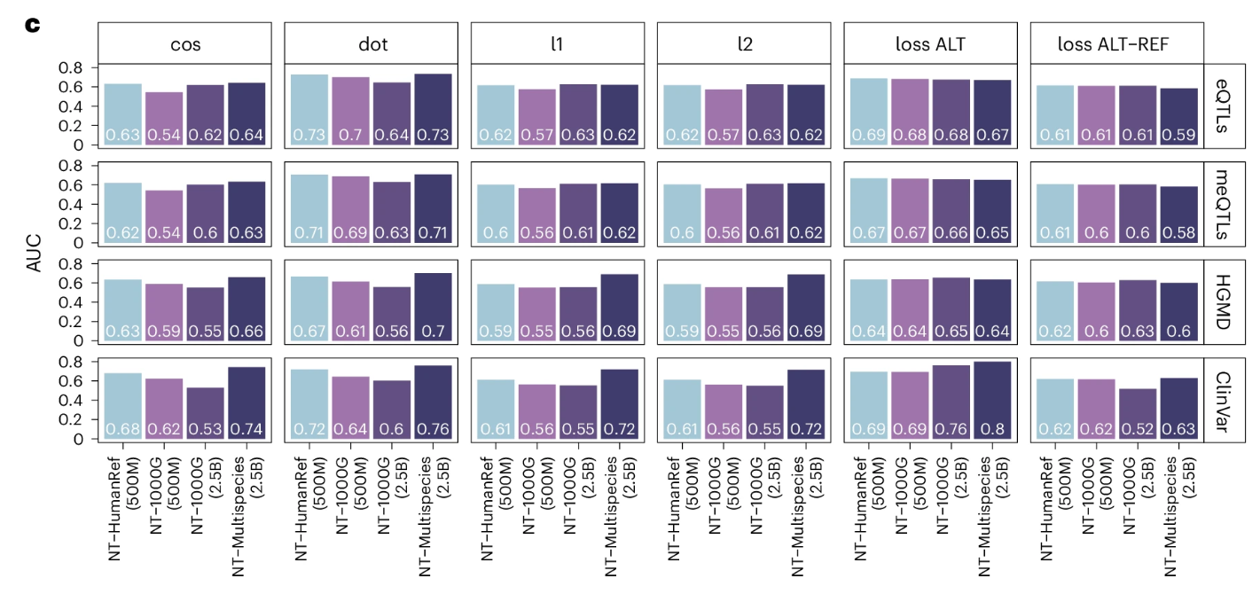
ZERO-SHOT PREDICTION USING GLM EMBEDDINGS
gLLM embeddings can be used for zero-shot prediction on downstream tasks
Instead of using supervised fine-tuning, we can use the embeddings as features
For instance, for variant effect prediction, we can do the following:
Extract embeddings for reference (wild-type) sequence
Extract embeddings for alternate (mutated) sequence
Calculate the difference in these embeddings as the variant effect score
The difference method we use affects the score!
7
Dalla-Torre, H., et al. (2024), Nature Methods

Slide 8
FINE-TUNING GLLMS
Pretraining | Fine-tuning
Self-supervised, using unlabelled data | Supervised, using labelled data
General | Task-specific
Whole model | Specific layers, e.g., classification head
Pretrained gLLMs are fine-tuned on labelled data for specific tasks
For variant effect prediction, this could involve a wild-type sequence, mutated sequence, and pathogenicity label for each variant
This can be a computationally costly process
Methods like LoRA (low-rank adaptation) can help to improve efficiency
Hu, E.J. et al. (2022) ICLR
8

Slide 9
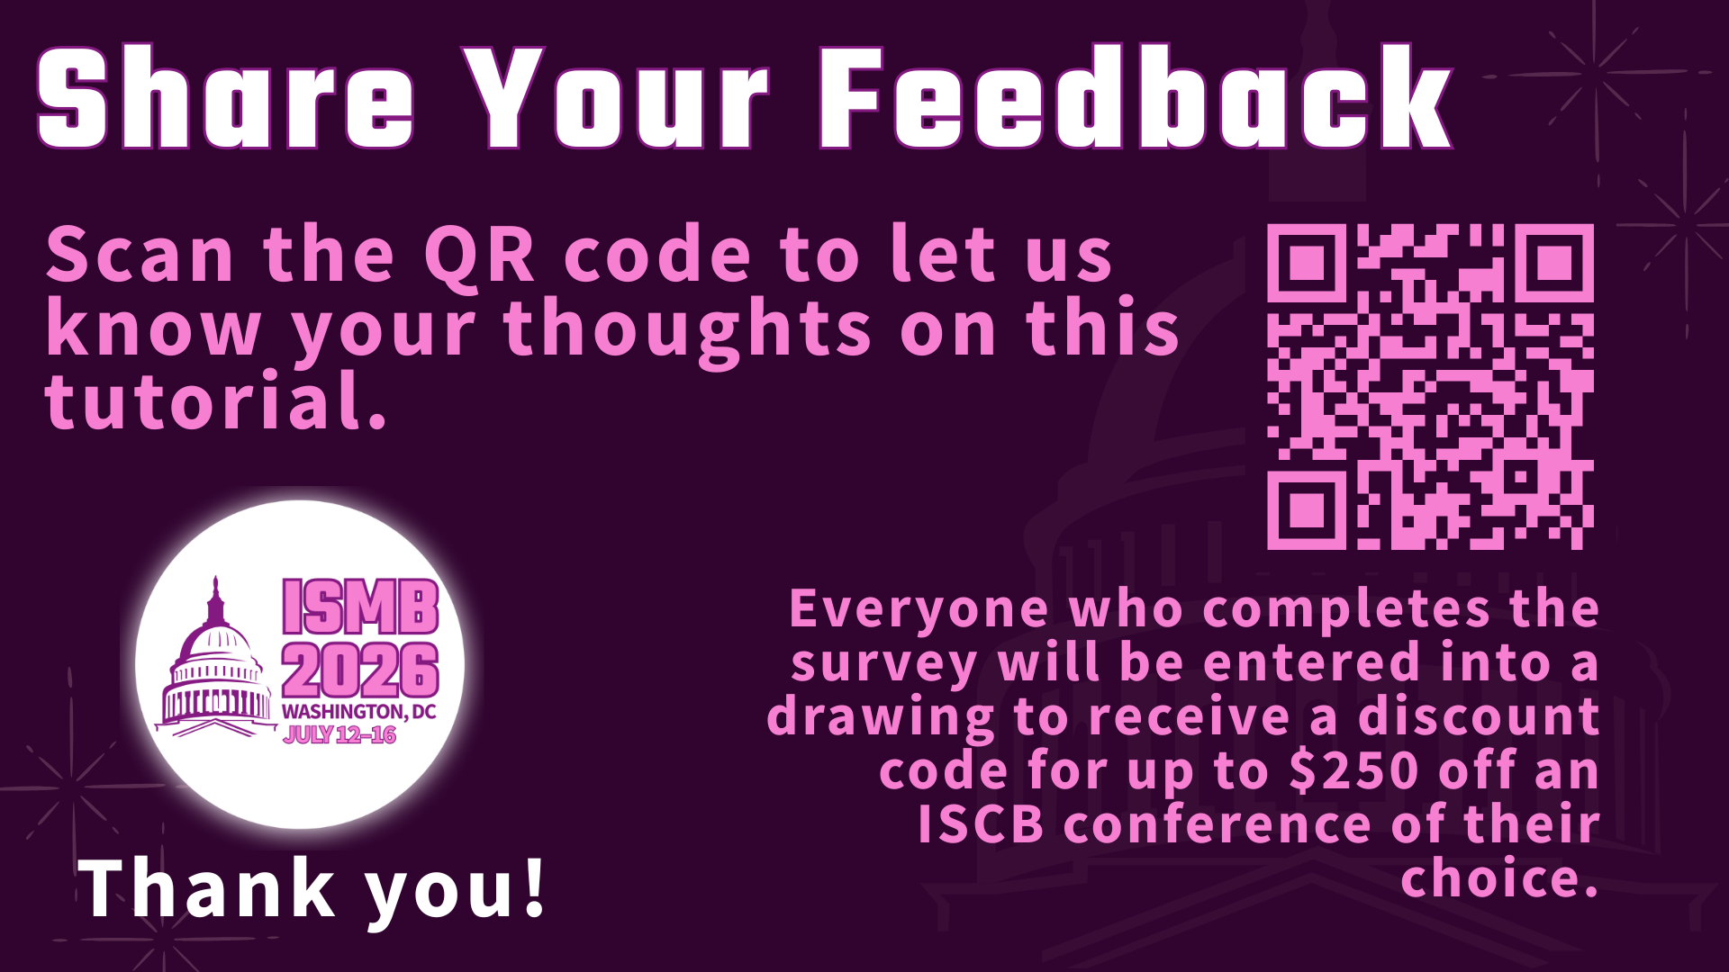
9

