Slide 2
Health Care Chatbot Using Machine Learning
Submitted to:
Department of Computer Science and Engineering

Slide 3
Supervised by: Prof. Gajendra S. Chouhan
Team Members
1. Jatin Jangid (0827CS201105)
2. Joshi Bansari (0827CS201110)
3. Kritarth Jain (0827CS201118)
4. Meghesh Solanki (0827CS201137)

Slide 4
Project Presentation Outline
Abstract
Introduction
Problem Statement
Survey of Existing Systems
Project Objectives
Requirement Analysis
Designs/UML Diagrams
Solution Proposed
The Outcome Discussion
Conclusions and Limitations

Slide 5
Abstract
The new healthcare delivery system is complicated, unreliable, and unsustainable. Machine learning (ML), used to improve system performance, has completely changed how businesses and individuals collect and analyze data. Structured, unstructured, and semi-structured data can all be analyzed using machine learning techniques. A virtual assistant may converse with patients in their local language to understand their complaints, provide medical advice, and monitor health indicators.

Slide 6
Introduction
The transition to modern medicine in healthcare has been sped using computer-generated analytics and electronic medical reporting to support clinical and administrative processes. The usage of specialised IT skills and resources is frequently required when attempting to get data from a sizable database.
As a result, healthcare professionals frequently rely their decisions on their own perspectives or those of their colleagues. To identify linked patients, predict disease rates, and identify effective therapies, health practitioners may find it particularly helpful to employ an information retrieval system based on a QA model. Businesses, universities, and organisations can automate a variety of online and customer support tasks with chatbots.

Slide 7
Introduction
Quick responses are given to frequently requested questions by the client. A chatbot system that interacts with patients has been proposed. Patients are more likely to worry about their medications and other programmes they utilise because of their conditions. Instead of dialling an anonymous individual to receive a quick response, chatbots will be used.
A chatbot is a piece of software that can communicate with and learn from people. For user input and output to and from chatbots, the great majority employ a graphical user interface (GUI) like that of a messenger. The chat bot comprehends and responds to user remarks.

Slide 8
The Problem Statement
The main intention behind developing the application is to provide healthcare services in dispersed areas of India and identify the gaps emerging in implementing cloud computing in the healthcare industry. The main problem in rural areas is limited internet connectivity and slow internet services. People in rural areas don’t have sufficient knowledge about using a healthcare application on their smartphone.

Slide 9
Survey of Existing Systems
1. OneRemission:
Problems Addressed
For cancer patients and cancer survivors, the app empowers them by providing a comprehensive list of diets, exercises, and post-cancer practices, curated by Integrative Medicine experts, so that they don’t need to constantly rely on a doctor.
Advantages
Useful for cancer patients

Slide 10
Survey of Existing Systems (Cont.)
Disadvantages
Only useful for Cancer patients
Gaps Identified
Specially made for Cancer patients
Reference link
[1] https://medicalfuturist.com/top-12-health-chatbots/

Slide 11
Survey of Existing Systems (Cont.)
2. Youper:
Problems Addressed
Basing itself on the latest scientific research, Youper’s A.I. monitors and improves users’ emotional health with quick personalized conversations using psychological techniques.
Advantages
Improve their emotional health, the app features personalized meditations as well as the ability to track mood and monitor emotional health.

Slide 12
Survey of Existing Systems (Cont.)
Disadvantages
Only take care of mental health of the patient
Gaps Identified
Improve mental health of the patient.
Reference link
[1] https://medicalfuturist.com/top-12-health-chatbots/

Slide 13
Objectives
The Objective of this project is to develop a CHATBOT for Health Care Facilities which will allow the user to communicate between patients and health care professionals. These bots will be used to provide timely access to relevant healthcare information to the patient .As treatment compliance and awareness of patients' symptoms increase, chatbots will lessen the strain of healthcare workers by lowering hospital visits, unneeded treatments and procedures, and hospital admissions and readmissions. The users of this Chabot will be benefited by spending less time commuting to the doctor’s office, less money spent on unnecessary treatments/tests and easy access to the doctor at the push of a button.

Slide 14
Requirement Analysis
Functional Requirements:
Sign-Up : This functionality will allow the user to register by providing a username, email, mobile no. and graphical password i.e., a sequential selection of images from the provided grid.
Login : At the time of authentication, user must enter his username/email and select the images in the proper sequence he had registered.
Forget Password : In case, the user forgot the password selection, a mail will be sent to his registered email address so that the user can reset his password.

Slide 15
Requirement Analysis
Non - Functional Requirements:
Performance
Reliability
Availability
Security
Maintainability

Slide 16
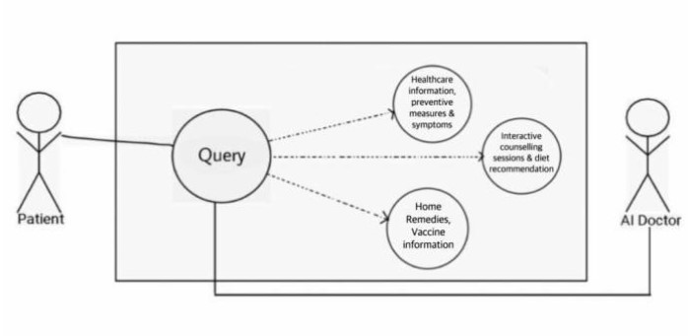
Design / Use Case Diagram
Fig.1 – Use case diagram for healthcare chatbot.

Slide 17
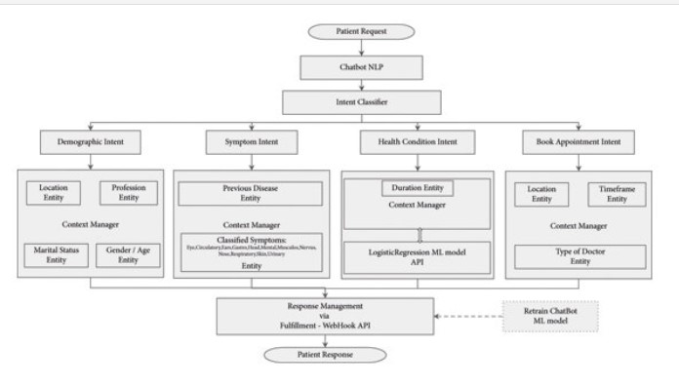
Design / UML Diagram
Fig.2 – Flowchart for Health care Chabot.

Slide 18
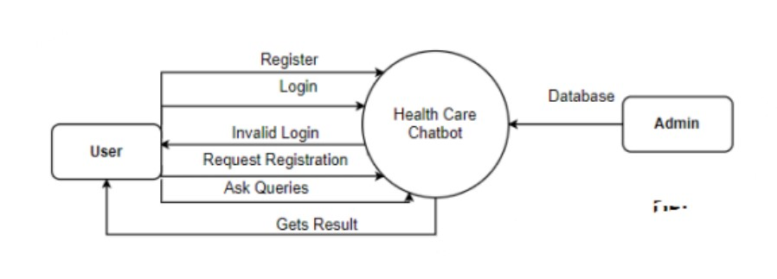
Design / DFD Level-0
Fig.3 – DFD level 0 of Health care chatbot.

Slide 19
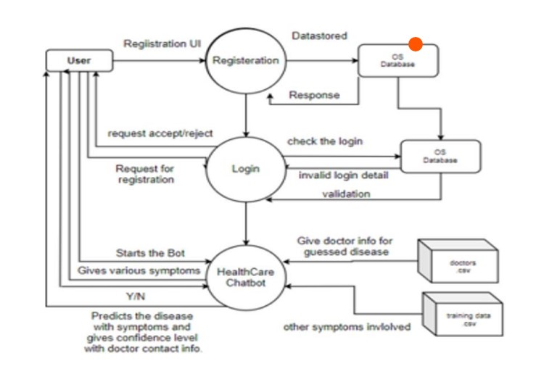
Design / DFD Level-1
Fig.4 – DFD level 1 of Health care chatbot.

Slide 20
Solution Proposed
There are various approaches to software development.
We have decided to use agile development for this program. An iterative method of software development is known as an agile methodology. The agile software development method usually incorporates usable product feedback. It is a collection of approaches that exhibit a dedication to rapid feedback cycles and ongoing improvement. At every step of the project, agile teams within the company collaborate daily in person meetings. By working together and communicating, the process is maintained.

Slide 21
The Outcome Discussion
The basic goal of this system is to provide health assistance.
To provide user preliminary health assistance.
Health care Chabot is a user-friendly health assistance system.
Offers a wider and broader view of any health issues and are not limited to some specific disease.
Provide basic knowledge of any disease on basis of symptoms.
Helps uses to get the basic knowledge of disease on basis of initial symptoms.

Slide 22
Conclusion and Limitation
Patients are never left unattended when using chatbots. They gain patients' trust by responding quickly and effectively. Undoubtedly, chatbots are beneficial. AI chatbots are particularly beneficial to the healthcare industry because they lighten workers' workloads. But setting expectations is a vital first step before implementing chatbots in the healthcare sector. Anyone who knows how to text in English language may utilize the Chatbot's mobile app or desktop version because it is so user-friendly.

Slide 23
Conclusion and Limitation
A medical chatbot offers individualized diagnosis in response to symptoms. In order for the medical chatbot to be able to manage all types of ailments, the efficiency of the chatbot can be increased by adding more word combinations and expanding the use of the database.

Slide 24
Acknowledgment
The satisfaction and euphoria that accompany the successful completion of any task would be impossible without the mention of the people who made it possible, whose constant guidance and encouragement crowned our efforts with success. Dr. Kamal Sethi, Professor and Head, Department of Computer Science and Engineering, for his support lastly, we would like to thank our institution for giving us this opportunity to learn even more apart from our curriculum. I have great pleasure in expressing my deep sense of gratitude to our guide Prof. Gajendra S. Chouhan.

Slide 25
Q&A

Slide 26
THANKS

