Slide 1
Baseflow prediction using
Multiple Regression
Supriyo Sadhya and Megh Kc

Slide 2
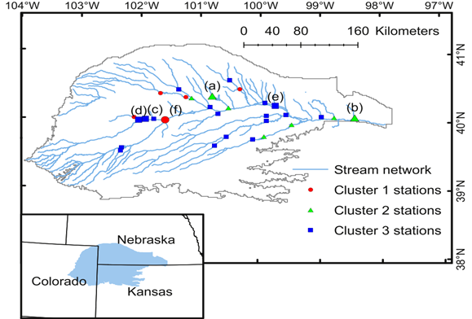
Study Area
Source: Xu & Valocchi, (2015)

Slide 3
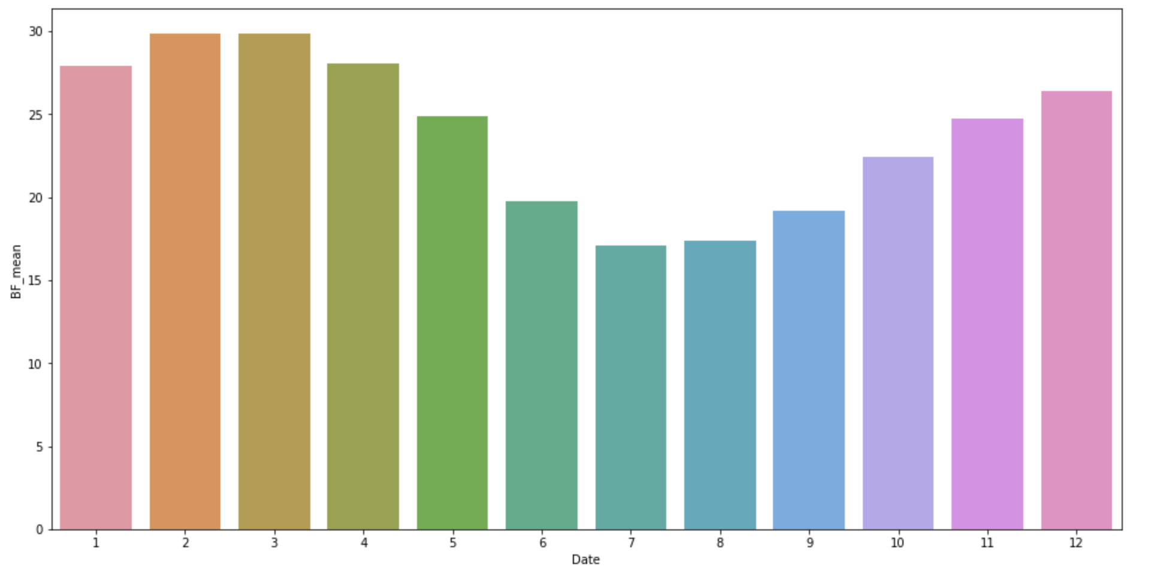
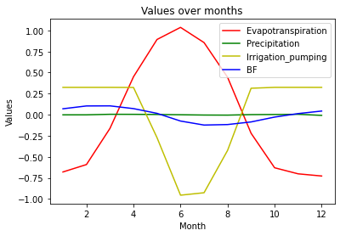
Analysis Techniques
Date conversion
Monthly mean flow observation
Dependent var :
observed flow
Independent var:
evapotranspiration,
precipitation,
irrigation_pumping
Standardization of dataset

Slide 4
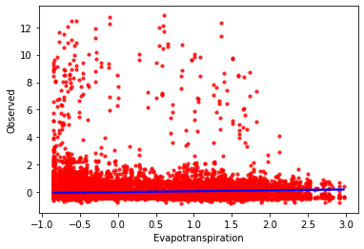
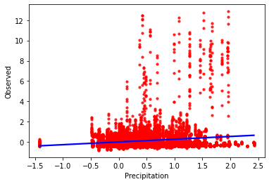
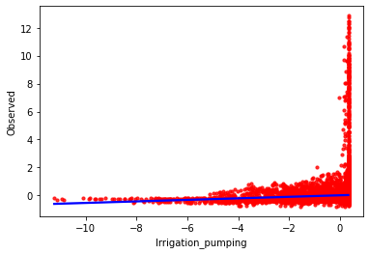
Scatter plots with least square lines for overall dataset
Precipitation
Evapotranspiration
Irrigation Pumping

Slide 5
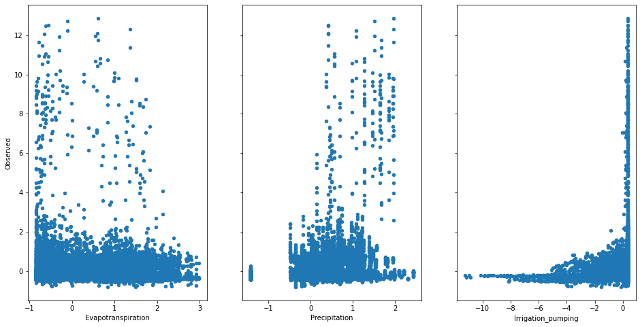
Scatter plots for overall dataset

Slide 6
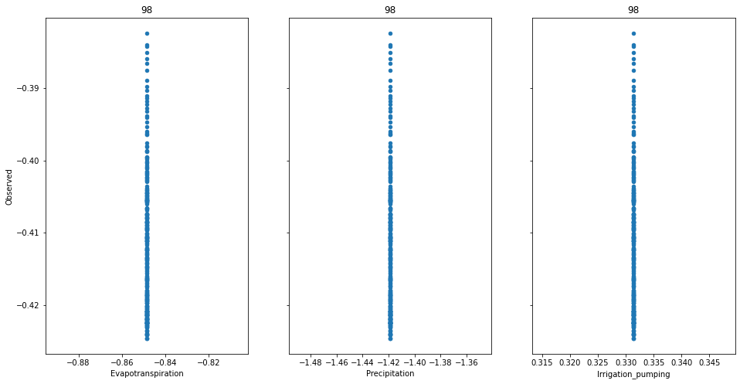
Scatter plots for section 98

Slide 7
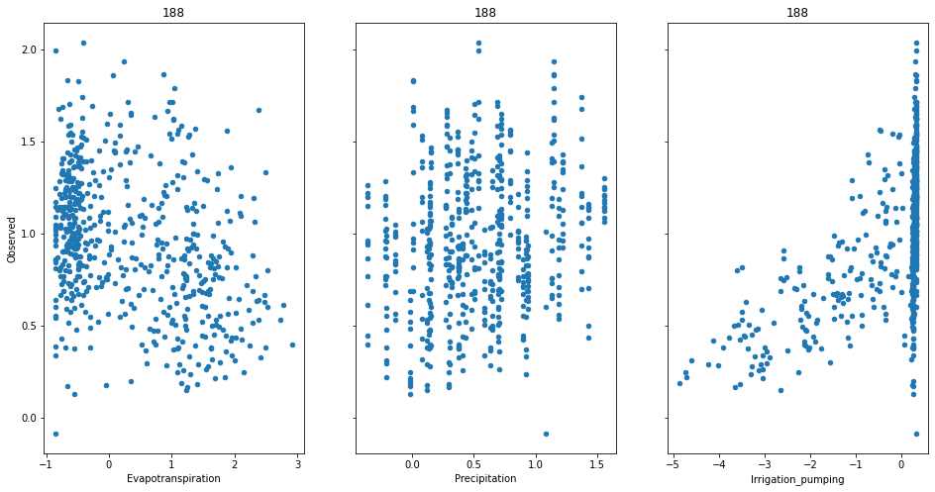
Scatter plots for section 188

Slide 8
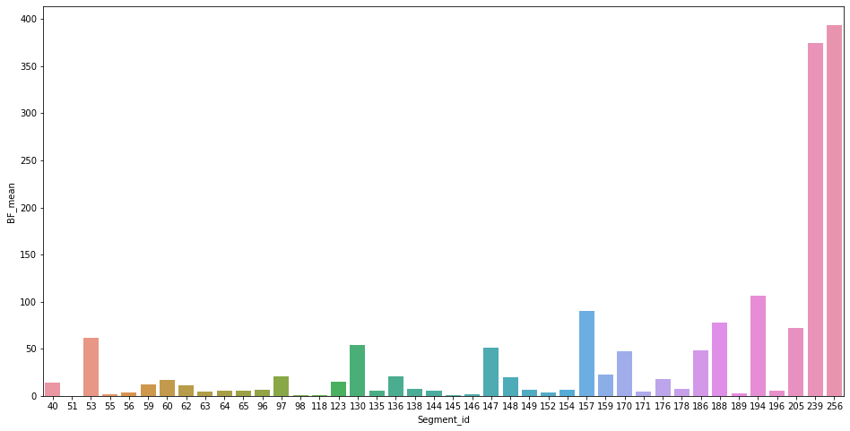
Average Base flow each segment

Slide 9
Results for Multiple Linear regression
Model no. | R2 value | p-value
Irrigation_pumping + Evapotranspiration + Precipitation | 0.083 | 2.91e-291
Evapotranspiration + Precipitation | 0.076 | 8.20e-270
Irrigation_pumping + Precipitation + Evapotranspiration + Date(one hot encoded) | 0.086 | 1.34e-291
Observed ~ Irrigation_pumping + Precipitation + Evapotranspiration + Segment_id(one hot encoded) | 0.718 | 0.00
Observed ~ Irrigation_pumping + Precipitation + Evapotranspiration + Segment_id(one hot encoded) + Date(one hot encoded) | 0.722 | 0.00
Finally,
used train test split to split our data into training and testing.
Fitted the model with the training data
R2 value - 0.72

