Slide 1

COVIDgilance Tracker Paul Kazalski, Flomo Kokro, Will Giordano, Maria-Elena Gorini, Meghna Agnish

Slide 2
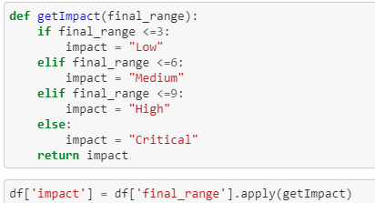
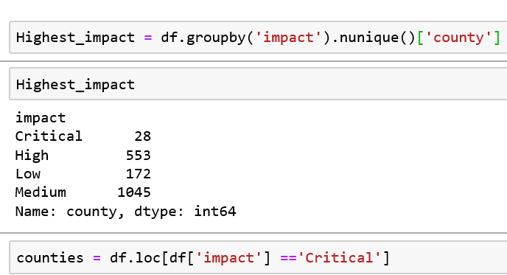
Risk Assessment Analysis
Created a risk profile of US counties by:
Population density
Age demographics with focus on over 70
Features were ranked and ranges were created to normalize the data
Final range column was created as a means of all ranges
Counties were placed into Low, Medium, High and Critical categories

Slide 3
Risk Assessment Analysis
Logistic Regression Model
Purpose of the model – to classify the counties risk impact based on the features
Checked the dataset for nulls
Dropped all columns except cases, deaths, population density and age as input variables
Output variable – Impact
Trained and tested the model
Accuracy rate – Trained data - 62.68%
Accuracy rate – Tested data - 62.61%
Not much improvement with Grid search method – 62.67%

Slide 4

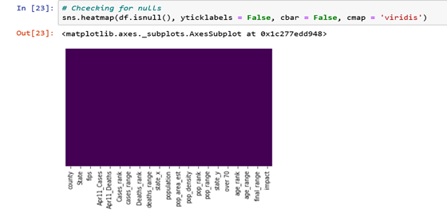
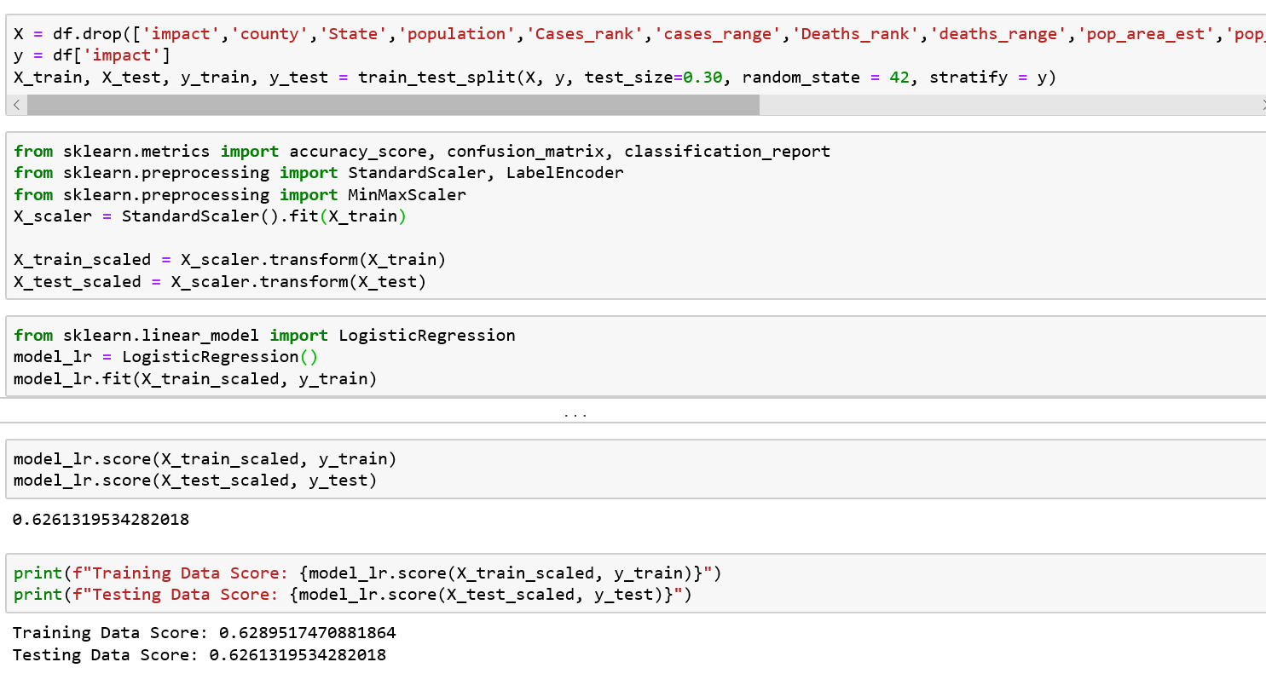
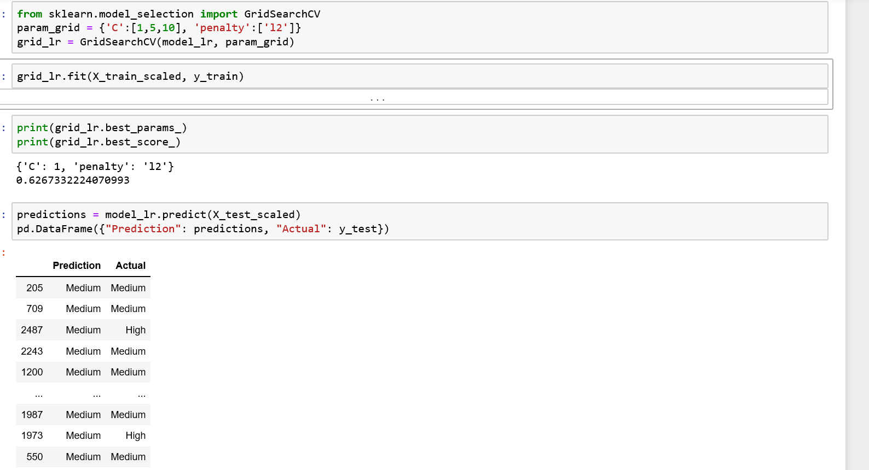
Risk Assessment Analysis
Logistic Regression Model

Slide 5
Risk Assessment Analysis
Logistic Regression Model – To dos
Add more features:
Health data like heart risk, diabetes to the existing dataset
Add transportation data

