Slide 1
Online Retail Industry
Meghna Venkatesha
Ruchitha M Shanmugha Sundar

Slide 2
Index
Abstract
Introduction
Data Description
Methodology
Result

Slide 3
Abstract
Online retail is expanding with the growth of e-commerce. With the growth of e-commerce comes a huge database of customers.
It is important for the online retailers to understand what customers’ expectations and requirements are.
To get a better understanding of what customers’ wants online retailers are trying to implement data mining techniques and work around the customers’ needs and satisfaction.

Slide 4
Using data mining techniques retailers can concentrate on each customer and extend the shopping experience to a personal level.
Along with providing best customer services, retailers can also stock their warehouse accordingly to maintain demand-supply balance.

Slide 5
Introduction
Online retail industry is a multibillion industry.
With World Wide Web it is an easy task to gather information about a customer, get to know their interests, likes and dislikes, etc.
With all these details a list of relevant products can be suggested.

Slide 6
For an online retailer to be the best in industry, they have to come up with a best marketing strategy to advertise their product as unique and best in market and to attract customers.
In order to achieve this online retailers consider many factors as follows,
Occasion, season, time, etc.
Valuable customers
Impact of promotional offers
Loyal customers
Etc.

Slide 7
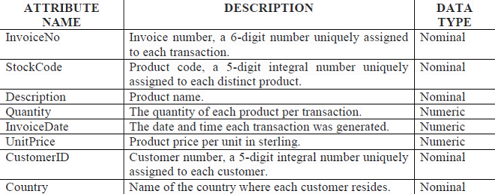
Data Description
We have considered a UK based online retailer data.
The main products of the company are occasional based gifts
There are 8 attributes associated with the data and they are as follows,

Slide 8
Methodology
One of the approach to solve this problem is using the RFM model i.e. Recency, Frequency and Monetary Model.
Customers can be categorized into various categories using k-means clustering algorithm.
Customers can be categorized into various categories using k-means clustering algorithm. Customers can be categorized as valuable, loyal, seasonal shopper, occasional shopper, product bloggers, promotional shoppers, etc.
Based on these categories online retailers can strategize a customer specific marketing technique

Slide 9
First the data needs to be prepared in order to perform Recency, Frequency and Monetary model based clustering analysis. Once the data is prepared clustering can be applied on the dataset.
The following attribute values will be selected: InvoiceNo, StockCode, Description, Quantity, InvoiceDate, UnitPrice, CustomerID and Country.
Create a new attribute Cost. Let this attribute be a product of attribute Quantity and UnitPrice, which will later be used to calculate the average quantity and unit price.

Slide 10
Once data clustering is performed, note the cluster that represents the sales data based on the quantity of the items being purchased.
Note the cluster that represents the sales data based on the price of the items being purchased.
Note the cluster that represents the sales data based on the country of purchase made.
The recency, frequency and monetary factors can be identified by identifying the busiest day of the week, busiest day based on the country, etc.

Slide 11
Result
Identify sales of a particular product that depends on any occasion, season, time, etc.
Identify profits gained from a particular customer.
Identify which customers are loyal and valuable.
Identify promotional offers that has yielded positive results.
Stock the inventory accordingly with appropriate products.

Slide 12
Thank you

