Slide 1
Diagnosis of Parkinson's Disease via Speech Analysis
Meghna Sharma
RA1911003010189

Slide 2
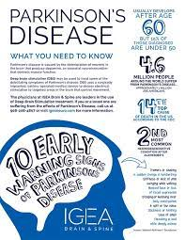
Parkinson's Disease
Parkinson's disease (PD) is a neurodegenerative disorder that affects predominantly dopamine-producing neurons. People with PD may experience:
Tremor, mainly at rest and described as pill rolling tremor in hands. Other forms of tremor are possible
Bradykinesia
Limb rigidity
Gait and balance problems

Slide 3
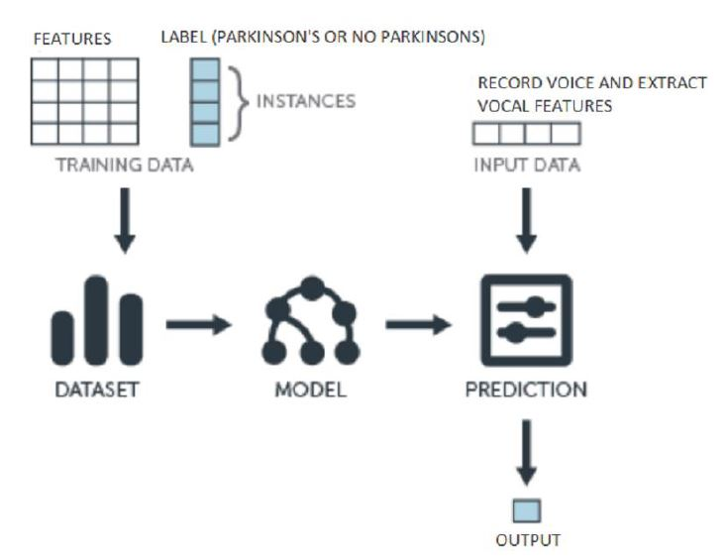
Project Pipeline

Slide 4
Algorithms Employed
Logistic Regression (LR)
Linear Discriminant Analysis (LDA)
k Nearest Neighbors (KNN)
Decision Tree (DT)
Neural Network (NN)
Naive Bayes (NB)
Gradient Boost (GB)

Slide 5
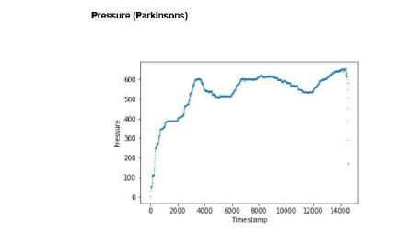
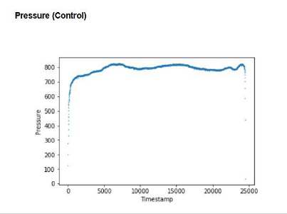
Sample Attribute

Slide 6
Conclusion
Current methods of early diagnosis are only 53% accurate, while machine learning model produces 98% accuracy. This 45% increase is critical because an accurate, early diagnosis is needed to effectively treat the disease. Typically, by the time the disease is diagnosed, 60% of nigrostriatal neurons have degenerated, and 80% of striatal dopamine have been depleted. With an earlier diagnosis, much of this degradation could have been slowed or treated.

