Slide 1
Project 2 Presentation
To Churn or Not to Churn
OPIM 5604 - B12: Predictive Modeling
Team 2: Meghna Ashok, Luke D’Agostino,
Mohit Khanna, Logan Miller, Stuti Viyulie
Notes:
Stuti

Slide 2
The Dataset
What is the dataset?
7043 rows and 21 columns.
The source of the dataset is Kaggle.
What is our target variable?
The target variable is Churn - Yes/No. The class of interest in our dataset is Yes
19 predictor variables
17 categorical
2 continuous
Business Value
We could explore how to retain customers and figure out what factors are the most influential in customers leaving.
We would want to answer how the company could keep customers from leaving regarding the variables that are most influential on churn.
Notes:
Mohit

Slide 3
The Business Problem
In an effort to capture a younger and more tech savvy customer base a telecom company has expanded its product offerings to digital services like smart TV, OTT bundled services along with their phone lines. This company believes that these customers have a higher upselling and cross selling potential. However, the company has recently noticed an increase in their customer churn rate.
The company wants to answer the following questions:
Is there a specific customer type that is churning out?
For customers that have churned out, are they customers of a specific product?
Is there a correlation between churned out customers and the number of lines that they are subscribed to?
If a customer is subscribed to additional security and general services is he less likely to churn out?
If a customer is subscribed to an additional device protection plan is he less likely to churn?
If a customer is subscribed to an additional tech support plan is he less likely to churn?
If a customer has dependents on his plan is he less likely to churn?
Does upselling TV and movie streaming plans to an existing customer reduce the likelihood of churn?
Notes:
Mohit

Slide 4
Data Pre-Processing & Methodology
SEMMA Process
Sample, Explore, Modify, Model, Assess
Partition of 60:20:20 (Training/Validation/Test)
15 categorical variables converted to Dummy variables using Indicator columns.
‘TotalCharges’ column had 11 missing values.
No Outliers.
No need of Standardization or Principal Component Analysis.
Notes:
Meghna
columns were converted from categorical variables to dummy variables (With values 1 (Indicating ‘Yes’/presence in column) and 0 (Indicating a ‘No’) using Indicator columns, to be able to perform math on our categorical variables more easily.
Moreover, the continuous variables are not skewed and hence do not need standardization. We have also chosen not to perform a Principal component Analysis on our dataset since there is not much complexity in our data, and since we have many categorical predictor variables, explainability is of the utmost importance with respect to making business decisions with our results.

Slide 5
Exploration of Data
Senior Citizens are more likely to churn than middle aged customers.
Customers without partners are more likely to churn as compared to customers with partners.
Customers without dependents are more likely to churn compared to customers with dependents.
Customers with phone service are more likely to churn as compared to customers without phone service. Only a small percentage of customers don't have phone service.
Customers with Multiple lines have a slightly higher churn rate, compared to customers with 1 service..
Customers who have taken FiberOptic Internet service are more likely to churn than customers who have taken DSL. Customers who have not taken up the Internet service have a very low possibility of churning.
Notes:
Meghna (1-6) and Logan (7-12)

Slide 6
Exploration of Data
Month to Month contract seems to be the most popular among customers, and has the highest chance of churning.
Customers who have taken up Paperless billing are more likely to churn than customers who have not.
Electronic check seems to be the most popular payment method among customers, and also has the highest churn rate.
Customers who have taken up all the 4 services- Online security, Online backup, Device protection and Tech support are less likely to churn, compared to customers who have not taken up these services.
Newer customers (Tenure<15 months) are more likely to churn.
Streaming TV and Streaming Movies have no correlation with Churn.
Notes:
Meghna (1-6) and Logan (7-12)

Slide 7
Exploration of Data
Senior Citizens | More likely to churn than middle aged customers.
Customers without partners | More likely to churn as compared to customers with partners.
Customers without dependents | More likely to churn as compared to customers with dependents.
Customers with phone service | More likely to churn as compared to customers without phone service
Customers with Multiple lines | Slightly higher churn rate, compared to customers who have taken up a single service.
FiberOptic Internet service | More likely to churn than customers who have taken DSL
Notes:
Meghna
Out of 1142 of the senior citizens in our dataset, 476 senior citizens churned i.e almost 42% of Senior Citizens have churned. This here is an interesting predictor. It may be finding it hard to use phone and internet service, orthe services are too technical and not user friendly enough.
Among customers without partners i.e unmarried, 33% of them churned.
I.e. Customers without partners are more likely to churn as compared to customers with partners.
Similarly, Customers without dependents (children, parents, grandparents, etc.) churned more than customers with dependents. Among customers without dependents, 31% of them churned. Similar to customers without partners.
I think we can clearly say family plans will lead to more customer retention here.
Customers with phone service are more likely to churn as compared to customers without phone service. Only a small percentage of customers don't have phone service.
Customers with multiple lines have a slightly higher churn rate. Only a small percentage of customers don't have phone service.
44% of total customers have Fiber optic InternetService and 34.4% of the customers have DSL InternetService.
Customers who have not taken up the Internet service have a very low possibility of churning. Customers who have taken FiberOptic Internet service are more likely to churn than customers who have taken DSL. This is interesting because DSL connections are slower and more expensive than FiberOptic, but are still less likely to churn.
Customers who have not taken up the Internet service have a very low possibility of churning.

Slide 8
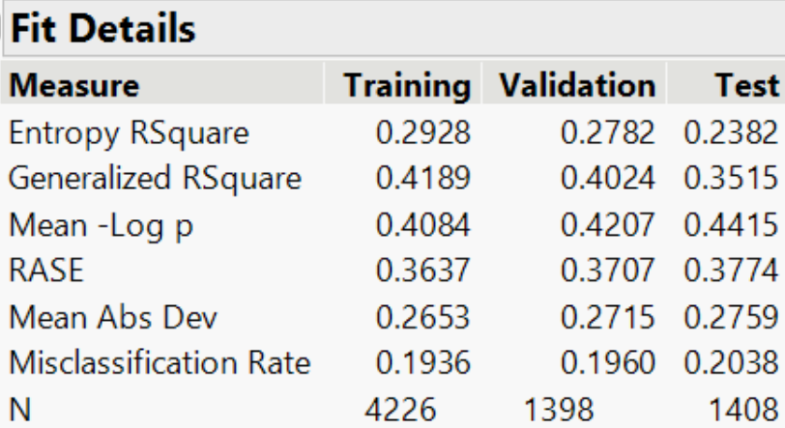
The Best Model
Logistic Regression
Most significant variables
Group 1 and Group 2 split
Group 1
Group 2
Nominal Logistic Model
Ensemble Model
Overfit → growth rate
Notes:
Logan
Talk at a high level about all the models built (all applicable model types for the type of target variable should be tried).
*Should focus on the best model during this ^ discussion.*
What were the most important variables (in this model)?
What results were obtained (from this model)?
How was this model chosen as the best model? (Must have accuracy measures for each model)
Did you make any trade-offs between accuracy & complexity?
*Include details about the other models you tried as slides in the appendix*

Slide 9
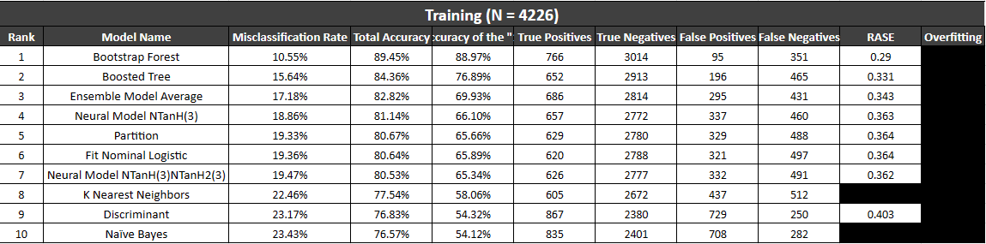
Model Assessment - Group 1 (All Variables)

Slide 10
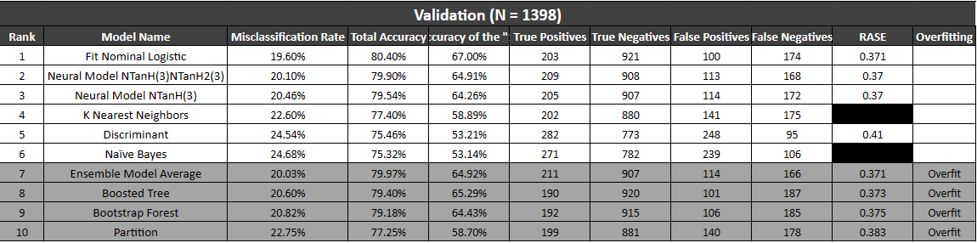
Model Assessment - Group 1 (All Variables)
Notes:
Luke

Slide 11
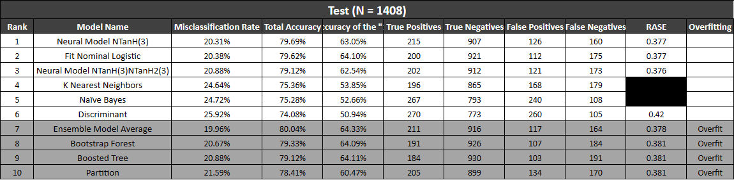
Model Assessment - Group 1 (All Variables)

Slide 12
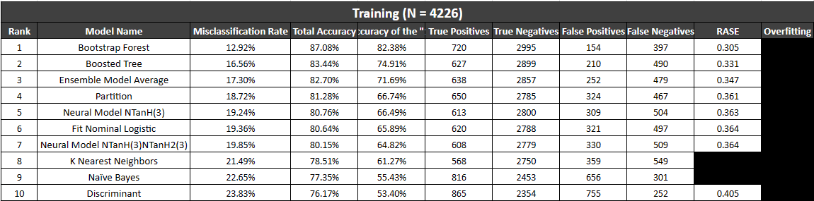
Model Assessment - Group 2 (Significant Variables)

Slide 13
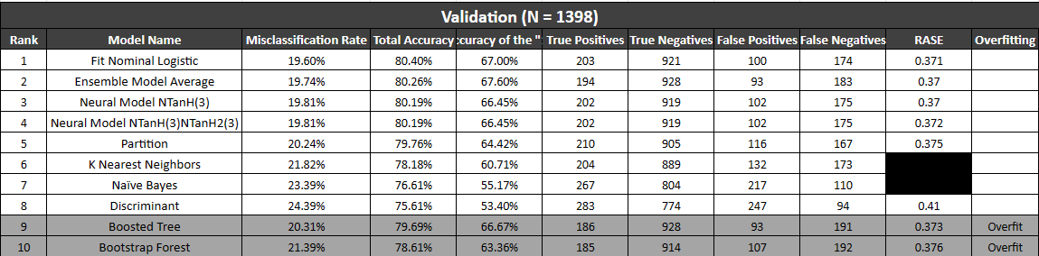
Model Assessment - Group 2 (Significant Variables)
Notes:
Luke

Slide 14
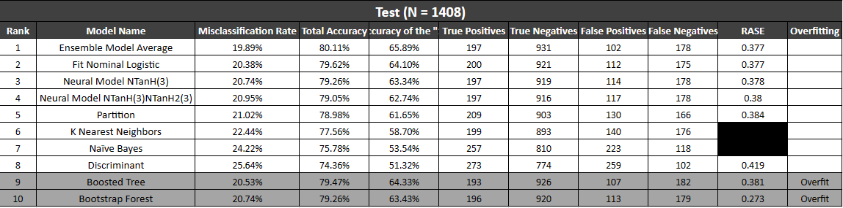
Model Assessment - Group 2 (Significant Variables)

Slide 15
Business Recommendations
The modeling efforts have led to the following recommendations:
Focus on at risk demographics
Improve customer service experiences
Push year-long contracts rather than month to month
Notes:
Stuti
Include the relevant business findings based on your work.
What recommendations can be made?
*NOTE: It is not sufficient to recommend that a company use your model… Rather, you should recommend what a company should do within their business based on the results of your model.

Slide 16
Appendix (Multiple Slides)
*Include details about the other models you tried as slides in the appendix*

