Slide 1

School of Business
OPIM 5604 – Predictive Modeling
Preprocessing Project
Forecasting the Future Sales of Superstore
Group 3
Aniket Jana, Pratiksha Nimesh, Kaman Dhami, Meghna Ashok,
Haneesha Balireddy, Kushagra Goyal

Slide 2

Background
The superstore sales dataset is a retail dataset of a global superstore for 4 years, from 2015 to 2018.
It consists of 9800 rows and 18 categorical attributes.

Slide 3
Problem Statement
The Superstore manager wants to forecast the future sales.
The manager also wants to evaluate the sales pattern and trends in the superstore data.

Slide 4
Details Provided
Row ID
Order ID
Order Date (Time ID)
Ship Date
Ship Mode
Customer ID
Customer Name
Segment
Country
City
State
Postal Code
Region
Product ID
Category
Product Name
Sales (Dependent Variable)

Slide 5
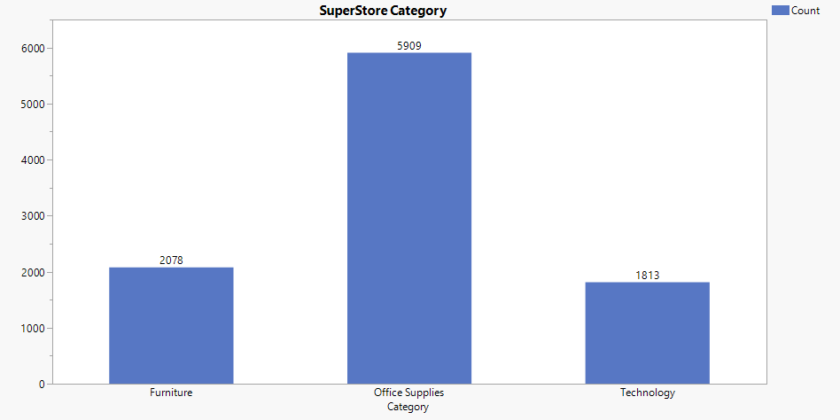
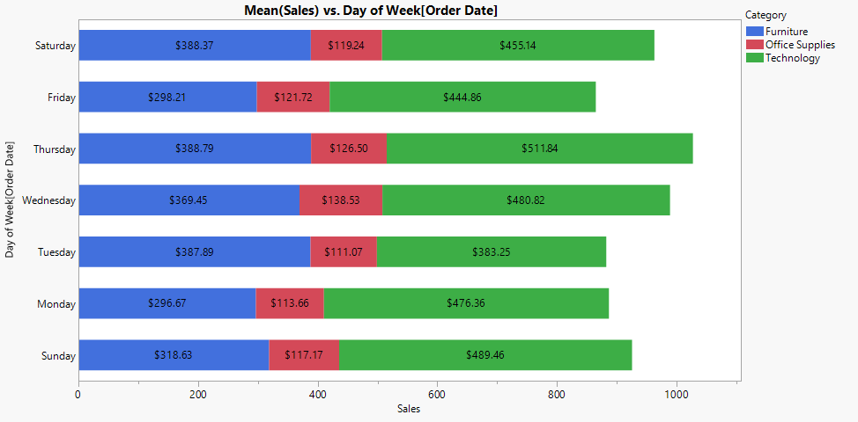
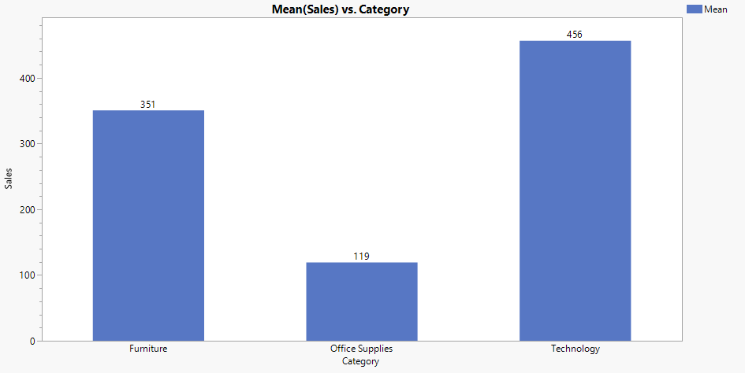
Superstore data exploration
Maximum sales records are for ‘Office Supply’ category.
Average sale is maximum for ‘Technology’.
Maximum average sales happen on Thursday.

Slide 6
Steps used for Data Preparation and Forecasting
Time Series exploration on the complete data set.
Complete data set is “White Noise”, and modeling cannot be performed.
Segregated data based on Category column:
Furniture
Office Supplies
Technology
Time Series exploration on above categories.
Multiple sales record per day: Aggregated sales amount based on order date.
Modeling and Forecasting.

Slide 7
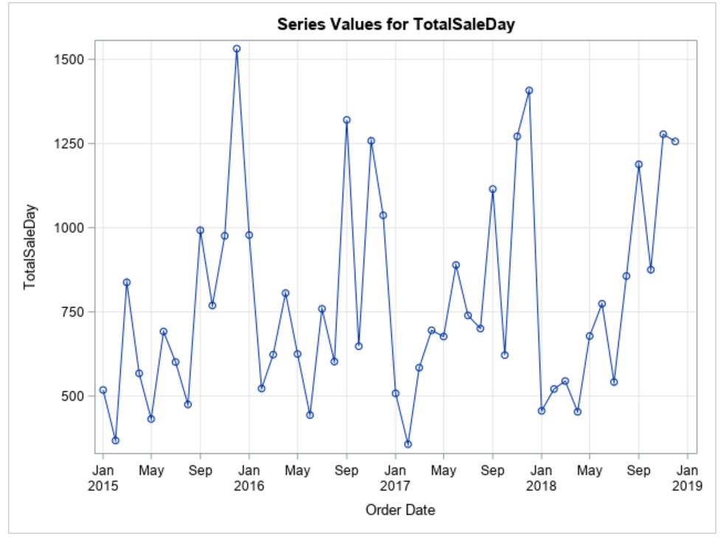
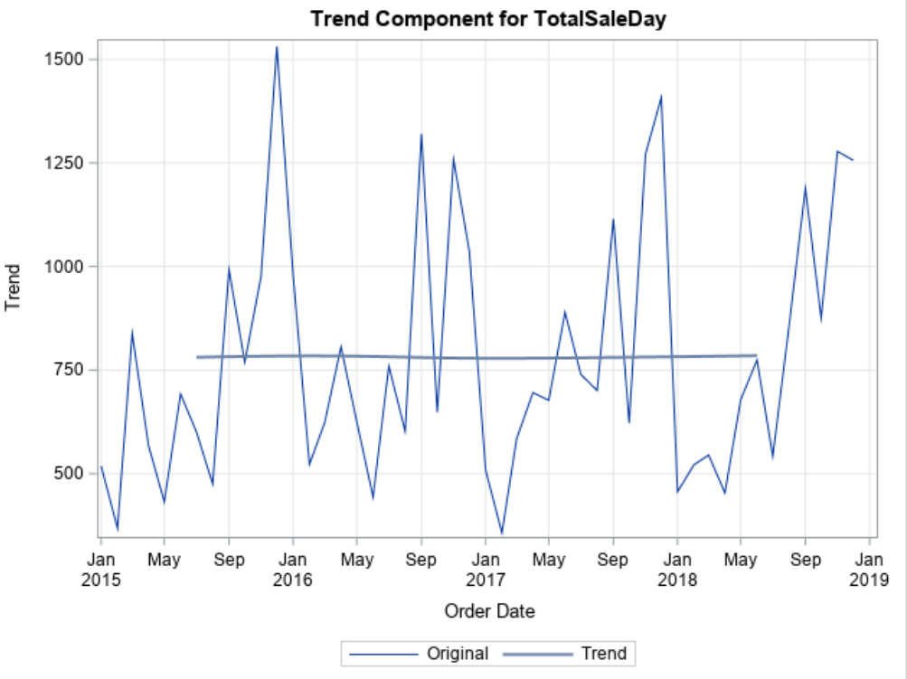
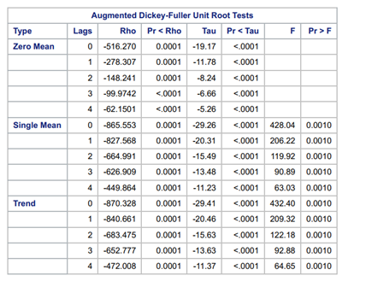
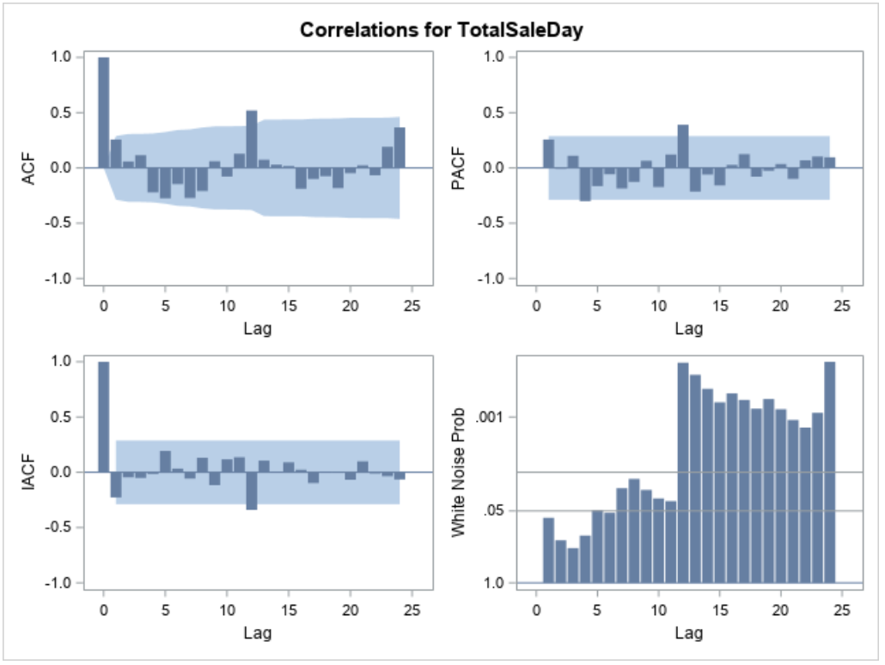
Time Series for ‘Furniture’ category
Notes:
Time Series for ‘Furniture’ category.
No trend.
White noise test shows – this is not a white noise series (p-value < 0.05; we reject Null Hypothesis)
ADF unit test – series is stationary, so we can use ARIMA models.

Slide 8
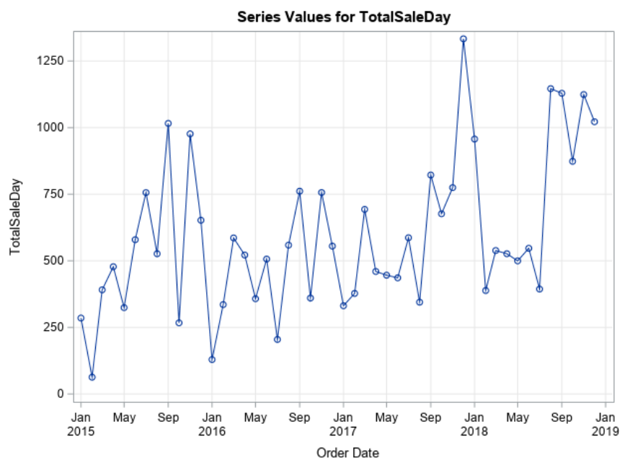
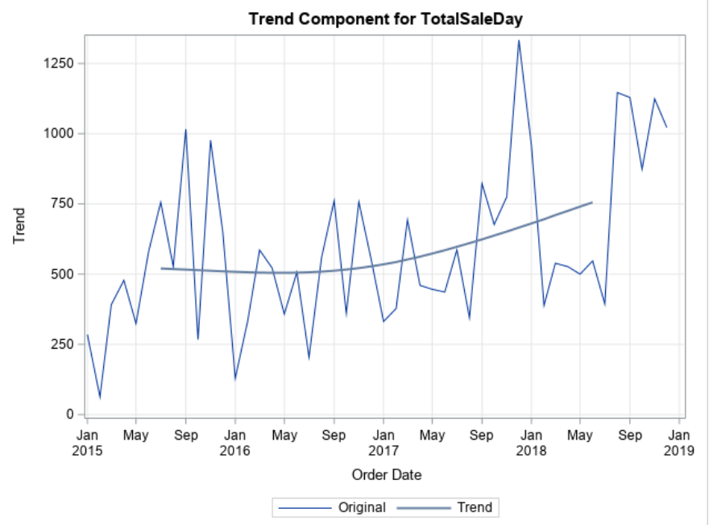
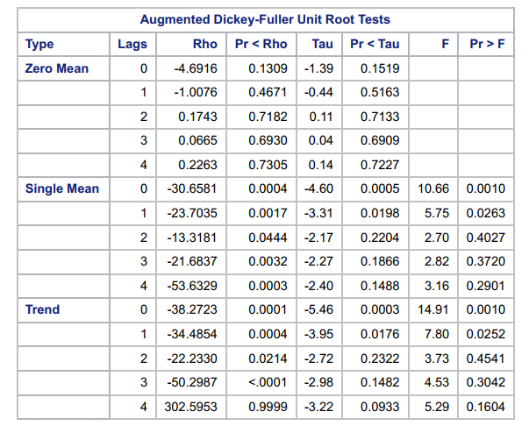
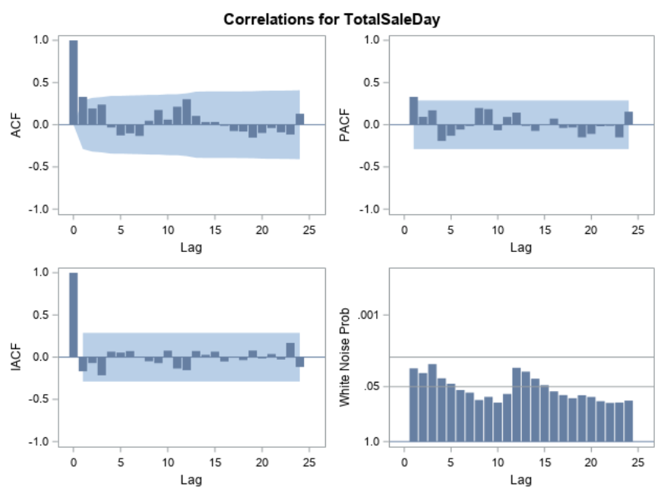
Time Series for ‘Office Supplies’ category
Notes:
Time Series for ‘Office Supplies’ category.

Slide 9
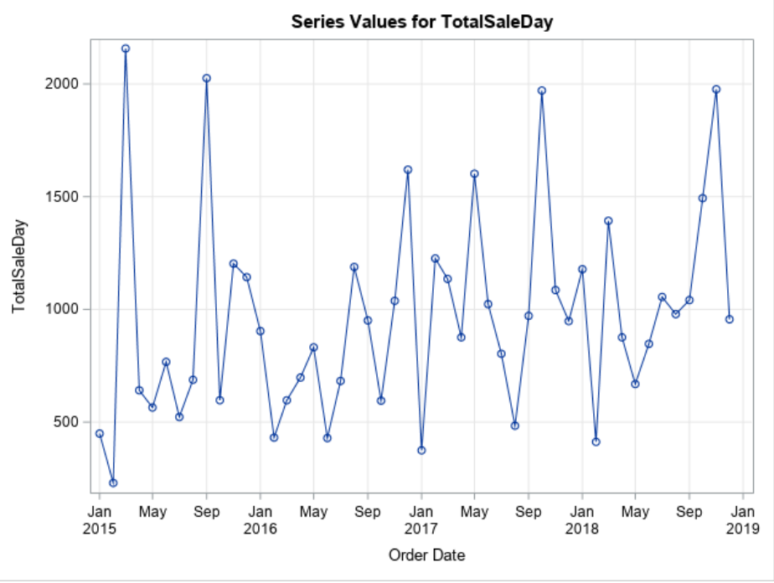
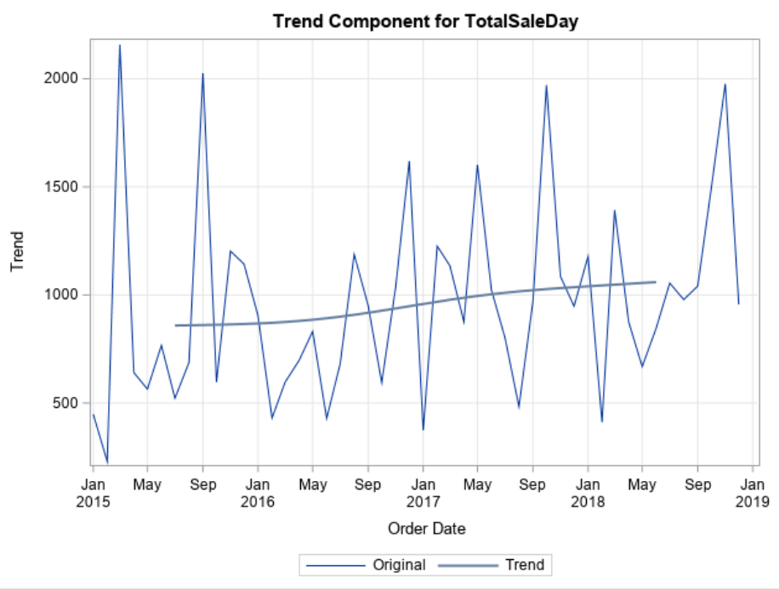
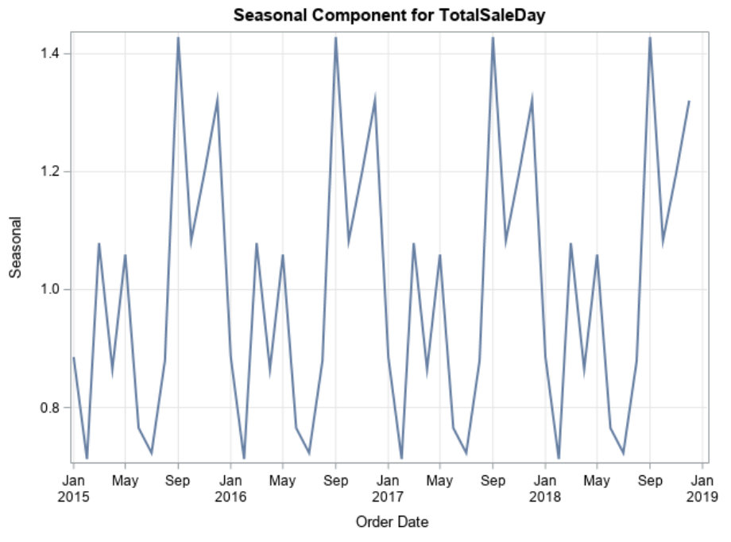
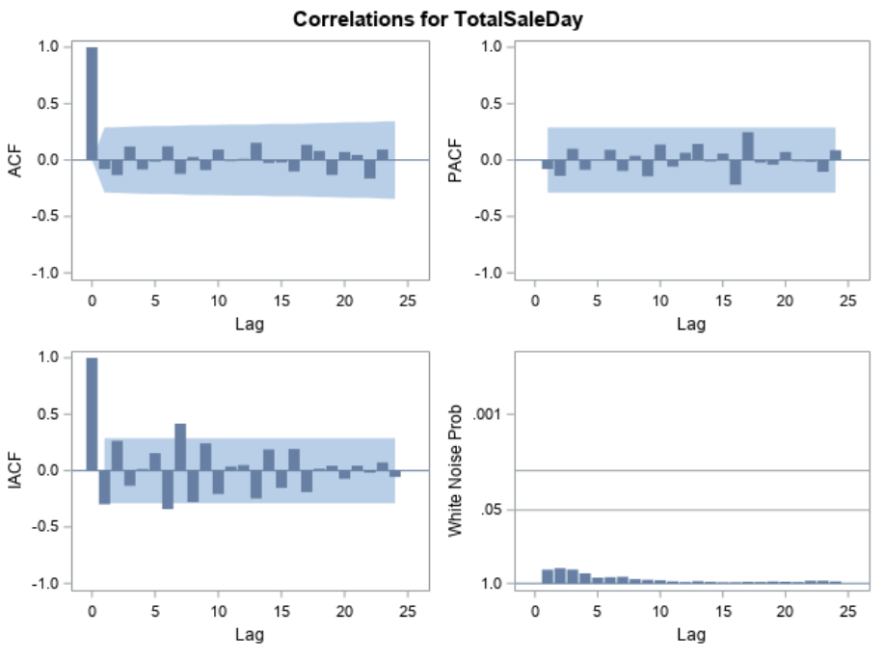
Time Series for ‘Technology’ category
Notes:
Time Series for ‘Technology’ category.

Slide 10
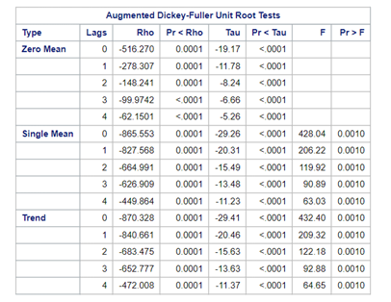
BOX JENKINS ARIMA MODELS
ARIMA (p,d,q) (P,D,Q)
p = Order of non-seasonal Auto Regressive (AR)
d = Order of non-seasonal difference
q = Order of non-seasonal Moving Average (MA)
P = Order of seasonal Auto Regressive (SAR)
D = Order of seasonal difference
Q = Order of seasonal Moving Average (SMA)
Notes:
●Furniture dataset is stationary so we run arima model. Since the data has some seasonality we will be running a seasonal arima model with different orders

Slide 11
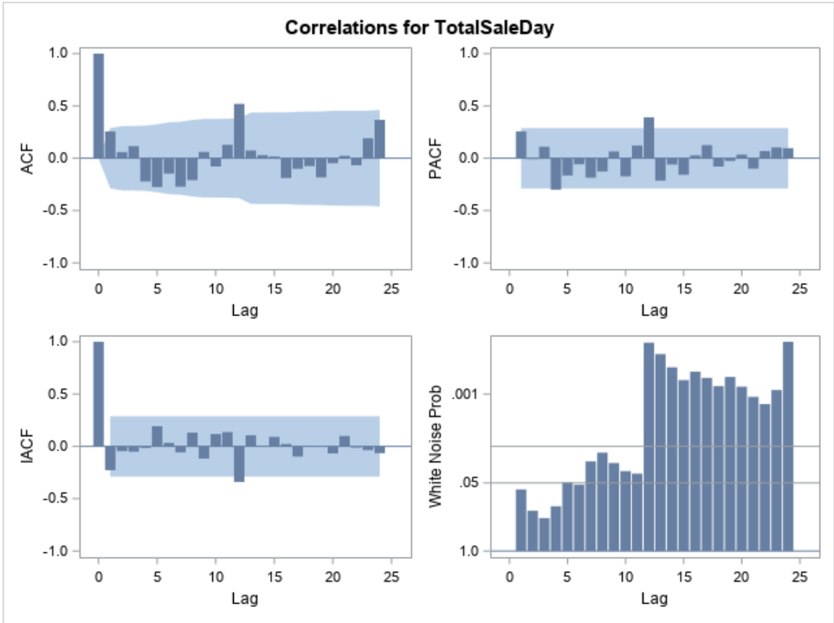
Forecasting Furniture Sales
Notes:
●There is a significant spike about lag 12 in the acf graph and pacf graph
●Sinusoidal element in acf graph indicates seasonality

Slide 12
Model comparison
Model | AIC | SBC
(1,0,0) (1,0,0) | 662.7234 | 668.337
(1,0,2) (1,0,2) | 675.959 | 689.0574
(1,0,1) (1,0,1) | 660.0262 | 669.3822
(1,0,1) (1,1,1) | 492.0802 | 499.9978
(1,1,0) (1,1,0) | 490.9189 | 495.5849
(1,1,1) (1,1,1) | 485.8904 | 493.6671
(1,0,1) (1,1,1) | 492.0802 | 499.9978
(2,1,0) (2,1,0) | 489.8776 | 497.6543
(0,1,0) (0,1,0) | 501.3034 | 502.8587
(2,0,1) (2,0,1) | 663.4496 | 676.548
(2,1,1) (2,1,1) | 491.4271 | 502.3145
(1,0,0) (1,1,0) | 489.5722 | 494.3228
Notes:
●AIC , sbc are measures of parsimoniousness of model

Slide 13
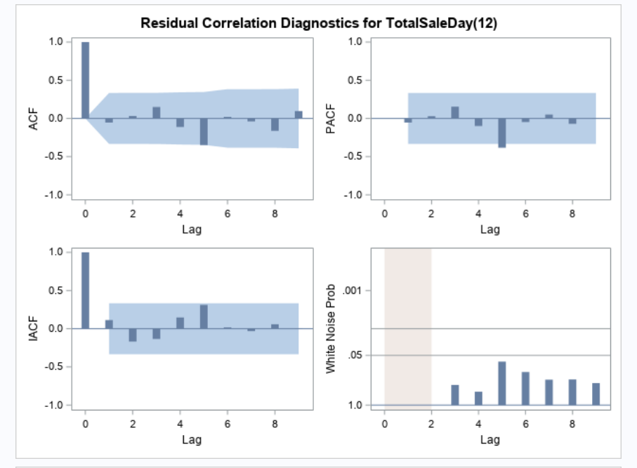
White noise Residual
Notes:
●White noise with the lags insignificant and as we know white means white.
●Meaning the model is well explaining all the signal in the series and only white noise is left.

Slide 14
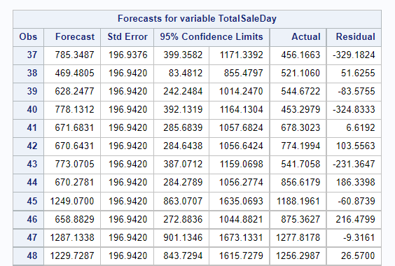
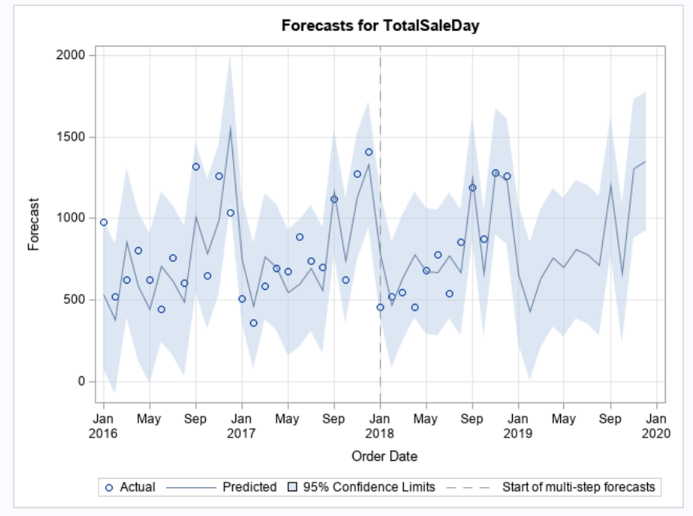
Furniture Forecasted values
Notes:
We have forecasted the next 2 years sales data for furniture

Slide 15
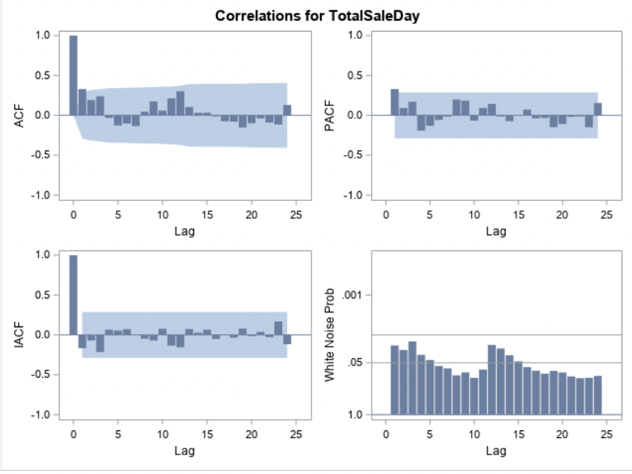
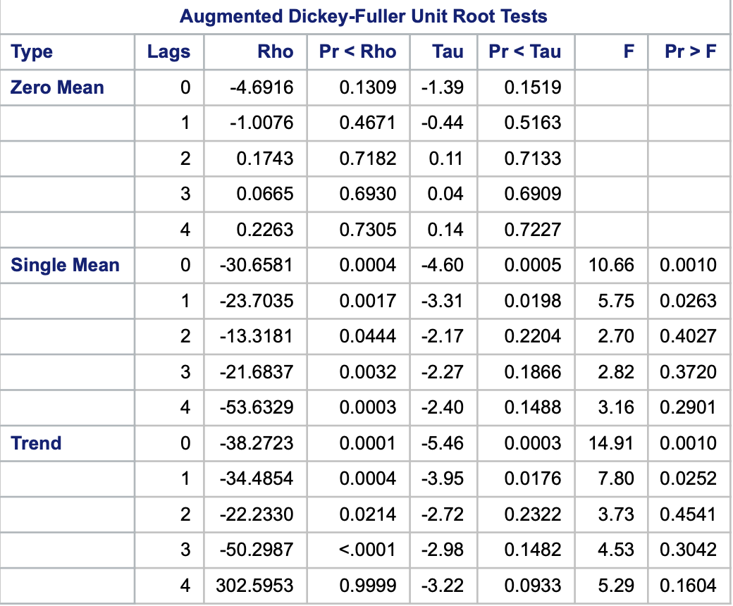
Forecasting Office Supplies Sales
ADF test
Correlations
Notes:
We can see upto 25 lags

Slide 16
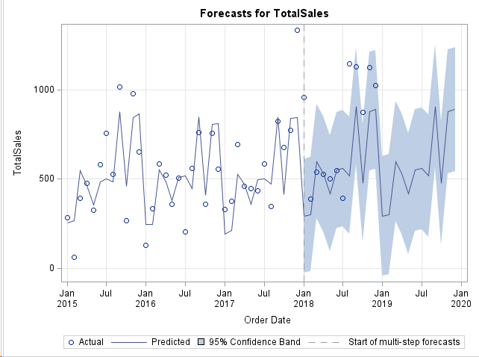
Running Additive seasonal Exponential Smoothening model as data is not Stationary

Slide 17
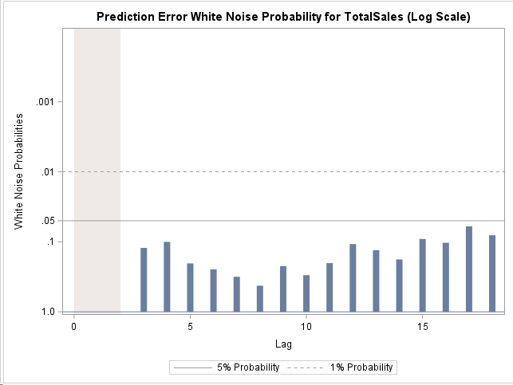

White noise for Prediction error
Stats obtained for the model

Slide 18
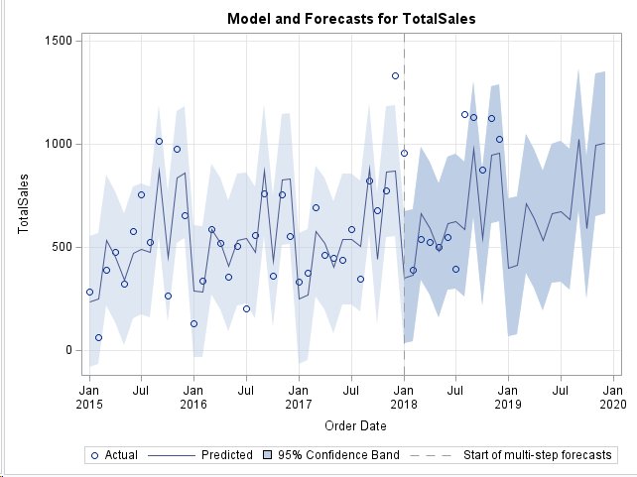
Also running Winters Additive Model as data is not Stationary

Slide 19
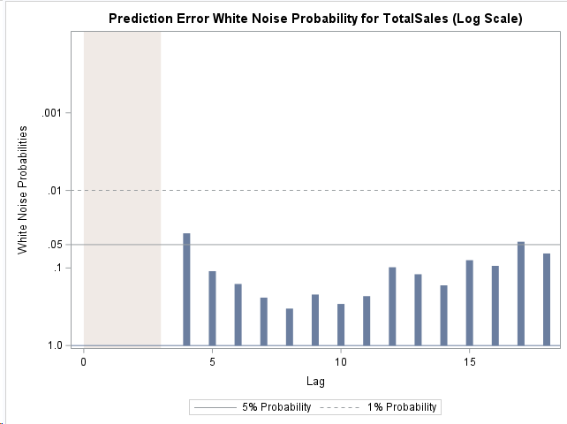

White noise for Prediction error
Stats obtained for the model

Slide 20
Comparing Models
Additive seasonal Exponential smoothening model
With the AIC of approximately 368.5 in validation data, Additive seasonal
Exponential smoothening model is the best model out of the two
Winters Addition Model

Slide 21
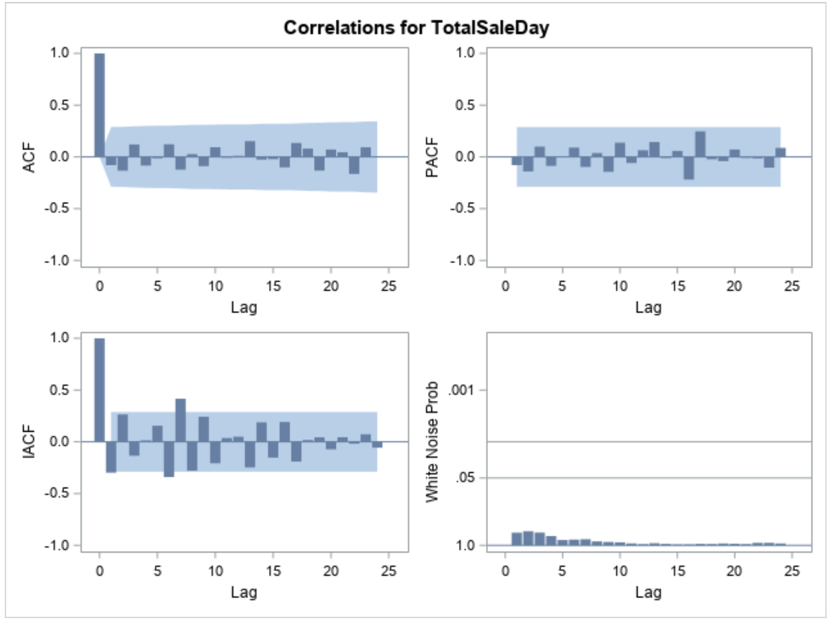
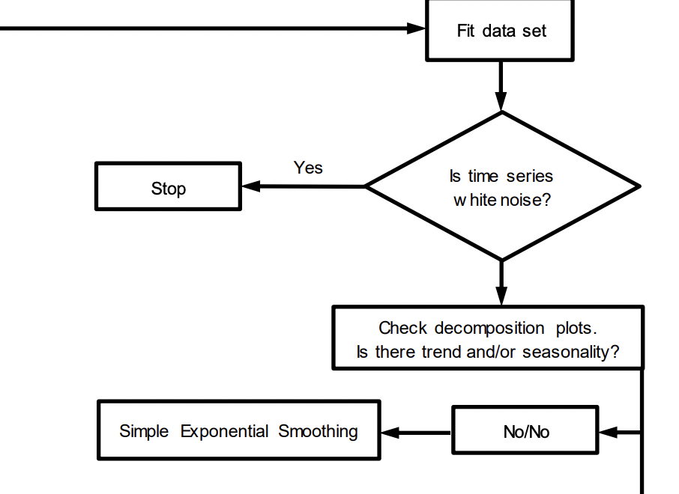
Forecasting Technology Sales
Cannot be modelled since there is white noise
Correlations
Notes:
We can see upto 25 lags

Slide 22
Conclusion
Furniture
Since the Data was stationary, we ran ARIMA model.
The Forecasted values have the seasonality component retained
The Period between September and January have high peaks
We should run Christmas And New Year Festive Sales to garner more traction
Office Supply
Here the Data was non-stationary, we ran exponential smoothening
The Forecasted values retained the same seasonality as well
There are multiple peaks in the forecasted period mainly on August, October and November
Run Promotional Campaigns during and before the above months to improve sales
Technology
Model was not run due to White noise

Slide 23
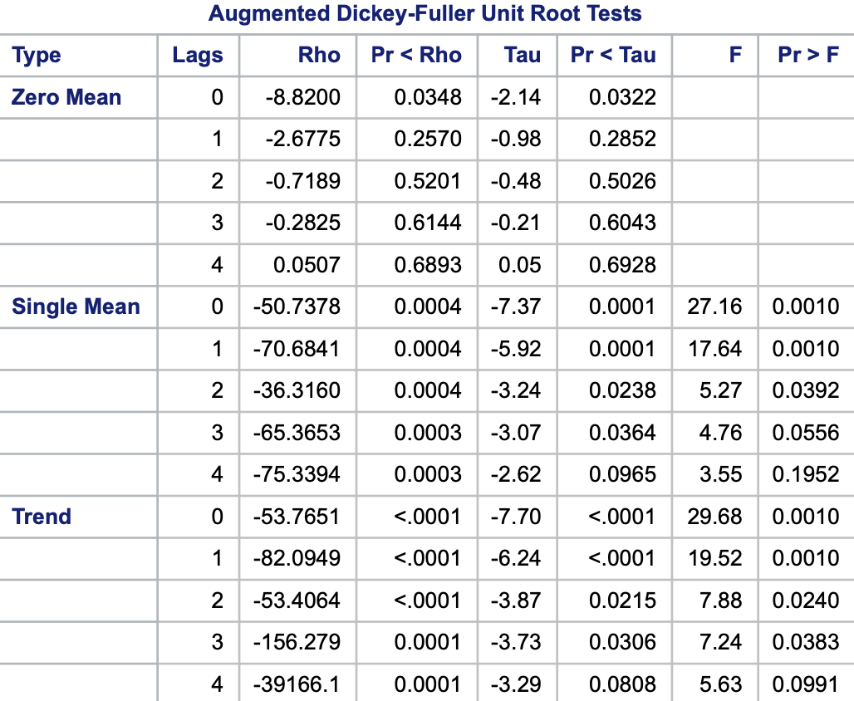
Forecasting Technology Sales
ADF test
Correlations
Notes:
We can see upto 25 lags

Slide 24
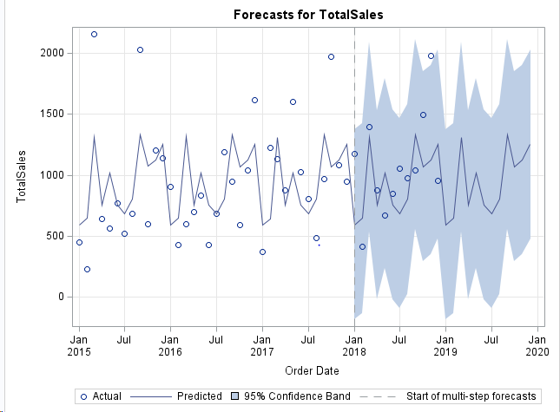
Also running Additive seasonal Exponential Smoothening model as data is not Stationary

Slide 25
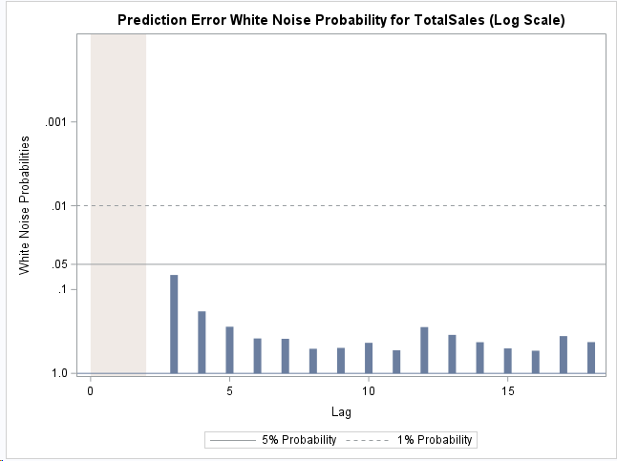

White noise for Prediction error
Stats obtained for the model

Slide 26
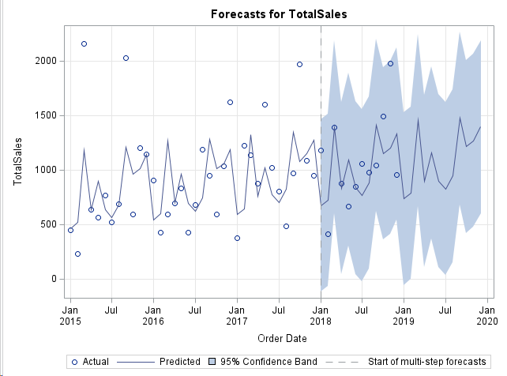
Running Winters Additive Model as data is not Stationary

Slide 27
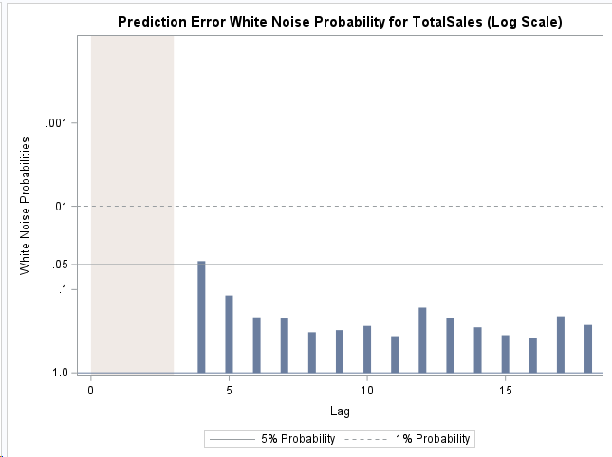

White noise for Prediction error
Stats obtained for the model

Slide 28
Comparing Models
Additive seasonal Exponential smoothening model
With the AIC of approximately 432.8 in validation data, Additive seasonal
Exponential smoothening model is the best model out of the two
Winters Addition Model

