Slide 1


A Web Development Enterprise
Team 2 :
Meghna Ashok, Yashi Gupta, Jasika Kalra, Pooja Shivhare

Slide 2





Our team
Meghna
Yashi
Pooja
Jasika

Slide 3

Agenda
Introduction
Workflow
As-is Diagram
To-be Diagram
ERD
Queries
Conclusion

Slide 4
Introduction
Webfactory is a start-up that 'Builds and Delivers a Website to the clients
The start-up comprises Developers, Testers, and Account Managers who focus on delivering Web Development Services
The aim is to enable clients in establishing their online presence, outfitted with their brand’s elements, content, and offerings, tailored to specific business goals
Notes:
Pooja

Slide 5
Workflow
Client comes with a request
Work Order is generated
One more employee is assigned to each work order
Website is designed as per the template choice and customization requirement of the client
Invoice is generated
Website Delivered to the client
Notes:
Let me give you a quick walk-through of how operations happen at Webfactory. Whenever a client approaches Webfactory, they are handled by a dedicated account manager who would try to understand their business, gather all the requirements and expectations, and suggest to them certain pre-designed templates choose from. A customer could proceed with the existing templates or ask for modifications, where each modification is labeled as customization. Upon completion of the phase, a work order is generated by the account manager capturing all the client details and expectations and assigning a developer to it.
an invoice is generated and mailed to the client upon completion of the project. The information captured in the invoice includes the clients' details, various charges, payment status, and the date on which the invoice was generated. As soon as the payment is made the website is hosted on the client's house server and the website link along with the access is shared with the client.
The key point to be noted here is web factory only caters to the website designing requests and is not responsible for the maintenance of the website.

Slide 6
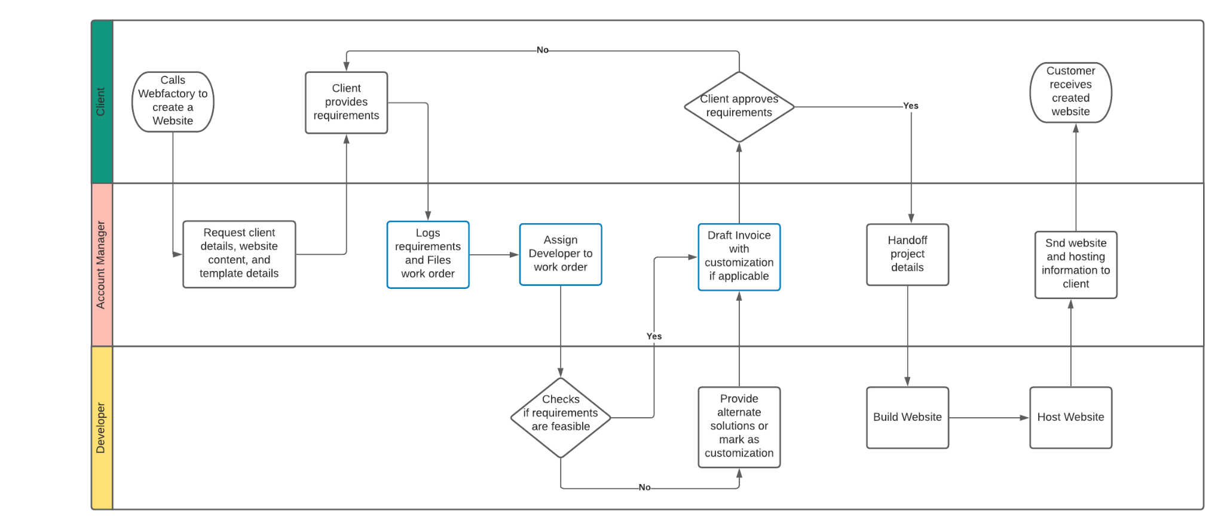
As-is
Notes:
Problems faced by webfactory with their current model:
PROBLEMS FACED. NEW CUSTOMER. Logs req and client details in EXCEL. CHECK DEVELOPER AVAIL. (ASSIGN, DELEGATE, INFORM, FOLLOW UP),
-> Every customer is treated as a new customer everytime they call to make a website. Like there is no record of their details, or previous projects or preferences.
-> The account manager stores the client details and website information in an excel spreadsheet AND FILES WORK ORDER.
->the account manager had to manually check if a developer was free and assign the developer to a work order, inform the developer.
->The account manager also has to calculate costs of requirements, customizations etc themselves while drafting the invoice and sending the same to the client.
->So this was a tedious process for the account manager.
-> The process has overall Too many handoffs esp on the account managers end, and he/she has to do a lot of manual work.
-> Overall, Too much time elapsed between customer request and end-product delivery.
And the process is time consuming and not very efficient.
And With so much going on, The client does not get timely updates.

Slide 7
Our solution
Enabler: Information Systems, Workflow design
Notes:
Meghna
We introduced a database system that helps optimize workflow and reduce the need for human intervention in the process,
We introduced a database system that helps optimize workflow and reduce the need for human intervention in the process

Slide 8
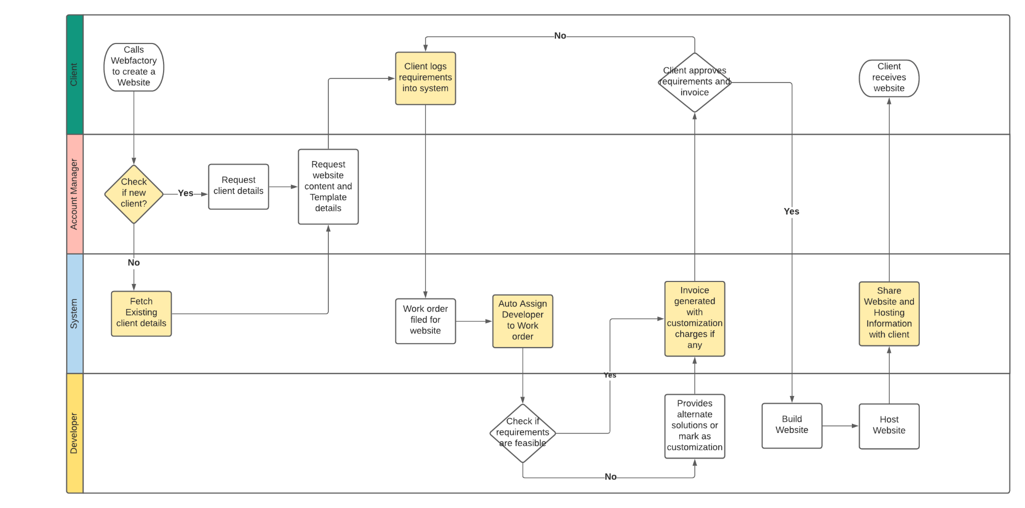
To-be
Notes:
->After the application of Database Management system to this process.
->Account manager checks if client in database. If so, existing customer details, preferences, previous project information is identified.
->If it is a new customer, the account manager requests for client details, template, website content, preferences, hosting details, customizations, etc additional information through a google sheet. The client fills up the sheet and all the details are auto. Logged into the database.
->Following this, a work order filing action is triggered by the system. This automatically triggers the creation of Work order, account manager doesn't have to file one,. OR following this, the system auto files work order, the account manager doesnt have to do anything.
-> Developers who are available, are automatically assigned to the work order and respective developers are notified as well.
-> An Invoice generated by the system, consisting of all proposed requirements and charges - customization, hosting, template, etc. Once the client approves the invoice, the website is built by the developers and then hosted, and final website and hosting details are shared with the developer as and when project is completed from the developers end.
->Overall, less handoffs. Chances of error are reduced as manual work is reduced. Efficiency is increased.

Slide 9
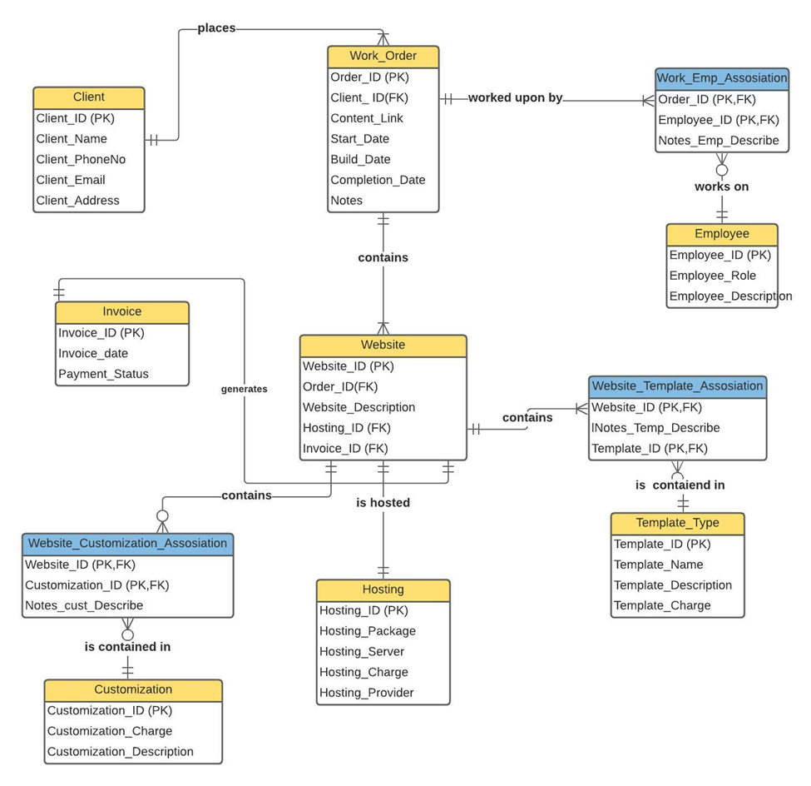
ERD
Notes:
Yashi

Slide 10
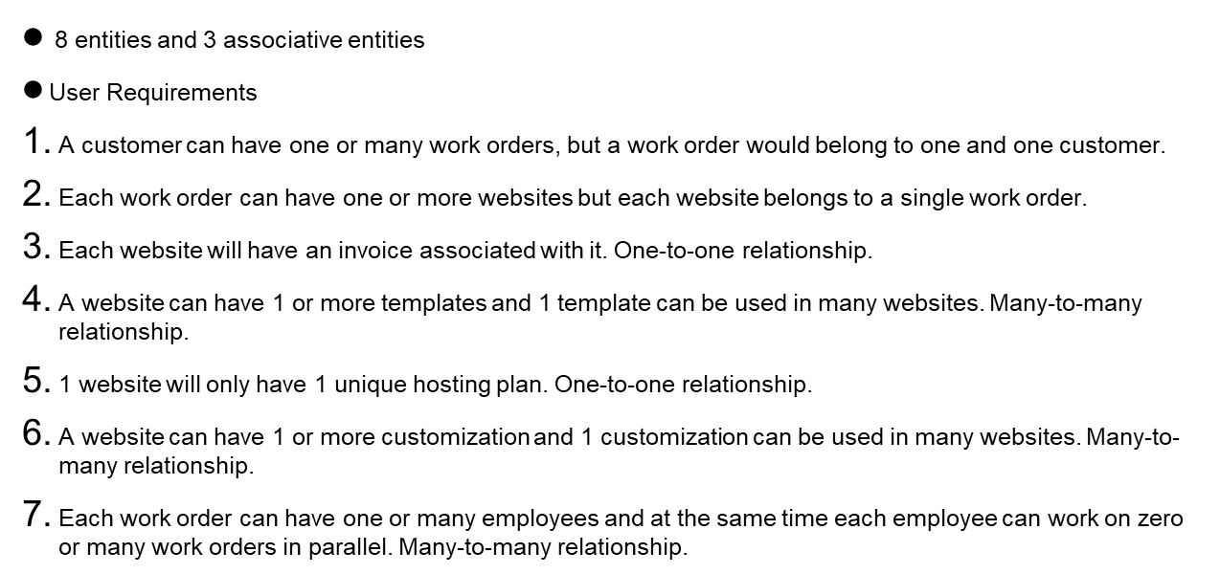
Entities
Notes:
Yashi

Slide 11
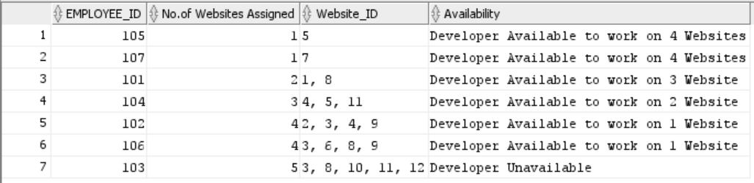
Query 1
Purpose :
To identify how many websites are handled by each developer on a given date, and whether that developer is available to work on a new incoming work order.
Notes:
In order to optimize the project allocation process and minimize the time taken by a account manager to manually identify the availability of each developer, we have generated this query which shall enable the account manager to check the accessibility of the employee before aligning him on a new delivery. The report provides a comprehensive view detailing the no of websites an employee is assigned on as of current date, the website id of each and if the employee has the bandwidth for a new project. Since each employee can only work on 5 websites at a time thus if the no of assigned website to a developer is 5 the availability status is marked as developer unavailable.

Slide 12
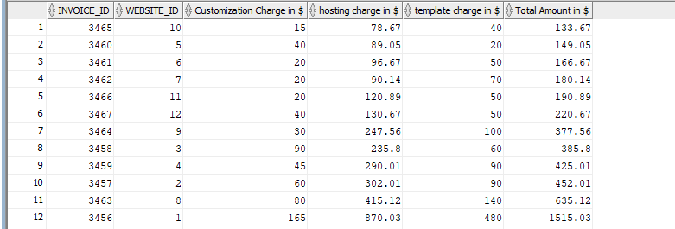
Query 2
Purpose :
To identify the total amount of the invoice for each website including customization charge, template charge and hosting charge.
Notes:
Since there are so many charges associated with designing each website we decided to automate the process of finding the total cost being billed from the client for each delivery.The formula used for calculating the total cost is no of templates requested * cost of each + no of customizations requested*cost of each + cost of hosting plan.
This also helps to ensure transparency in billing details and provides to the customer a complete breakdown of the cost asked for website designing.

Slide 13
Conclusion
Introduction of database system helped in optimizing the workflow and reduce the need for human intervention in the process.
Implementation of database was instrumental in tracking every client, project, requirement, and progress.
SQL reports generated to enable employees and businesses in automating and streamlining their workflow.
Webfactory delivers professional websites to clients who save time and effort in building one.
Notes:
Pooja

Slide 14
Thanks!

