Slide 1
Online Comic library
Presented by
Meghna Patil
Kuldeep Singh
Project Guided by
Prof. Sunny Nahar

Slide 2
Introduction
The Online Comic website is used for assisting readers to read comic books more conveniently.
Online Comic book reading website provides interface for user to easily access available comics and read them over the web.

Slide 3
Existing System
In Conventional system, a comic reader has to go to the shop to purchase comics and reas them.
Reader has to search for the comic he/she wishes to read and then but it.

Slide 4
Drawback of Existing System
In existing system, reader has to make effort to go to comic book store.
The comic book reader wants may not be always be available.

Slide 5
Proposed System
The proposed system allows reader to read comics from their Personal Computer while sitting home.
Thus it is more convenient for user.
Also It offers wide range of comics to choose from.

Slide 6
Requirement Analysis
Hardware Specification:
256MB or above of RAM for a single-computer website.
85MB of storage or above.
Software Specification:
XAMPP application.
Notepad.
Browser.

Slide 7
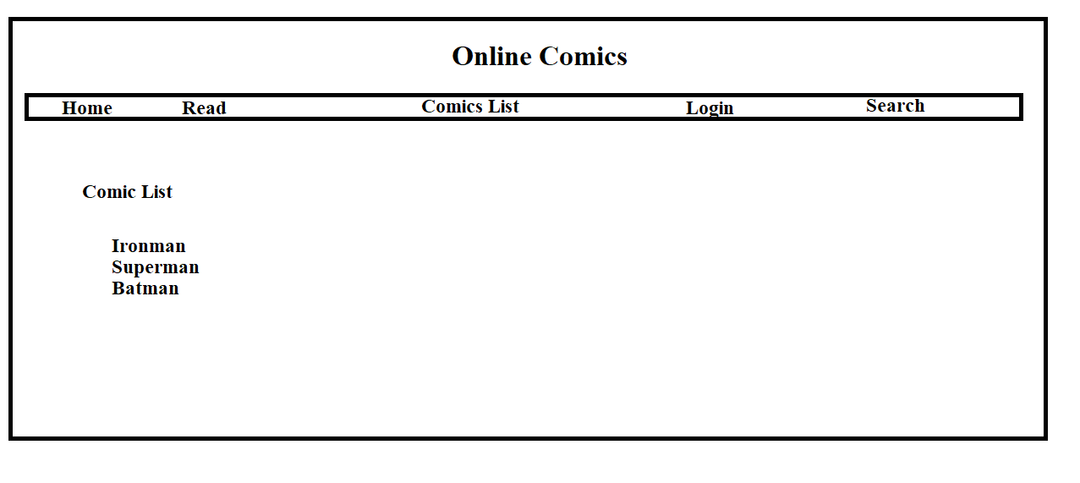
Design

Slide 8
References
https://www.w3schools.com
https://stackoverflow.com/

