Slide 1


Slide 2
Detecting Fake News with Python and Machine Learning
Introduction-
In today's age of information overload, distinguishing between authentic news and misinformation is more critical than ever. Python, coupled with machine learning techniques, offers a powerful solution to this challenge.

Slide 3
This project has been inspired from the below Case Study:
Case Study: Fake News Detection in Social Media
Background: In 2019, a leading social media platform faced widespread criticism for the proliferation of fake news and misinformation on its platform. To address this issue, the platform launched a dedicated team to develop and implement advanced algorithms for detecting and flagging fake news content.
Approach:
Data Collection: The team collected a vast amount of user-generated content, including posts, articles, and images, from the platform. They also gathered labeled datasets of verified fake news articles for training their machine learning models.
Feature Engineering: Utilizing natural language processing (NLP) techniques, the team extracted key features such as sentiment, word frequency, and linguistic patterns from the text data. They also incorporated metadata features such as user engagement metrics and publishing source credibility.
Model Development: Employing state-of-the-art machine learning algorithms such as deep learning-based neural networks and ensemble methods, the team trained robust classification models to distinguish between genuine and fake news content.
Validation and Fine-tuning: The models underwent rigorous validation using cross-validation techniques and were fine-tuned based on performance metrics such as accuracy, precision, recall, and F1-score.
Integration and Deployment: Once validated, the best-performing models were integrated into the platform's content moderation system. The models continuously monitored incoming content in real-time, flagging potentially fake news articles for human review.
Continuous Improvement: The platform implemented a feedback loop mechanism where flagged content and user reports were used to retrain the models periodically, ensuring adaptability to evolving tactics used by misinformation campaigns.
Outcomes:
Significant reduction in the dissemination of fake news content on the platform.
Enhanced user trust and confidence in the platform's content integrity.
Continuous monitoring and adaptation to emerging threats, maintaining effectiveness over time.
Lessons Learned:
The importance of leveraging advanced technology, such as machine learning, for proactive identification of fake news.
Collaboration between data scientists, content moderators, and domain experts is crucial for success.
Transparency and user education are essential for fostering a responsible online community.
This case study highlights the proactive measures taken by a social media platform to combat fake news and underscores the role of data-driven approaches in ensuring the integrity of online information ecosystems.

Slide 4

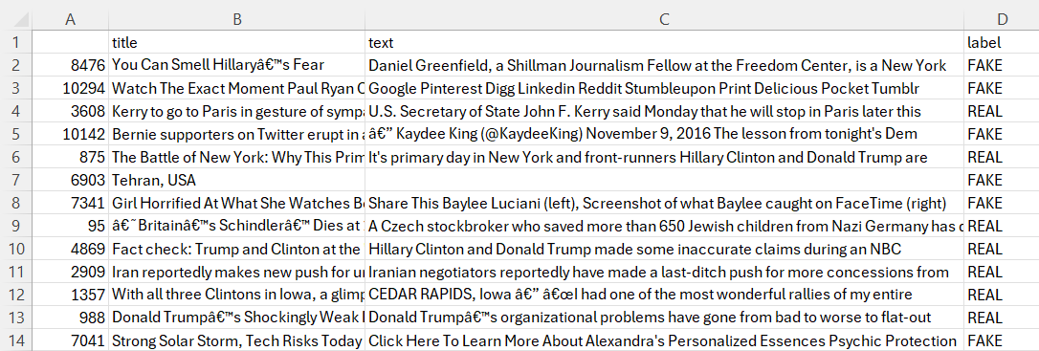
About the dataset –
This dataset contains the following columns: "title" and "text", along with a "label" column indicating whether each news article is real or fake.
Here's a breakdown of the columns:
Title: This column contains the titles of the news articles.
Text: This column contains the main body of the news articles, providing additional context and information.
Label: This column classifies each news article as either real or fake. In this dataset, the label "FAKE" indicates that the news article is fake, while the label "REAL" would indicate that the news article is authentic.
The dataset appears to be focused on controversial news items recorded worldwide. It includes detailed analysis and commentary on various events and controversies surrounding the election, offering insights into the political landscape during that time.
This dataset can be used for training and testing machine learning models to classify news articles as real or fake based on their titles and text content. By leveraging natural language processing (NLP) techniques and machine learning algorithms, we can develop models capable of detecting and identifying fake news, contributing to efforts to combat misinformation and ensure the dissemination of accurate information in the media landscape.

Slide 5

Exploratory Data Analysis (EDA) for Fake News Detection
In this EDA for fake news detection, we aim to understand the dataset's structure, explore key features, and identify patterns for building a detection model. Through this analysis, we seek insights crucial for feature selection and model design, enhancing the accuracy of our fake news detection system.
The following tasks have been performed as a part of EDA:
Data Exploration
Label Distribution
Text Length Analysis
Word Frequency Analysis
N-gram Analysis
Feature Correlation
Visualization

Slide 6
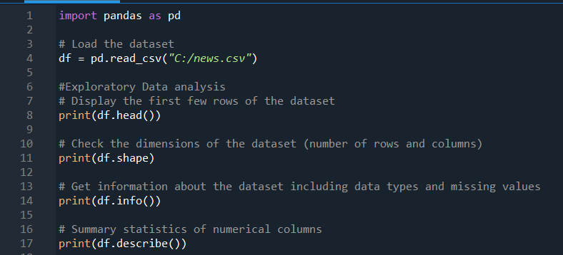
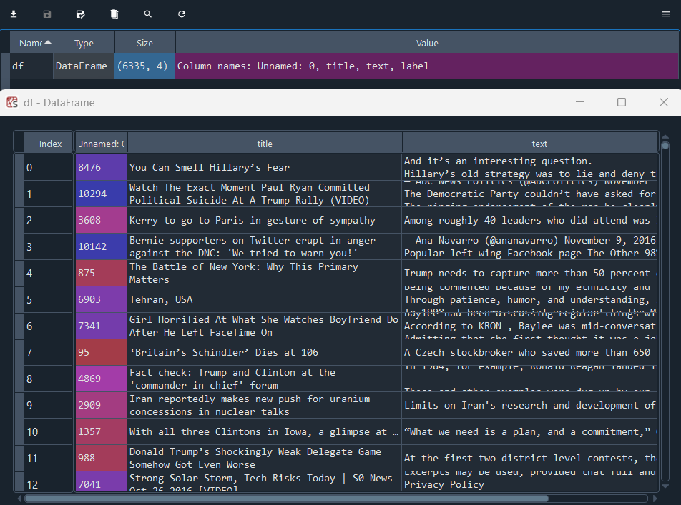
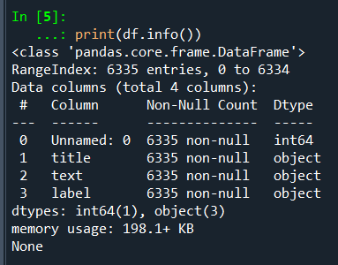
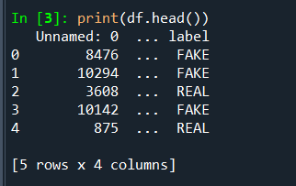
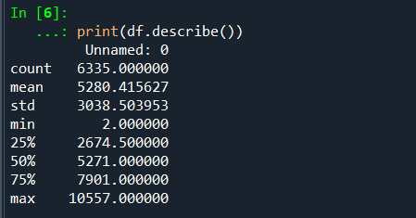

1)Data Exploration:
It is performed to examine the structure of the dataset, including the number of rows and columns, as well as the data types of each column.
By performing this , we could determine the dimensions of the dataset , data types , and descriptive statistics.
Hence it is concluded that this dataset mostly comprises of categorical variables.

Slide 7
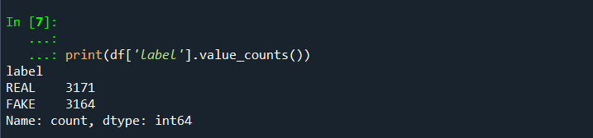
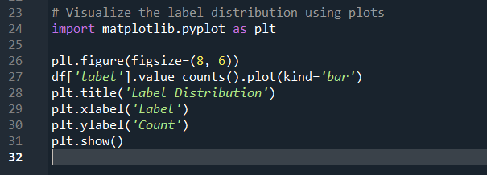
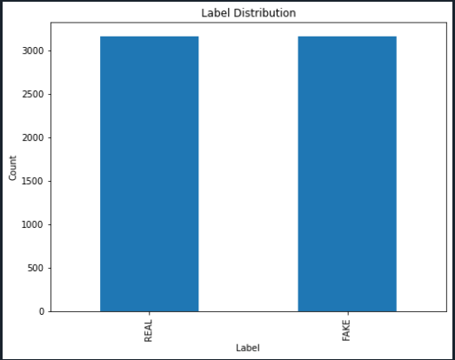
2. Label Distribution
This is done to explore the distribution of labels (real vs. fake news) to understand the balance of classes in the dataset. This is crucial for assessing potential biases and imbalances that could impact the performance of our fake news detection model.
The output shows the count of each unique label in the dataset's 'label' column. There are 3171 instances labeled as "REAL" and 3164 instances labeled as "FAKE". This indicates a relatively balanced distribution, with just 7 more instances labeled as "REAL" compared to "FAKE". Such balance is crucial for training a reliable fake news detection model, ensuring it learns from a representative sample of both real and fake news articles.

Slide 8
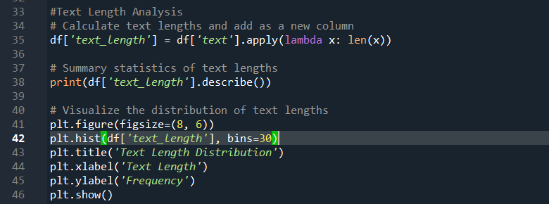
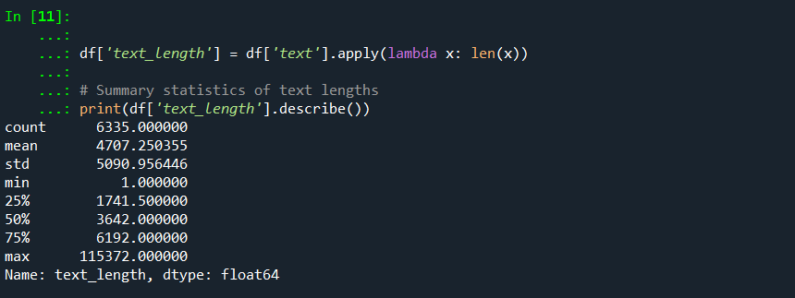
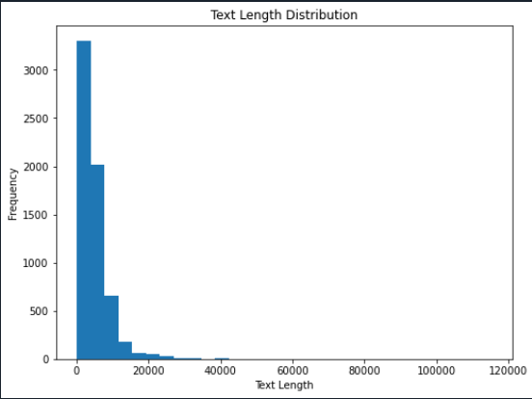
3.Text Length Analysis
This helps to analyze the distribution of text lengths (e.g., number of words or characters) for real and fake news articles. Understanding these distributions can reveal patterns and aid in feature engineering for improved model accuracy.
The dataset comprises 6335 news articles with an average length of approximately 4707 characters and a wide variation, ranging from 1 to 115,372 characters, highlighting the need for preprocessing and outlier handling.

Slide 9
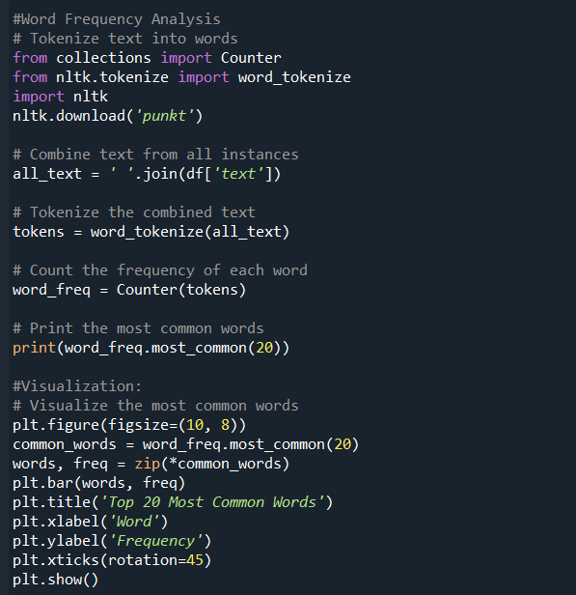
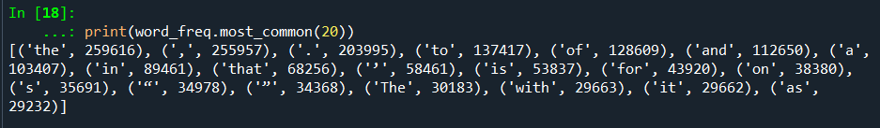
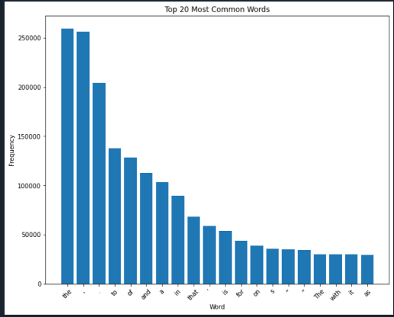
4.Word Frequency Analysis:
This helps in identifying the most frequent words in both real and fake news articles.
We couldn’t really interpret any thing from this as the returned results show basic words like the ,an etc which do not provide considerable insights.

Slide 10
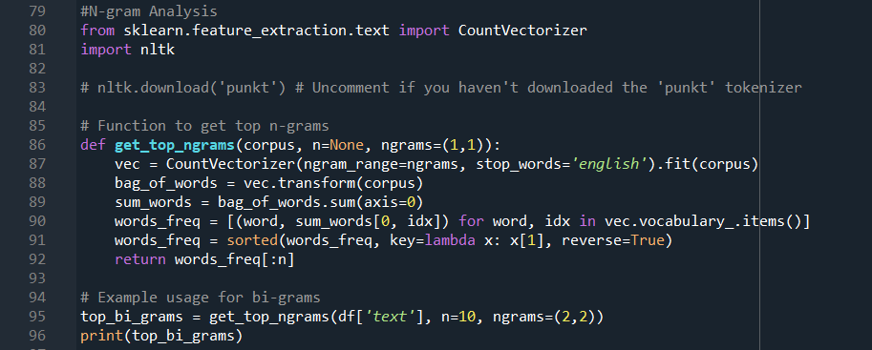
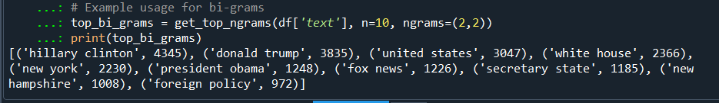
5. N-gram Analysis:
N-gram analysis is conducted to uncover patterns and relationships between words in the text data. This analysis aids in feature extraction and model building for fake news detection by capturing linguistic nuances and contextual information.
This output demonstrates the top 10 bi-grams (pairs of adjacent words) along with their frequencies in the text data. By identifying these frequent bi-grams, such as "hillary clinton" and "donald trump," we gain insights into the key topics or themes discussed in the text. This analysis aids in understanding the prominent subjects and can be utilized to uncover patterns or sentiments within the dataset, contributing to more informed analyses and interpretations.

Slide 11
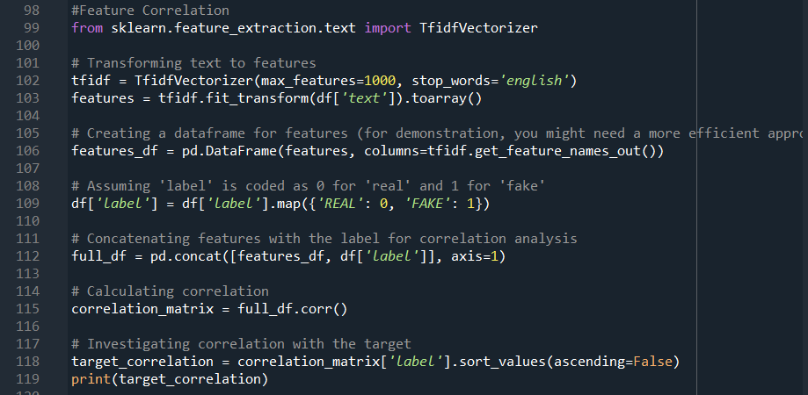
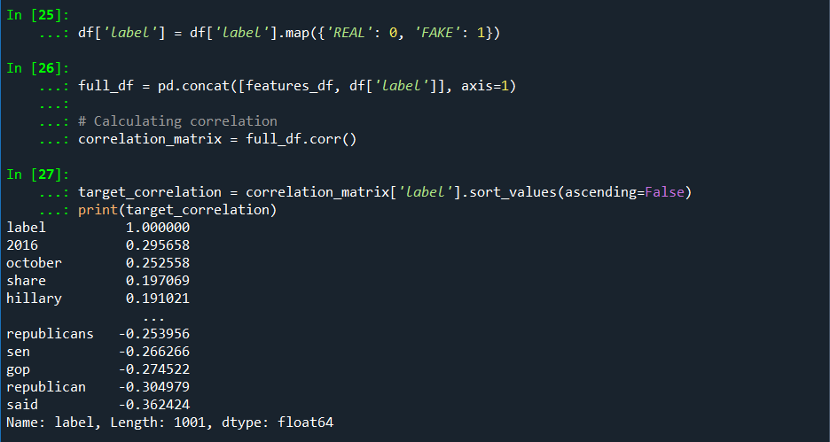
6.Feature Correlation
Exploring feature correlations helps us understand the relationships between different attributes (e.g., text length, word frequency) and the target variable (real or fake news). By analyzing these correlations, we can identify which features are most influential in determining the authenticity of news articles.
Correlation coefficients reveal the relationship between features and the target variable. Positive values indicate a tendency towards fake news, while negative values suggest real news association. For instance, "hillary" and “share" correlate positively with fake news, while "republican" and "said" correlate negatively, implying real news association.

Slide 12
Agile Methodology for Fake News Detection
Iterative Development:
Rapidly prototype and refine detection models in short iterations.
Continuously improve algorithms based on evolving patterns of fake news.
Continuous Feedback:
Gather feedback from users and stakeholders to enhance the accuracy and effectiveness of detection algorithms.
Adapt quickly to emerging trends and new types of fake news.
Collaboration and Transparency:
Foster collaboration between data scientists, domain experts, and stakeholders.
Transparent communication ensures alignment with project goals and user needs.
Flexibility to Change:
Embrace changes in requirements and priorities based on real-time insights.
Adjust detection strategies to address evolving challenges in the fake news landscape.
Focus on Value Delivery:
Deliver incremental value with each iteration, prioritizing features with the highest impact on fake news detection.
Continuously assess and prioritize tasks to maximize the project's overall value.

Slide 13
Project Success Factors for Fake News Detection
Robust Data Collection: Ensure diverse and reliable data sources, rigorous preprocessing for quality.
Advanced ML Algorithms: Utilize NLP, deep learning for accurate pattern identification.
Continuous Model Evaluation: Regularly assess model performance, refine based on metrics.
Collaboration with Experts: Engage journalists, fact-checkers for insights, context.
Ethical Considerations: Address privacy, fairness, mitigate bias in algorithmic design.
User Engagement: Foster active participation, feedback loop for continuous improvement.

