Slide 1
Revive
Bhakti Bharat Desai
Divyasree Gandikotta
Meghna Allam
Sai Sravani Pillarisetty

Slide 2
Agenda
OBJECTIVE 3
CONTRIBUTION 4
TECHNOLOGY USED 5
FEATURES 6
REFERENCES 9

Slide 3
Objective
Having a platform to pour down your thoughts just the way you feel is what helps one organize and clear their mind. This application is focused on decluttering the mind which is piled up with millions of thoughts and helps to bring you back to a stable state.
Letting out all the thoughts present in the mind and having a daily check on yourself gives you a relieved/liberating feeling and also one gets a clear understanding of what they are going through and what must be their main focus/priority and then work in an organized way to keep their thoughts and the mind filled with positivity.

Slide 4
Contributions
Bhakti Bharat desai
Backend Connections
Architecture
Draft-js
DIVYAsREE GANDIKOTTA
UI Design
Notes Component
Activities Component
SAI SRAVANI PILLARISETTY
Sign In/Sign Up Page
Quotable API
Draft-js
MEGHNA ALLAM
UI Design
User Dashboard
Relax Component

Slide 5
Technology Used
Node
Express
Mongoose & MongoDB database in cloud (Atlas)
React and Redux
Local Storage
Axios, Fetch
SCSS
JWT

Slide 6
Features
Login and Register using JWT Tokens
CRUD operations in Journal using external npm package Draft-js
Viewable Quotes using External API - Quotable
CRUD and Local Storage in Text Editor(Daily Check-In)
Relax focus timer

Slide 7
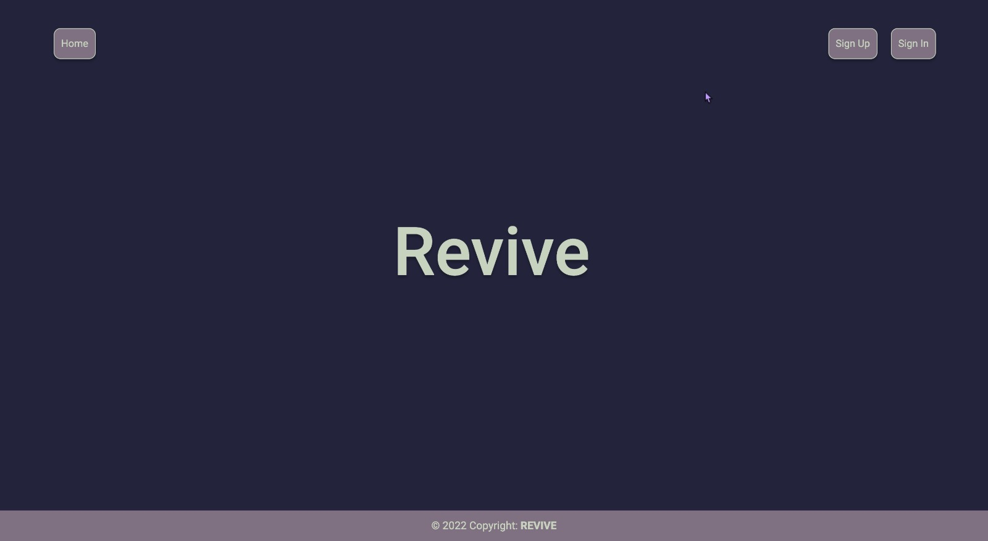
Landing Page

Slide 8
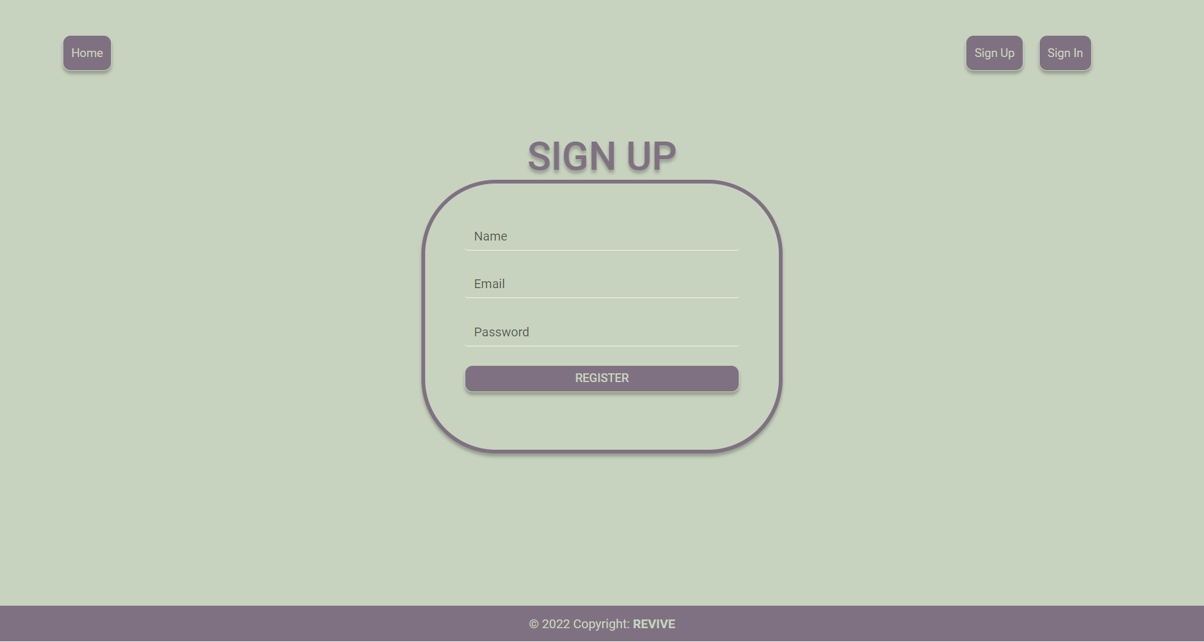
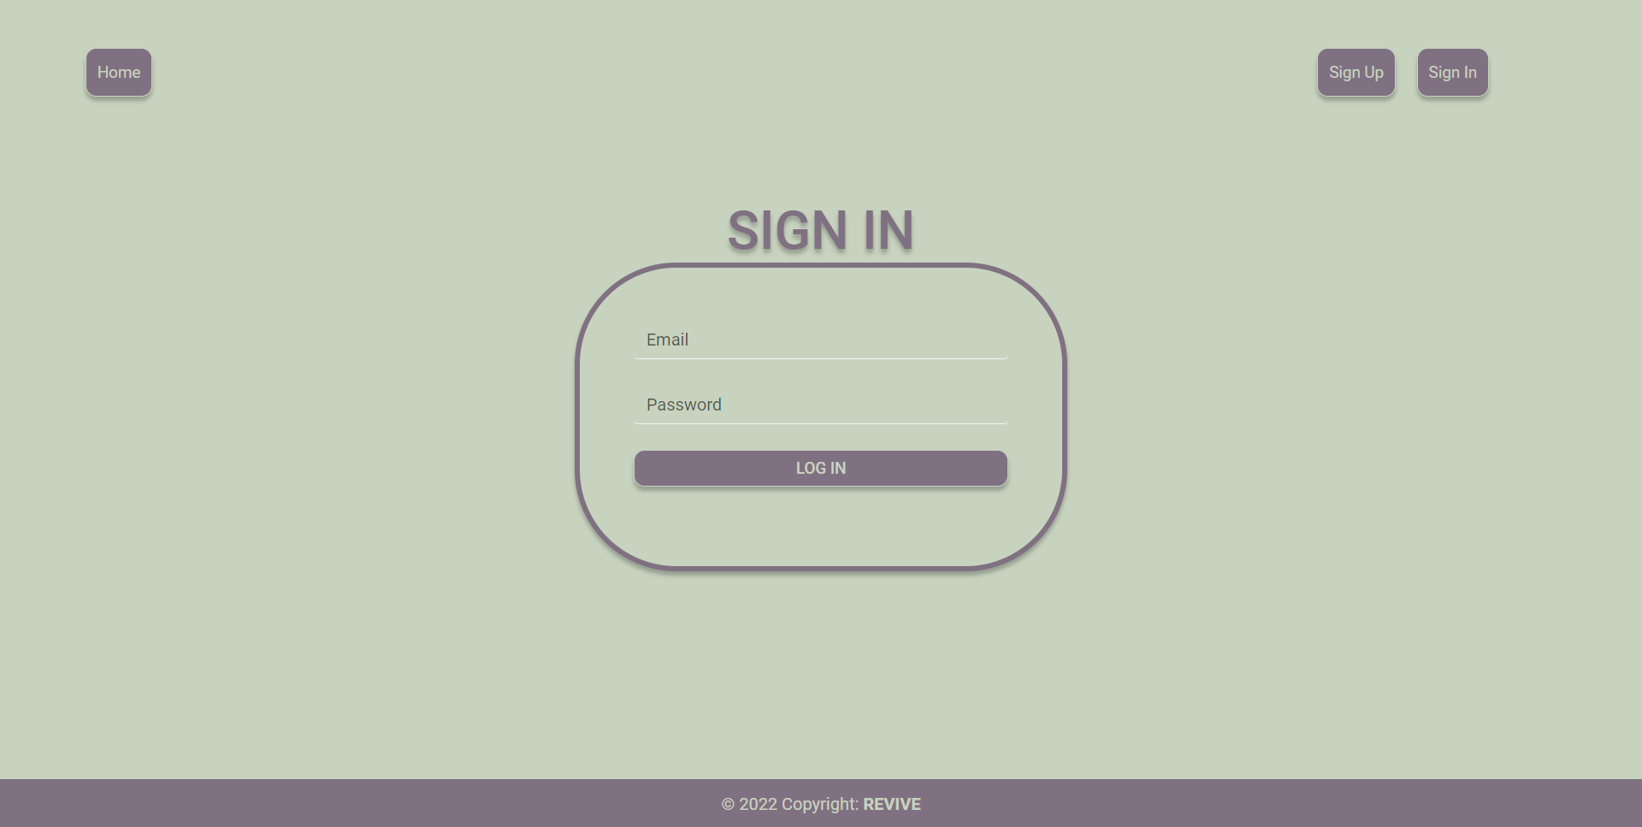
Sign Up/Sign In

Slide 9
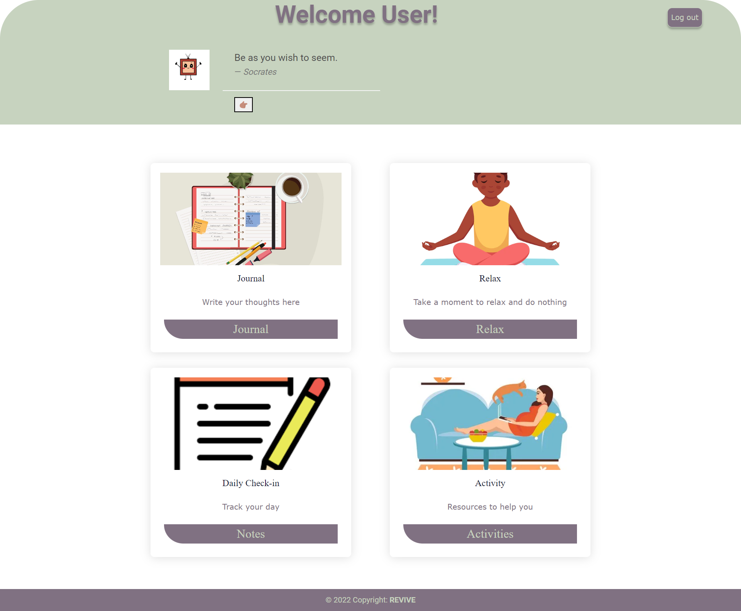
User Dashboard

Slide 10
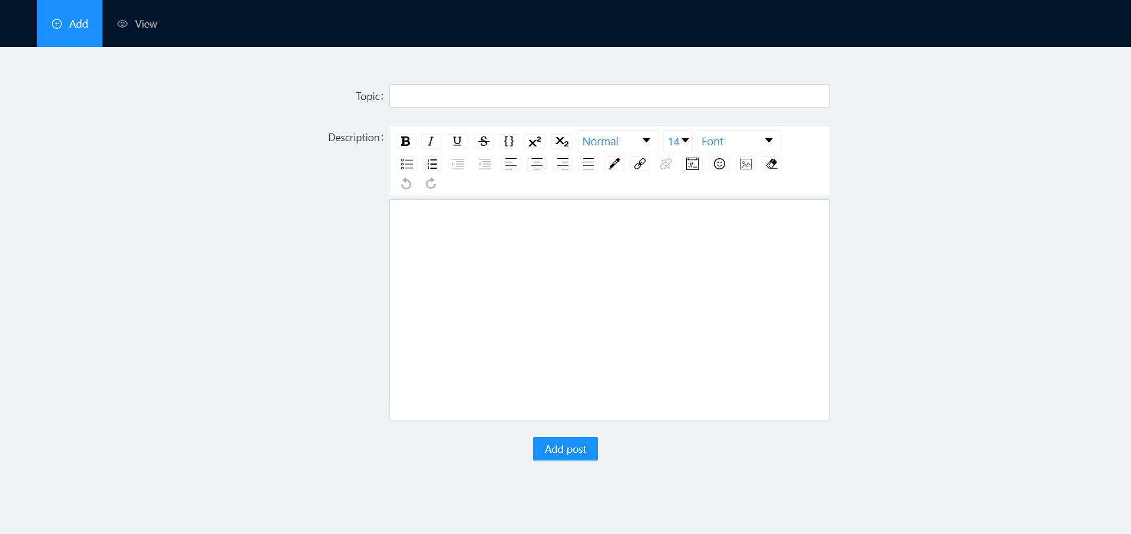
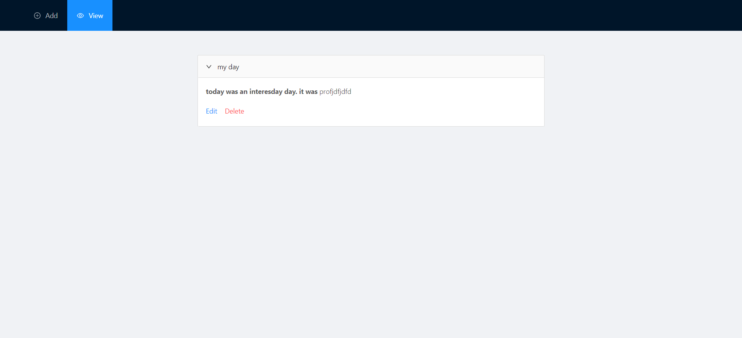
Journal

Slide 11
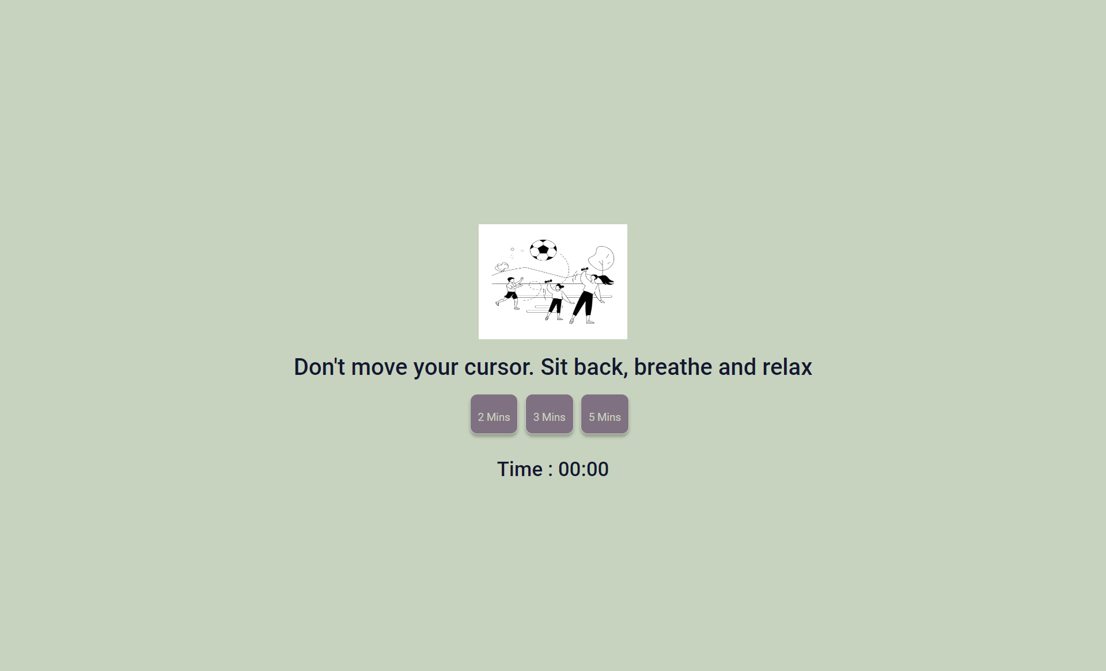
Relax

Slide 12
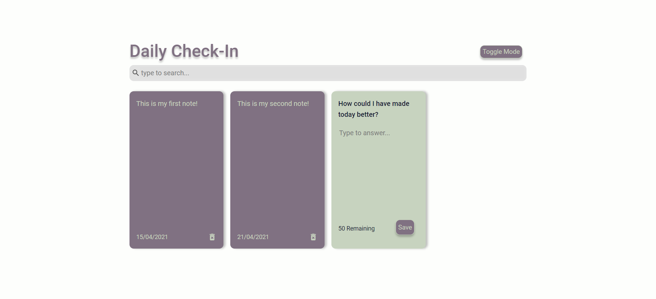
Daily Check-In

Slide 13
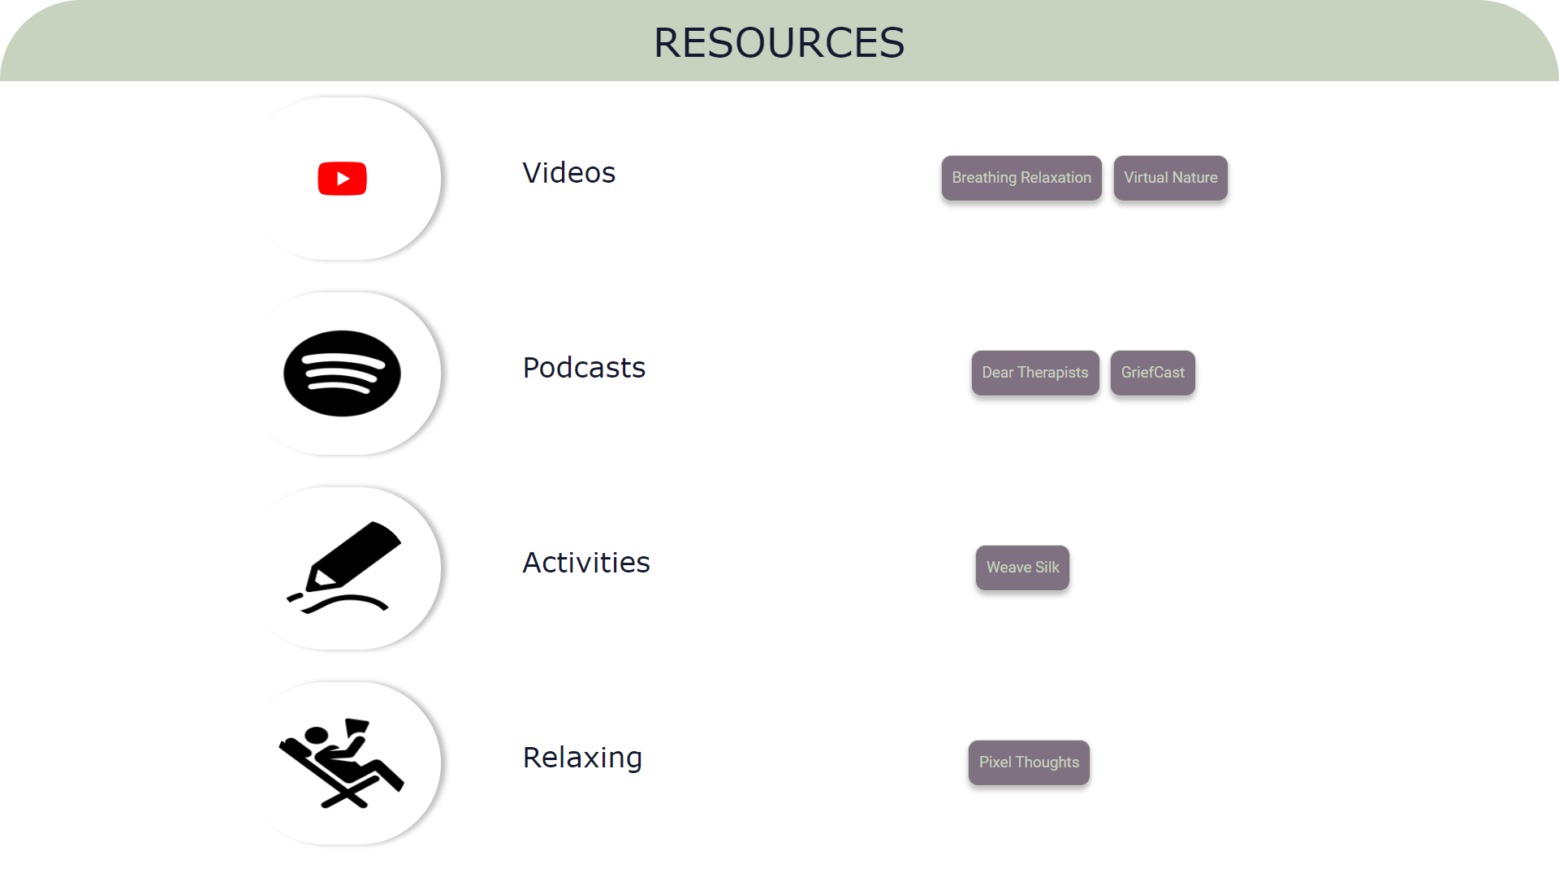
Activities

Slide 14
References
https://developer.mozilla.org/en-US/docs/Web/JavaScript/Guide
https://jwt.io/
https://reactjs.org/

Slide 15
Thank you ☺

