Slide 1



MCP and Custom tools enabled Personal Assistant
Jaypee University of Information Technology
Department of Computer Science and Engineering and Information Technology
Major Project - I (18B19CI791) | AY 2025-26
End-Term Evaluation | December 2025.
Group No.: 44
Team Member (s)
Meghna Mankotia (221030146)
Nikhilesh Sharma (221030003)
Shashvat (221030117)
Yuvraj Saini (221030233)
Supervisor
Name: Prof. Dr. Pradeep Kumar Gupta
Designation: Professor, Department of CSE & IT

Slide 2
Outline
Introduction
Problem Statement
Objectives
Literature Review
Work Done (after Mid-Term Evaluation)
Project Design
Tools, Technologies and Languages
Dataset
Implementation
Experimental Results and Evaluation
Key Learnings
Work Contribution and Attendance
Supervisor Interactions
Future Work
Project Plan
References

Slide 3
Introduction
The rapid growth of AI and NLP has enabled intelligent systems that help automate tasks, manage workflows, and enhance productivity. LLM-based personal assistants have become a key part of this progress, offering context-aware and efficient support for everyday activities.
This project introduces a customizable personal assistant built with the Mastra TypeScript framework. It uses Google’s Gemini Flash (Gemini Pro 2.5 API) as the core LLM, providing strong reasoning, conversational capabilities, and adaptability.

Slide 4
Problem Statement
Conventional personal assistants are restricted to basic tasks like answering questions or performing simple actions, and they cannot manage complex workflows. They also fail to integrate well with real-world productivity tools, making them inadequate for professional and academic use. As a result, there is a strong need for a scalable, customizable assistant that unites LLM-based reasoning with tool access, enabling automated document processing, task execution, and greater workflow efficiency.

Slide 5
Objectives
Design and implement a customizable AI personal assistant using the Mastra framework and Gemini Flash LLM for advanced reasoning and conversation.
Automate repetitive tasks such as scheduling, reminders, and document management to save time.
Integrate with Google Docs & Drive via GCP APIs for seamless access, editing, and retrieval of files.
Provide context-aware assistance that adapts to user behavior and preferences.
Improve productivity and efficiency in professional and academic workflows.
Demonstrate scalability and usability for potential real-world deployment.
Create a flexible system that can be extended with additional APIs and functionalities in the future.

Slide 6
Literature Review
S. No. | Author & Paper Title [Citation] | Journal/ Conference (Year) | Tools/ Techniques/ Dataset | Key Findings/ Results | Limitations/ Gaps Identified
1. | V. Chaturvedi et al. “Development of a Virtual Personal Assistant for Enhanced Productivity and Efficiency“ | International Journal of Scientific Research & Engineering Trends (2024) | Evaluate available AI technologies, including NLP, ML, and voice recognition, to determine the most suitable for VPA development. | VPA systems largely bring about betterment in daily life.They can do lots of things, like opening apps, searching the web, setting alarms, and playing music, just by listening to your voice. | The use of VPAs can pose several ethical risks.
2. | M. Garg et al. “Virtual Personal Assistant using Artificial Intelligence” | International Journal of Creative Research Thoughts (2022) | Speech-to-Text and Text-to-Speech features. Use of Mel Frequency | The VPA provides a single point of communication for all of the user's messages, contacts, schedule, and information sources, reducing interruptions and enhancing time utilization. | Time taken to compute each task is generally longer than other VPAs
3. | S. Hosseini et al. “The role of agentic AI in shaping a smart future: A systematic review” | Array 26 (2025) : Available on Sciencedirect | Identifies LangGraph, CrewAI, AutoGen and AutoGPT as most commonly used tools. | Adopt tools/frameworks that support agentic features. Evaluate tools based on features, not only hype. Differentiates between assistants and autonomous agents. | A lack of industry specific case studies, which can help build more tailor made assistants.
4. | P. S. Sawant “Agentic AI: A Quantitative Analysis of Performance and Applications” | Journal of Advances in Artificial Intelligence (2025) | Consists of a Perception module, Cognitive module, Action module and Learning(Reinforcement) module. | Across many organizations, agentic AI shows significant gains over more traditional AI systems. | Data Privacy and Security, Integration with Legacy Systems, Skill Gap, Ethical Considerations

Slide 7
Literature Review (cont…)
S. No. | Author & Paper Title [Citation] | Journal/ Conference (Year) | Tools/ Techniques/ Dataset | Key Findings/ Results | Limitations/ Gaps Identified
5. | Y. Shavit, S. Agarwal, M. Brundage et. al. “Practices for Governing AgenticAI Systems” | OpenAI whitepaper (2023) | Evaluate Suitability for the Task, Setting Agents’ Default Behaviors. | Governance across the life-cycle (developer, deployer, user) is crucial. Simpler measures are practical near-term steps. | Operationalization Uncertainty, Trade-offs Between Safety vs Usability / Cost, Dependence on Context & Domain
6. | Arun Kumar N, Valarmathy B – AI Based Virtual Assistant | International Research Journal of Modernization in Engineering, Technology and Science (IRJMETS), Vol. 05, Issue 03, March 2023 | - Python libraries - Speech recognition APIs - Speech-to-text model - NLP techniques | - Developed a Windows-based AI virtual assistant capable of executing commands through voice input (e.g., sending emails, reminders, WhatsApp messages) | Mainly designed for Windows system (platform-limited). Lacks large-scale testing and evaluation. Limited detail on performance metrics
7. | Shubham Thorbole, Anuradha Pandit, Gayatri Raut, Tejas Sirsat — AI-Based Desktop Voice Assistant | Journal of Emerging Technologies and Innovative Research (JETIR), Vol. 10, Issue 5, May 2023 | - Python (OOPs, high-level language) - Speech Recognition - Pyttsx3 - Que.py | - Implemented Jarvis AI, a desktop-based voice assistant. - Understands natural language, executes tasks (e.g., open YouTube, send mail, fetch Wikipedia info). - Enhances productivity by automating repetitive tasks. | Ethical & privacy issues. Limited scalability to complex decision-making compared to commercial assistants
8. | Sakshi R. Jain, Prof. Feon Jason — Personal Desktop Voice Assistant - Research Paper | International Journal of Advanced Research in Computer and Communication Engineering (IJARCCE), Vol. 12, Issue 3, March 2023 | - Python - Google Speech-to-Text & gTTS -SpeechRecognition library - NLP (NLTK, spaCy, CoreNLP) | - Designed for visually impaired users and seniors for accessibility. - Enhances independence, usability, and productivity. - Case study shows healthcare potential (patient outcomes, cost reduction). | Requires stable internet for APIs (web search, weather, music). Privacy & security concerns with data collection. Limited multimodal interaction

Slide 8
Literature Review (cont…)
S. No. | Author & Paper Title [Citation] | Journal/ Conference (Year) | Tools/ Techniques/ Dataset | Key Findings/ Results | Limitations/ Gaps Identified
9. | Gayatri Nair, Soumya Johnson, V. Sathya — Chatbot as a Personal Assistant | International Journal of Applied Engineering Research (IJAER), Vol. 13, No. 20, 2018 | - Java (Eclipse IDE) - AIML (Artificial Intelligence Markup Language) - Pattern Matching, NLP, ANN - APIs (Google Calendar, Gmail) | - Proposed ResumeBot: chatbot-based interactive resume. - Functions as a personal assistant: scheduling meetings, managing calendars, answering queries. | Accuracy limitations in pattern matching Lacks continuous learning. Limited to text-based chat, less voice integration.
10. | Khalid M. Jaber, Mohammed Laf, Mohammad A. Jawad A Comparative Study for Virtual Personal Assistants (VPA) | IJCESEN, Vol. 10, No. 3, 2024 | NLP, ASR Comparative study Literature-based review | Google Assistant best in interaction; Alexa weakest Siri & Cortana use NLP + CI Device-specific compatibility | Weak human-like interaction Privacy/security risks Device exclusivity (e.g., Siri on Apple only)
11. | Shuaihang Chen et al. — A Survey on LLM-based Multi-Agent System: Recent Advances and New Frontiers in Application [arXiv:2412.17481] | arXiv preprint (2024, revised 2025) | Looked at many research papers, grouped them into categories, compared systems and uses | • Gave a clear definition and types of LLM-based Multi-Agent Systems (MAS) • Showed how they are used: solving complex problems, simulations, evaluations • Pointed out challenges like coordination, alignment, and communication | No new experiments, only a review May miss very new works (fast-moving field) Does not measure or compare actual performance in detail
12. | Satyadhar Joshi — Review of Autonomous and Collaborative Agentic AI and Multi-Agent Systems for Enterprise Applications [PhilPapers record] | International Journal of Innovative Research in Engineering and Management, Vol. 12, No. 3 (2025) | Reviewed about 65 papers, grouped by themes like architecture, collaboration, governance | • Explained how enterprise AI is moving from passive tools to active autonomous agents • Shared reported efficiency gains (40–60%) in business processes • Stressed need for governance, collaboration, and human supervision | Efficiency numbers are only from other sources, not tested by the author Very high-level discussion, little technical detail Doesn’t deeply discuss risks like scalability or failures

Slide 9
Literature Review (cont…)
S. No. | Author & Paper Title [Citation] | Journal/ Conference (Year) | Tools/ Techniques/ Dataset | Key Findings/ Results | Limitations/ Gaps Identified
13. | A. Singh et al. — SafeMate: A Model Context Protocol-Based Multimodal Agent for Emergency Preparedness | arXiv preprint (2025) | Model Context Protocol (MCP), multimodal agents, tool integration (retrieval, summarization, checklists) | Demonstrates MCP as a framework for integrating multiple tools, enabling an emergency assistant to respond dynamically. Validates MCP’s scalability in real-world applications | Still early-stage, limited to emergency preparedness scenario. Needs broader validation across domains
14. | D. Madotto et al. — Plug-and-Play Conversational Models | EMNLP Findings (2020) | Plug-and-Play Language Models, controllable generation, API-based modular design | Shows how conversational systems can flexibly integrate features or tools without retraining the entire model. | Primarily tested on text-based tasks; lacks evaluation on multi-modal or real-time assistants
15. | S. Hosseini et al. — Insert-expansions for Tool-enabled Conversational Agents | arXiv preprint (2023) | Insert-expansion method, tool-augmented dialogue systems | Improves coherence of conversations when agents invoke external tools, ensuring minimal disruption to flow. | Needs large-scale deployment studies; mostly lab experiments
16. | A. Sharma et al. — AI Based Virtual Personal Assistant | International Journal of Innovative Science and Research Technology (IJISRT), 2024 | Python-based implementation, Speech Recognition, Pattern Matching for intents, API integrations (News, YouTube, Weather, Search) | Developed a functional voice-controlled assistant capable of executing basic tasks (e.g., searching, fetching news, playing YouTube, providing location info). | Uses rule-based intent parsing (less scalable), lacks MCP or standardized tool integration, limited evaluation (no accuracy/latency metrics), narrow scope of supported tasks, basic journal

Slide 10
Literature Review (cont…)
S. No. | Author & Paper Title [Citation] | Journal/ Conference (Year) | Tools/ Techniques/ Dataset | Key Findings/ Results | Limitations/ Gaps Identified
17. | Shanshan Han, Qifan Zhang, Yuhang Yao et al. — LLM Multi-Agent Systems: Challenges and Open Problems | arXiv (2024) | Survey of multi-agent LLM systems, context & memory modeling, task allocation, tool invocation | Presents a structured overview of major challenges in designing multi-agent LLM systems: how to decompose tasks, allocate work, share context and memory, coordinate tool usage | Being a survey, it does not propose a concrete MCP-based implementation; lacks experimental validation or detailed case studies. Focus is general MAS rather than focused personal assistant design
18. | M. Hasan et al. “Model Context Protocol (MCP) at First Glance: Studying the Security and Maintainability of MCP Servers” | arXiv Preprint (2025) | Analyzed ~1,900 open-source MCP servers for security and maintainability | Found MCP adoption is growing, but many servers have vulnerabilities like outdated dependencies and tool poisoning | Focuses only on open-source MCP servers, not enterprise/closed systems
19. | S. Rasal “A Multi-LLM Orchestration Engine for Personalized, Context-Rich Assistance” | arXiv Preprint (2024) | Architecture with multiple LLMs, graph database, and vector database; supports orchestration and iterative reasoning | Improves personalization, reduces hallucinations, handles multi-step workflows better | Requires high computing resources; still experimental for large-scale real-world use
20. | J. Zhang et al. “WorkflowLLM: Enhancing Workflow Orchestration Capability of Large Language Models” | arXiv Preprint (2024) | Built WorkflowBench dataset of real-world workflows; fine-tuned WorkflowLlama model | Boosts LLM ability to manage multi-step tasks, cross-API workflows, and orchestration | Dataset still limited in scope; real-world deployment challenges remain

Slide 11
Work Done (after Mid-Term Evaluation)
Created a vector query tool- uses Google’s text embedding 4 model, to find embeddings from the vector database that match the context. Returns top 5 results to the agent.
Create a mind maps tool- saves a snapshot of the mind map locally. Mermaid script is created by the LLM and rendered using Puppeteer.
Wrote a research paper under the supervision of our mentor.

Slide 12
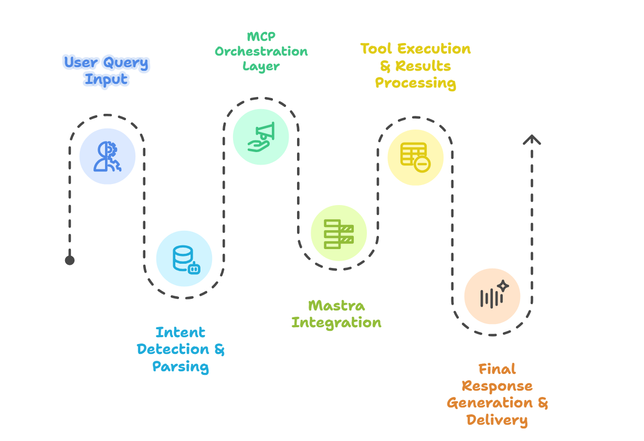
Project Design (cont…)
AI Agent Workflow

Slide 13
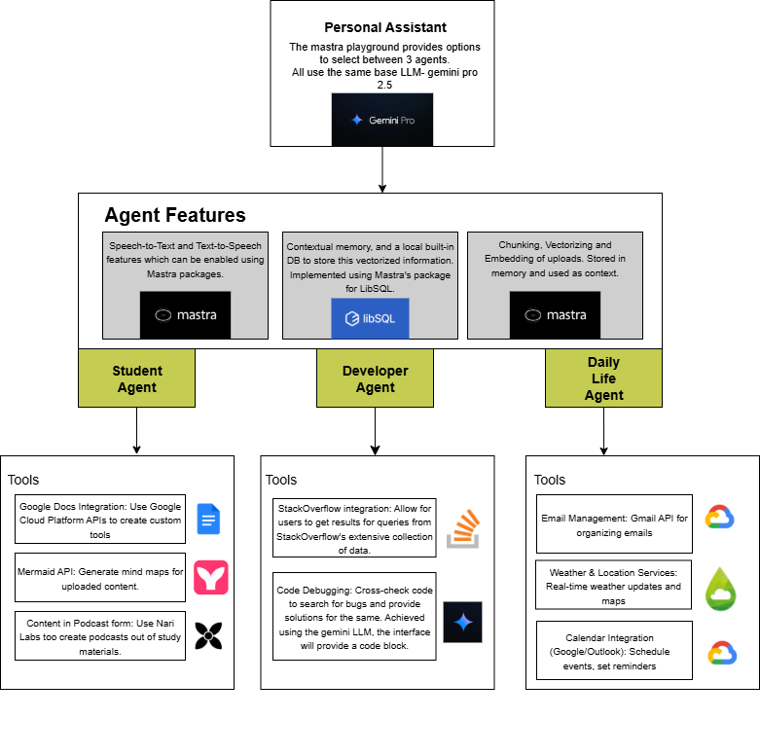
Project Design (cont…)
System Design

Slide 14
Tools, Technologies and Languages
Framework & Base Language Model
Component | Description | Version / Details
Framework | Mastra(TypeScript Framework) | Latest stable version
Base LLM Model | Google Gemini Flash | Gemini Pro 2.5
Programming Languages | TypeScript, JavaScript | TypeScript 5.x / JavaScript ES2023

Slide 15
Tools, Technologies and Languages (cont…)
Tools & APIs
Tool / Integration | Purpose | Version / Details
Google Docs Integration | Read, write, and manage Google Docs | Google Docs API v1, Drive API v3
Google Cloud Platform API | Authentication & API management | Gemini Pro 2.5
Custom Tools | User-defined automation functions | N/A (built-in via Mastra)

Slide 16
Dataset

Slide 17
Implementation
APIs & Tools:
Google Docs & Drive API – authentication & integration, used to create a Write/Create google doc tool for a student agent in Mastra.
Vector Query – Uses google’s text embedding 4 model to search uploaded documents and returns the top 5 results.
Mind Maps – Mermaid.js library is used to generate mermaid script for mind maps which is rendered using puppeteer and saved locally as a png screenshot.
Workflow:
User Query Input – user initiates the process with a query
Intent Detection & Parsing – Gemini analyzes the query to extract intent
MCP Orchestration Layer – MCP decides which tools are needed
Mastra Integration – Mastra executes the selected tools
Tool Execution & Results Processing – external tools perform tasks and return results
Final Response Generation & Delivery – AI composes and delivers response to the user

Slide 18
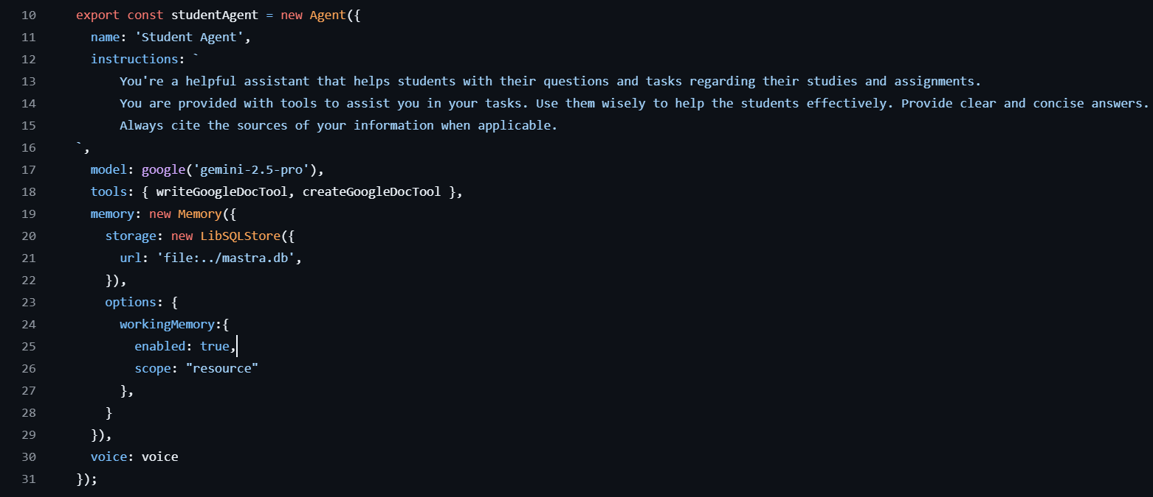
Implementation (cont…)
Code Snippets
Main Components
Student Agent (Mastra + Gemini 2.5 Pro)

Slide 19
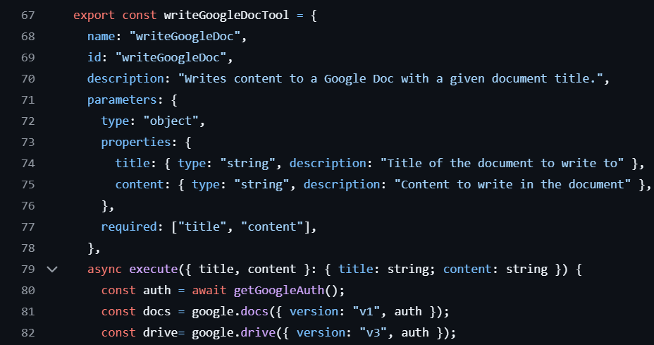
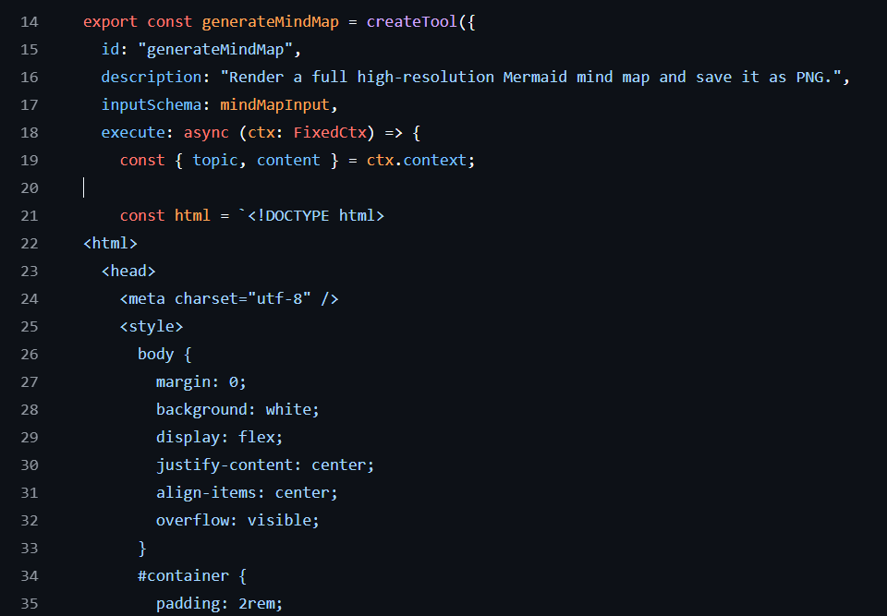
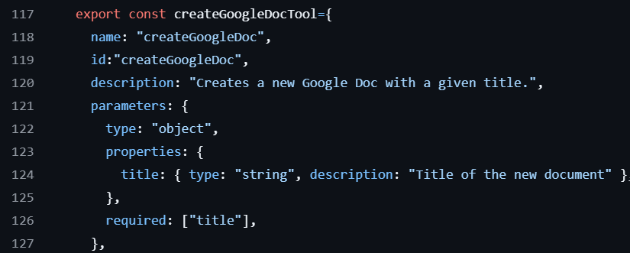
Implementation (cont…)
Tool Layer
  Google Docs Tools:
  MindMap Tool:

Slide 20
Implementation (cont…)
Workflow With Code Interaction
User Query → Agent
studentAgent
→ Gemini identifies intent
→ MCP decides required tool
Tool Execution
Google Docs Tools
getGoogleAuth() → OAuth2
drive.files.list() → find doc
batchUpdate() OR documents.create()
Mind Map Tool
Mermaid script injected into HTML
puppeteer.launch() → render SVG
Screenshot saved as PNG
Vector Query Tool
embedContent() → embedding
store.query() → top-K chunks

Slide 21
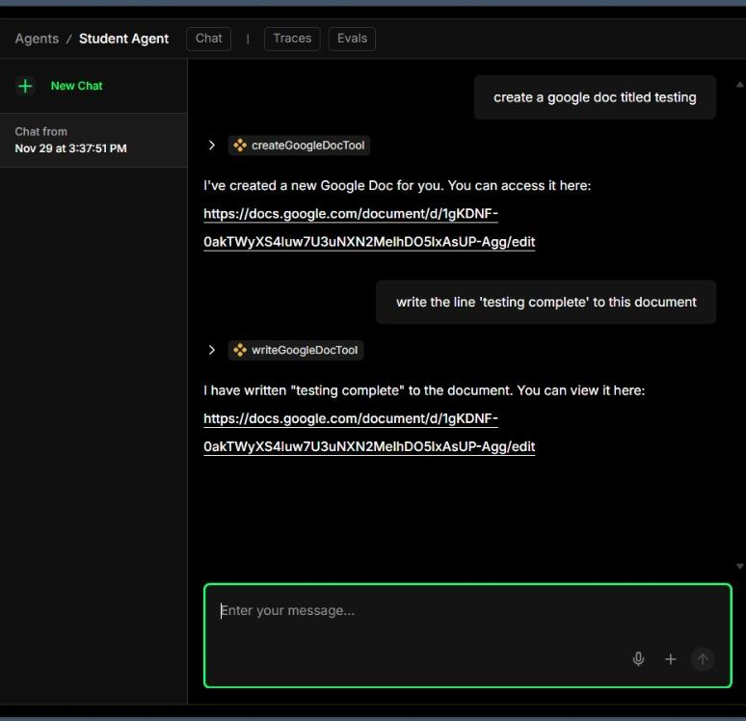
Experimental Results and Evaluation (cont…)
createGoogleDocTool
The create google docs tool completes the OAuth to access the user’s drive
Then it creates the desired doc using docs.documents.create.
writeGoogleDocTool
Searches for the desired file from the list of files in the drive.
Write the content to the file using the batchUpdate method.

Slide 22
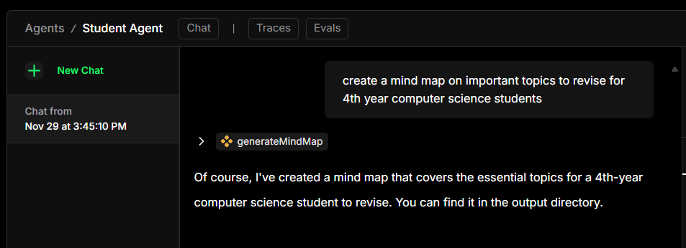
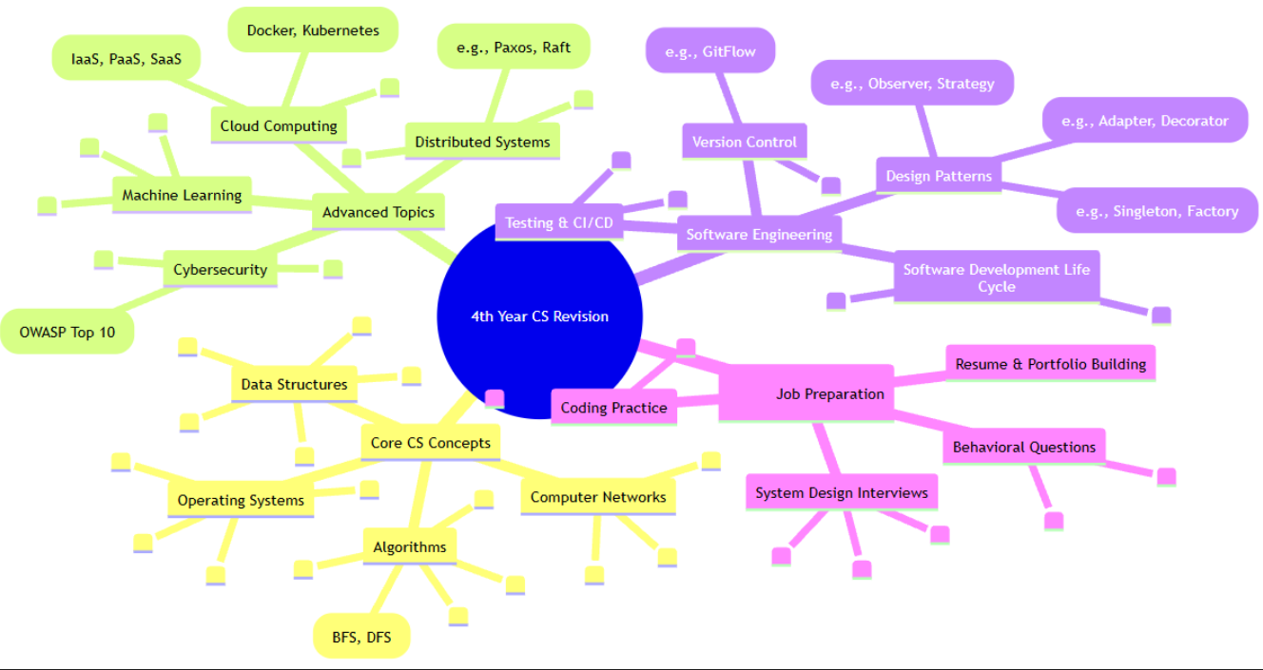
Experimental Results and Evaluation
generateMindMap
Title and nodes created by gemini
Title and nodes sent to the tool in the form of input.
Mermaid script for the map created using Mermaid JS.
The script is rendered within HTML using Puppeteer.
A screenshot of the map is saved to the local output directory.

Slide 23
Experimental Results and Evaluation (cont…)
Metric Observed | Performance
Average Response Accuracy | 0.92
Average Latency (sec) | 1.8
Tool Invocation Success Rate | 95.2%
OAuth Authentication Success Rate | 100%

Slide 24
Key Learnings
Technical Concepts & Skills
Gained expertise in MCP (Model Context Protocol) for secure LLM-to-tool integration
Worked with Mastra (TypeScript Framework) for building modular assistants
Applied Google Gemini Flash (Pro 2.5) for natural language understanding and task automation
Hands-on with Google Docs & Drive APIs (authentication, document handling, automation)
Improved skills in API integration, workflow automation, and prompt engineering
Learned about Puppeteer, a tool to automate Chrome and Firefox.
Methodologies
Designed a modular architecture for extensibility with custom tools
Applied NLP-driven workflows for task automation
Focused on secure API management using GCP
Outcomes
Open-source contribution: Shared custom tool modules for integration

Slide 25
Work Contribution and Attendance
GitHub Repository URL: link
Team Member | Roll No. | Work Done (provide complete details) | Work Contribution (%) | Lines of Code (if any) | Lab Attendance (%)
1. | 221030146 | Literature Review Created Student and Developer agent Worked on research paper, report and ppt | 25 | 421 | 91
2. | 221030003 | Literature Review Worked on research paper, report and ppt Designed overall project methodology and structured workflow Worked on Student agent | 25 | 31 | 90
3. | 221030117 | Literature Review Worked on research paper, report and ppt Helped the team and worked on the project. | 25 |  | 95
4. | 221030233 | Literature Review Helped the team and worked on the project. Worked on research paper, report and ppt | 25 |  | 90

Slide 26
Supervisor Interactions (as mentioned in weekly log)
No. of Meetings with Supervisor: 9
Week No. | Duration | Remarks (as mentioned in the weekly log) | Incorporated (Yes/No)
1. | 21/08/2025 to 28/08/2025 | N/A | Yes
2. | 15/09/2025 to 20/09/2025 | Make methodology and workflow diagram Start draft report Complete literature review | Yes
3. | 22/09/2025 to 27/09/2025 | Update methodology and workflow diagram Make changes to ppt as discussed Make changes to report as discussed | Yes
4. | 29/9/2025 to 04/10/2025 | Validate design with other models | Yes
5. | 27/10/2025 to 01/11/2025 |  | Yes

Slide 27
Supervisor Interactions (cont…)
Week No. | Duration | Remarks (as mentioned in the weekly log) | Incorporated (Yes/No)
6. | 02/11/2025 to 08/11/2025 | Submitted a research paper to supervisor Writing is under processing | Yes
7. | 09/11/2025 to 15/11/2025 | Experimental Results Discuss it on 24th November | Yes
8. | 16/11/2025 to 22/11/2025 | Discussed results as observed from experiments | Yes
9. | 23/11/2025 to 29/11/2025 | Updates received in paper at overleaf | Yes
10. | dd/mm/2025 to dd/mm/2025

Slide 28
Future Work
Integrate StackOverflow API for developer use.
Create Daily Life agent to handle user calendars, weather updates and email management using the GCP and other APIs.
Automate the personal assistant by making it completely voice activated and introducing hand gestures using media pipe.
Scope out other possible tools that can incorporated to increase productivity.

Slide 29
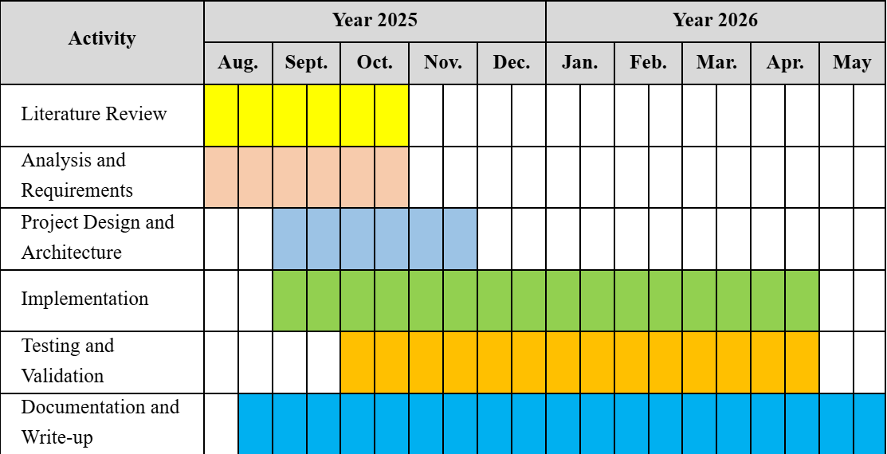
Project Plan

Slide 30
References
[1] V. Chaturvedi, S. S. Tripathi, A. Pateria, H. P. Chakrapani, M. Yadav, and V. Rathore, "Development of a virtual personal assistant for enhanced productivity and efficiency," Int. J. Sci. Res. Eng. Trends (IJSRET), vol. 10, no. 2, Mar.–Apr. 2024.
[2] M. Garg, K. Bala, and S. Sharma, "Virtual personal assistant using artificial intelligence," Int. J. Creative Res. Thoughts (IJCRT), vol. 10, no. 12, Dec. 2022.
[3] S. Hosseini and H. Seilani, "The role of agentic AI in shaping a smart future: A systematic review," Array, vol. 26, p. 100399, May 2025.
[4] P. D. Sawant, "Agentic AI: A quantitative analysis of performance and applications," J. Adv. Artif. Intell., vol. 3, no. 2, pp. 132–140, May 2025.
[5] Y. Shavit, S. Agarwal, M. Brundage, S. Adler, et al., "Practices for governing agentic AI systems," OpenAI, Dec. 14, 2023.
[6] A. Kumar N. and B. Valarmathy, "AI based virtual assistant," Int. Res. J. Modern. Eng., Technol. Sci. (IRJMETS), vol. 5, no. 3, Mar. 2023.

Slide 31
References (cont…)
[7] S. Thorbole, A. Pandit, G. Raut, and T. Sirsat, "AI-based desktop voice assistant," J. Emerg. Technol. Innov. Res. (JETIR), vol. 10, no. 5, May 2023.
[8] S. R. Jain and F. Jason, "Personal desktop voice assistant," Int. J. Adv. Res. Comput. Commun. Eng. (IJARCCE), vol. 12, no. 3, Mar. 2023.
[9] G. Nair, S. Johnson, and V. Sathya, "Chatbot as a personal assistant," Int. J. Appl. Eng. Res. (IJAER), vol. 13, no. 20, 2018.
[10] K. M. Jaber, M. Laf, and M. A. Jawad, "A comparative study for virtual personal assistants (VPA)," Int. J. Comput. Eng. Social Eng. Netw. (IJCESEN), vol. 10, no. 3, 2024.
[11] S. Chen et al., "A survey on LLM-based multi-agent system: Recent advances and new frontiers in application," arXiv preprint, 2024, revised 2025.
[12] S. Joshi, "Review of autonomous and collaborative agentic AI and multi-agent systems for enterprise applications," Int. J. Innov. Res. Eng. Manage., vol. 12, no. 3, 2025.
[13] A. Singh et al., "SafeMate: A model context protocol-based multimodal agent for emergency preparedness," arXiv preprint, 2025.

Slide 32
References (cont…)
[14] D. Madotto et al., "Plug-and-play conversational models," in Findings of the Assoc. Comput. Linguistics: EMNLP 2020, 2020.
[15] S. Hosseini et al., "Insert-expansions for tool-enabled conversational agents," arXiv preprint, 2023.
[16] A. Sharma et al., "AI based virtual personal assistant," Int. J. Innov. Sci. Res. Technol. (IJISRT), 2024.
[17] S. Han, Q. Zhang, Y. Yao, et al., "LLM multi-agent systems: Challenges and open problems," arXiv preprint.
[18] M. Hasan et al., "Model context protocol (MCP) at first glance: Studying the security and maintainability of MCP servers," arXiv preprint, 2025.
[19] S. Rasal, "A multi-LLM orchestration engine for personalized, context-rich assistance," arXiv preprint, 2024.
[20] J. Zhang et al., "WorkflowLLM: Enhancing workflow orchestration capability of large language models," arXiv preprint, 2024.

Slide 33

Thanks.

