Slide 1



ANDROID APPLICATION DEVELOPMENT
Nirbhaya-A ray of hope
Presented By
Anannya Chandra
Arnab Ghosh
Meghna Nag
Ovijeet Sircar
Pranay Dassarma
Under the Guidance of
Naveen Reddy.Y
DEPARTMENT OF INFORMATION TECHNOLOGY
MEGHNAD SAHA INSTITUTE OF TECHNOLOGY
2012-2016

Slide 2
ABSTRACT OF THE PROJECT
“Nirbhaya – A Ray Of Hope” helps the user when he is in some trouble or difficult situations by easing up the tensed situation with the help of user friendly technology.
In this proposed system, the recipients and the content of the message are predefined by the user in the leisure time. So, when he/she is in some danger by just opening the app and pressing the HELP button they can get there desired help.

Slide 3

ABSTRACT OF THE PROJECT
Two additional features which are included in the application are SOS call feature and Custom Message.
In SOS call, few contacts like Hospital, Ambulance, Fire Brigade, Police Stations are by default stored in the application. In the case of any emergency, we just need to press the respective buttons and the help will be in our doorsteps.
in the custom message fragment we can send SMS to any number which are not present in our recipient list which is required at times when the desired recipients are not available.

Slide 4
Existing SYSTEM
In the existing system, that is prevalent and is commonly used by the greater mass of Android mobile users, the user has to write the message content that is to be send in detail and the select the contacts and only then he can send the message.
This methodology, though popular, takes up a lot of time for a user to express his thoughts.
But what if the user does not have that much of time for the said method or he is unable to do it in the given difficult circumstances.
2

Slide 5
PROPOSED SYSTEM
In the proposed system, the user, using the Nirbhaya App, stores his three most reliable contact before hand by uploading it to a database. writes the message content and also selects the contacts to which the message has to be sent and save it.
So, when he is in some sort of a danger, he can bring it to himself by just opening the app and pressing the SOS button. So that he can receive the help in correct time.
This action enables a relevant stored message to be sent to those numbers he has added in the application.
This feature ensures that the user can receive help in the current time.
An additional feature allows the user to rapidly connect to an array of emergency services via an in build calling feature.
The app can also be used as a conventional messenger
2

Slide 6
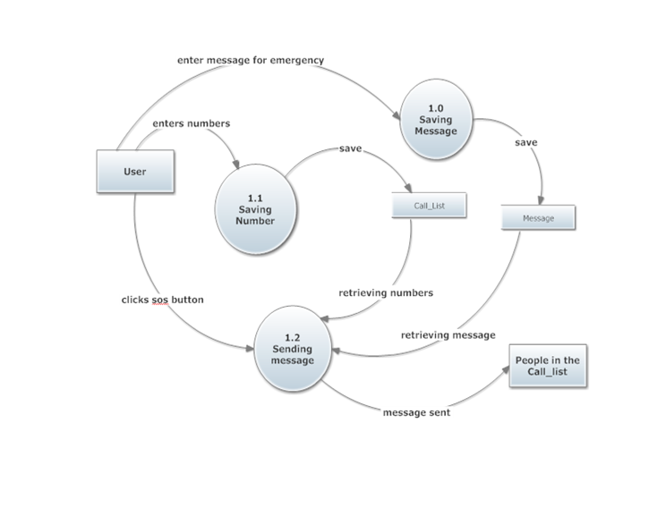
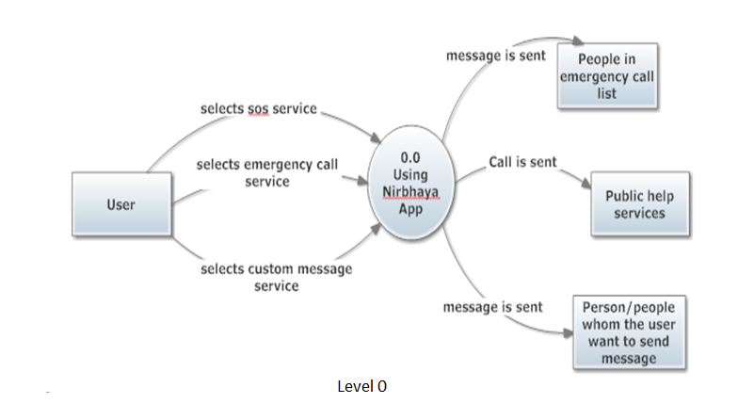
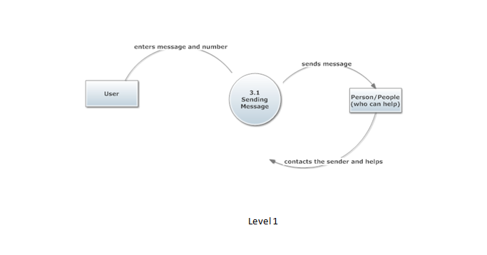
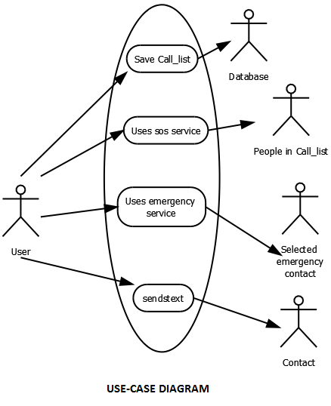
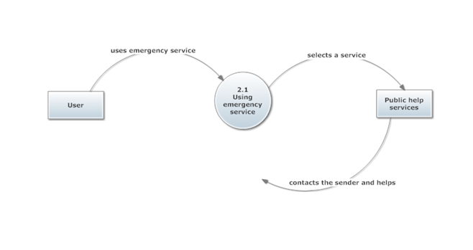
UML DIAGRAMS

Slide 7

TECHNOLOGIES USED IN THE PROJECT
Hardware Requirements
Processor :Intel (R) Core TM (R) I3 – 4005U @ 1.7GHz
RAM :4.00 GB (2.5GB RAM usable)
System Type :32 – bit Operating System and above, x64–based processor
Software Requirements
Operating System :Windows 7 and above.
Developing Tool : JDK 8
Developing Software : SDK Tool 24.0.2
IDE : Eclipse Mars
Database : SQLite Database

Slide 8


BRIEF DESCRIPTION OF THE TECHNOLOGIES
SQLite Database
SQLite is a software library that implements a self-contained, server less , zero- configuration, transactional SQL database engine. SQLite is the most widely deployed database engine in the world.
Eclipse Mars
In computer programming, Eclipse is an integrated development environment (IDE). It contains a base workspace and an extensible plug-in system for customizing the environment. Written mostly in Java, Eclipse can be used to develop applications. By means of various plug-ins.

Slide 9
WHAT IS ANDROID?
Modules are a series of discrete, isolated entities which are bound together as a greater whole by the project definition.
The modules used in this project are :
1. A SQLite database.
2. SMS feature.
3. Calling feature.
2

Slide 10
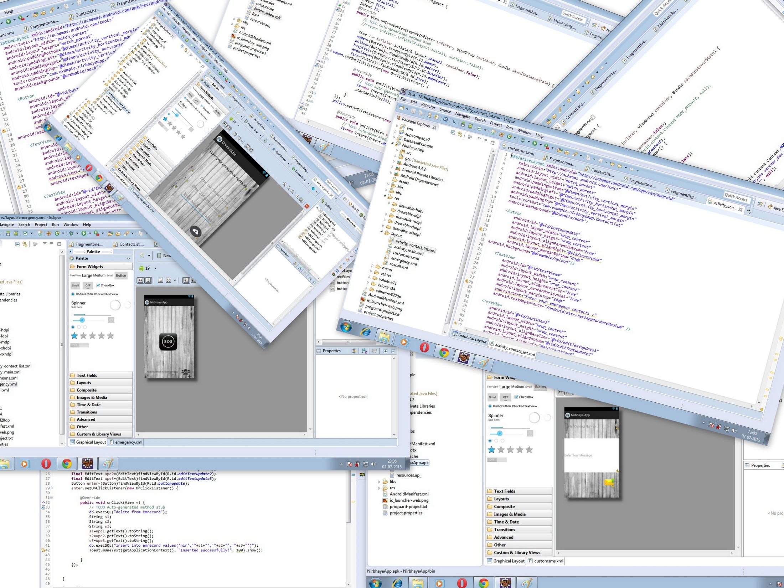
SCREENSHOTS

Slide 11
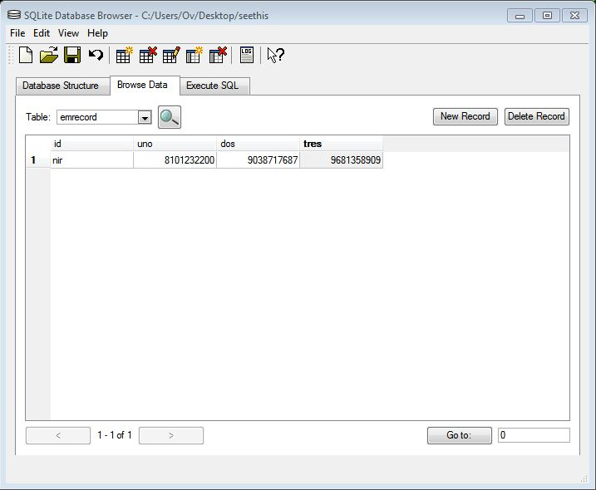
DATABASE SCHEMA

Slide 12
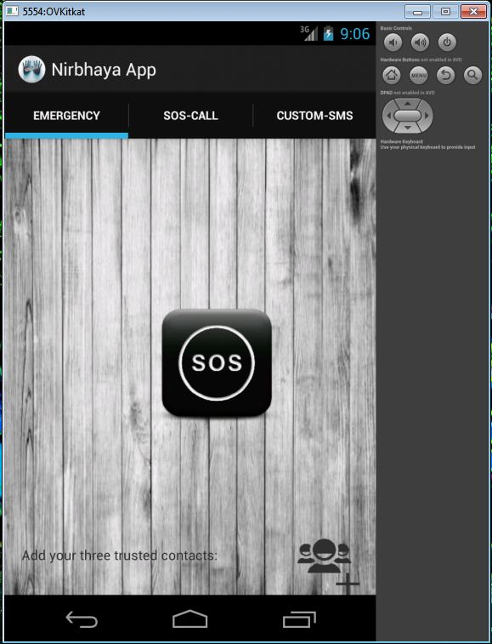
EMERGENCY

Slide 13
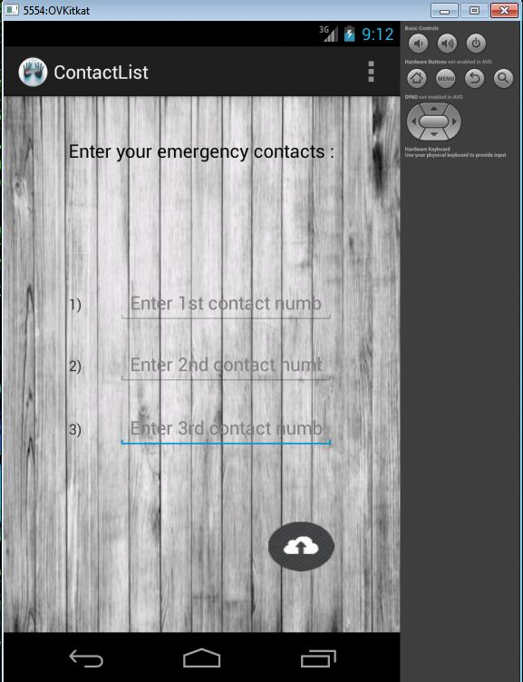
UPDATE CONTACT LIST

Slide 14
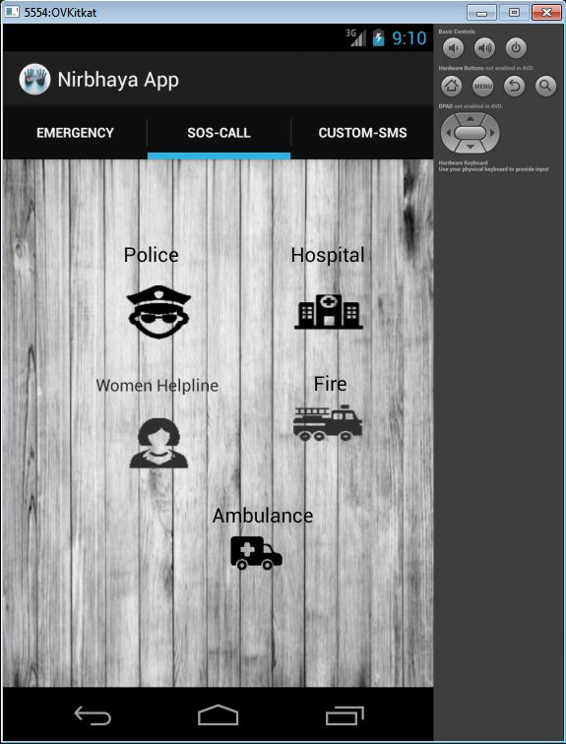
SOS CALL

Slide 15
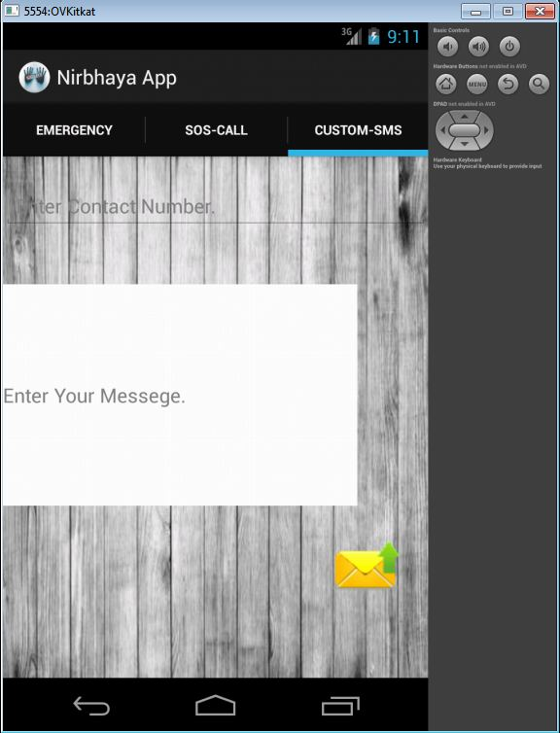
CUSTOM SMS

Slide 16
CONCLUSION
Future scope
Why We will use this app?
We are looking forward to make more user friendly by creating a widget application of out Nirbhaya App that is nothing but a shortcut of button on the home screen which will make this application more efficient and effective to use for safety .
We are working on creating a service through our application which will send message to the selected contacts on pressing the power button twice.
We are also looking forward to combined GPS service to this application for fetching the user’s exact location.
We conclude that this application can prove to be very useful for human safety.
This application can rescue people from hazardous situation.
Developing this application helped us in learning basic android application development.
As most of the people have turned towards using a smartphone, so the android application development is proved to be beneficial

Slide 17



