Slide 1


IMAGE ENCRYPTION AND IMAGE TO IMAGE STEGANOGRAPHY

Slide 2

Objective
The objective of the proposed work is to use technology like clouds for storage of medical data of the patients along with the provision of 2 layered security with the usage of technologies like image encryption and image to image steganography.

Slide 3
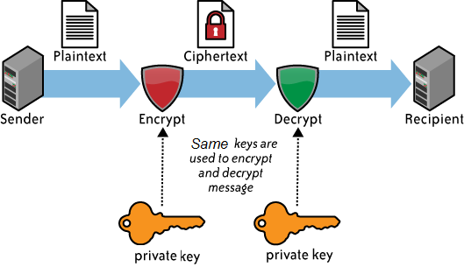
What Is Image Encryption ?
Image encryption plays an important role in the field of information hiding.
Image encryption method makes information unreadable. Therefore no hacker or eavesdropper , including server administrator and others , have access to original image or any other type of transmitted information through public network such as internet.

Slide 4
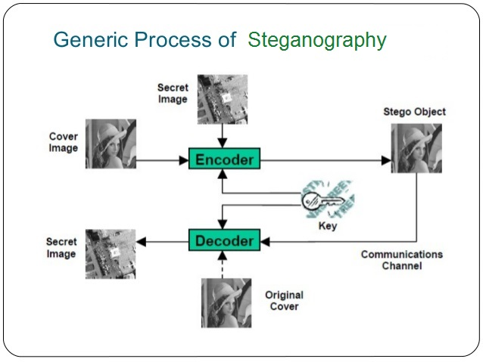

What Is Steganography ?
Steganography is the art and science of writing hidden message in such a way that no one apart from the intended recipient knows of the existence of the message.

Slide 5

Cloud Computing
cloud computing is a huge collection of inter connected network, our proposed work is to provide security to cloud network.
Cryptography is an effective way of protecting sensitive information as it is stored on media or transmitted through network communication paths .

Slide 6
Image to Image Steganography
The secret image hides into a cover image by applying the embedding algorithm using a secret key -the result is the Stego image.
The Stego Image is sent through the channel to the authorized recipients to whom secret image needs to be transferred.
On the receiver side the stego image receives, and by applying the reverse algorithm and the secret key the secret image extracted from the cover image.

Slide 7
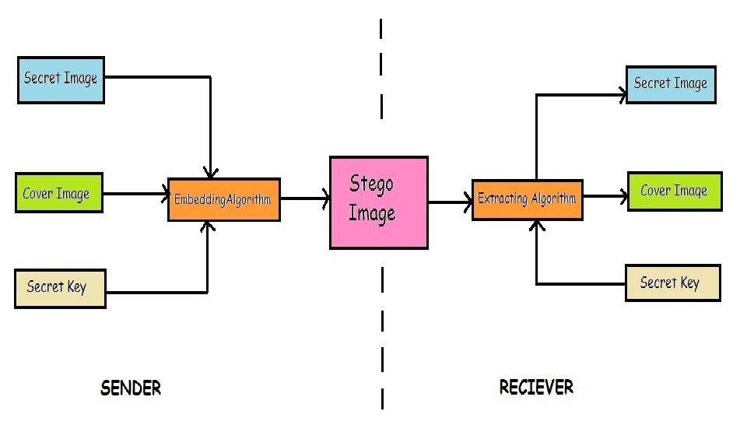
Image to Image Steganography

Slide 8
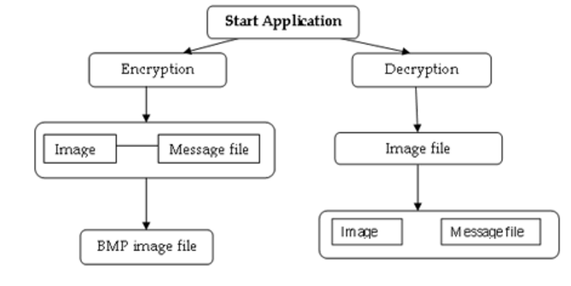
Working Principle

Slide 9
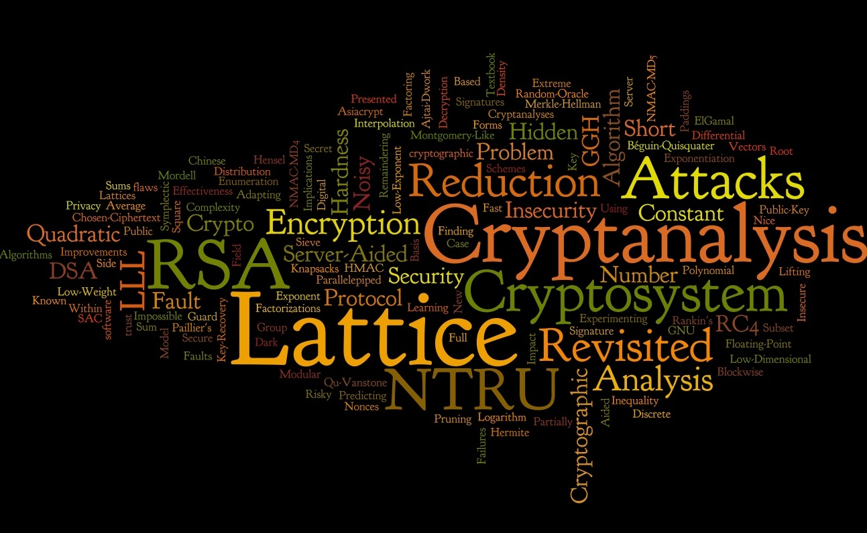
Working Principle
encrypting the image and then embedding it in cover image by Image to Image steganography
In receiving end, the receiver first applies reverse steganography and then decrypts it to retrieve the original image.

Slide 10

Algorithms
IMAGE ENCRYPTION
IMAGE PROCESS
EMBEDDING ALGORITHM
REVERSE STEGANOGRAPHY
IMAGE DECRYPTION

Slide 11
Image Encryption Algorithm
global Img ;
global EncImg;
global key;
EncImg = imageProcess(Img,key);
imshow(EncImg);
imwrite(EncImg, ‘Encrypted.jpg’, ‘jpg’);

Slide 12
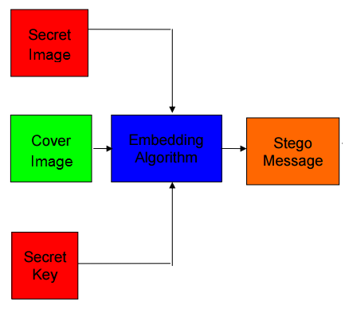
Embedding Algorithm: LSB Substitution

Slide 13
Decryption Algorithm
global DecImg;
global EncImg;
global key;
DecImg = imageProcess(EncImg,key);
Imshow(DecImg);
imwrite(DecImg, ‘Decrypted.jpg’, ‘jpg’);

Slide 14

Advantages of Steganography
Used in the way of hiding not the information but the password to reach the information.
Difficult to detect.
Can be applied differently in digital image, audio and video file.
It can be done faster with the large number of soft wares.

Slide 15

Disadvantages of Steganography
Huge number of data, huge file size, so someone can suspect about it.
If this technique is gone in the wrong hands such as terrorists, hackers, criminals then this can be very much dangerous for all.

Slide 16

Conclusion
Security is an important issue while transferring data using internet because any unauthorized user can hack the data and make it useless or know information unintended to him.
The future work of this project is to encrypt a text message in an image and hide it in an cover image. Then at the receiving end that message can be decrypted using the reverse steganography technique.

Slide 17

Presentation by : Anannya Chandra (Roll no-14200212001) Meghna Nag (Roll no-14200212024) Nidhi Kumari (Roll no-14200212027) Sourav Das (Roll no-14200212048)

