Slide 1
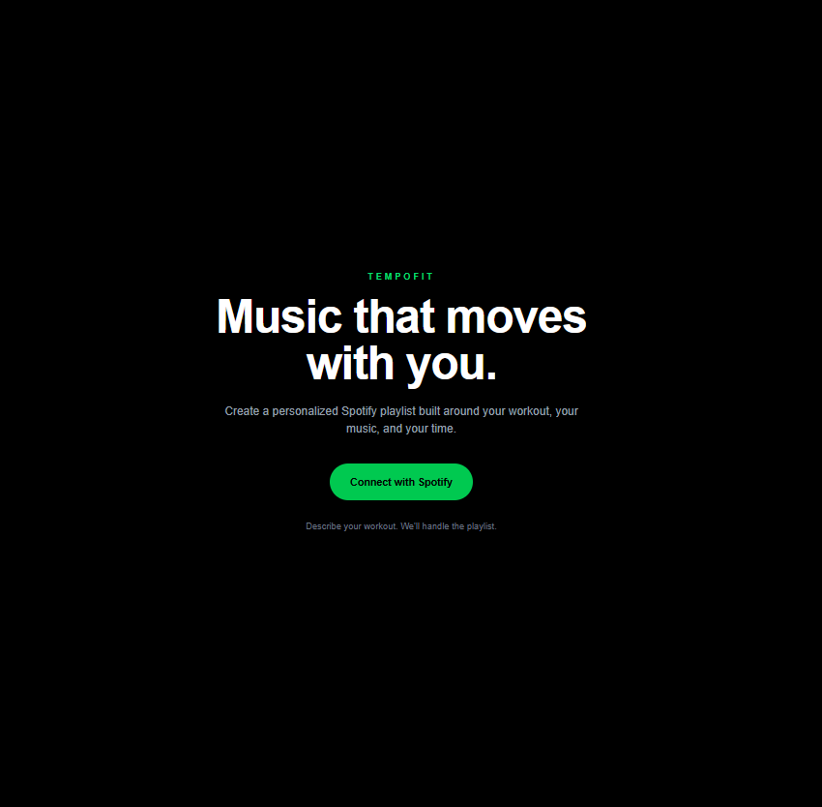
TEMPOFIT
Music that moves
with you.
A Spotify-integrated workout playlist generator that turns natural-language workouts, music preferences, and target duration into a structured playlist.
Product case study • Next.js • TypeScript • Spotify Web API • OAuth
Role: Product strategy, UX, architecture, implementation, QA
01

Slide 2
TEMPOFIT
Problem → Product Opportunity
TempoFit was scoped as a portfolio MVP: small enough to ship, but complete enough to demonstrate product and integration decisions.
THE PROBLEM
THE USER NEED
THE MVP
Workout playlists are often static. Users still have to search, sequence songs, and manually estimate whether a playlist fits the workout.
Describe the workout once, keep control over genre and familiarity, and get a playlist that roughly matches the workout’s duration and phases.
Spotify connection + preferences + natural-language workout input + phase-based playlist generation + regenerate + save to Spotify.
Deliberate non-goals
• No Apple Music or multi-provider support
• No native mobile app, social features, wearables, or monetization
• No production database or ML recommendation model
• Focus: prove the end-to-end product experience and technical architecture
02

Slide 3
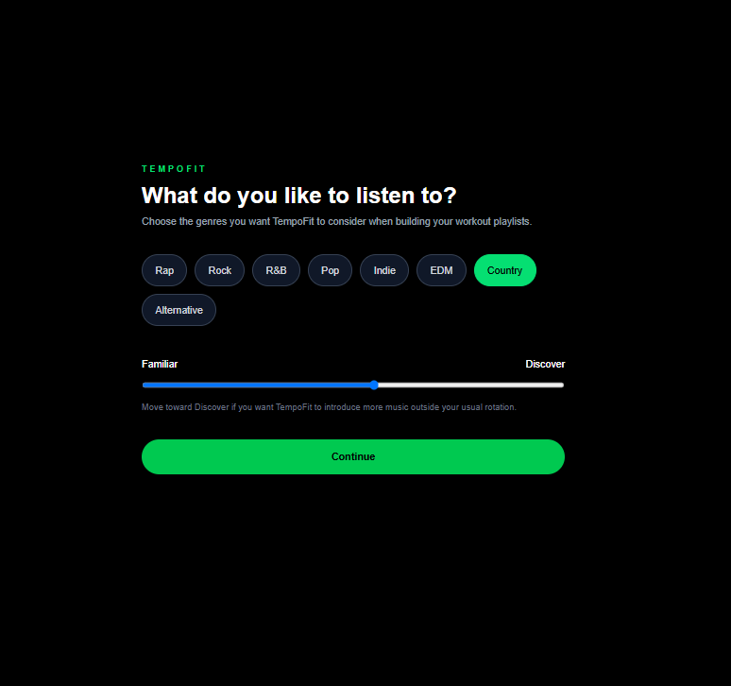
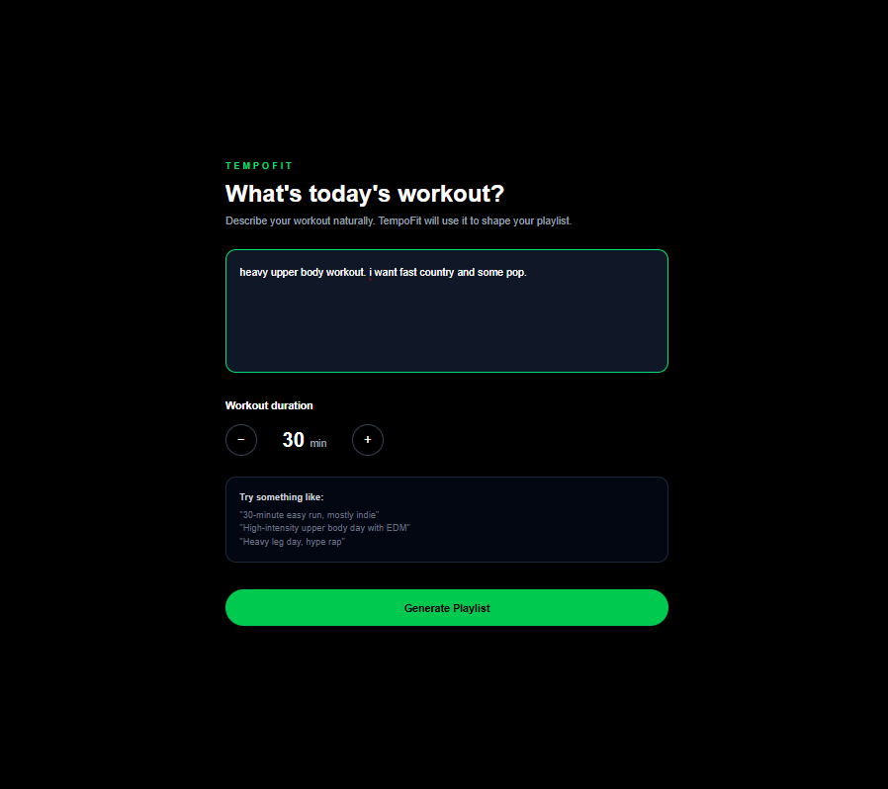
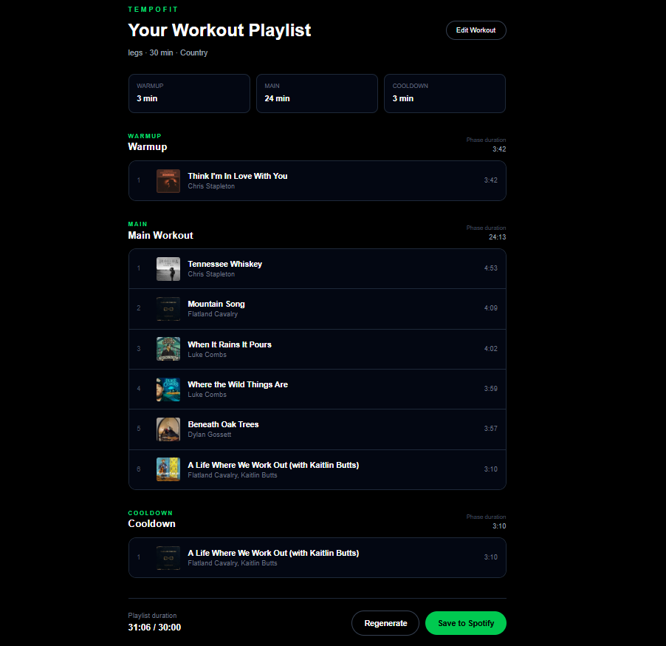
TEMPOFIT
End-to-End Product Flow
The experience intentionally stays linear: connect → personalize → describe workout → review → save.
1 CONNECT
2 PERSONALIZE
3 DESCRIBE
4 REVIEW + SAVE
03

Slide 4
TEMPOFIT
System Architecture
A deliberately lightweight architecture: client-side preferences, server-side Spotify calls, deterministic parsing and playlist generation.
WORKOUT PARSER
AUTH LAYER
Natural language →
structured parameters
Spotify OAuth
Access + refresh tokens
USER
NEXT.JS UI
SPOTIFY
Workout + duration
Genres + discovery
App Router
React + TypeScript
Web API
PLAYLIST ENGINE
SEARCH / SAVE
Warmup / main / cooldown
Duration matching
Track search
Create private playlist
Key implementation choices
• Preferences stored in localStorage for the MVP; no database required.
• Spotify Client Secret remains server-side; OAuth uses a local redirect callback.
• Automatic refresh-token flow recovers when the access token expires.
• Recommendation behavior is rule-based and explainable rather than ML-driven.
04

Slide 5
TEMPOFIT
Constraints → Engineering Decisions
The hardest part was not building more features; it was adapting the product when the external API could not support the original recommendation approach.
CONSTRAINT
DECISION
WHY IT MATTERED
01
Spotify recommendation / audio-analysis limitations
Reworked recommendation architecture around curated Familiar vs. Discover artist pools and Spotify Search.
Preserved user control without depending on restricted endpoints.
02
Workout duration is not equal to exact song lengths
Split playlists into warmup, main, and cooldown targets, then selected tracks with deterministic duration heuristics.
Generated playlists that stay close to the requested workout length.
03
OAuth access tokens expire
Implemented a refresh-token endpoint and retry path rather than forcing the user to reconnect.
Maintained the playlist flow after token expiration.
04
External API calls can fail or return weak results
Added fallback behavior, regeneration, and test coverage around search, auth, and playlist creation.
Made failures recoverable instead of dead-ending the experience.
05

Slide 6
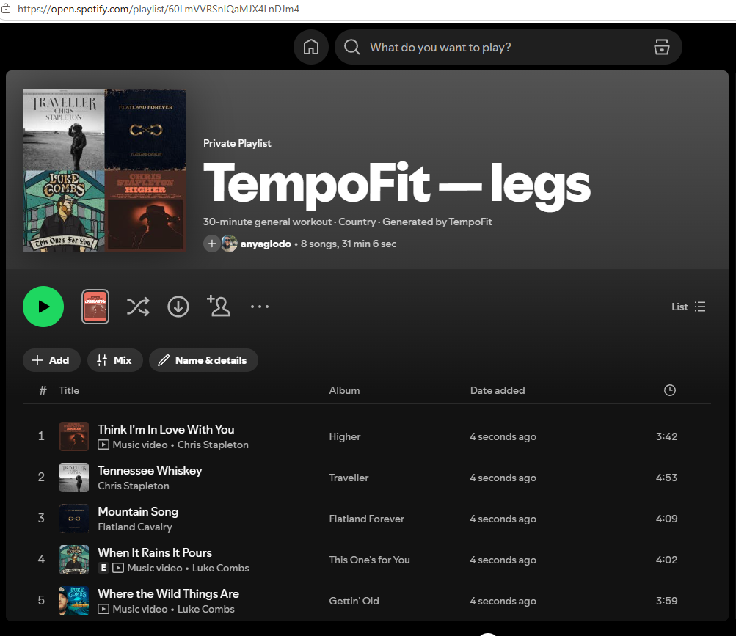
TEMPOFIT
Validation & QA
Testing focused on the flows most likely to break: duration matching, regeneration, authentication, and saving back to Spotify.
15–45 MIN
TOKEN REFRESH
REGENERATION
SPOTIFY SAVE
Playlist generation validated across short, medium, and longer workout targets.
Manually removed the access cookie and verified automatic recovery.
Verified a user can request a new playlist without restarting the flow.
Created a private Spotify playlist and confirmed tracks were added successfully.
Example end-to-end result
30-minute Country workout
TempoFit generated and saved an 8-song Spotify playlist at 31:06 for a 30:00 target.
• Verified Familiar / Discover preference changes the candidate pool.
• Production build completed successfully.
• Secret scan confirmed no Spotify client secret was committed.
• Known limitation: heuristic matching aims for approximate—not exact—duration.
06

Slide 7
TEMPOFIT
What I’d Build Next
The MVP proves the workflow. The next phase would focus on production readiness and richer personalization—not simply adding more screens.
01 PRODUCTION AUTH
02 PERSISTENT USER DATA
03 BETTER PERSONALIZATION
Move beyond local portfolio OAuth/session handling with hardened session storage, deployment-safe redirects, and production monitoring.
Add a database for preferences, playlist history, saved workout templates, and cross-device continuity.
Use permitted listening signals or richer user feedback to evolve beyond curated pools while keeping recommendations explainable.
04 OBSERVABILITY
05 USER VALIDATION
06 PLATFORM EXPANSION
Instrument API failures, auth errors, generation latency, and save success so integration health can be measured.
Run structured usability tests and measure whether generated playlists actually reduce setup time and improve workout fit.
Evaluate additional music providers only after the core Spotify experience and retention signals justify the added complexity.
Takeaway
TempoFit demonstrates end-to-end ownership: product scoping, UX, API integration, architecture tradeoffs, debugging, QA, and a working Spotify output.
07

