Slide 1
New Delhi
RESTAURANT DATA SET

Slide 2
INTRODUCTION
Hands down, food has its own way of getting someone to trip over heels, making them drool, dream and munch. Hands down, food has its own way of getting someone to trip over heels, making them drool, dream and munch. And while some say that their heart beats for food, why not get close to the heart of India, Delhi is like a buffet of some of the best mouthwatering food that can be found anywhere else. Whether it's the narrow streets of old Delhi where vendors mix different flavors,the overcrowded bazaars of central and southern Delhi where the aroma of food can pull you in from kilometers awayor the posh restaurants around Delhi that boast of their authenticity, there's plenty to catch up with when in Delhi.

Slide 3
BUSINESS PROBLEM
New Delhi City has many restaurants, each of which belongs to various categories such as Chinese, Italian , French, etc. So we will list and visualize all major parts of New Delhi City as part of this project.
Points to note:
Famous places for chinese food
Maximum Chinese Restaurants
Least Number of Chinese Restaurants
Recommended place to stay if someone prefers Chinese Food
Places with reputed restaurants in New Delhi

Slide 4
DATA
For this project we need the following data :
New Delhi Restaurants data that contains list Locality, Restaurant name,Rating along with their latitude and longitude.
Data source : Zomato kaggel dataset
Description : This data set contains the required information. And we will use this data set to explore various locality of new delhi city.
Nearby places in each locality of new delhi city.
Data source : Fousquare API
Description : By using this api we will get all the venues in each neighborhood.

Slide 5
APPROACH
Collect the new delhi city data from Zomato kaggel dataset
Using FourSquare API we will find all venues for each neighborhood.
Filter out all venues that are nearby by locality.
Using aggregative rating for each resturant to find the best places.
Visualize the Ranking of neighborhoods using folium library(python)

Slide 6
RESULTS

Slide 7
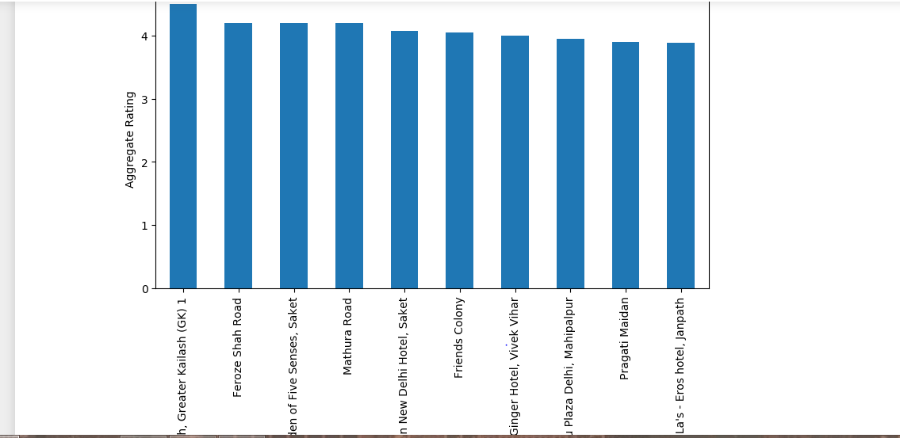
What places are have best restaurant in New Delhi?

Slide 8
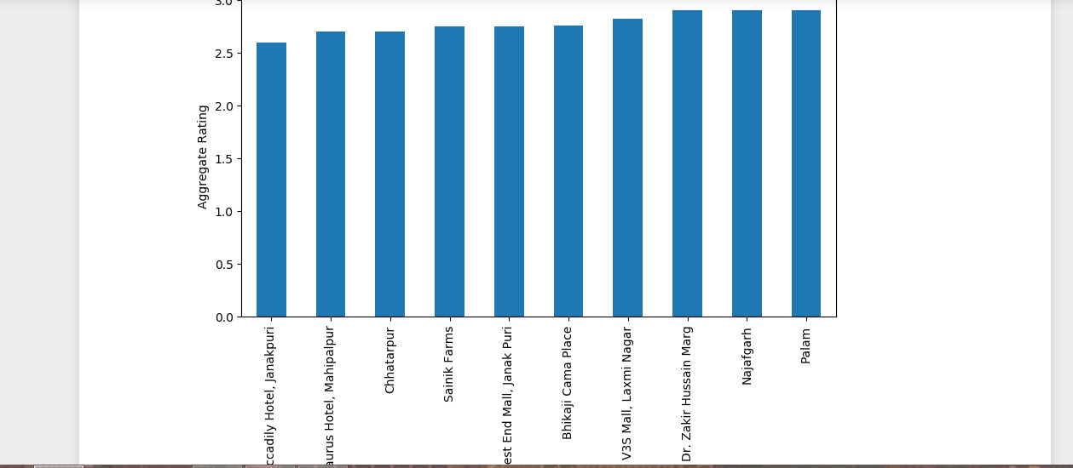
what places are have least rating restaurants in New Delhi?

Slide 9
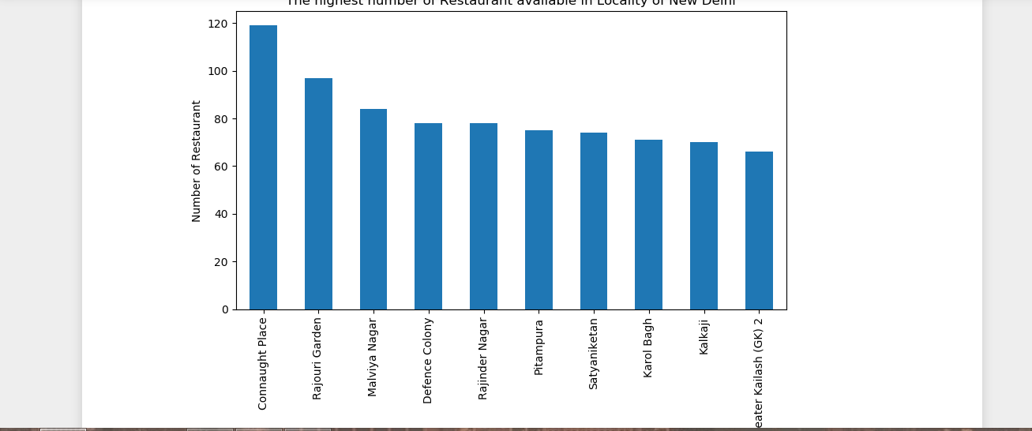
Which place are suitable for edible person in New Delhi city?

Slide 10
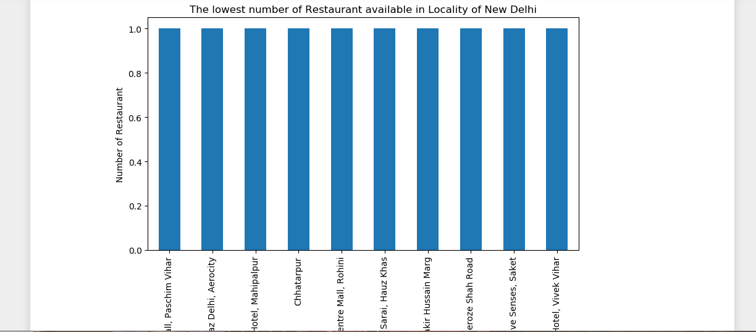
Which place are not suitable for edible person in New Delhi city?

Slide 11
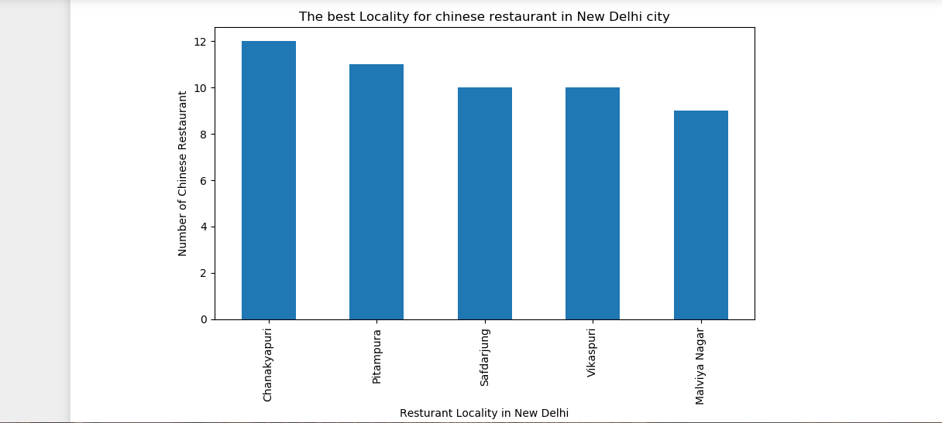
What are the best places for chinese restaurant in New Delhi city

Slide 12
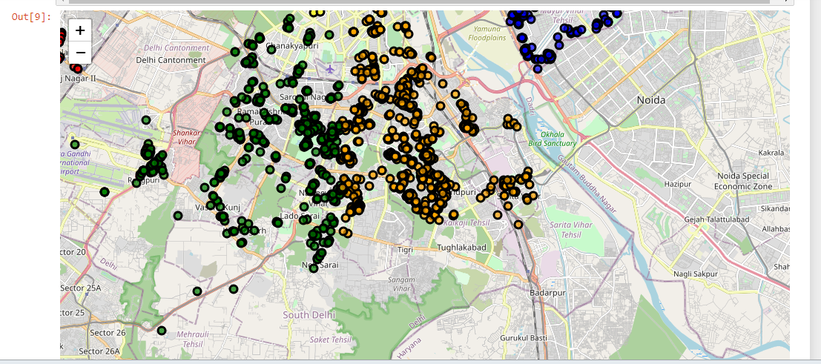
MAP OF RESTAURANT CLUSTERS:

Slide 13
FINAL MAP

Slide 14
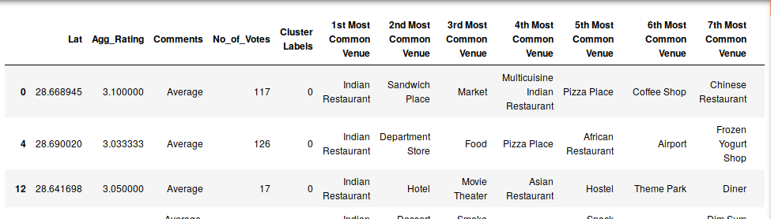
CLUSTER 1 The Indian restaurants are most recommended venues nearby the locations.

Slide 15
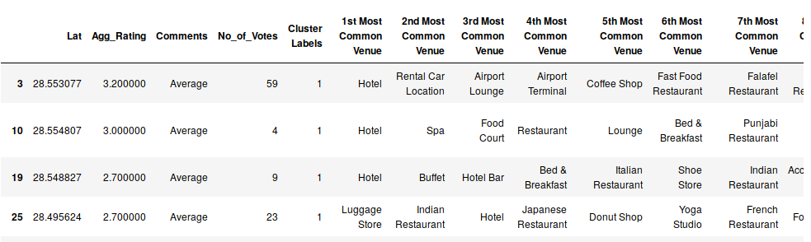
CLUSTER 2: It is recommended for the Hotel and Nightclubs venues areas:

Slide 16
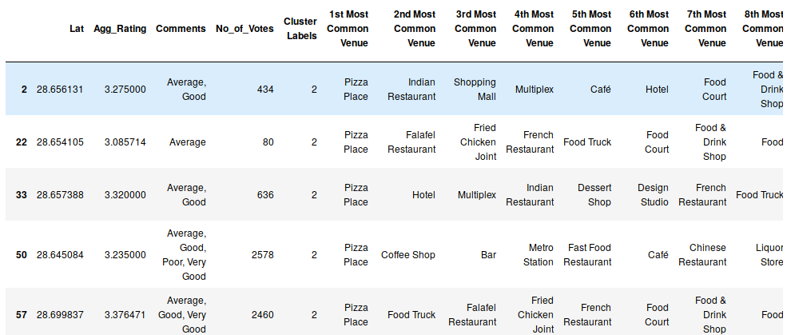
CLUSTER 3: PIZZA PLACE

Slide 17
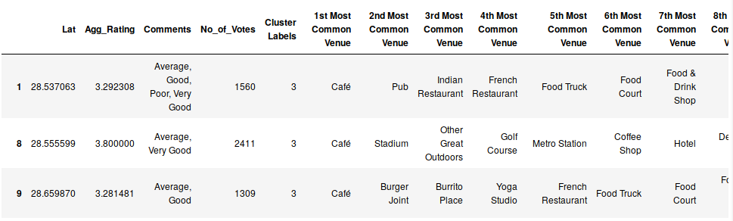
CLUSTER:4 Recommended for cafes

Slide 18
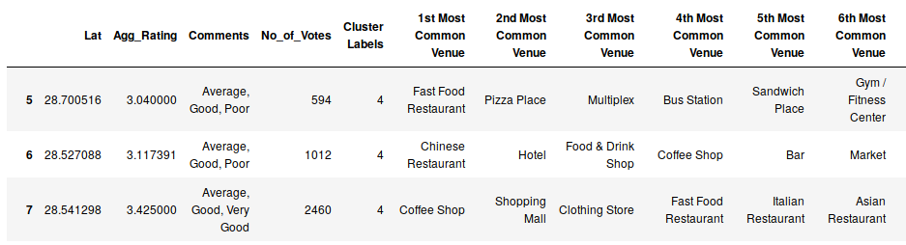
Cluster 5: Fast food, cafes are the most recommended venues

Slide 19
CONCLUSION
Chanakyapuri, Pitampura, Safdarjung are some of the best neighborhoods for Chinese cuisine.
Panchsheel park, Nehru place have the best Chinese Restaurant.
Connaught place, Rajouri garden, Malviya nagar are the best places for edible person.
Greater kailash, Feroze shah road, Saket have best rated restaurants in New Delhi.

