Slide 1
RETAIL PROJECT
BY
MEGHNA VINOD
E-COMMERCE PROJECT

Slide 2
CONTENTS: → Team Members → Sprint1 → Sprint2

Slide 3

Team Members
Mahfooza
Meghna
Nandita
Prerana
Mithali
Naija
Gowri
Keerthana
Kusum

Slide 4
SPRINT 1-FUNCTIONALITY
USER SIDE
My Order – Order Details
My Account
ADMIN SIDE
Order
Returns
Work Assigned for Manual Test

Slide 5
Manual Testing- Assigned Functionalities-User
Creation of test cases for MyOrder and MyAccount
Test Cases Created based on all possible scenarios
Checklist reviewed for the Order detail and for My Account
Issue log created for the assigned functionalities
Testing Status Updated.
All the documents and charts are uploaded in JIRA
Planning And Testing Activities

Slide 6
Manual Testing- Assigned Functionalities-Admin
Test Cases Created for Sales→ orders and returns
Test cases created based on all possible scenarios
No defects found
Issue Log is updated
Testing Status is updated
All the test documents are uploaded in JIRA
Planning And Testing Activities

Slide 7
Sprint 1- Manual Testing
Manual Test completed for :
Admin - Customer
Admin – Customer Fields
Admin – Customer Groups
User – Login
User- Registration
Tasks Reviewed

Slide 8
SPRINT 2-FUNCTIONALITY
Admin → Add Categories
Admin →Delete Categories
Admin → Edit Categories
Smoke Test is done using selenium IDE
Project is created in selenium ide
URL of the page was given
Started recording the above functionalities
Asserted the destination element
Stopped recording
Script will be generated for what has been recorded
At last Run the Script
Work Assigned for Smoke Testing

Slide 9
SPRINT 2-FUNCTIONALITY
Admin →Returns →Add Returns
Admin →Returns →Delete Returns
Admin →Returns →Edit Returns
Admin →Returns →Filter Returns (returns filtered based on Order Id)
Test is Done in Eclipse IDE using Java
Created separate package for Page Class and Test case Class to implement Page Object Model
In Page Class reference to the web element is given using id/xpath/CssSelector.
Function to login the admin page , returns filter page and add returns is given in page class
Function to add, delete ,edit and filter is given testcase class
Page class will be called in Test case class
The expected output is given within Assert Statement
TestNG and extend Reports are created
Work Assigned for Sanity Testing

Slide 10
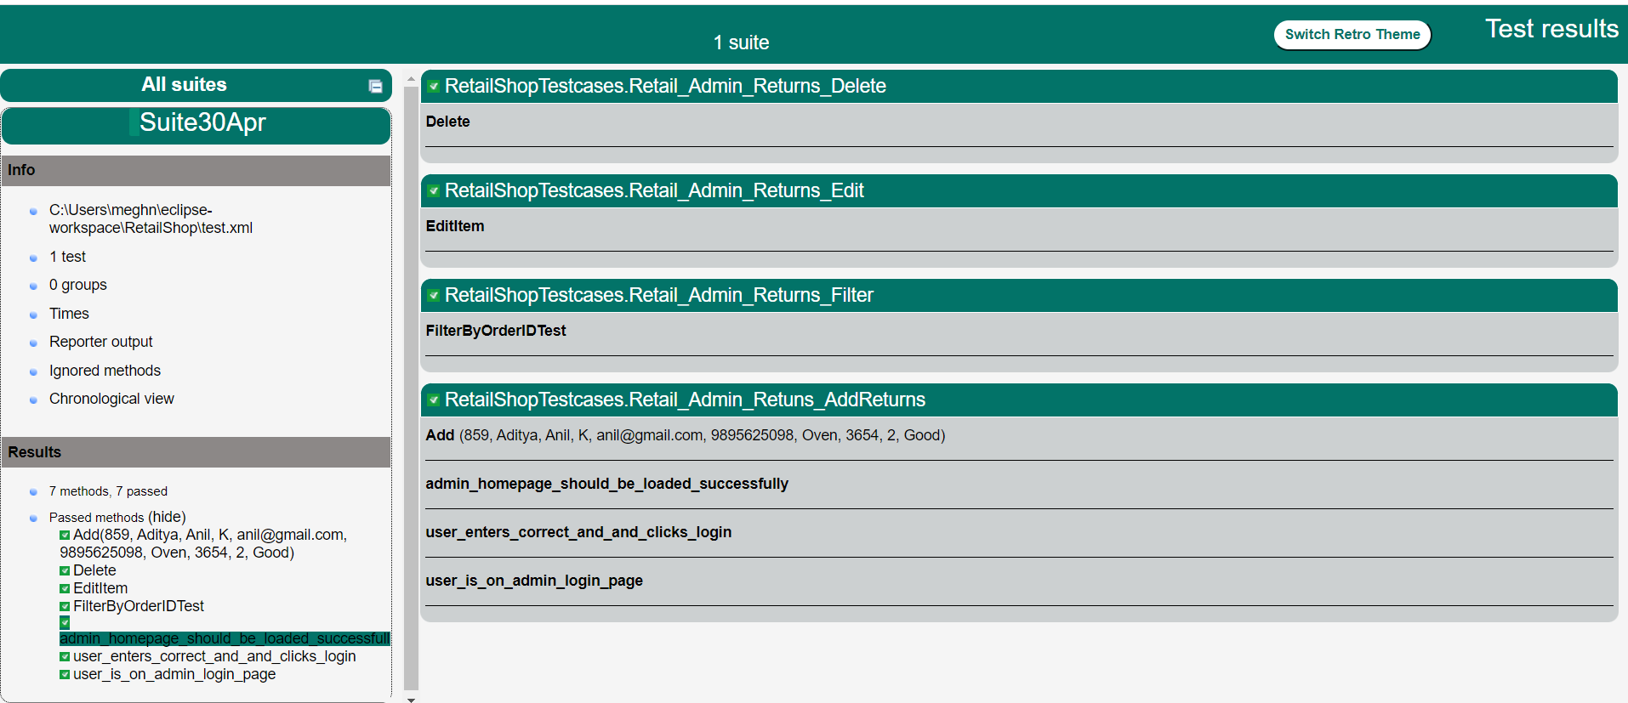
TestNG Report

Slide 11
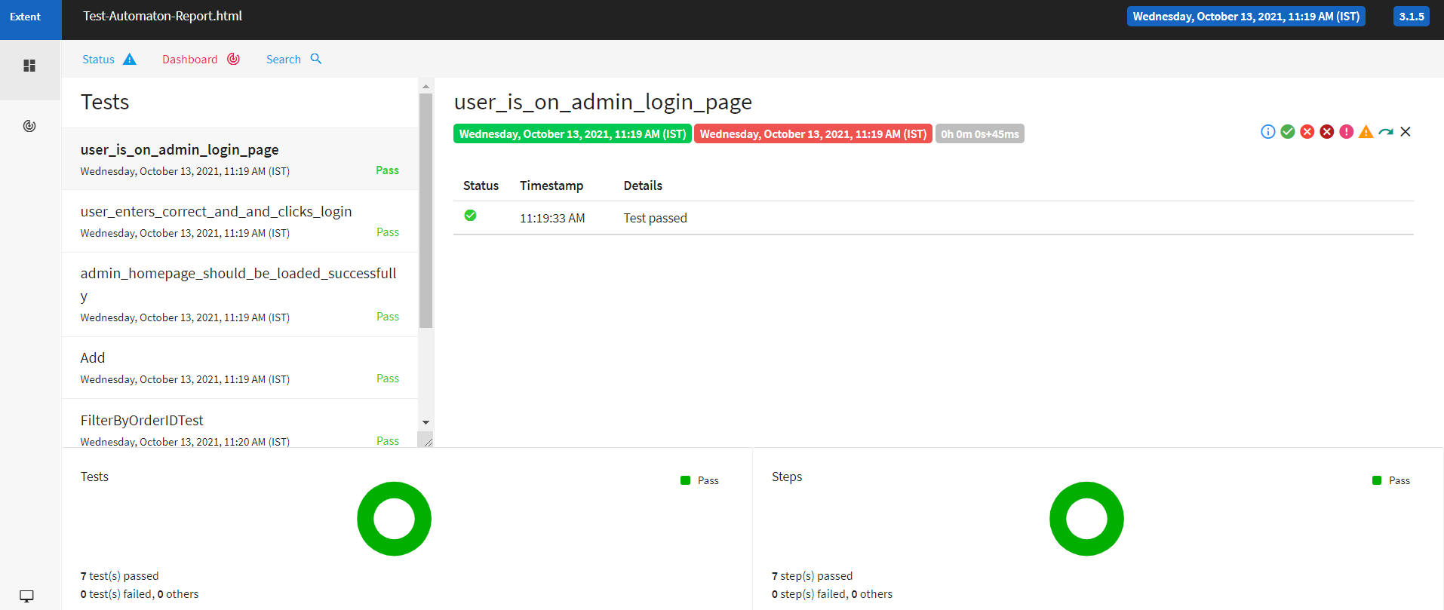
Test-Automation Report

Slide 12
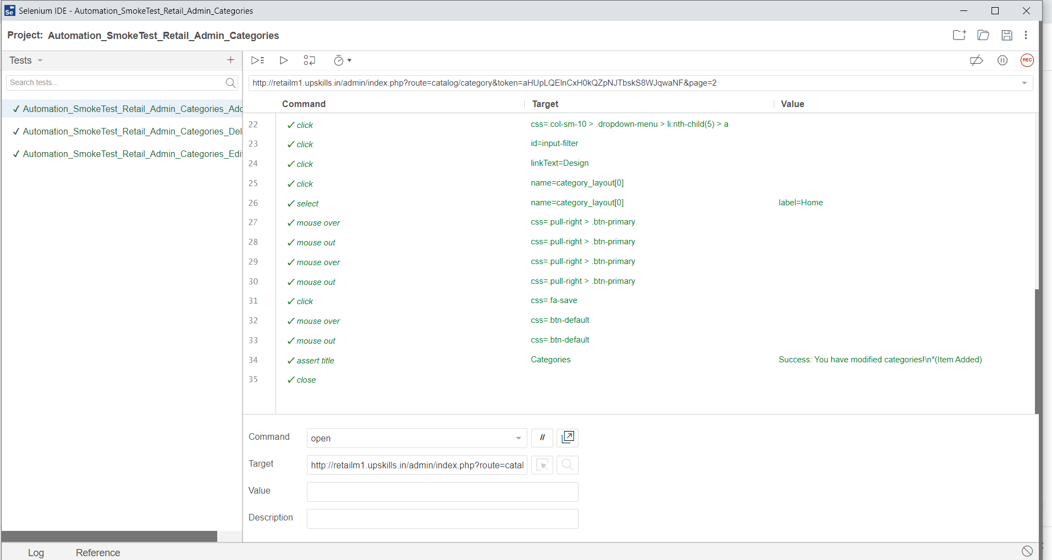
Selenium IDE - Smoke Test

Slide 13
Thank You!!

