Slide 1
Understanding and Simulating the Predator – Prey Model.
J.Raj Rohit and D.Siva Prakash
UG201113030 and UG201113010

Slide 2
What is a Predator-Prey model
This model is about the predator-prey interaction in an eco-system
The model is all about the dynamics of the balance in the eco-system and how it is affected by the population of the Predators and the prey.

Slide 3


Lotka-Volterra Model
The Lotka–Volterra equations, also known as the predator–prey equations, are a pair of first-order, nonlinear, differential equations frequently used to describe the dynamics of biological systems in which two species interact, one as a predator and the other as prey. The populations change through time according to the pair of equations:

Slide 4


Predators:
where,
x is the number of prey (for example rabbits);
y is the number of some predator(for example foxes);
and represent the growth rates of the two populations over time;
t represents time; and
α, β, γ and δ are parameters describing the interaction of the two species.
PREY:

Slide 5
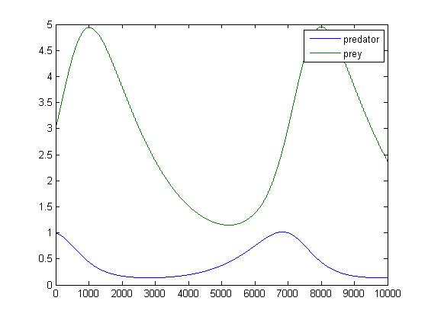
Solutions to the equations:
Time series plot of predator and prey

Slide 6
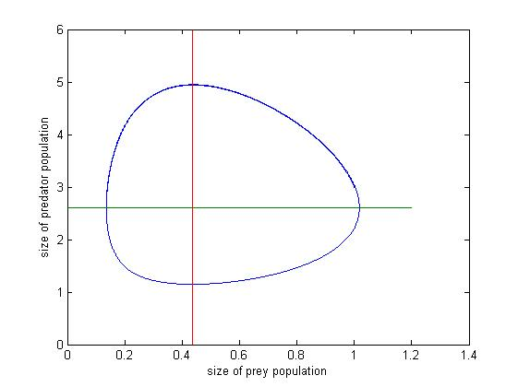
Phase portrait of the equation:

Slide 7
Holling Tanner Model
It is an idea of the Predator-prey model.
It assumes same amplitude in the population variation.
The amplitude does not depend on the initial population of both the species.
Dx = x[1- (x/7)]-(6xy/(7+7x)) Dy = 0.2y[1 – (Ny/x)]

Slide 8
Explanation of the equations
The term x[1-(x/7)] represents the logistic growth of the prey in the absence of the predators.
The term -6xy/(7+7x) represents the effect of predators subject to max. predation rate.
The term 0.2y(a – Ny/x) is the predator growth rate, when the maximum of x/N predators is supported by x prey.

Slide 9
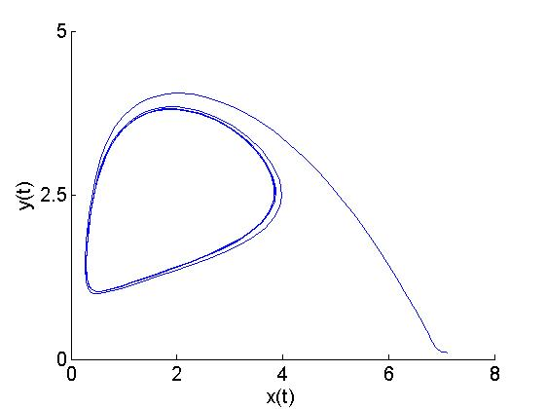
The phase portrait for the above mentioned equations. (at N=0.5)
It has been observed that at N = 2.5 (around that value); the portrait gets convoluted.
The isoclines get separated; thereby making the system “structurally unstable”.

Slide 10
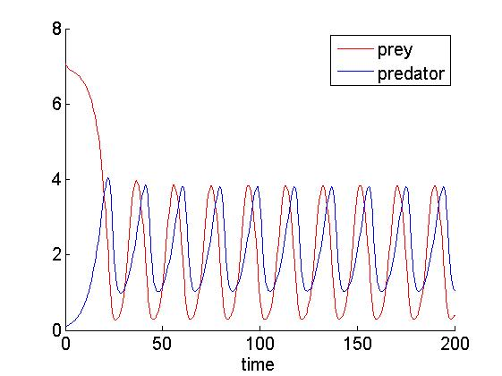
Time-series plots of both the prey and the predators.

Slide 11
External Factors affecting the analysis
Environmental epidemics like natural disasters, Pollution, Global Warming, etc.
Diseases; affecting one or more than one species.
Harvesting and urbanization.
Three or more species interaction.(The analysis would become more complex then.)
The above mentioned reasons are assumed to carry a null value as they can affect the analysis of the eco-system dynamics.

Slide 12
The code is written in Matlab.
References: Google, Wiki.

Slide 13

_{THANK YOU}

