Slide 1
The Battle of Neighbourhoods
by
Jaya Simha Reddy

Slide 2
Problem Statement
"Would you recommend a location in Hong Kong to open a new cinema?"
My boss, the stakeholder wants to open a new cinema as company's new business.
He explains that watching movie is a part of whole afternoon or night activities. Cinema should has many restaurants and shopping places nearby. Transportation is also an important factor. Customer can walk to cinema within 5 minutes from public transport facilities is perfect.

Slide 3
By, analysing the collected data, Cinema really has many 'Bus Stop', 'Food', 'Shop & Service' venues around.
Lets Plot the distribution of these features to understand it better

Slide 4
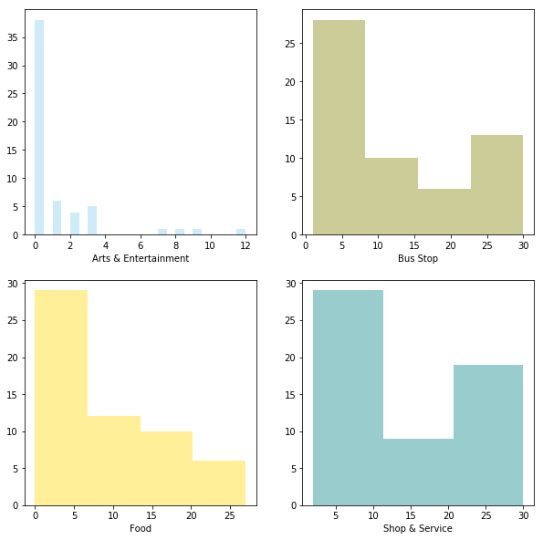
Distribution of Features

Slide 5
Let's visualize the location of cinemas, target location and stakeholder's favourite cinemas on the map.

Slide 6
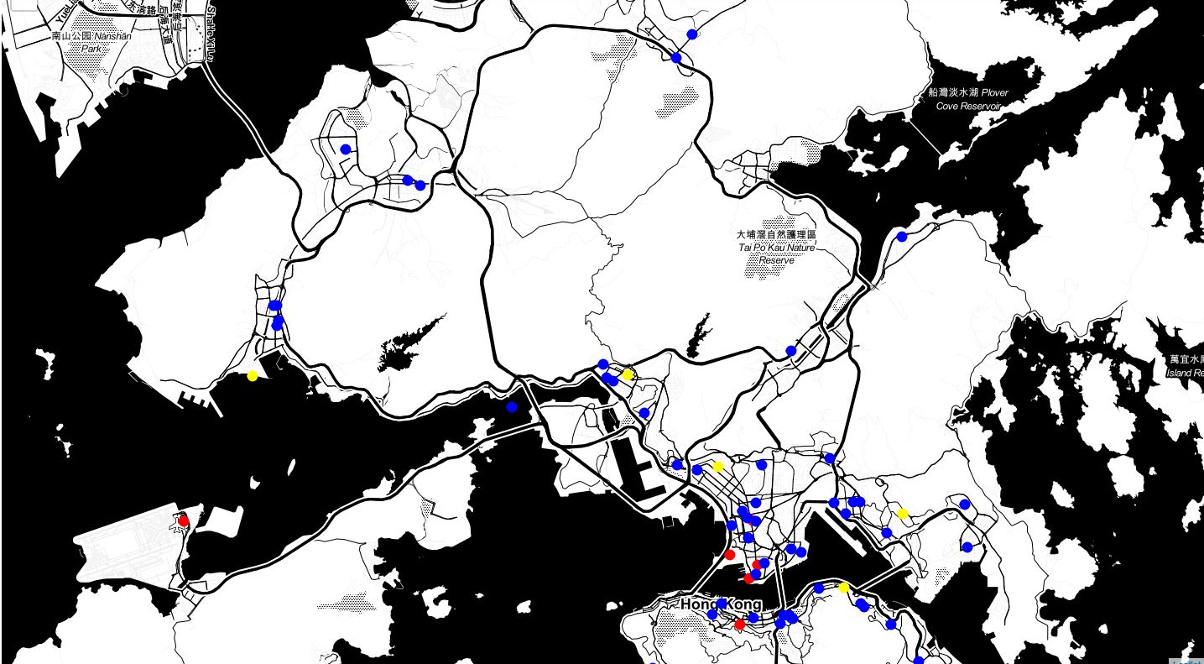
Visualizing the data using Foursquare API

Slide 7
Now, let's use Content-Based or Item-Item recommendation systems.
In this case, I am going to try to figure out the boss's favourite new cinema location by counting number of nearby venues and ratings given.
Following diagram explain the steps to create the recommendation

Slide 8
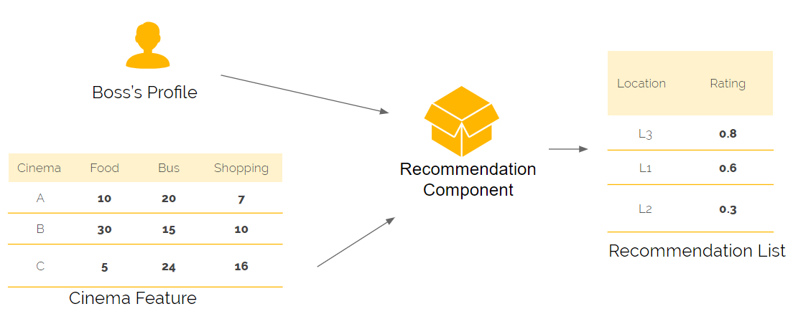
Movie Recommendation

Slide 9
The stakeholder's problem is resolved. Stakeholder wants to find the best place to build a new cinema in Hong Kong, and the factors of "best location" is based on the number of venues in eating, shopping, transportation category around the location. Stakeholder also provide his favourite list of cinema to further explain what the "best location" is. Content-based filtering machine learning technique is the most suitable method to resolve the problem. It combines stakeholder's preference and cinema profile to make the recommendation result.

Slide 10
Thank You

