Slide 1
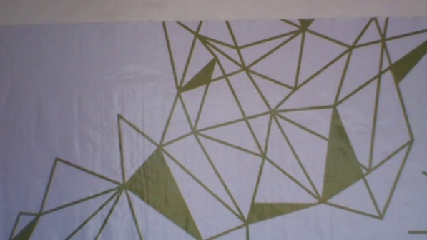
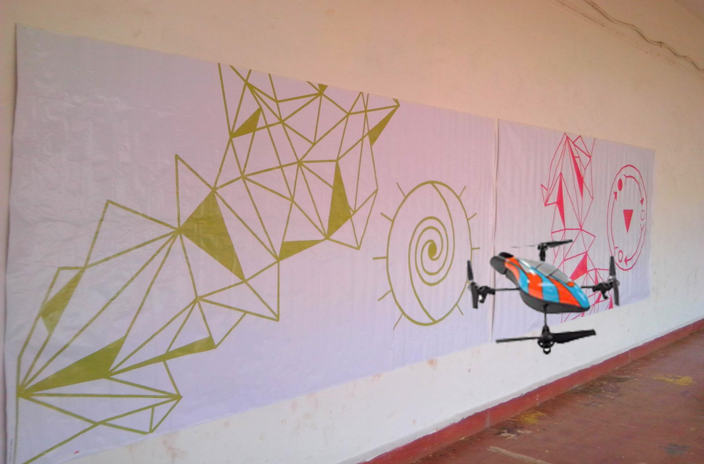

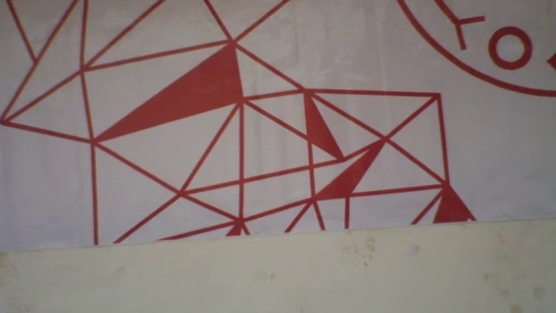

Automatic Selection of Interesting Images
Imagery Capture Sequence
Graph Creation
Super Panorama

