Slide 1
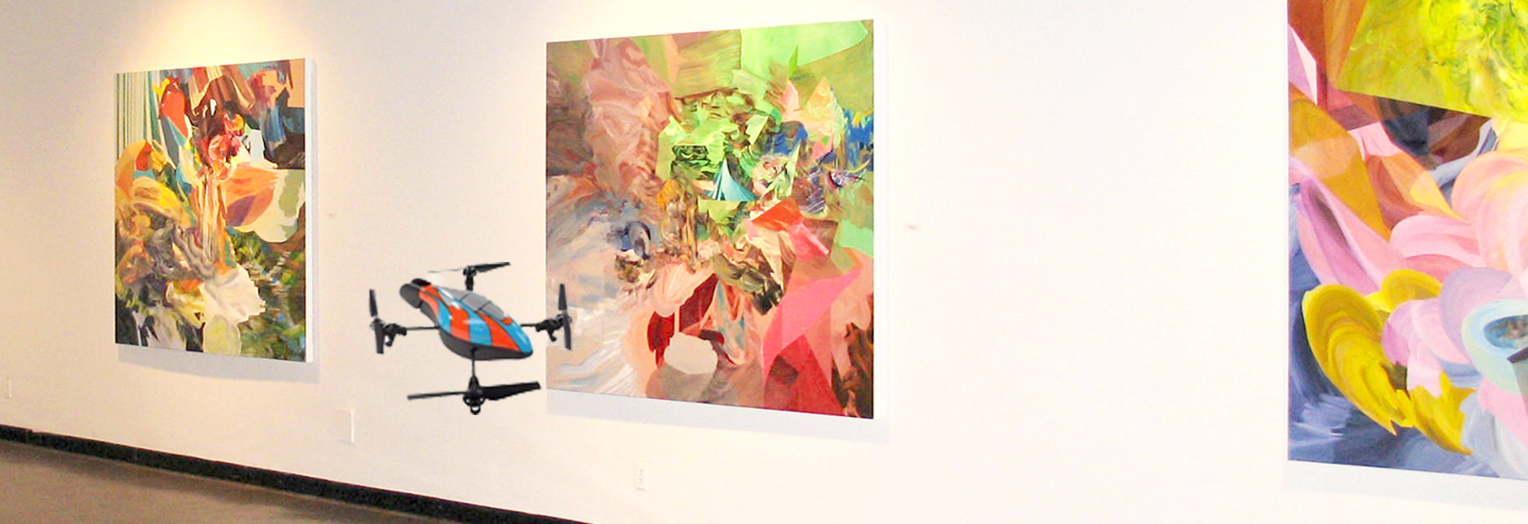
Large Painting
Dead Space
Mosaicing Art Gallery Using Quadcopter

