Slide 1
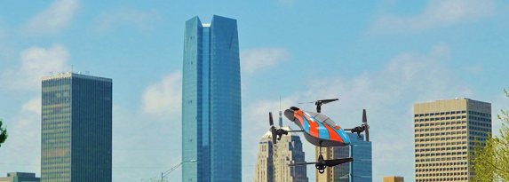
Long Skyline
Dead Space
Mosaicing Urban Skyline Using Quadcopter

