Slide 1
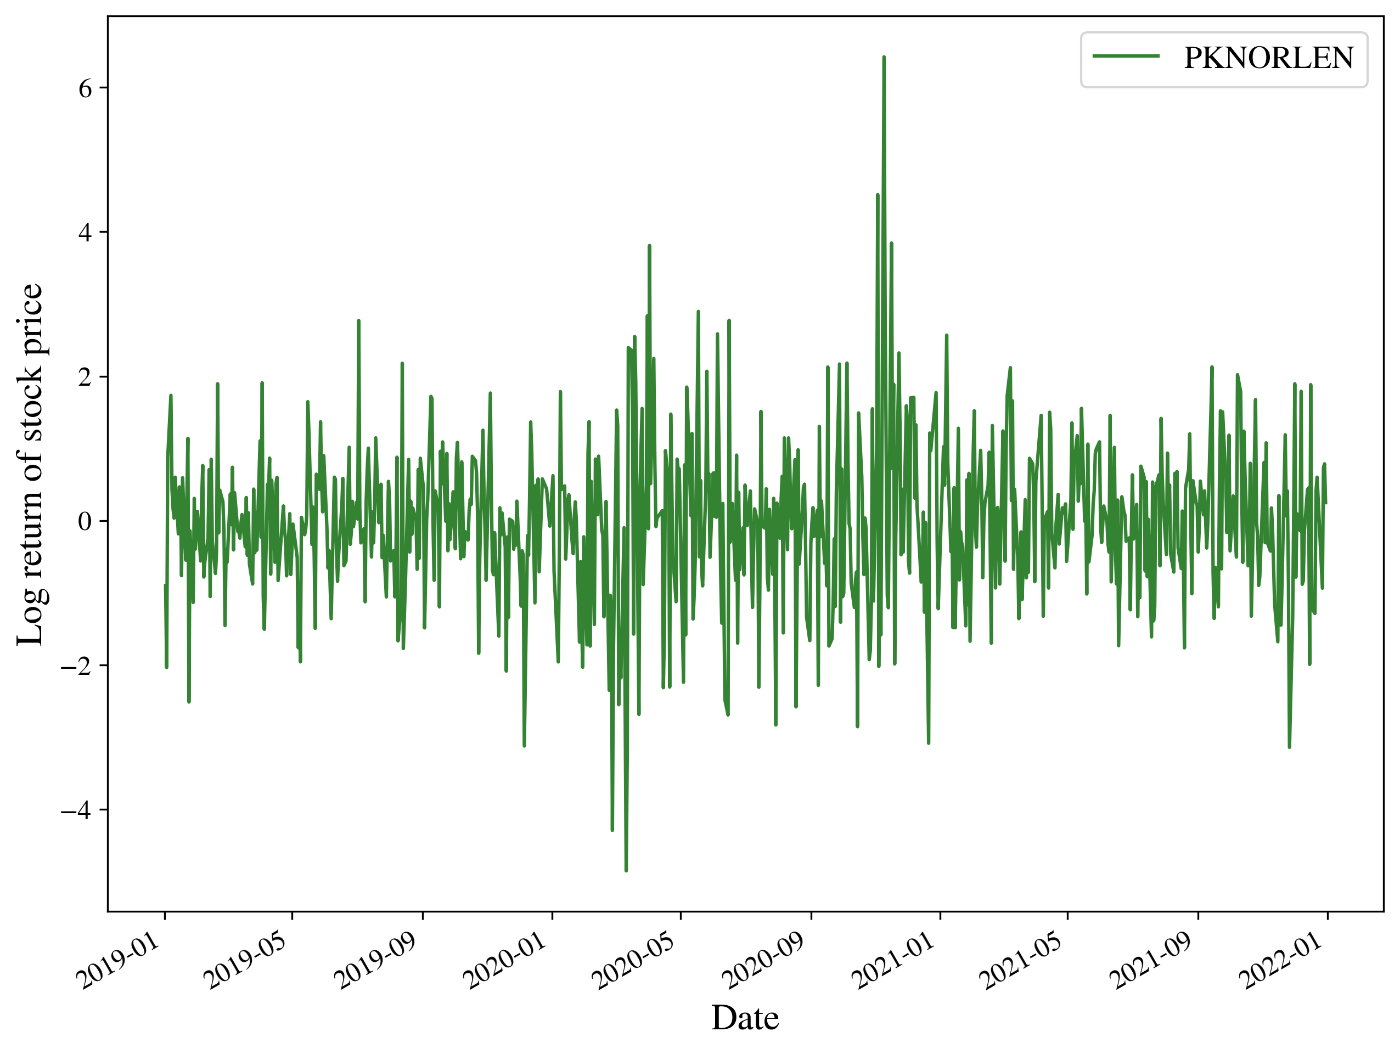
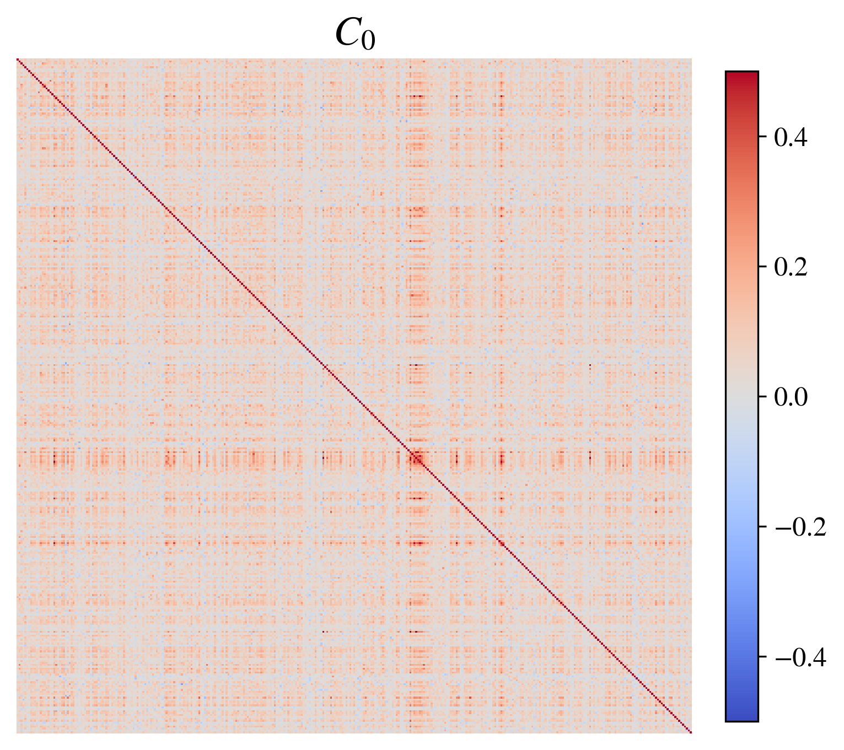
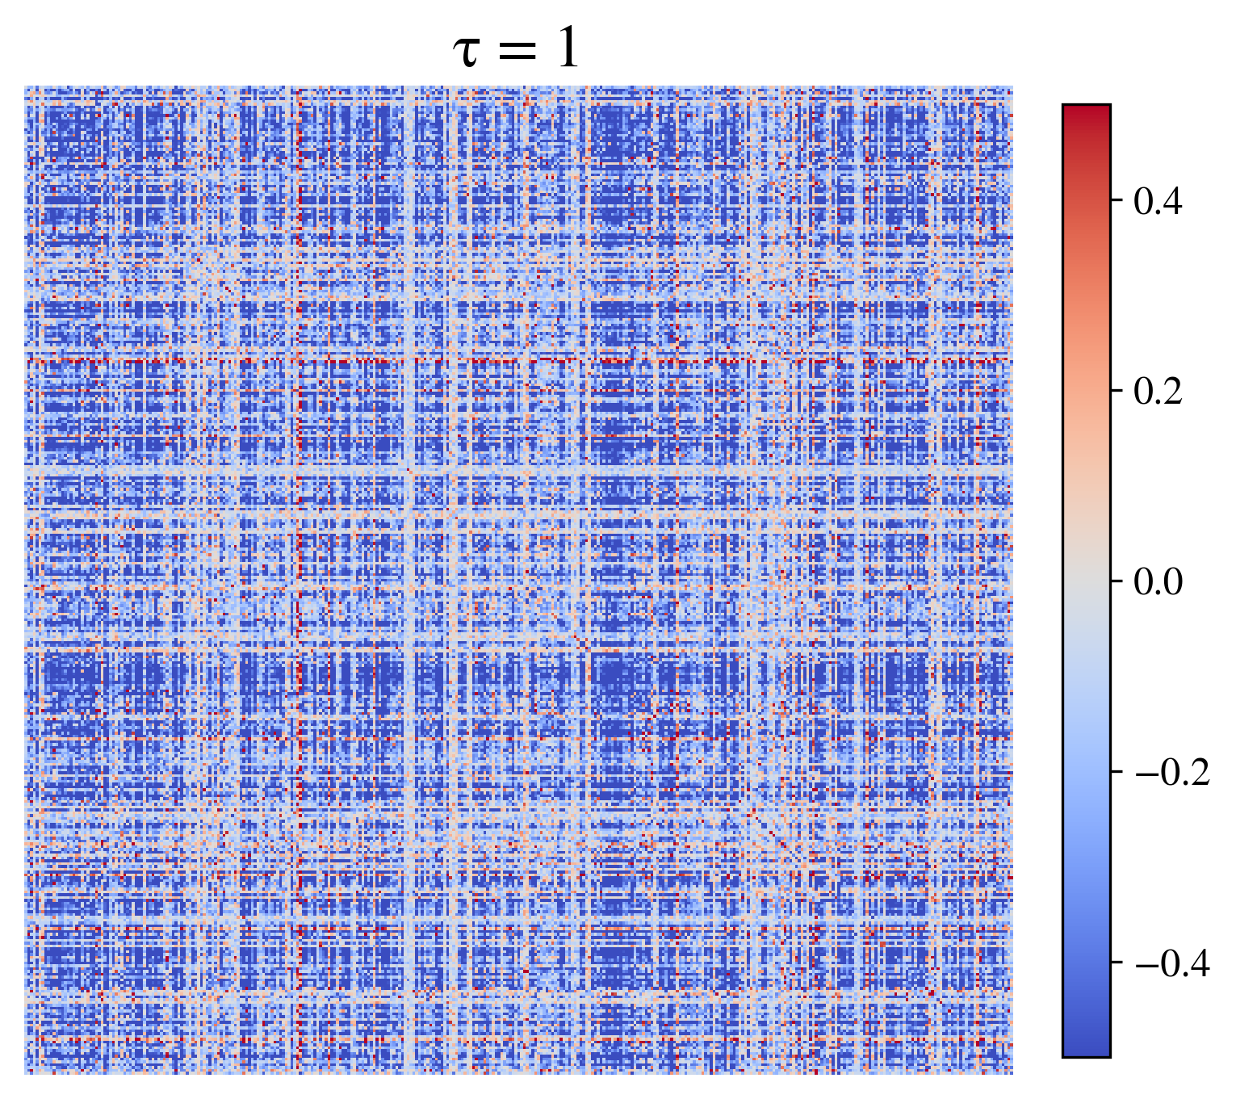
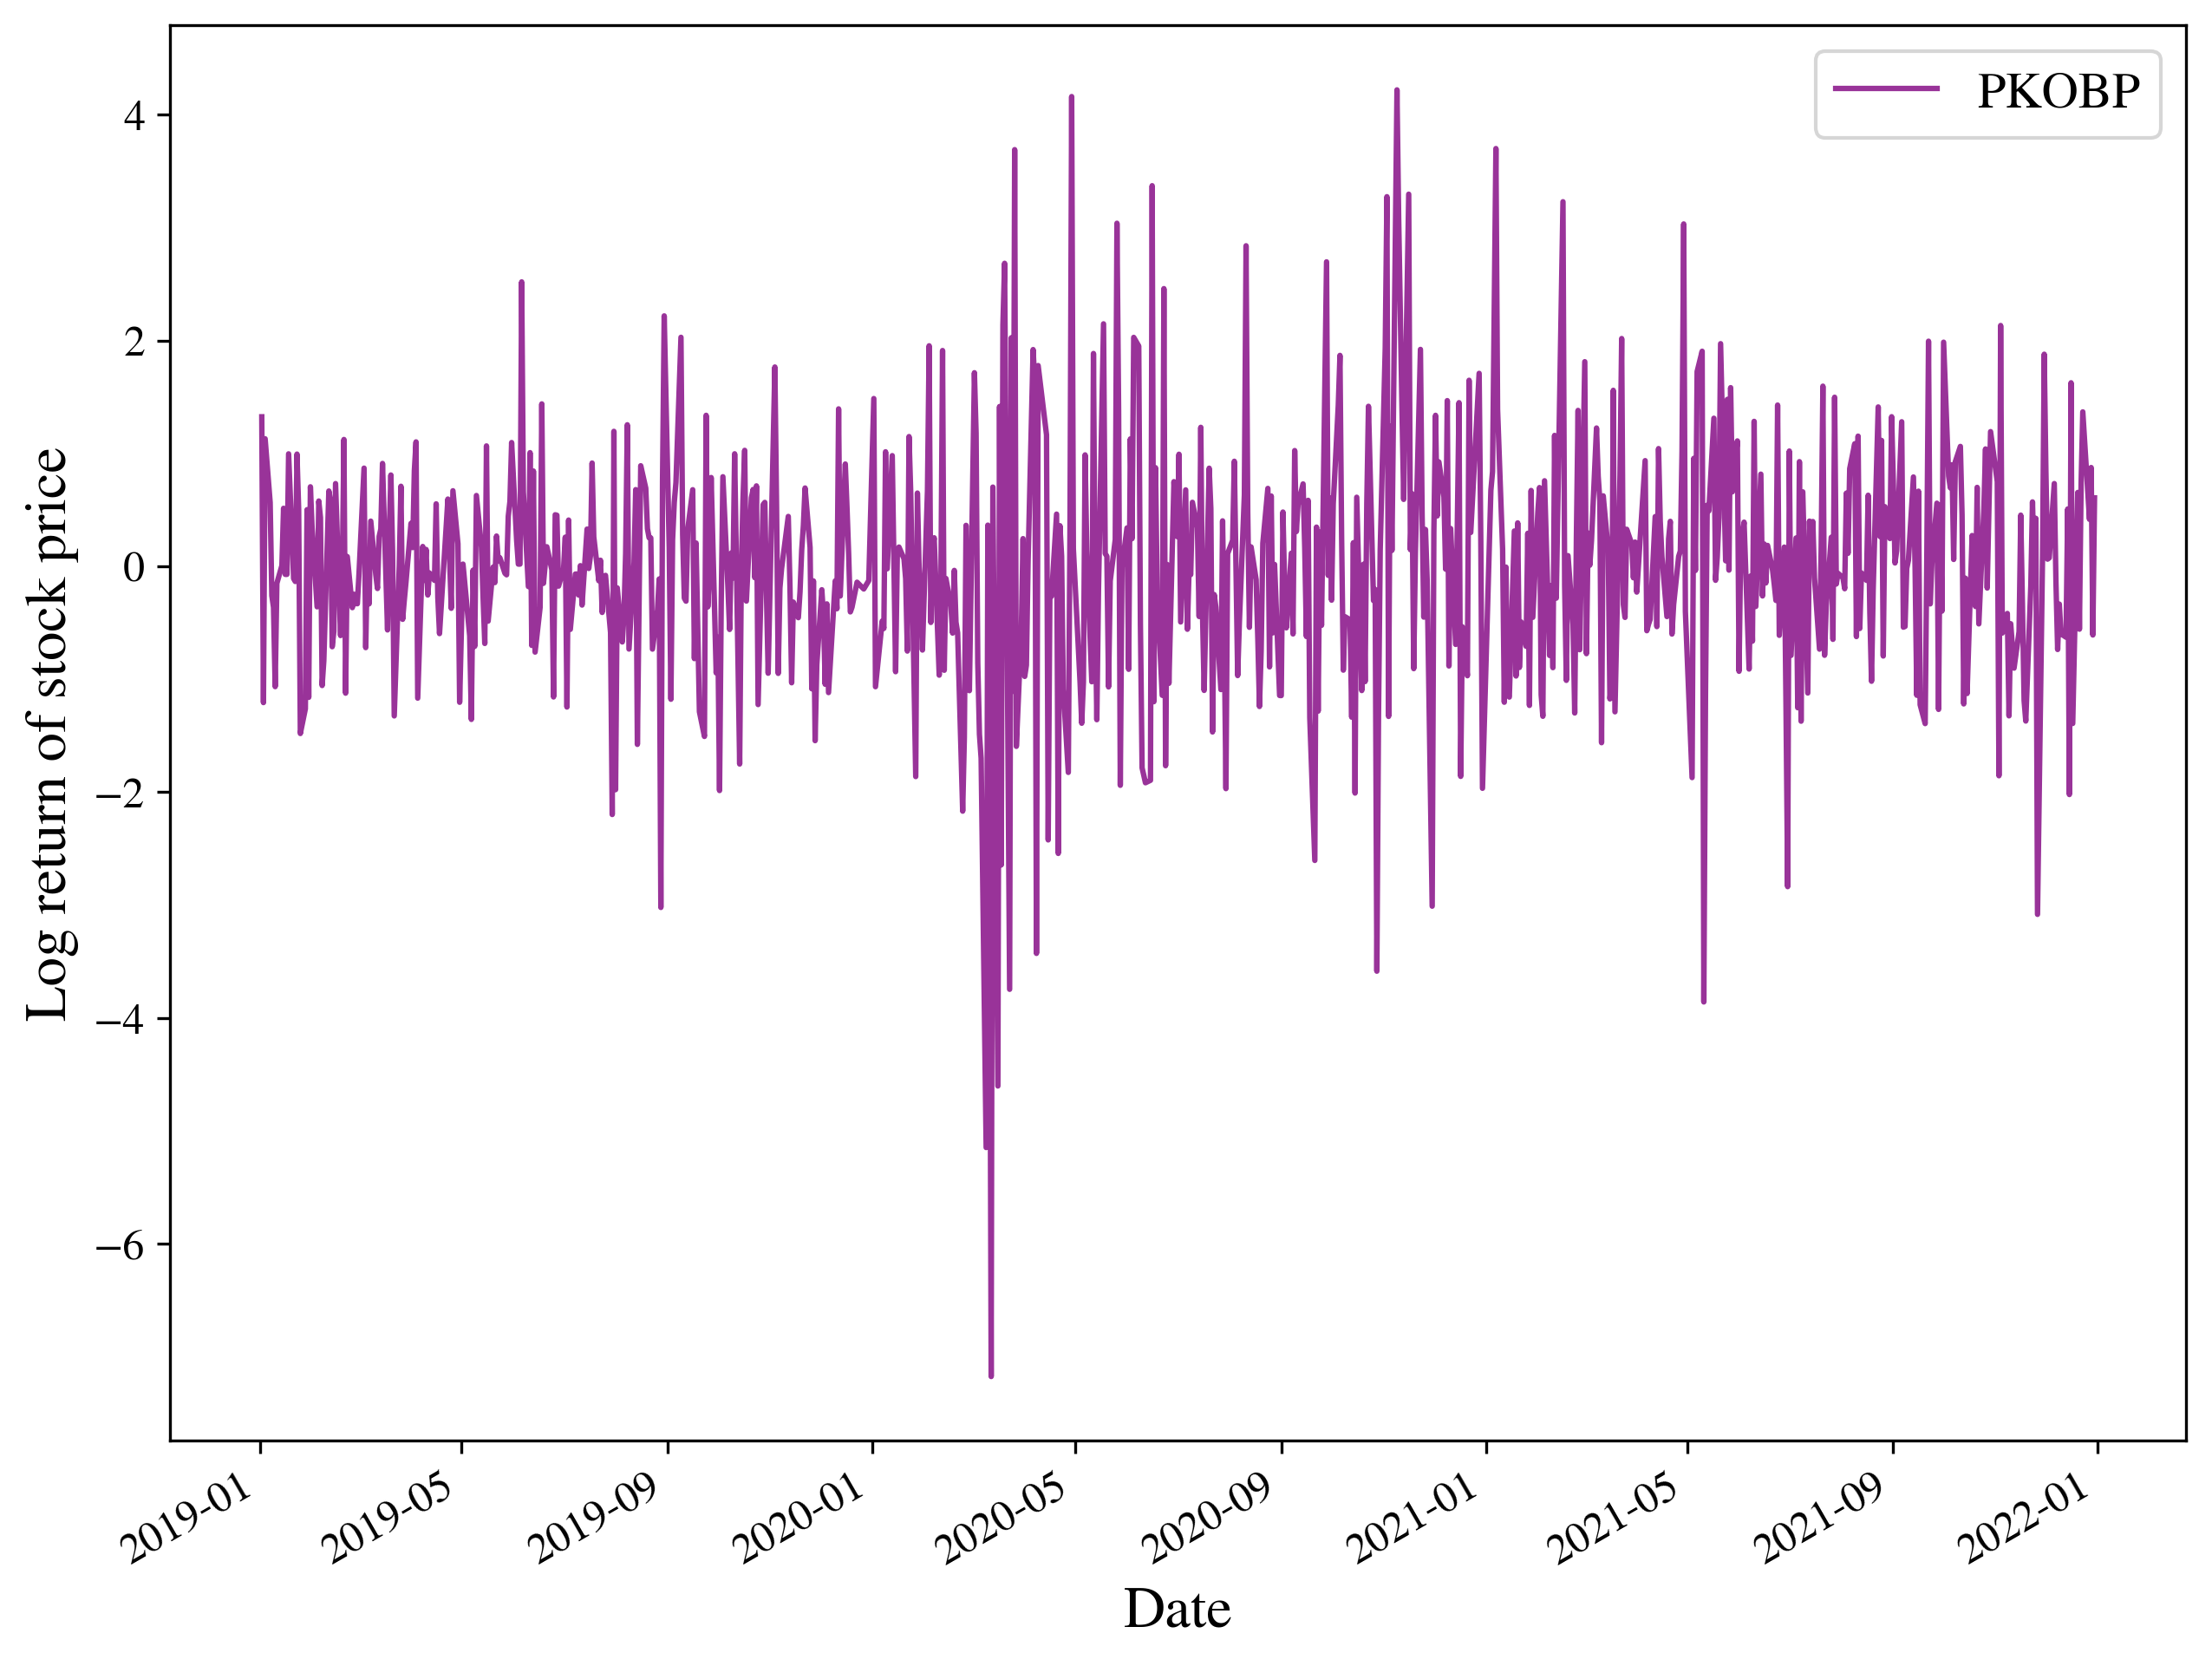
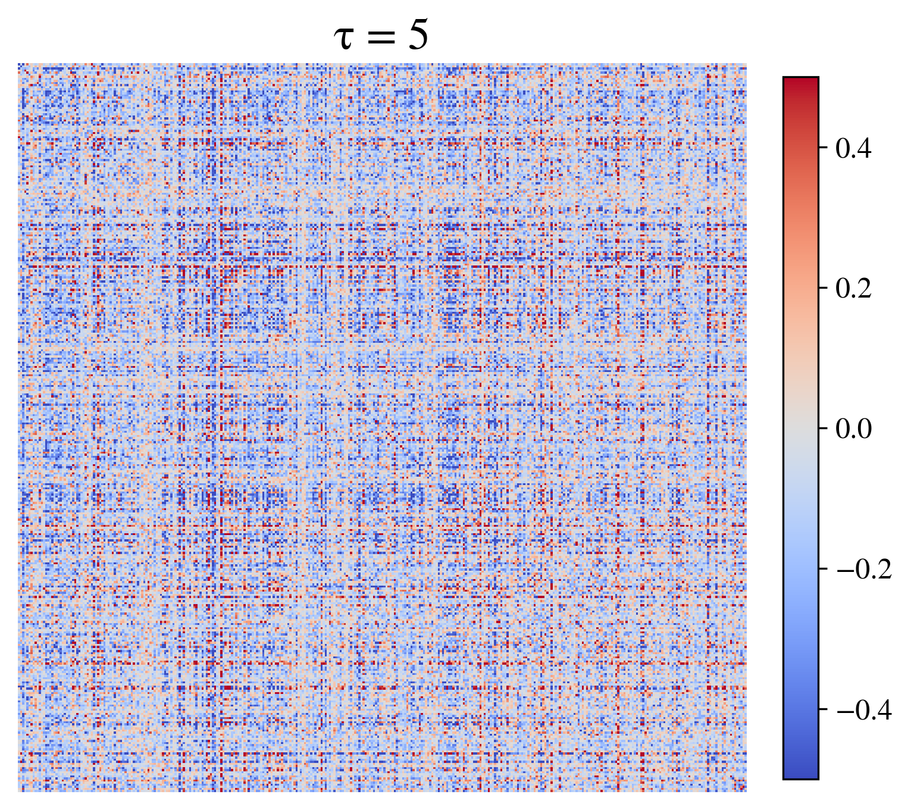
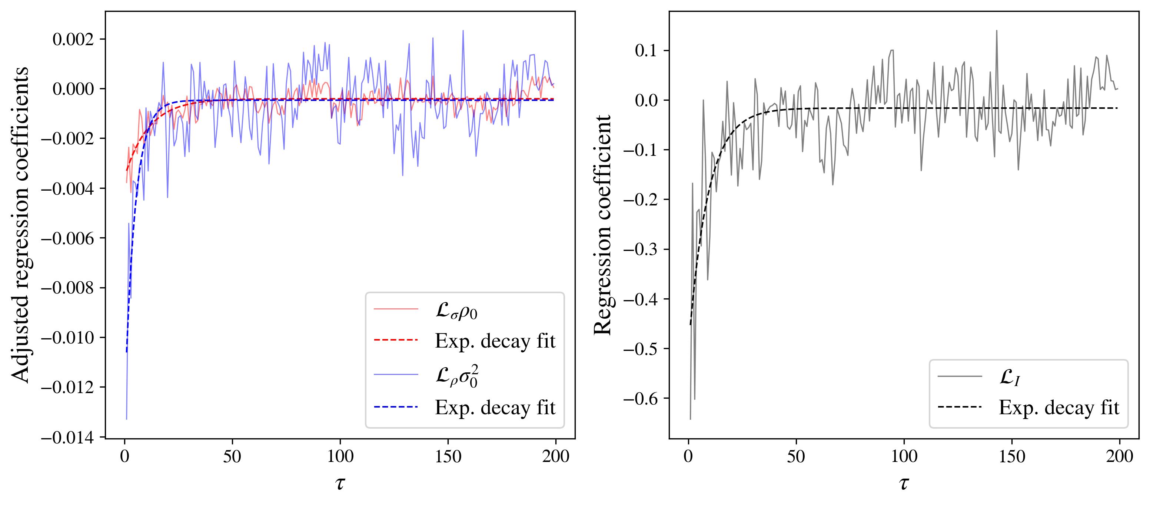
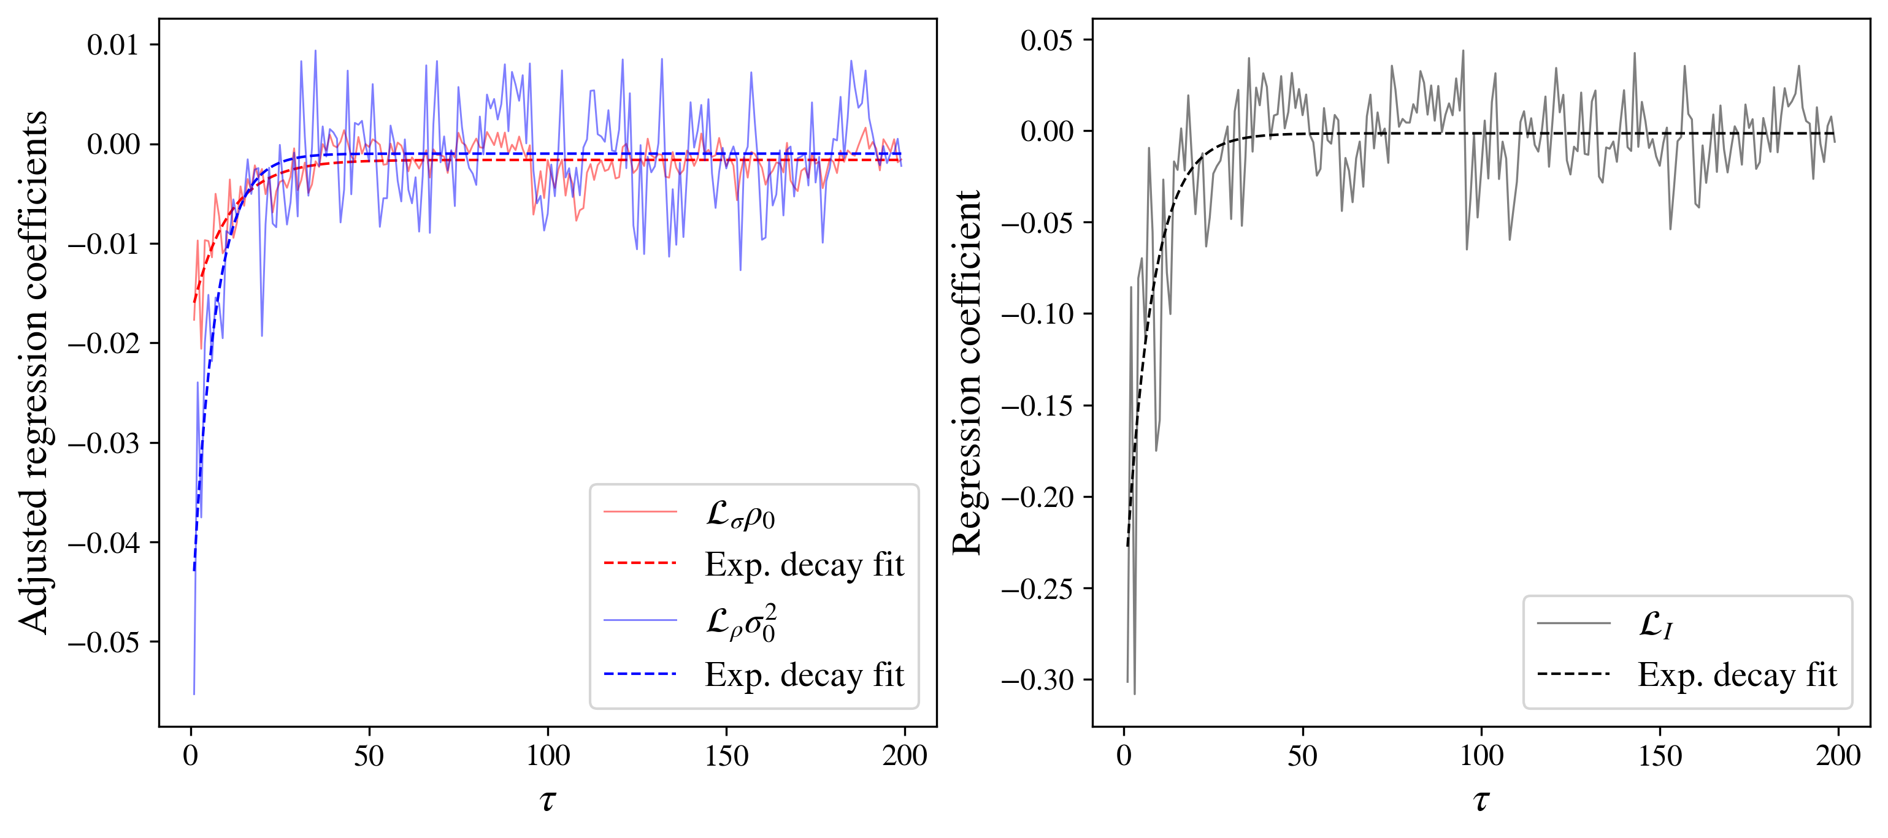
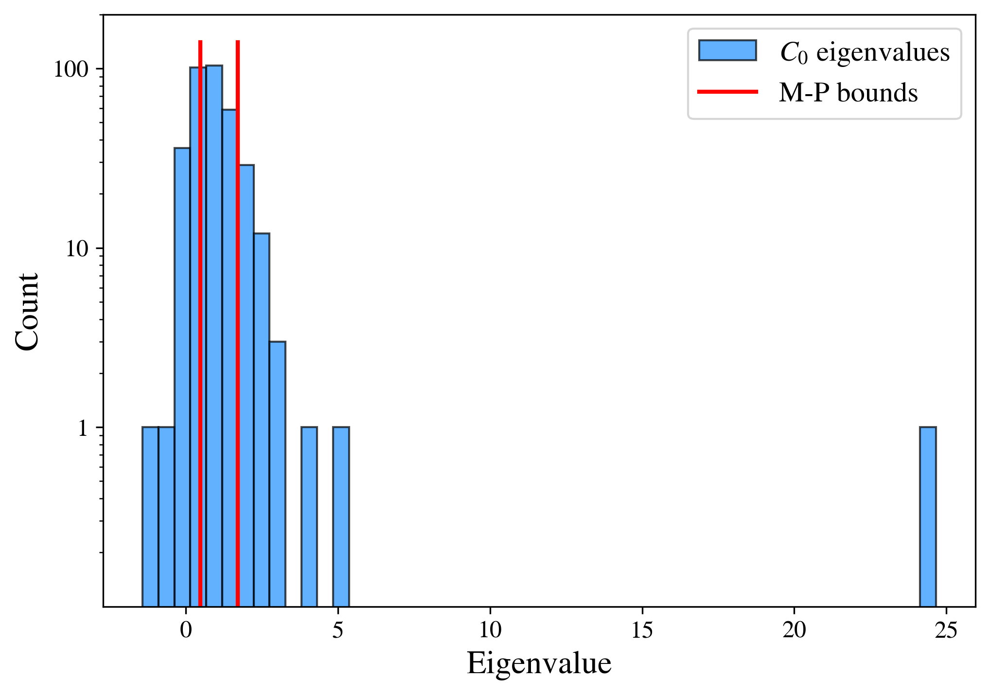
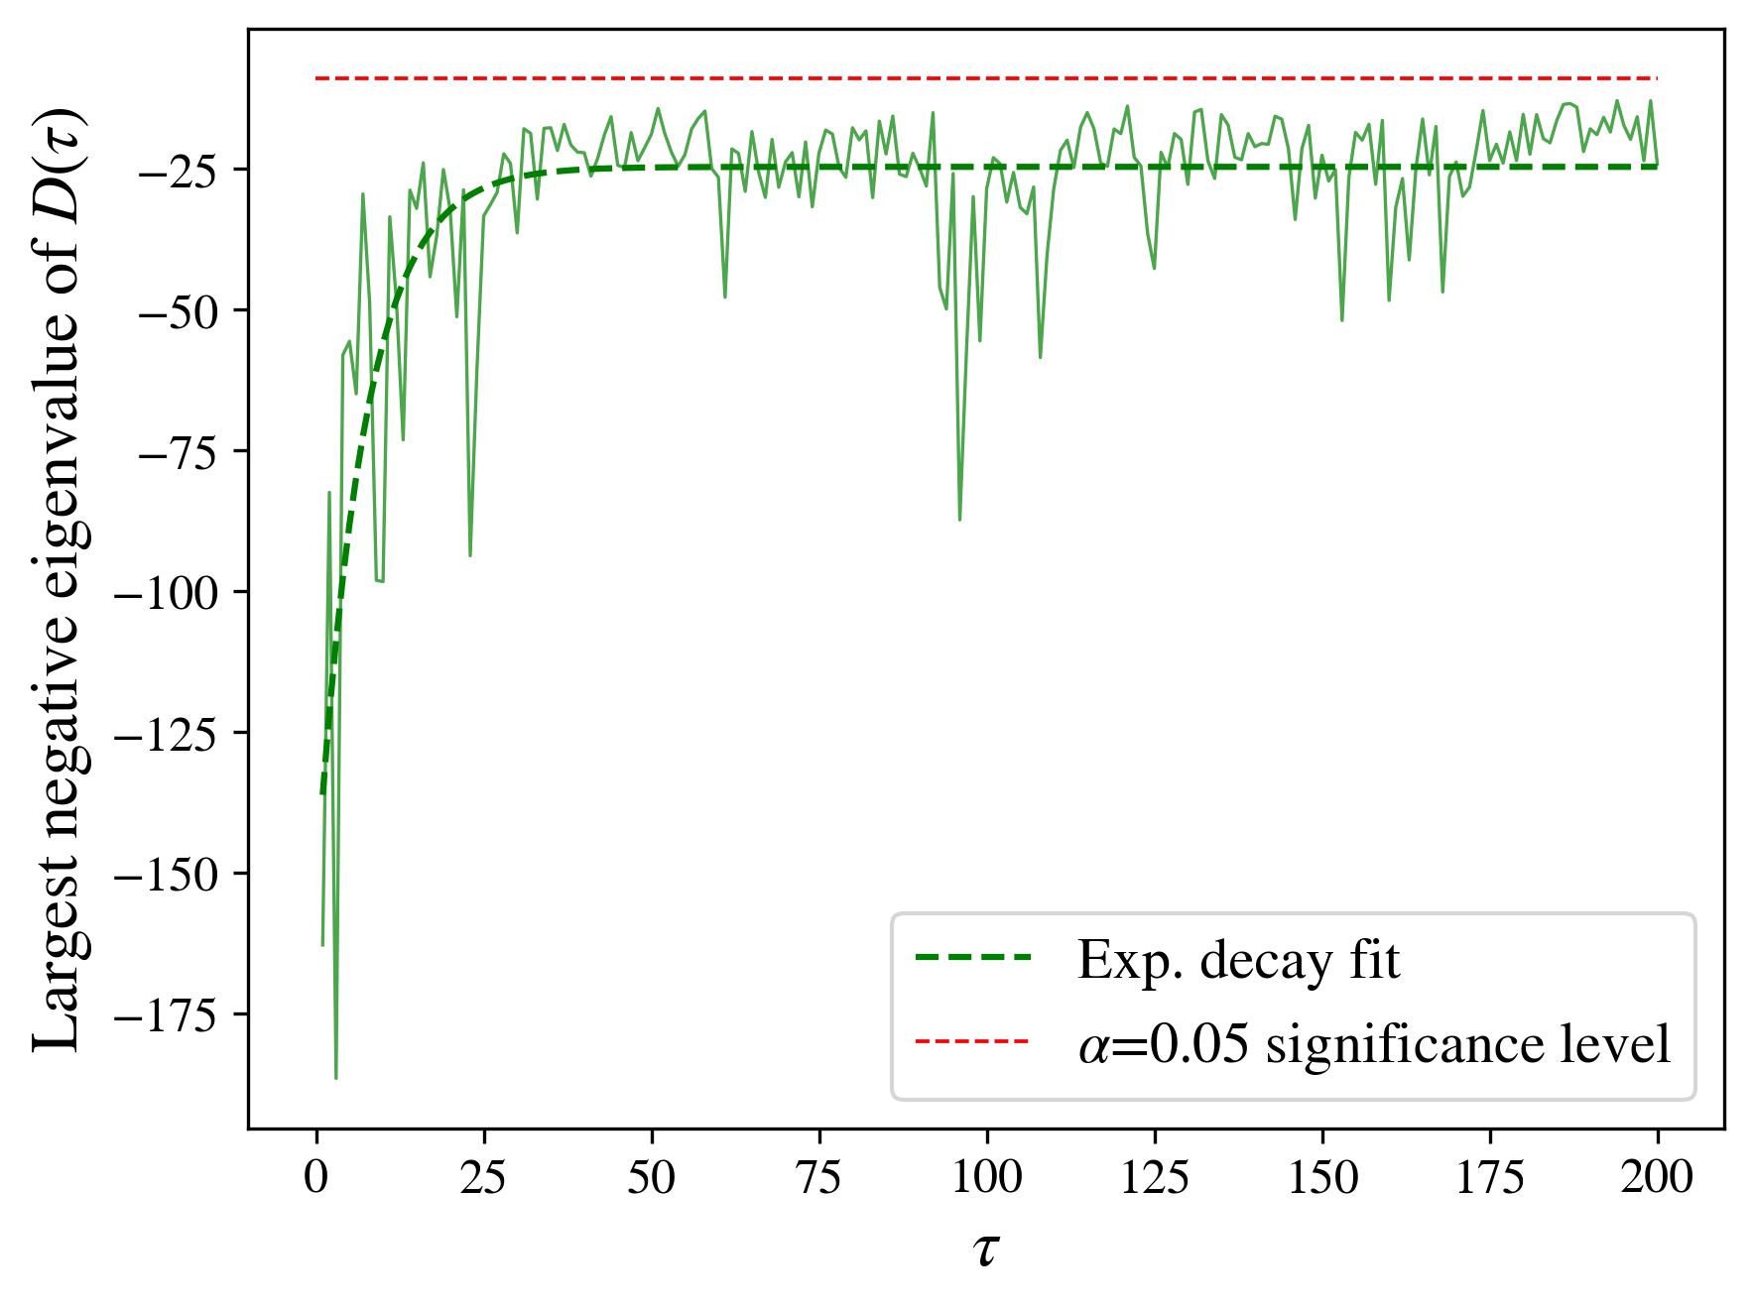
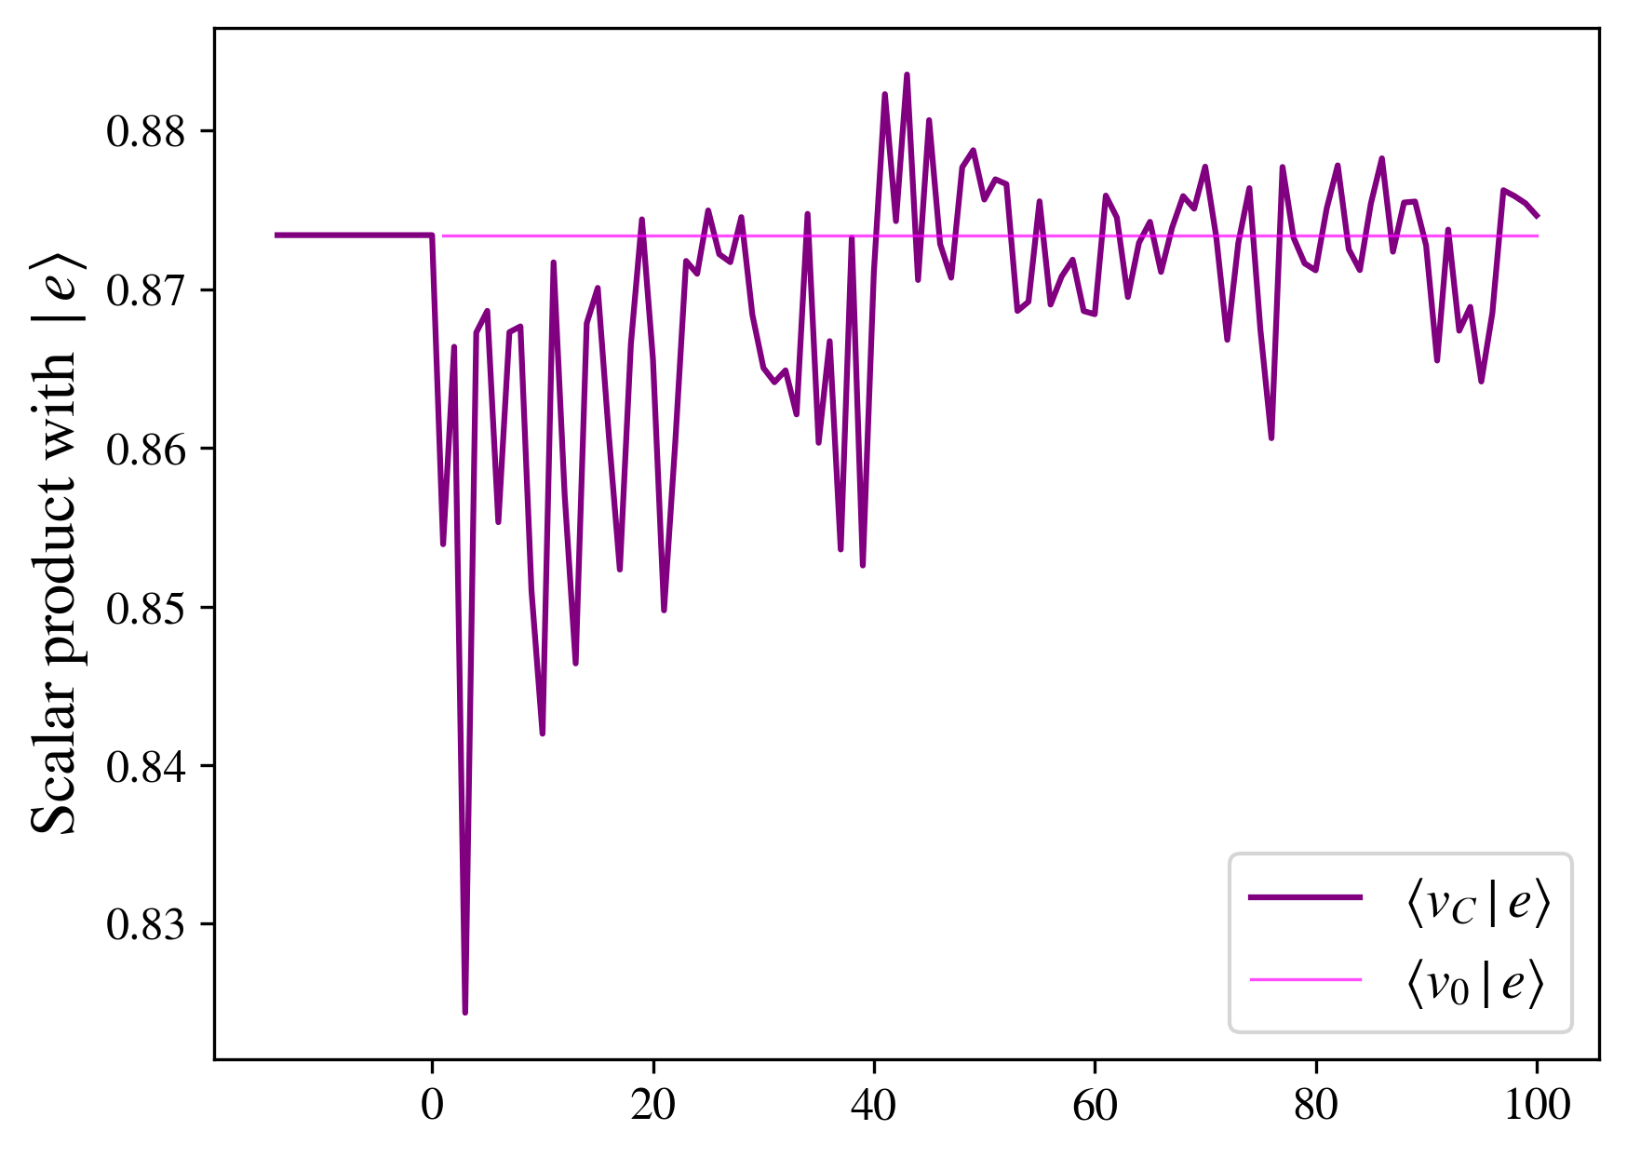
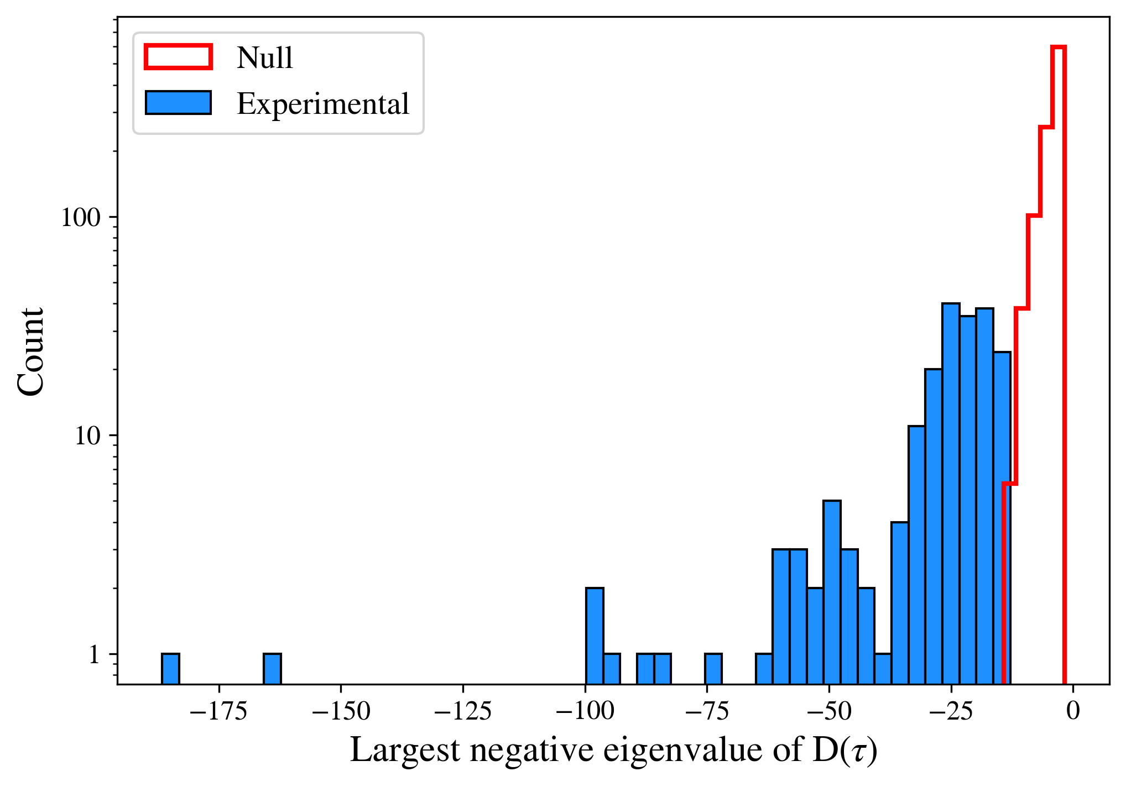
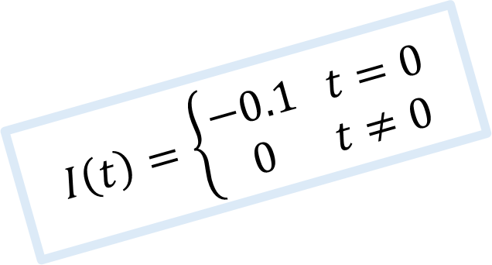
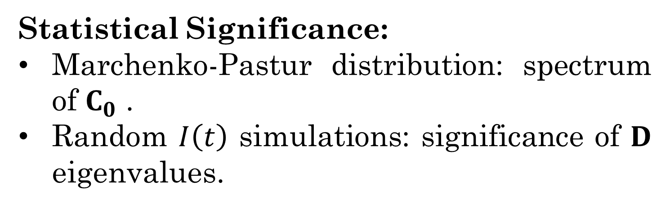

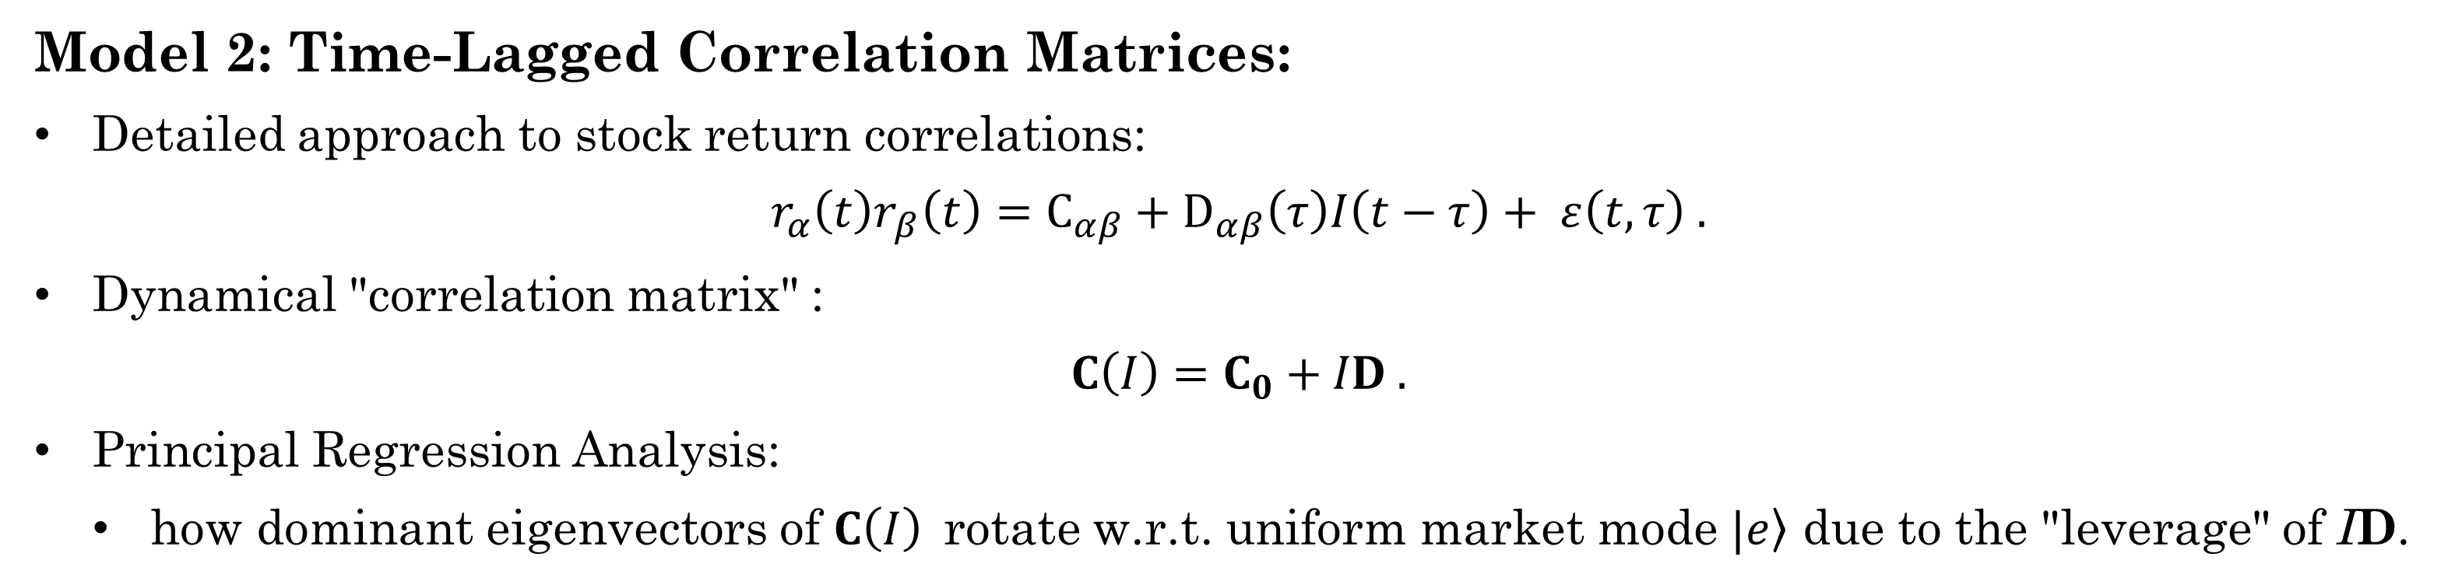


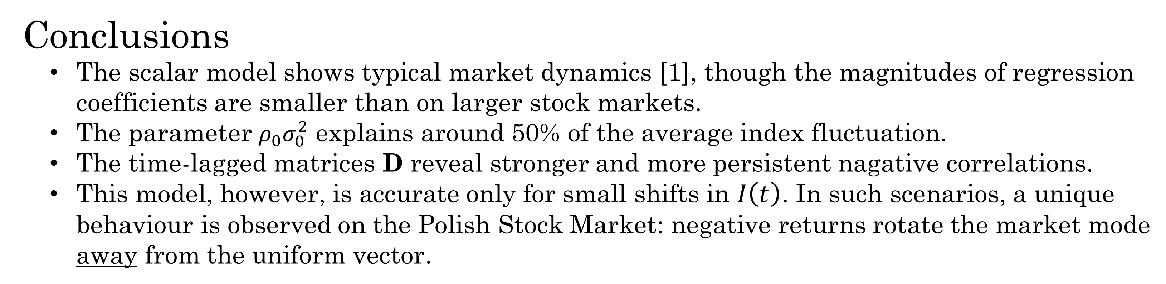
Investigating the Leverage Effect on the Polish Stock Market Using Principal Regression Analysis
Magdalena Latała¹, Tomasz Gubiec²
¹Faculty of Physics, University of Warsaw, Poland
²Institute of Experimental Physics, Faculty of Physics, University of Warsaw, Poland
Introduction
Financial markets are complex systems where, despite significant randomness, many intriguing mathematical patterns can be observed. One such phenomenon is the leverage effect, i.e. the tendency for market downturns to be associated with increased fluctuations and instability.
We investigate the presence of this effect on the Warsaw Stock Exchange. Specifically, we explore how correlations between assets contribute to its magnitude using two different approaches. Lastly, we predict how the correlations may evolve after a one-time market drop.
Methods
Results
Beyond the custom index: results of the same analysis for real index WIG.
Data:
Daily stock prices from the Warsaw Stock Exchange (2010-2014). The data used to be publicly available at https://bossa.pl/. 349 stocks and 3616 trading days were selected.
Log return of a stock $α$ :
$$r_{α}\left(t\right)=\log{\frac{p_{α}(t)}{p_{α}(t−1)} .}$$
Normalization: ${\left\langle r_{α}\right\rangle }_{t}=0$, ${\left\langle r_{α}^{2}\right\rangle }_{t}−{\left\langle r_{α}\right\rangle }_{t}^{2}=1$ .
Model 1: Scalar Regression of Volatility Components:
Regress $f∈\left\{I^{2}, σ^{2}, ρ\right\}$ on lagged index returns:
$$f\left(t\right)= f_{0}+ℒ_{f}\left(τ\right)I\left(t−τ\right)+ ε\left(t, τ\right) .$$
The two main components of index volatility $I^{2}\left(t\right)$:
$$I^{2}\left(t\right)≈ ρ\left(t\right)σ^{2}\left(t\right) .$$
Expected relation between regression coefficients:
$$ℒ_{I}\left(τ\right){≈ρ_{0}ℒ}_{σ}\left(τ\right){+ σ_{0}^{2}ℒ}_{ρ}\left(τ\right) .$$
Quantities Describing the State of the Market:
Mean-return, custom index:
$$I\left(t\right)={\left\langle r\left(t\right)\right\rangle }_{α} .$$
Average daily fluctuations of stock returns:
$$σ^{2}\left(t\right)={\left\langle r^{2}(t)\right\rangle }_{α} .$$
Average pairwise correlations between stock returns:
$$ρ\left(t\right)={\left\langle r_{α}(t)r_{β}(t)\right\rangle }_{α≠β} .$$
Model 2: Time-Lagged Correlation Matrices:
Detailed approach to stock return correlations:
$$r_{α}\left(t\right)r_{β}\left(t\right)=C_{αβ}+D_{αβ}\left(τ\right)I\left(t−τ\right)+ ε\left(t, τ\right) .$$
Dynamical "correlation matrix" :
$$C\left(I\right)=C_{0}+ID .$$
Principal Regression Analysis:
how dominant eigenvectors of $C\left(I\right)$rotate w.r.t. uniform market mode $|\left.e\right\rangle$ due to the "leverage" of ID.
Statistical Significance:
Marchenko-Pastur distribution: spectrum of $C_{0}$ .
Random $I\left(t\right)$ simulations: significance of $D$ eigenvalues.
$$I\left(t\right)=\left\{\begin{aligned}−&0.1 t=0 \\ &0 t≠0\end{aligned}\right.$$
t
Conclusions
The scalar model shows typical market dynamics [1], though the magnitudes of regression coefficients are smaller than on larger stock markets.
The parameter $ρ_{0}σ_{0}^{2}$ explains around 50% of the average index fluctuation.
The time-lagged matrices D reveal stronger and more persistent nagative correlations.
This model, however, is accurate only for small shifts in $I\left(t\right)$. In such scenarios, a unique behaviour is observed on the Polish Stock Market: negative returns rotate the market mode away from the uniform vector.
References
[1] P.-A. Reigneron, R. Allez, and J.-P. Bouchaud, Physica A 390, 3026–3035 (2011). [2] A. Karami, R. Benichou, M. Benzaquen, and J.-P. Bouchaud, Wilmott 2021, 63–73 (2021).

