Slide 1
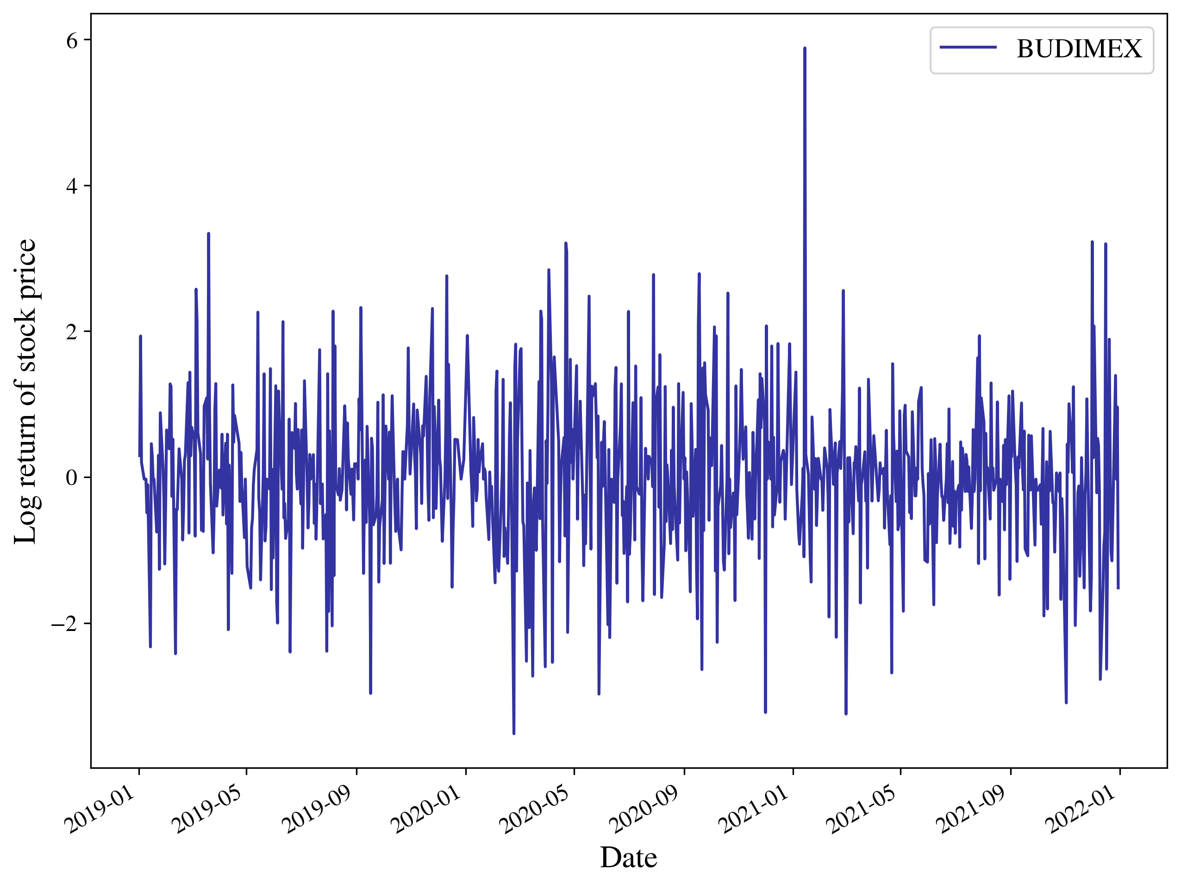
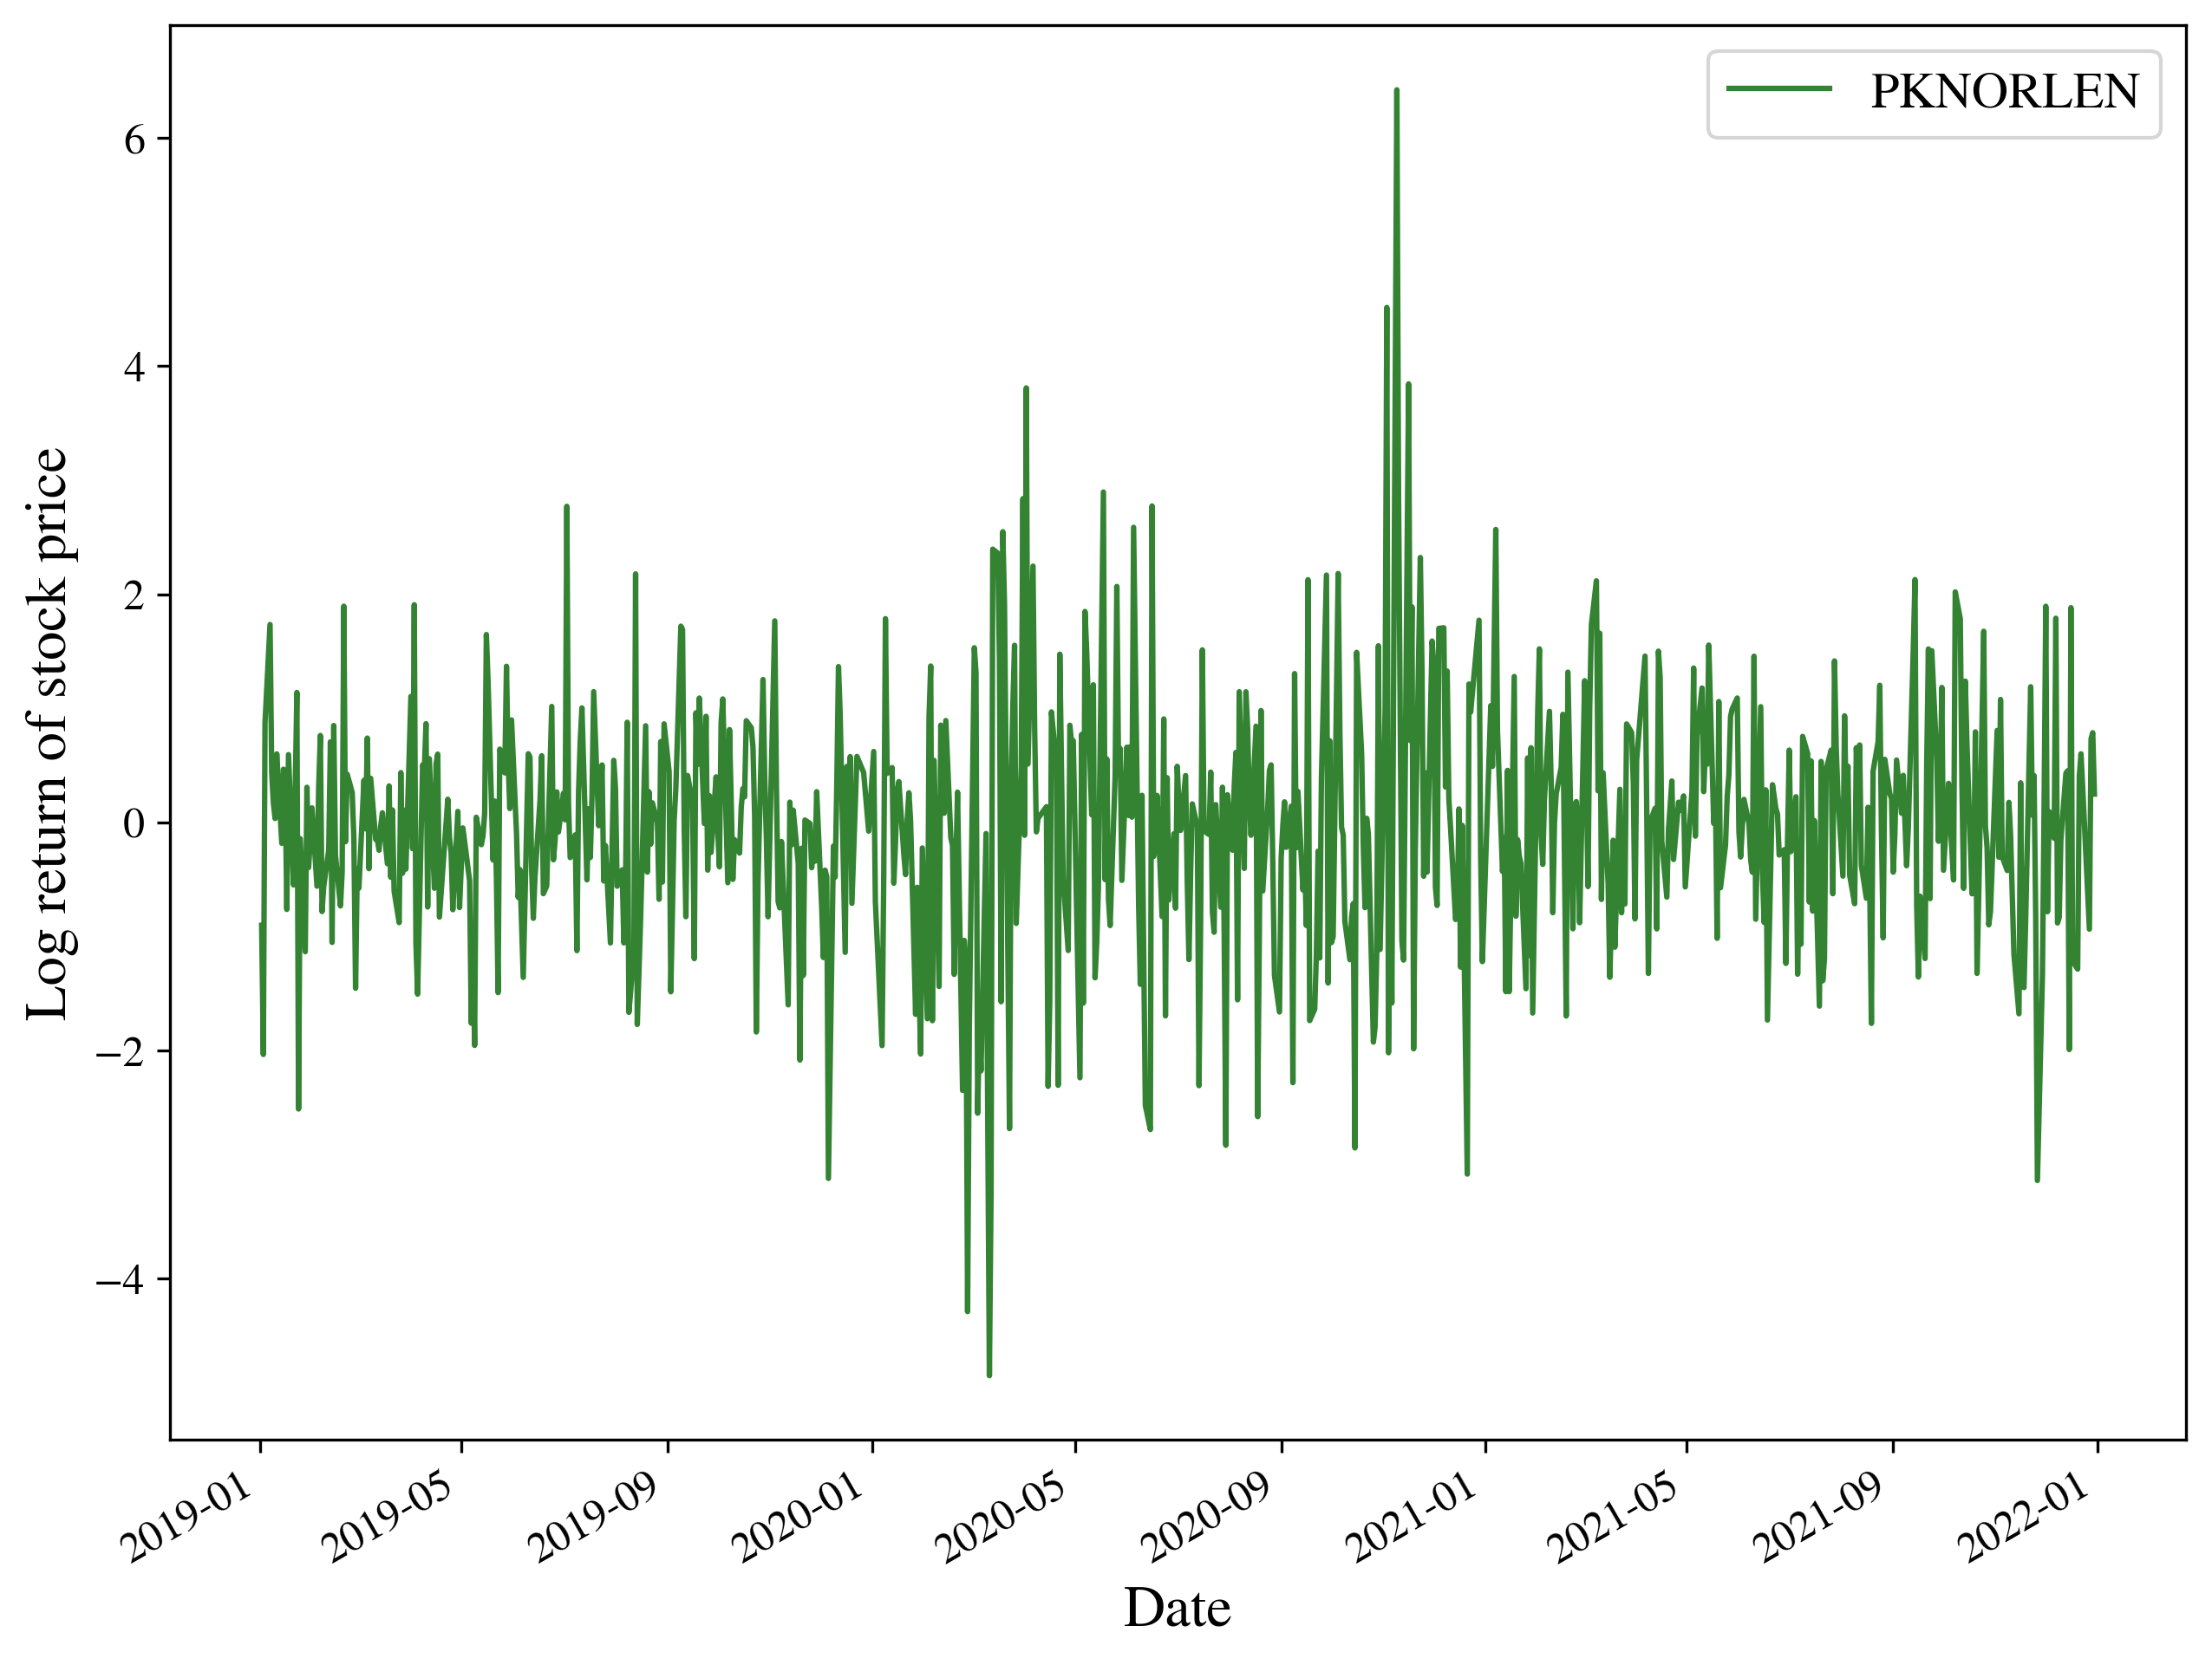
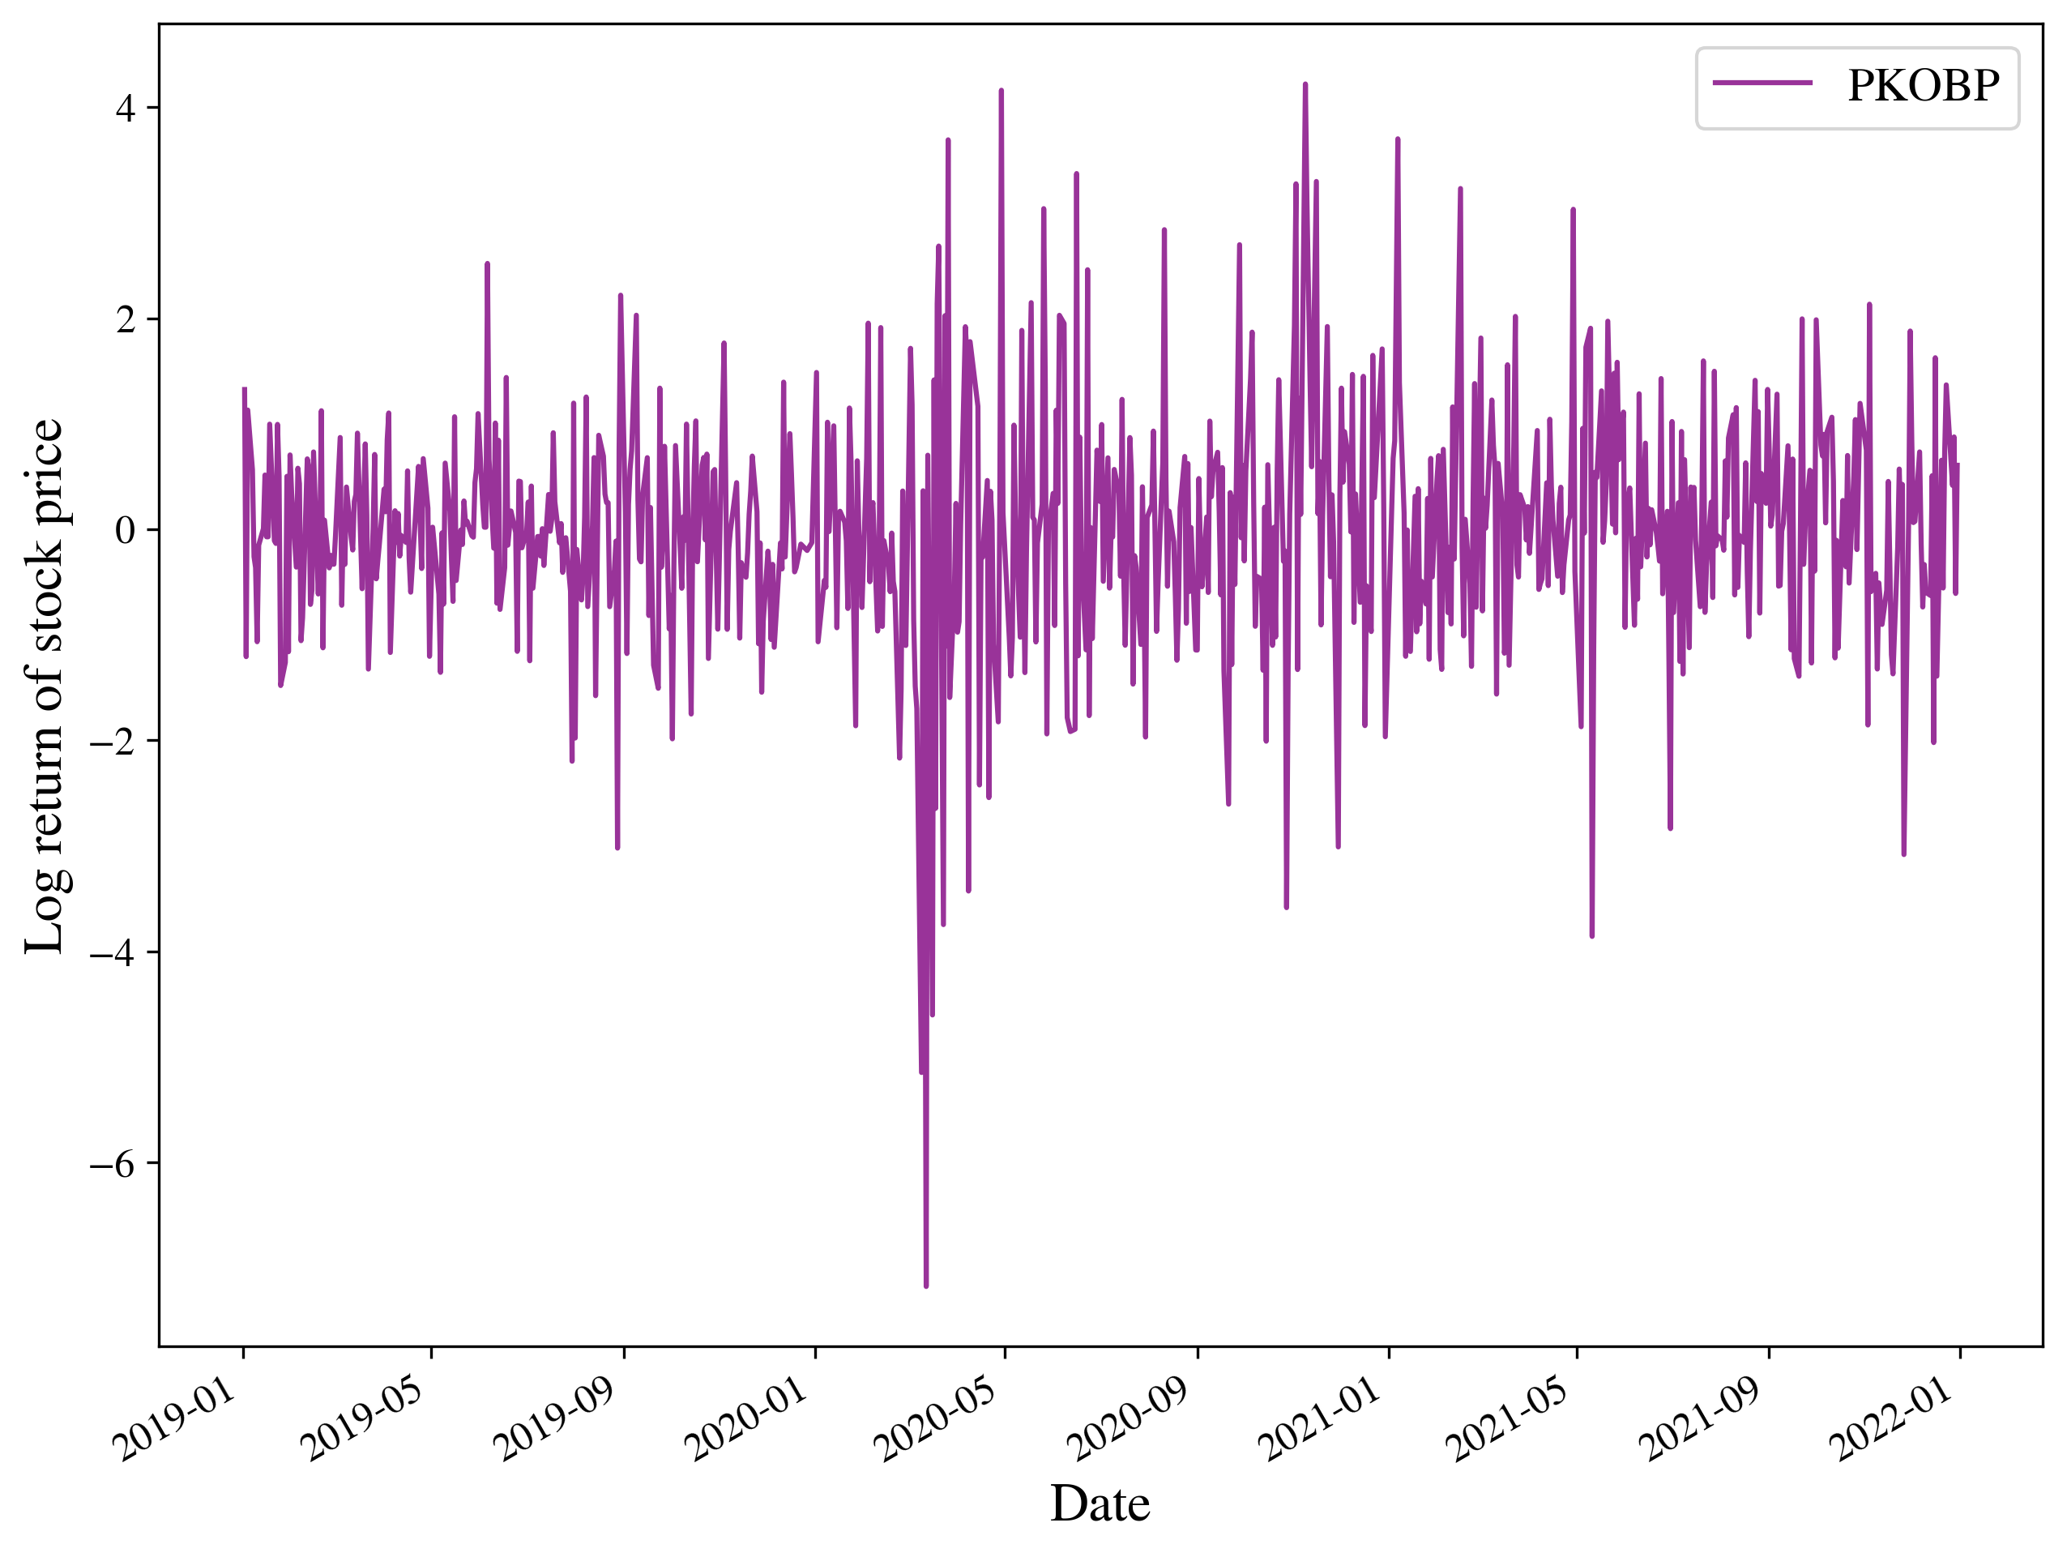
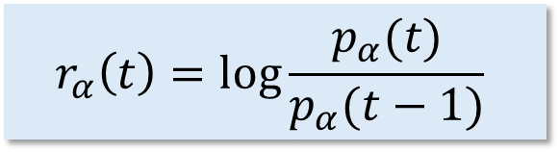
Investigating the Leverage Effect on the Polish Stock Market Using Principal Regression Analysis
Authors: Magdalena Latała, dr Tomasz Gubiec
$$r_{α}\left(t\right)=\log{\frac{p_{α}(t)}{p_{α}(t−1)} }$$

Slide 2
Investigating the Leverage Effect on the Polish Stock Market Using Principal Regression Analysis
Negative returns
Increased fluctuations
Fluctuations of an Index
Fluctuations of stocks
Correlations between stocks
The Index Leverage Effect

Slide 3
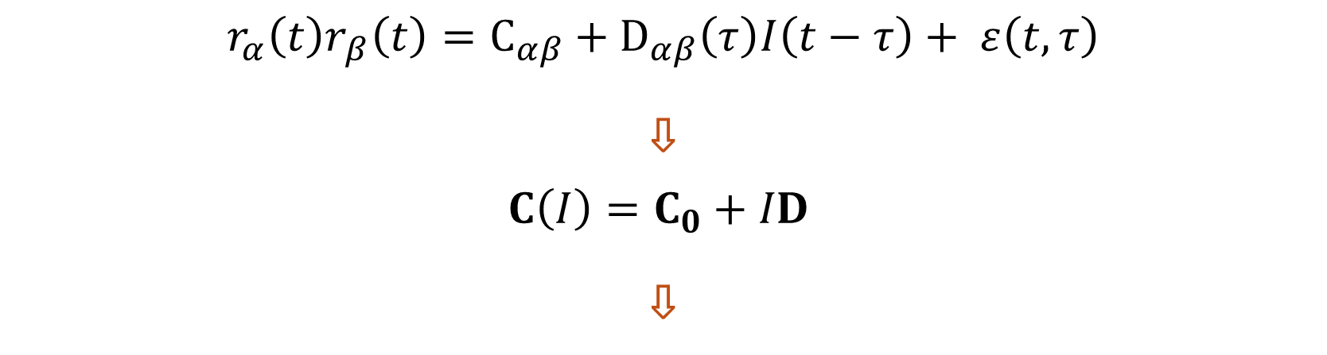
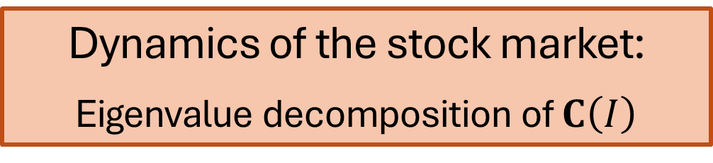
Investigating the Leverage Effect on the Polish Stock Market Using Principal Regression Analysis
$$r_{α}\left(t\right)r_{β}\left(t\right)=C_{αβ}+D_{αβ}\left(τ\right)I\left(t−τ\right)+ ε\left(t, τ\right)$$
⇩
$$C\left(I\right)=C_{0}+ID$$
⇩
Dynamics of the stock market:
Eigenvalue decomposition of $C\left(I\right)$

