Slide 1
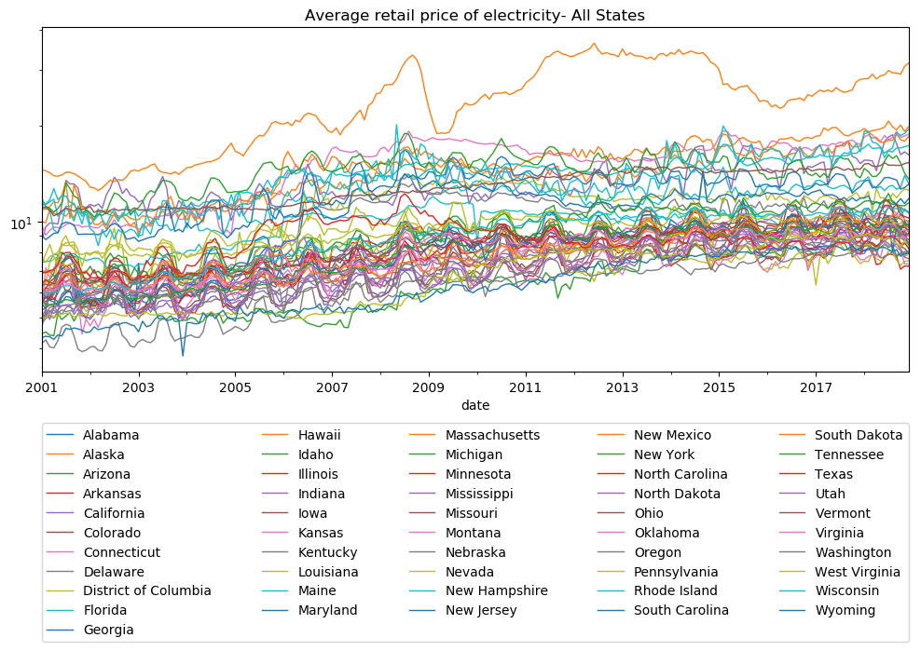

Electricity Price Forecast
July 2019

Slide 2

Problem Overview
Electricity has a very dynamic market price since it is a commodity that is essential for daily life and non-storable where generation and demand must be continuously balanced. This in turn make it dependable of the weather conditions.
Data Sources:
•U.S. Energy Information Administration (EIA)
•National Oceanic and Atmospheric Administration NOAA
2

Slide 3
Data Acquisition and Wrangling
API Exploration,
Data Acquisition
Data Wrangling
U.S. Energy Information Administration (EIA)
U.S. Energy Information Administration (EIA)
Summary monthly data per state
Summary data from each station at a State into a time range. Some States have around 350 stations
Data
Average Retail Price of Electricity
Net Generation
Average Retail Price of Electricity
Revenue from retail sales of electricity
Number of Customer Accounts
Date
State
Average Temperature
Minimum Temperature
Maximum Temperature
Date
ISO3166
Notes:
​ ​
Data Acquisition and Data Wrangling:¶
The data has to be gotten from different web sources. Each source provides APIs which have to be explored to get the required data for the project.
The data acquisition and data wrangling was divided in the following parts:
U.S. Energy Information Administration (EIA): API Exploration, data acquisition and data wrangling in order to get a single view data set of electricity prices, demand, etc by state per month in a year
Findings: Each variable series has to be independently fetched per State through APIs. Approach: All the data by state corresponding to the same variable was fetched in a loop and concatenated while adding the state information. It was nested in a loop corresponding to all the variables of interest where after fetching each variable, merged them in a single view. The rows that do not correspont to one State were deleted. Sample Result: [Link to Getting Sample Code] [Link to Sample Result]
National Oceanic and Atmospheric Adminostration (NOAA): API Exploration, data acquisition and data wrangling of data in order to get a single view data set of temperatures by state per month in a year Link to Section 2 Code
Findings: Global Monthly Summary series can be fetched per state through APIs. It provides summary data from each station at a State into a time range. Some States have around 350 stations. Nevertheless, the API maximum limit is 1000 records per fetch. Approach: A couple of loops where nested to fetch data per state per month to cope with the fetching limit. The first loop was used to get the data from all the stations in a State in a month. It was then grouped by date and variables to get the mean of all the stations in the state during that month. The group was unstacked to be able to concatenate with the information of the following month while adding the corresponding State information. This was nested in a per-state loop. Sample Result:[Link to Getting Sample Code]
Merging EIA and NOAA Datasets of one year data Link to Section 3 Code
Findings: The columns ('date' and 'iso3166'/'State') to be used to merge in a single view both data sets had different formats. Approach: - The ISO3166 acronyms for US states with its correspondent states where searched and placed in a csv file. - On the NOAA temperature data set, a column with the corresponding ISO3166 codes was added, as well as, 'date' was formatted to “YYYY-MM-DD’. - On the EIA data set, the date was formatted to “YYYY-MM-DD’' - Cleaning functions were defined for both EIA and NOAA data sets. - Merging of both data sets was done to get a single view of all the data of interest.
Retrieving Data from 2001 to 2018: Link to Section 4 Code
Findings: - NOAA server disconnect after cretain time. - EIA doe snot have data available through API previous to 2001 Approach: - Getting the data Year by Year (From 2001 to 2018): The three previous steps (1.- EIA data set acquisition per month by state in a year, 2.- NOAA data set Acquisition per month by state in a year, and 3.- Merging of EIA and NOAA data sets) were nested in a loop to get 18 years of data and save them in individuals .csv files per year. See cell In[30] in order to cope with server disconnections. - Getting all years of data in a single view: All the yearly .csv file were appended to get all the data in a single view and saved into a file. Files generated: eia_YYYY_YYYY.csv - one file per EIA year fetched noaa_YYYY_YYY.csv - one file per NOAA year fetched data_all_YYYY_YYYY.csv - one file per year fetched with EIA and NOAA data merged AllData_1.csv - File with all the data_all_YYYY_YYYY.csv files combined
Data Processing Link to Section 5 Code
5.1. Checking for missing information: Link to Section 5.1 Code
Findings: - All States were missing "number of accounts' per month for years early to 2008. In addition the state of Alaska also missed the 'monthly customer accounts' in the year 2016.

Slide 4
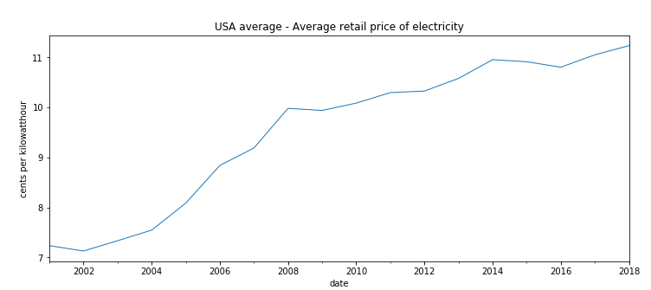
Behavior of historical electricity prices
Retail price of Electricity grows over time.

Slide 5
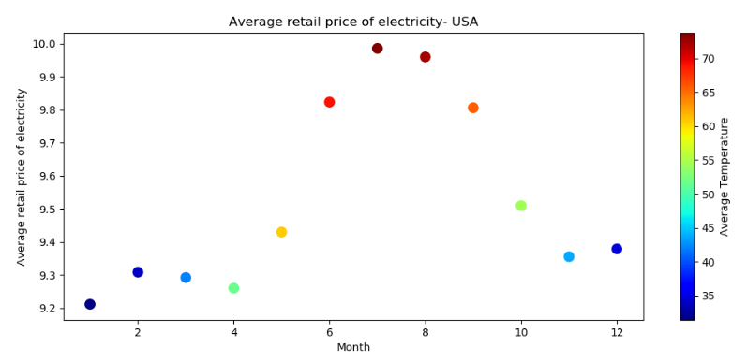
Electricity price & Temperature
Months of higher temperature, higher prices

Slide 6
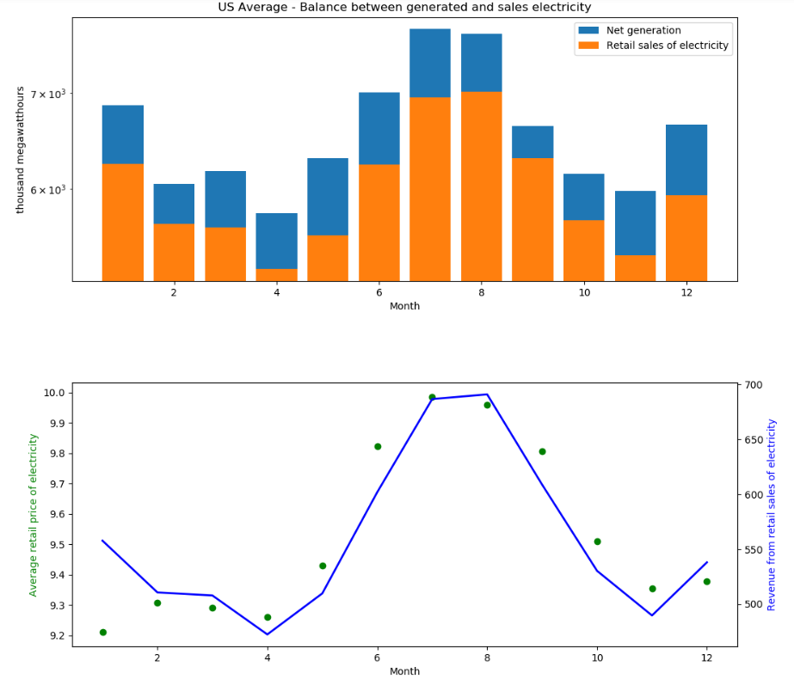
Price, Revenue, Demand
Higher sales, higher revenues.
Consecutive months with similar temperatures/demands as Dec-Jan and July-Aug, the prices slightly decrease the second month but revenue stay or increase.
Notes:
Revenue is higher when demand is higher.
Appropriate demand prediction lead to lower prices and higher revenue.

Slide 7
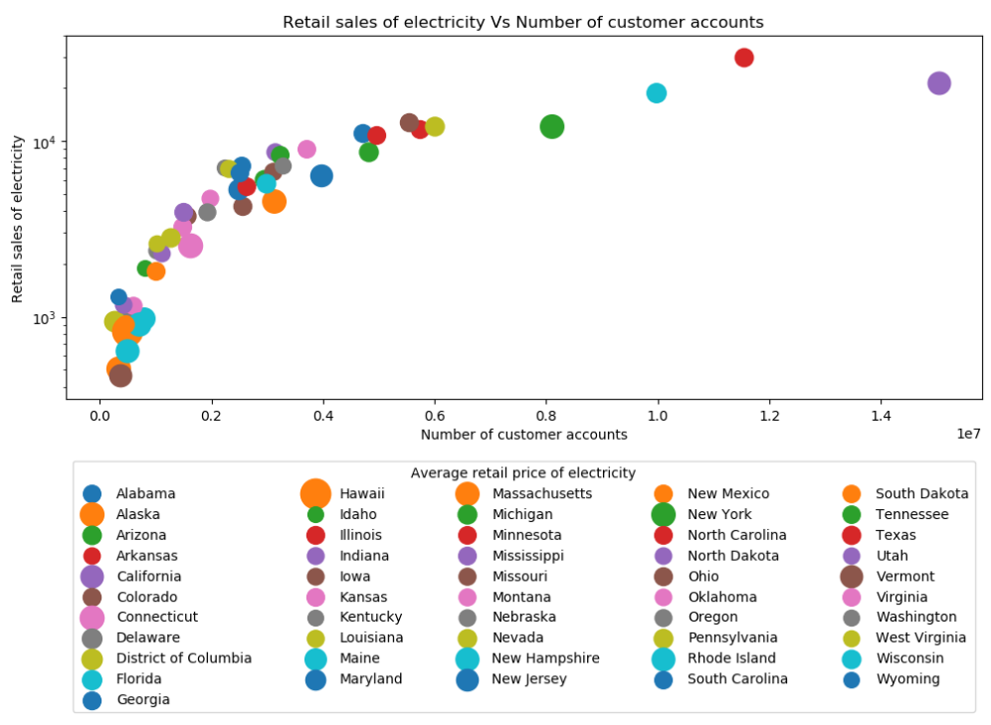
Number of customer Accounts

Slide 8
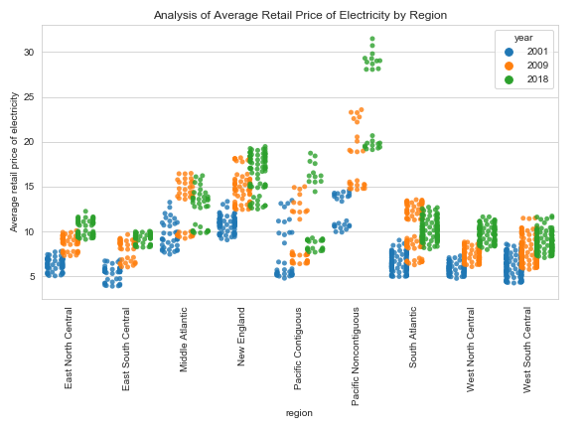
Exploratory Data Analysis
Notes:
-For this analysis the years 2001, 2009 and 2018 were selected for comparison purposes.
- It is observed that there is a tendency in electricity price increase. No remarkable outliers were identified. The regions with higher average price variance are the pacific continuos and non-continuos regions

Slide 9
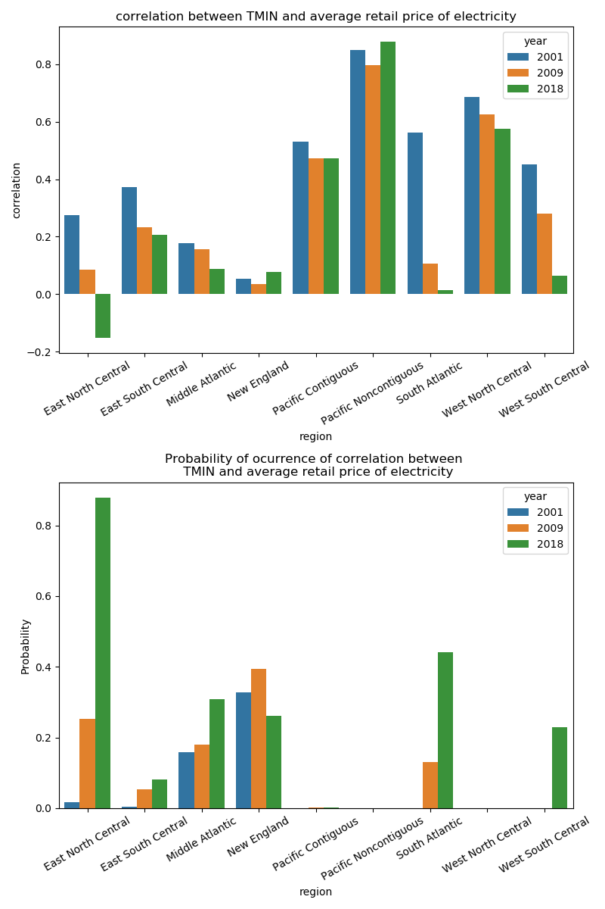
Exploratory Data Analysis
Low correlation between TMIN and Retail Price is something that is likely to happen but high correlation does not seen to be very likely
Notes:
-For this analysis the years 2001, 2009 and 2018 were selected for comparison purposes.
- It is observed that there is a tendency in electricity price increase. No remarkable outliers were identified. The regions with higher average price variance are the pacific continuos and non-continuos regions

Slide 10
Models under consideration
The Data is Time Series and non-stationary:
Time-series uni-variable models:
Moving Average
Facebook profet
ARIMA
- Grows over time
- Inflation or other macro-economic factors
Trend
- Periodic change of the price
- Correlation with temperature and/or other features
Seasonality
Multi-variable models:
Moving Average + Linear Regression (Combined model)
Moving Average + Lasso (Combined model)
Moving Average + Ridge (Combined model)
Moving Average + ElasticNet (Combined model)
Long Short-Term Memory (LSTM) (Unsupervised model)
Notes:
From Project1_Part2 can be visualized that the Data is Time Series and non-stationary due to:
1.Trend - the Retail price of Electricity grows over time. The trend component of our predicted variable might be due to inflation or some other macro-economic factors that are not reflected in the collected features into the data.
2.- Seasonality - there is a periodic change of the price which might be considered in some models as sesonality. Nevertheless, It was studied that the Retail price of Electricy tend to be higher in months with higher temperature. Thus, depending on the model these changes can be considered as a consequece of the correlation with temperature and/or other features.
time series uni-variable models base their predictions only on the date-time information. The above considered models are traditionally used for time-series predictions.
Combined models - Time-series univariable model + atemporal multivariable model: it considers a Time-series univariable model to forecast the trend + an atemporal multivariable model to forecast the differentiated data. The intention is to remove the trend part (inflation and other macro-ecomic factors) by using moving average and predict the remaining part (which depends on temperature, net generation, consumption, etc) by using different regressors. Thus, the predicted value would be the addition of both predictions.

Slide 11
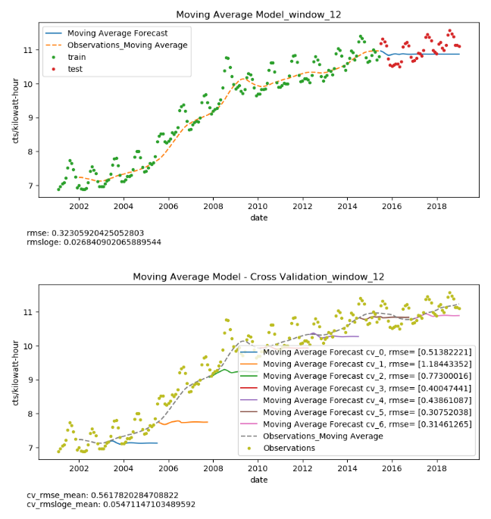
Moving Average
Smooth out short-term fluctuations and highlight longer-term trends or cycles.
A decent option for trend forecast but not for price fluctuations in short term.

Slide 12
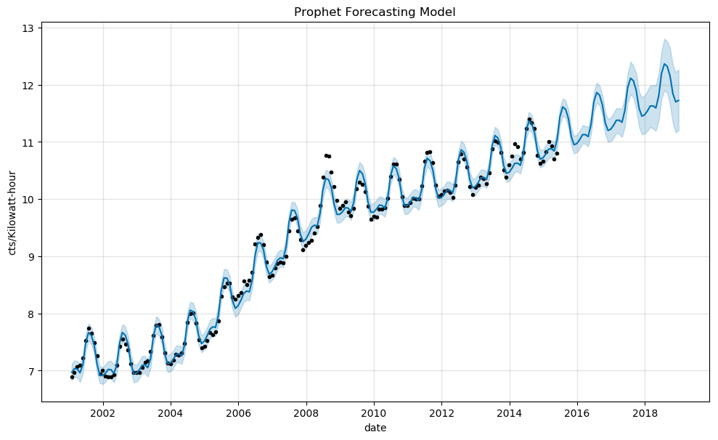
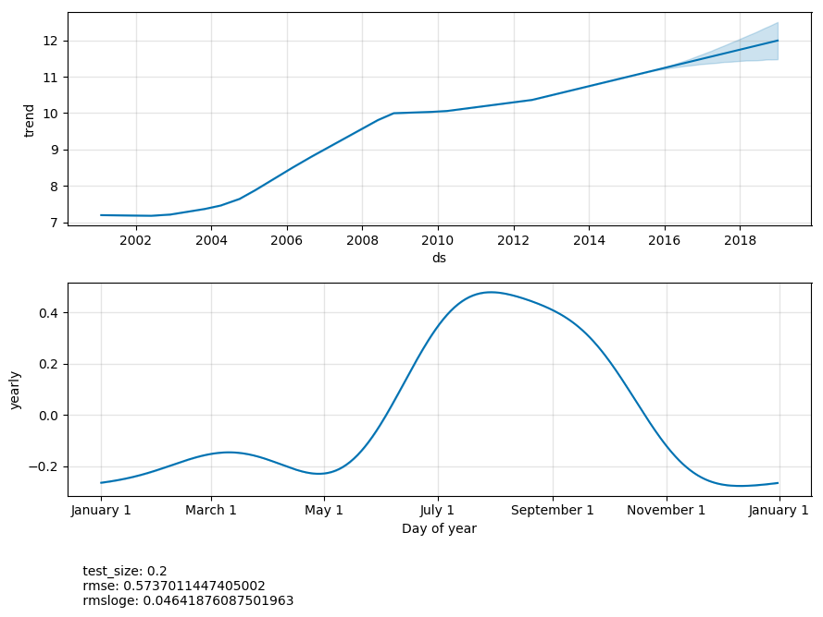
Facebook-Prophet
Y =Xi(1) Trend + Xi(2) Seasonality
Trend: linear regression with changing points as hyperparameter.
Hyperparameter: Default 'autoscale‘
Seasonalities: partial Fourier sum.
Hyperparameter: fourier_order=5 selected by inspection
Notes:
Time-series univariable model
Reference: https://facebook.github.io/prophet/docs/seasonality,_holiday_effects,_and_regressors.html
Prophet is a univariate model. It could be considered a naive model since it intends to predict the outcome based just on the dates (time series). The model descompount the outcome/response variable 𝑌 behavior into trend and seasonality parts.
Y =Xi(1) Trend + Xi(2) Seasonality
The trend estimator uses linear regression with changing points as hyperparameter. It was used 'autoscale' which is the default hyperparameter was used.
Seasonalities are estimated using a partial Fourier sum, which is a well known mathematic method traditionally used to model periodic electrical signals. The parameter fourier_order=5 was used. This values was selected by inspection of the graphs of the components since in Project 1_part2 was visualized the dependency of variation of price with respect month of the year due to temperatures. Also, an additive annual seasonality of 365 days was added based on the data analysis done in previous parts.

Slide 13
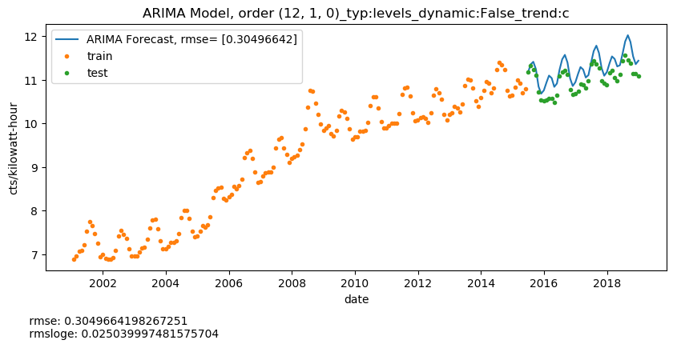
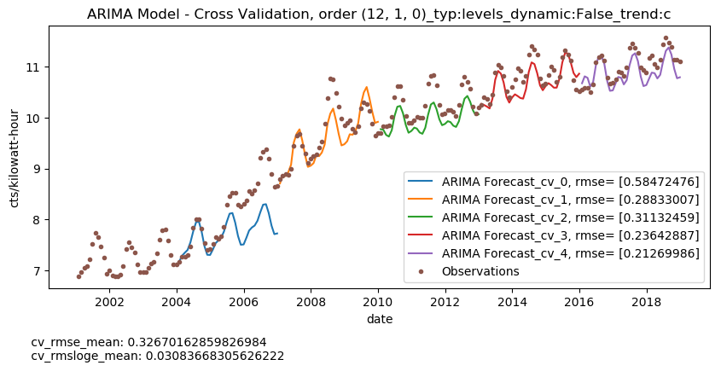
ARIMA
Notes:
Refrence: http://www.statsmodels.org/devel/generated/statsmodels.tsa.arima_model.ARIMA.fit.html
GridSearch from scikit-learn could not be used with ARIMA estimator as it does not implement a 'get_params' methods. Thus, a custom Gridsearch with cross validation was performed. It was found that the best ARIMA model hyperparameters are: order (12,1,0), typ=Levels, Trend=constant, Dinamic=False.
Due to the date dependency, the data split (done by TimeSeriesDataSplit of ScikitLearn) is performed sequentially taking different chunk sizes of sequential data. Bigger the number of splits, smaller the initial training sets. Therefore, there are additional convergence problems when the training data set is too small.
A manual cross-validation, in order to find the best tuned model, was done by splitting the data with TimeSeriesDataSplit of ScikitLearn. At most of the cases, the performance metrics (rmse and rmsloge) seems to be consistent with exception of the cv_0 which might be due to the short size of the training set.
<img src="img_part4/arima_model_(12, 1, 0)_levels_False_c.png">

Slide 14
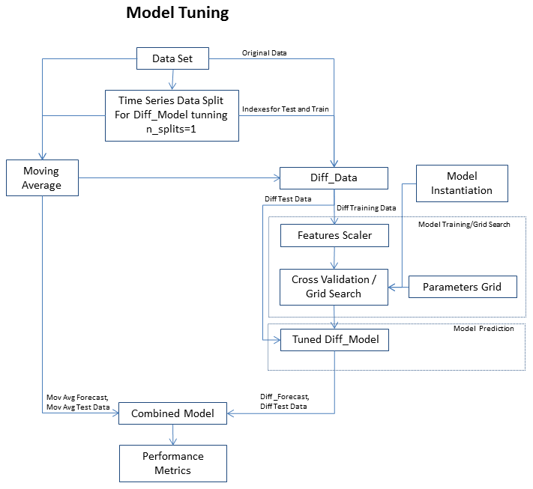
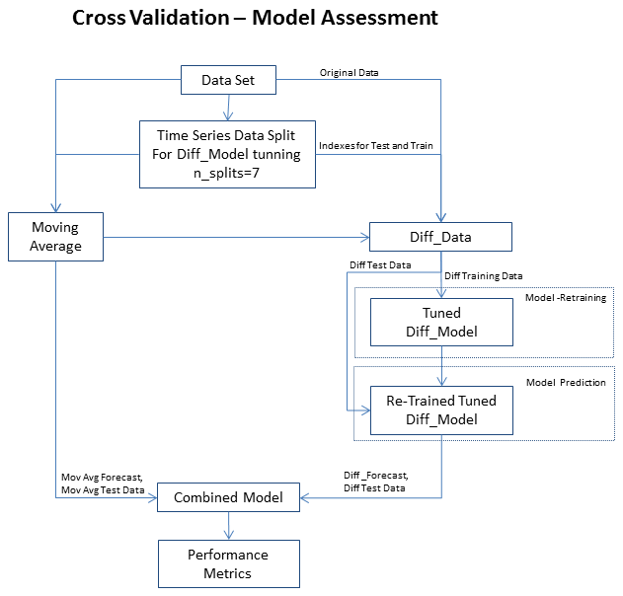
Moving Average + Other regressors
Moving average (Mov Avg) is used in this case to estimate the trend .
The difference of the outcome/response Y and the Mov Avg is called “differentiated outcome/response variable diff_𝑌” which is then considered an atemporal data set.
Notes:
In this part, the moving average is calculated to estimate the trend and substract it from the outcome/response variable 𝑌 in order to eliminate the growing trend. The differentiated outcome/response variable diff_𝑌 without trend is then considered an atemporal data set. The atemporability is giving by the fact that the "seasonality" changes can be predicted by using the features that affect such changes others than date/time.
Also, due to the scale difference between different features, pipeline consistent of a Scaler and a model from ScikitLearn had to be applied.
The standard cross-validation of the GridSearch from ScikitLearn was applied in this section of model tuning since the differentiated data is considered at this point atemporal.
Once, the best fit-parameters were found for the model of the differentiated data (See model Tuning diagram), It was found that passing just the best parameters to the 'differentiated' model to train it with smaller training data set was not as good as when the model is re-trainned with a small data set. Therefore, the model is saved to be re-trained for later predictions (See Cross-validation model assessment).

Slide 15
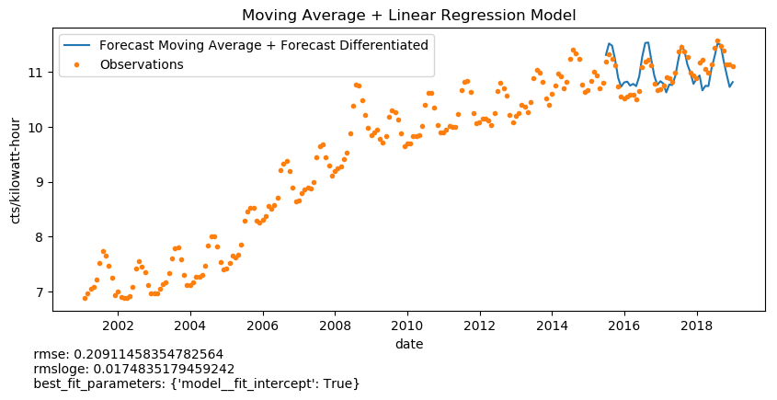
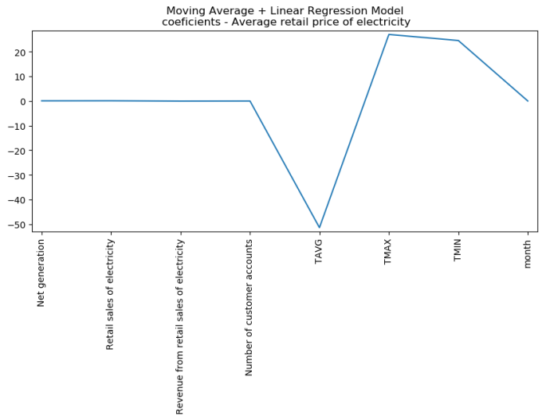
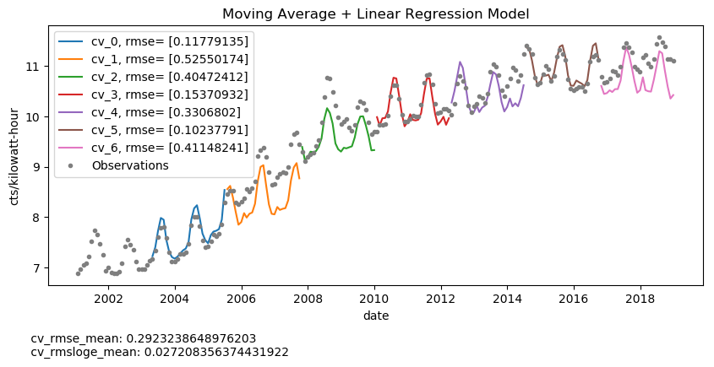
Mov Avg + Linear Regression

Slide 16
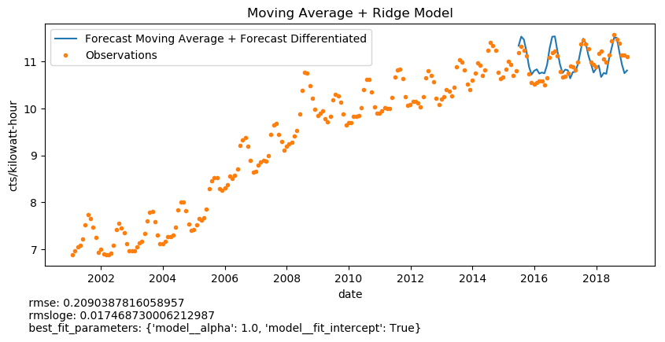
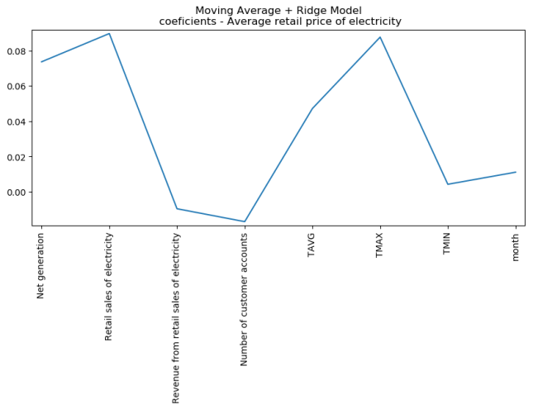
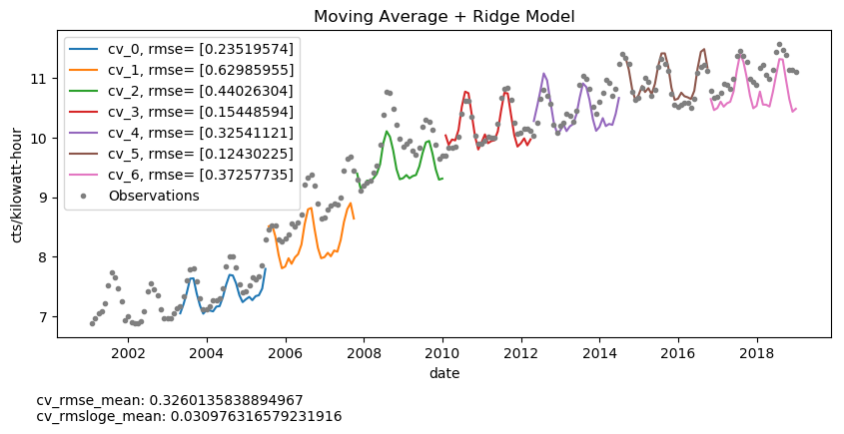
Mov Avg + Ridge

Slide 17

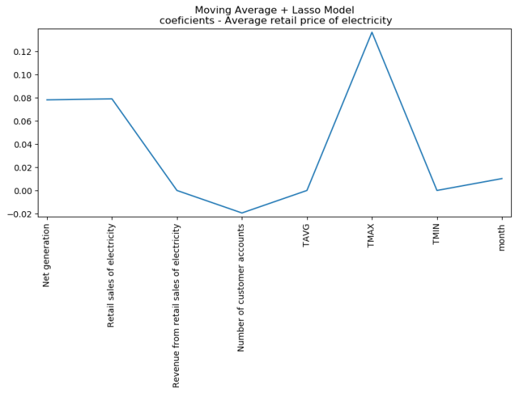
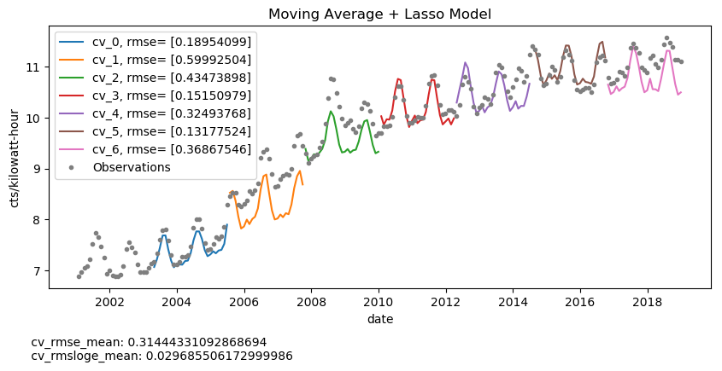
Mov Avg + Lasso

Slide 18
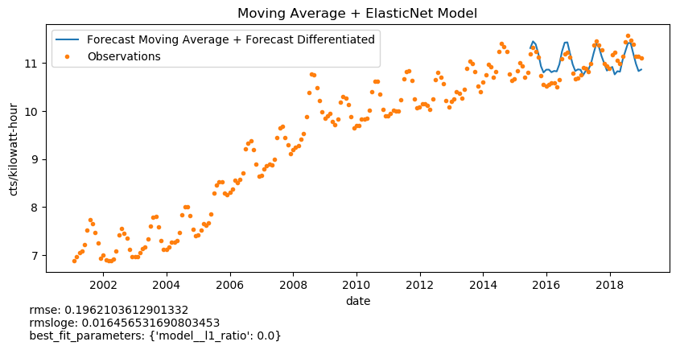
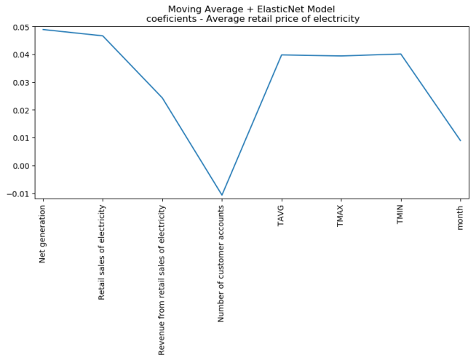
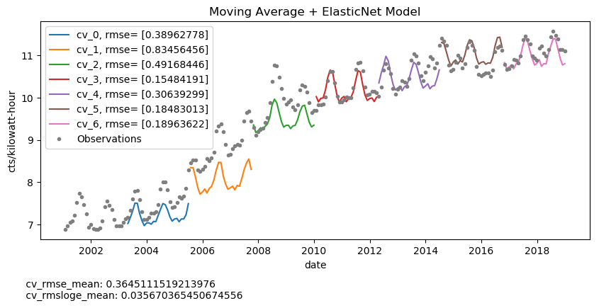
Mov Avg + ElasticiNet

Slide 19
Model Selection Metrics
 | cv_rmse_mean | cv_rmsloge_mean | rmse | rmsloge
Moving Average | 0.5618 | 0.0547 | 0.3231 | 0.0268
fbprophet | 0.3647 | - | 0.5737 | 0.0464
Mov_Avg+Linear Regression | 0.2923 | 0.0272 | 0.2091 | 0.0175
Mov_Avg+Lasso | 0.3144 | 0.0297 | 0.2081 | 0.0174
Mov_Avg+Ridge | 0.3260 | 0.0310 | 0.2090 | 0.0175
Mov_Avg+ElasticNet | 0.3645 | 0.0357 | 0.1962 | 0.0165
ARIMA | 0.3267 | 0.0308 | 0.3050 | 0.0250

Slide 20
Conclusions
Time Series models as fbprophet and ARIMA are good options to forecast prices based on historical trends and seasonality.
Combined models Mov_Avg + other regressors performance is comparable to fbprophet and ARIMA model in the electricity price case.
Time series models as fbprophet and ARIMA use as only feature the date-time information while the combined models use other features to forecast the differentiated (seasonality) part.
The best model to use would depend on the purpose of the forecast and the available information.
It is recommended to re-trained the selected model with new data in order to capture changes on patterns of behavior.

Slide 21
Next Steps
The current analysis was based on US average temperature. Nevertheless, individual models per US region has to be tuned in order to be able to forecast Electricity price at any state of USA.

Slide 22

Contact:
Elizabeth Izarra, PhD, PMP, P.E., MBA
maria_e_g@hotmail.com
Tlf: 202- 436-4505

