Slide 1

Parchment Press
Meg Kellenberger
CSD310

Slide 2
Case Study—Parchment Press
My case study for this project was Parchment Press.
The goal of this case study was that the owners of parchment press wanted to see if they were doing well enough to expand the store to a new location in the same city (Parchment Press, n.d.).
To determine if this is possible the team needed to know the following:
What are the sales reports by department for each month for the past six months? Employee time. During each of the last four quarters, how many hours did each employee work? Which buyer brought in the most inventory? Which brought in the least? (“Parchment Press”, n.d.)
The reports and ERD are on the next few slides.

Slide 3
Assumptions & Business Rules Made During the Project
Each hourly employee can work overtime, but salaried employees cannot
Only one employee can have the most and least sales
Each department has only one buyer.
Each department can only have one report.
Each employee can belong to only one department.
Each department can have multiple direct employees.
The name of the individual employees is not necessary but would be a part of the business data and the case study requested a report of the employee with the most sales and least sales, a name can make results more readable than the ID. It is assumed that overtime are any worked hours greater than 40. Hours are assumed to be for the week.

Slide 4
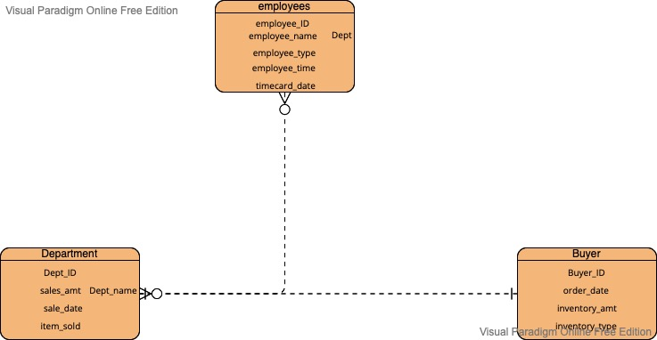
ERD

Slide 5

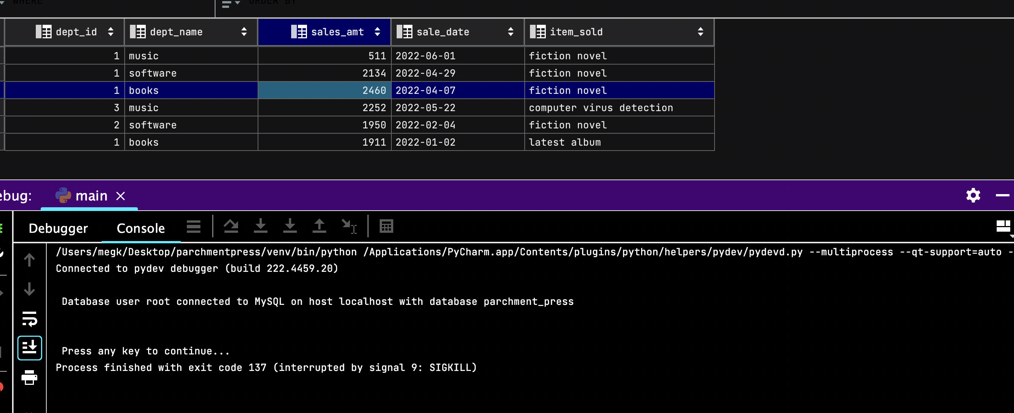
Report and Table 1
Sales reports by department ID for the last 6 months. This shows which departments are selling the most.

Slide 6
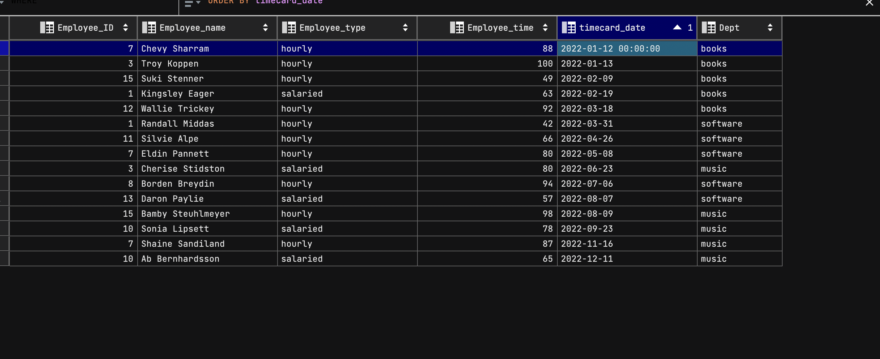

Report and Table 2
Employee Time—employees who worked overtime in past 12 months by quarter
Shows which employees are working overtime, therefore showing whether more staff/an expansion would be needed.

Slide 7
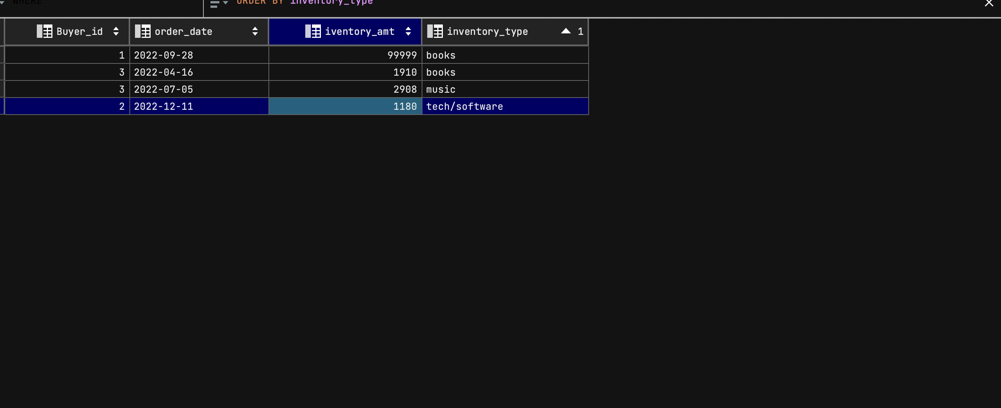
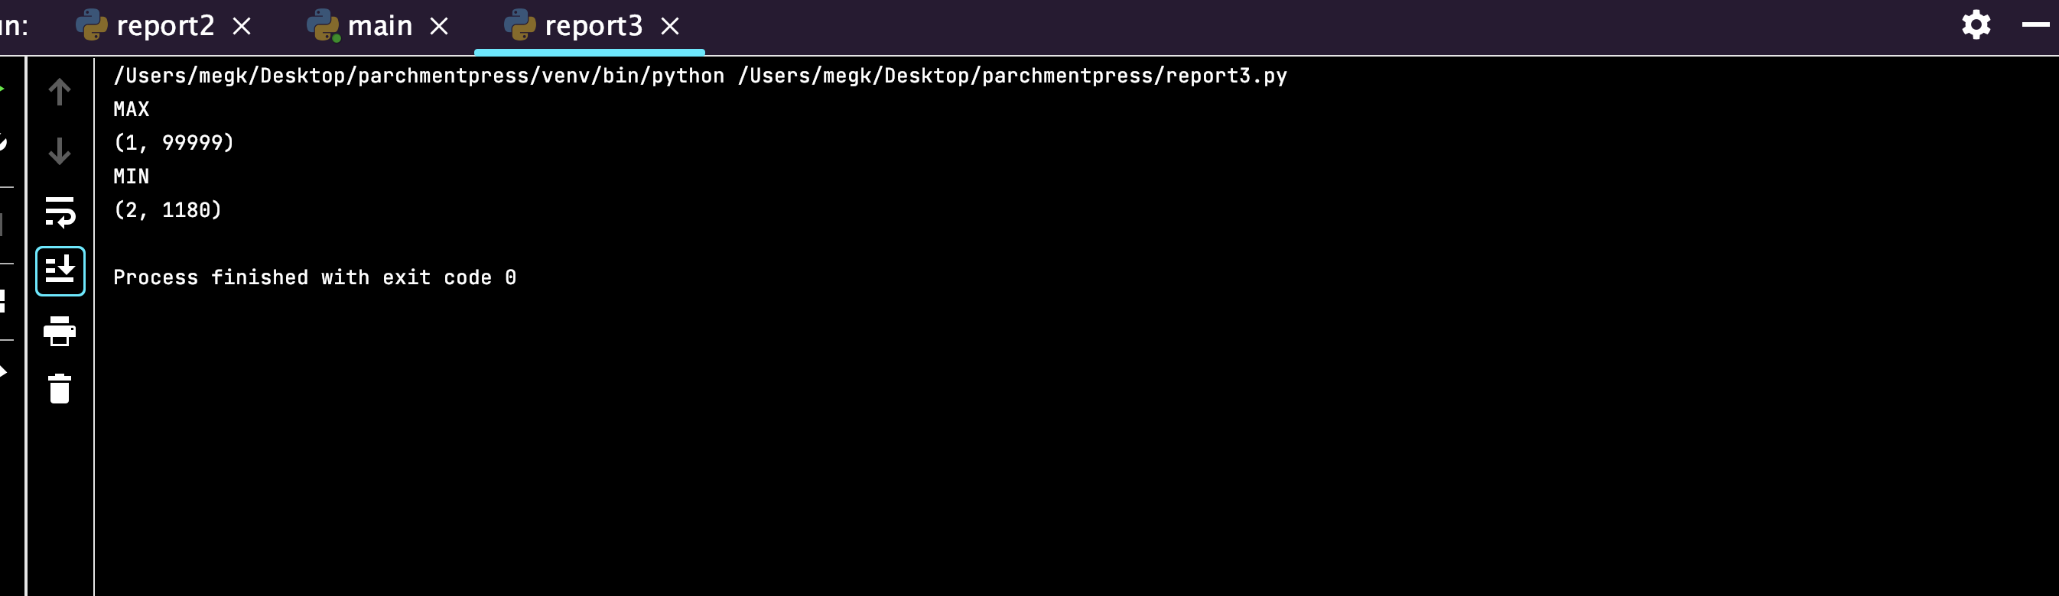
Report and Table 3 Buyers with the most and least inventory amounts. Shows which buyers are bringing in most and least inventory-–thus what may be selling.

Slide 8
Thank you!
The END

