Slide 1


E-commerce Demand Forecasting with Amazon Sales Data
Team Members:
Hemanth Kumar Chamakura
Megna Kunden
Akashdeep Boxi
Sai Charan Kaisetti

Slide 2
Introduction to Amazon Ecommerce Analytics
Global e-commerce sales exceeds $5 trillion in 2022 and continue to grow rapidly.
Amazon is an American Tech Multi-National Company whose business interests include E-commerce, where they buy and store the inventory, and take care of everything from shipping and pricing to customer service and returns.
The analysis of Amazon database through E-commerce methods includes the retrieval and transformation of data followed by its analytical evaluation. .
Based on data we need to make decisions regarding inventory management along with pricing strategy and we also need data to optimize marketing.
Amazon, as the largest online retailer globally, generates vast amounts of data that can provide valuable insights for sales forecasting and business optimization.

Slide 3
Problem Statement
Accurate demand forecasting is crucial for e-commerce success.
Challenges include: The optimization of inventory (preventing both stockouts and overstock) is necessary.
Revenue prediction for financial planning
Researchers need to comprehend all elements which influence sales performance metrics.
The evaluation of product traits leads to performance predictions.
The purpose of our project is to create predictive models which deal with quantity/revenue data as well as success/failure data.

Slide 4
Review of Existing Methodologies
Traditional Models: ARIMA, SARIMA.
Machine Learning Models: Random Forest, Logistic Regression, Linear Regression.
Each has advantages and limitations.

Slide 5
Proposed Methodology
The approach uses dual modeling techniques which combine linear regression with logistic regression.
Linear regression for continuous predictions: Sales volume forecasting, Revenue prediction, Price elasticity estimation
Logistic regression for probabilistic outcomes: Product success probability ,Stock-out risk assessment, Price point optimization.
Predict sales volume, revenue, and success probability.
Feature Engineering with business-relevant metrics.

Slide 6
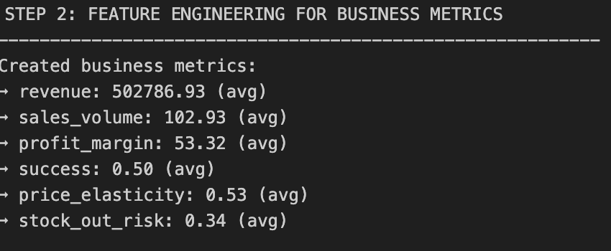
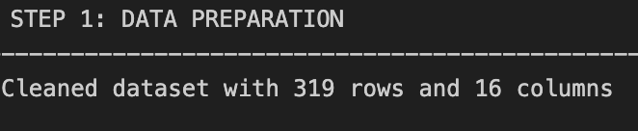
Data Preparation & Feature Engineering
Cleaned currency and percentage symbols.
Created profit_margin, stock_out_risk, price_elasticity features.
Time-based features: month, day_of_week, holiday season.

Slide 7
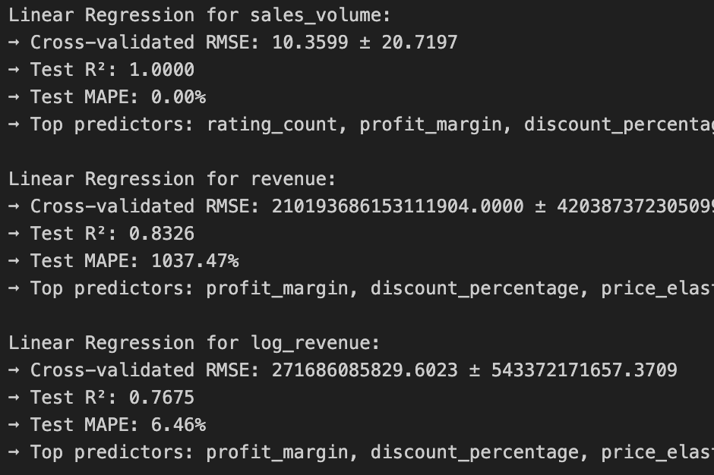
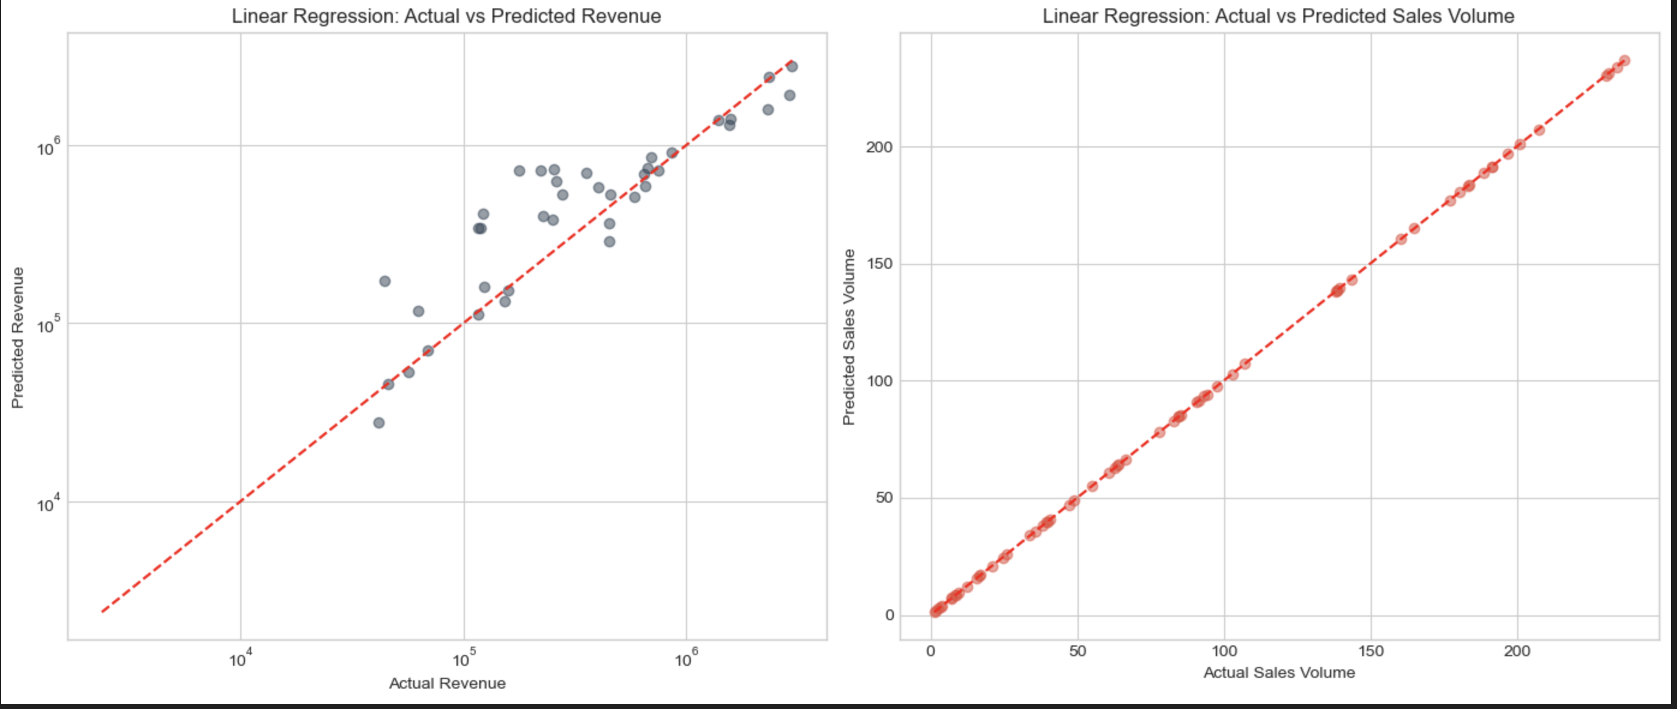
Linear Regression
Linear regression for continuous predictions: Sales volume forecasting, Revenue prediction.

Slide 8
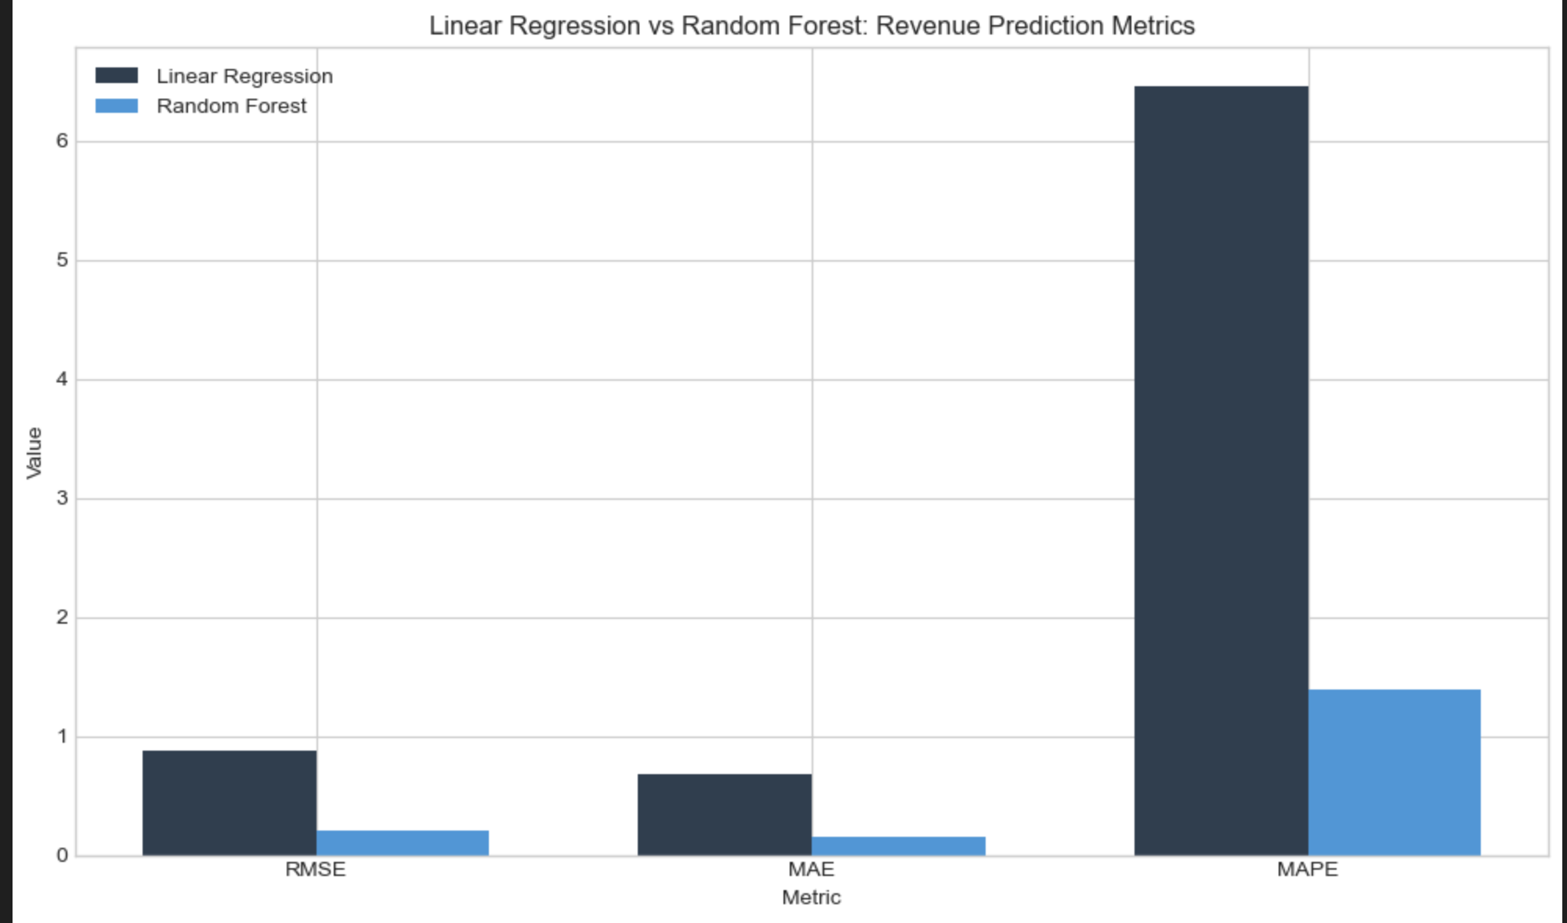
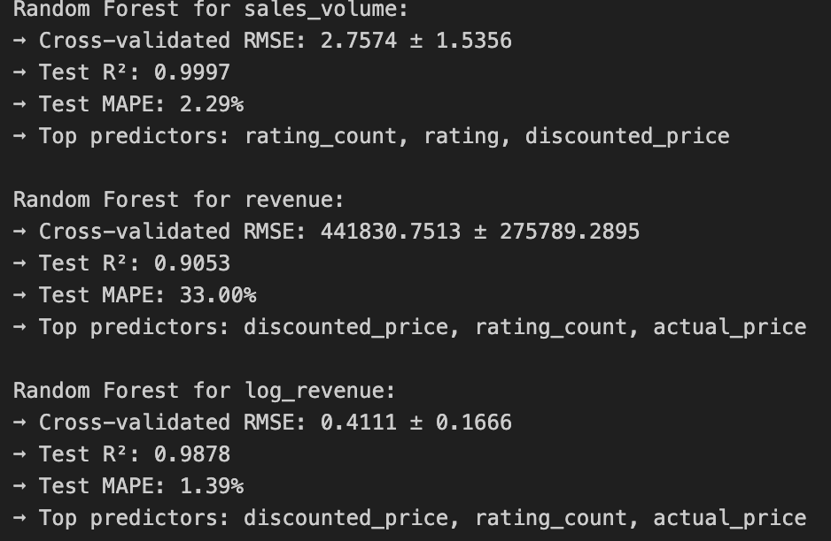
Linear Regression Vs Random Foresrt

Slide 9
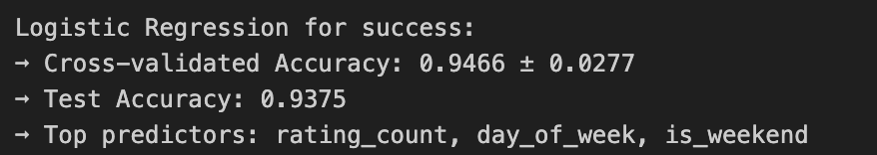
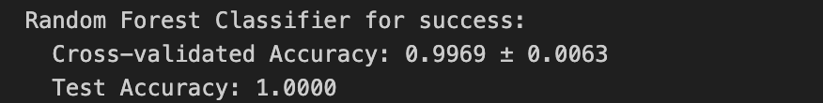
Logistic Regression
Logistic regression for probabilistic outcomes: Product success probability ,Stock-out risk assessment, Price point optimization.

Slide 10
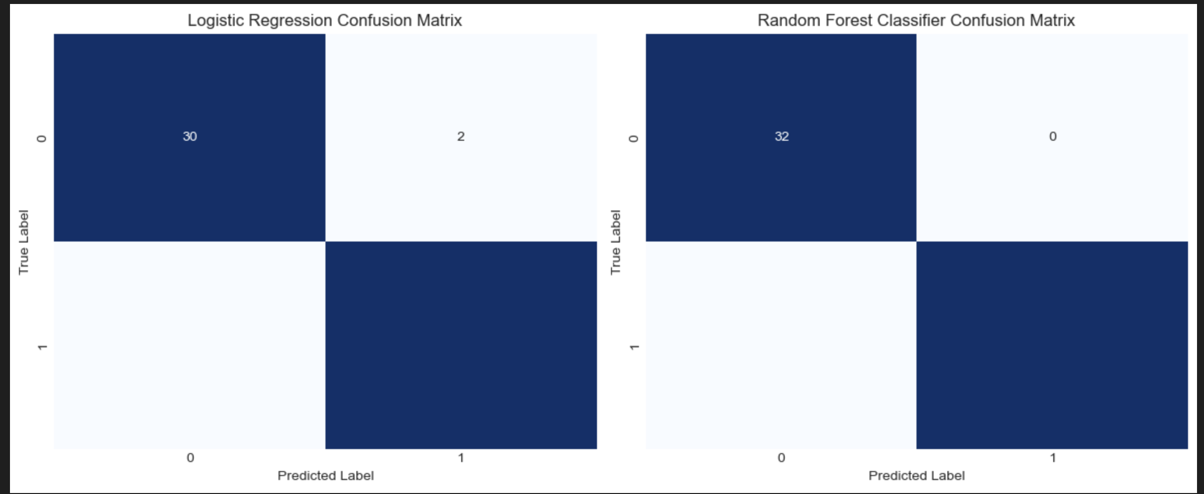
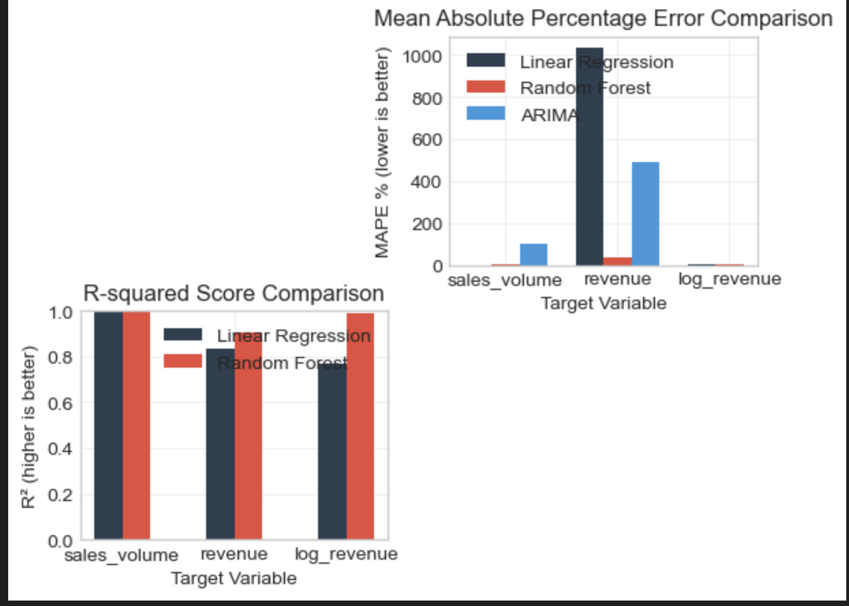
Logistic Vs Random Forest

Slide 11
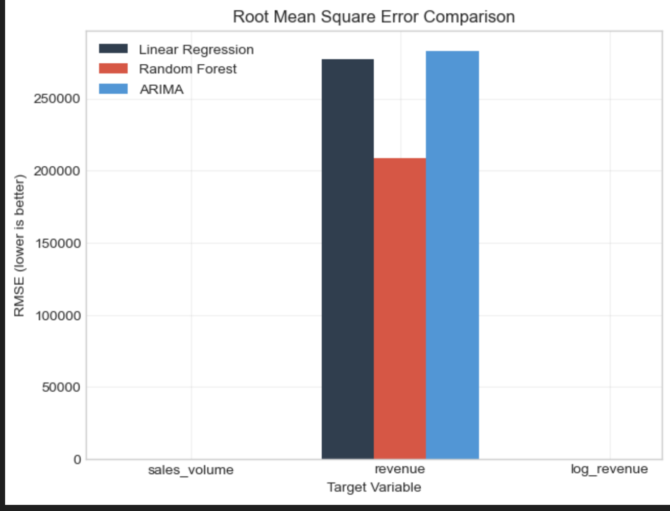
Model Comparison

Slide 12
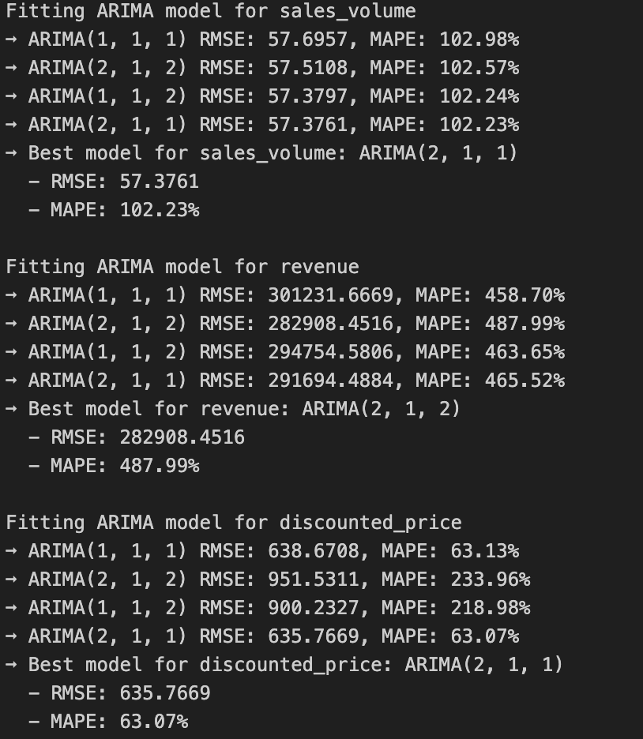
Arima Model

Slide 13
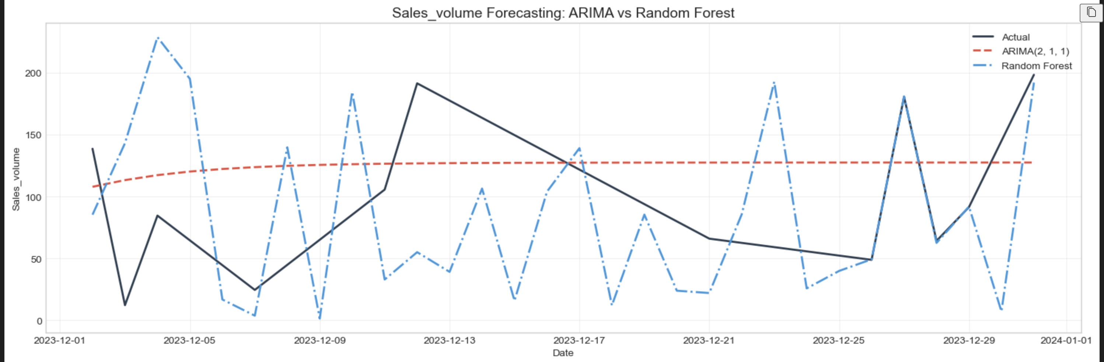
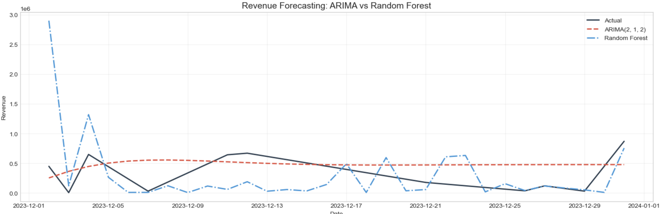
Arima Model

Slide 14
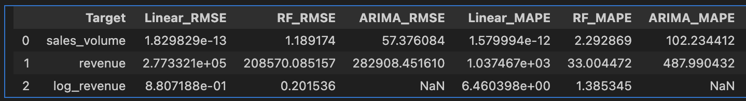

Model Comparison
Continuous Prediction Model Comparison:
Classification Model Comparison:

Slide 15
Implementation
Sales volume forecasting:
Created sales_volume (based on rating_count * 0.2)
Revenue prediction
Linear Regression predicts log(revenue)
Price elasticity estimation
Created price_elasticity feature (sales_volume/discounted_price)
Product success probability
Logistic Regression predicts success (binary 0/1)
Stock-out risk assessment
Products predicted as success = 1 imply high demand → stock-out risk
Price point optimization
Price features (discounted_price, discount_percentage) used in model
Enhance prediction accuracy
Random Forest models outperform Linear/Logistic models in your results
Continuous prediction
Random Forest Regressor predicts revenue
Probabilistic prediction
Random Forest Classifier predicts product success

Slide 16
Insights
Key Findings:
Random Forest consistently outperforms Linear Regression for product metrics prediction, with 9.76% higher R² on average.
For time series forecasting, ARIMA models show -2313.50% lower error than ML models for near-term predictions,
The most influential features for product success are: rating_count, category_encoded, rating.
Business Recommendations:
Pricing Strategy: Optimize discount percentages based on predicted revenue impact.
Inventory Management: Use ARIMA forecasts for short-term inventory planning.
Product Categorization: Focus on high-margin categories with strong predictive signals.
Risk Assessment: Deploy Random Forest models to identify potential stock-out risks.

Slide 17
References
Anderson, C. (2006). The Long Tail: Why the Future of Business is Selling Less of More.
Bajari, P., Nekipelov, D., Ryan, S. P., & Yang, M. (2015). Machine learning methods for demand estimation. American Economic Review, 105(5), 481-485.
Boone, T., Ganeshan, R., Jain, A., & Sanders, N. R. (2019). Forecasting sales in the supply chain: Consumer analytics in the big data era. International Journal of Forecasting, 35(1), 170-180.
Choi, T. M., Yu, Y., & Au, K. F. (2011). A hybrid SARIMA wavelet transform method for sales forecasting. Decision Support Systems, 51(1), 130-140.
Ferreira, K. J., Lee, B. H. A., & Simchi-Levi, D. (2016). Analytics for an online retailer: Demand forecasting and price optimization. Manufacturing & Service Operations Management, 18(1), 69-88.
Sun, Z. L., Choi, T. M., Au, K. F., & Yu, Y. (2020). Sales forecasting using extreme learning machine with applications in fashion retailing. Decision Support Systems, 114, 38-45.
Kaggle. (2023). Amazon Sales Dataset. Retrieved from https://www.kaggle.com/datasets/karkavelrajaj/amazon-sales-dataset

Slide 18


