Slide 1
Computational Modeling in Python: Distributional Semantic Models
EMLaR 2025
Utrecht University
Meaghan Fowlie

Slide 2
Plan for today
Computational Modelling: what is it, and why should we care?
Our case study for today:
Learning Words from Context
Representing word meaning from context:
Distributional Semantic Models
Practical: let’s implement the model!

Slide 3
Getting set up
Install the Anaconda distribution of Python
Download the tutorial materials from GitHub
Open the Jupyter Notebook called EMLAR2022.ipynb

Slide 4
What is a model?
A model is a formal and simplified representation of some aspect of reality

Slide 5

What is a Model?
A model is a formal and simplified representation of some aspect of reality
Reality

Slide 6

What is a model?
A model is a formal and simplified representation of some aspect of reality
Reality
Simplification

Slide 7


What is a computational model?
A model that can be described in a programming language as a sequence of steps that transform an input x into an output y.
x → → y

Slide 8
Why should we use computational models?
Formalization of a theory
  Eliminate vagueness of verbal descriptions
Prediction of unseen cases
Explore causal explanations and build new theories (bottom-up)
Automatization: we can apply (multiple) models to large amounts of data

Slide 9
What kinds of computational models exist?
1000s of different architectures available

Slide 10
What kinds of computational models exist?
1000s of different architectures available
Most models are designed to answer specific questions
  How do children segment words? How do people represent semantics?

Slide 11
What kinds of computational models exist?
1000s of different architectures available
Most models are designed to answer specific questions
  How do children segment words? How do people represent semantics?
But some are unified theories of cognition (e.g., Soar, ACT-R)

Slide 12
What kinds of computational models exist?
1000s of different architectures available
Most models are designed to answer specific questions
  How do children segment words? How do people represent semantics?
But some are unified theories of cognition (e.g., Soar, ACT-R)
There are some common ways of classifying cognitive models
  Connectionist (Neural, Deep Learning, PDP), Symbolic, Bayesian

Slide 13
What kinds of computational models exist?
Often there are multiple ways to model the same behaviour or cognitive processes

Slide 14
What kinds of computational models exist?
Often there are multiple ways to model the same behaviour or cognitive processes
But this is not necessarily a problem

Slide 15
What kinds of computational models exist?
Often there are multiple ways to model the same behaviour or cognitive processes
But this is not necessarily a problem
It is often a good thing! Creates opportunities for comparing different theories

Slide 16
What kinds of computational models exist?
Models can target different levels of abstraction (Marr, 1982)
  What is learnable? How is it learned? How does this arise from neural structures?
Different models might serve different goals, while still being derived from the same theory/hypotheses

Slide 17
All models are wrong but some are useful
For language acquisition research, our main goal with modelling is to test causal hypotheses and make predictions
Your model doesn’t have to be an airtight explanation of every aspect of a phenomenon (semantics is very complex!)
If the model provides a way of formally testing your ideas or can make testable predictions, then it is useful

Slide 18
Today: Learning Words From Linguistic Context

Slide 19

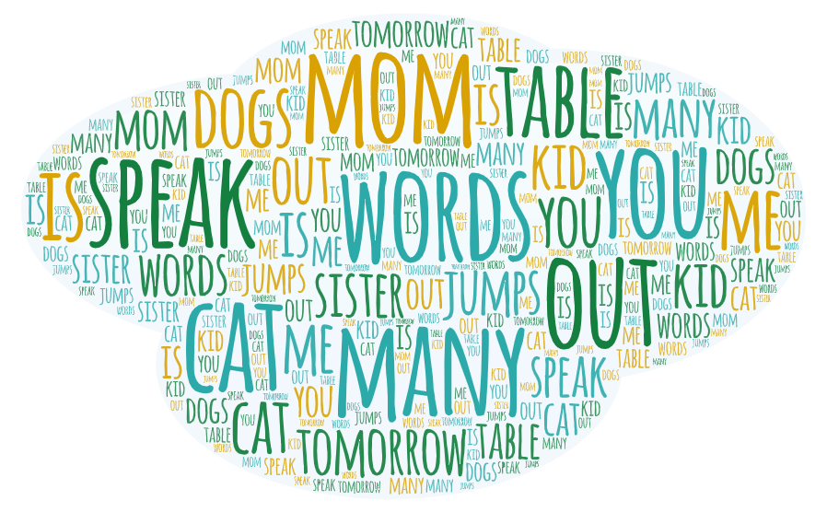



Word Learning
words
meaning

Slide 20
Word Learning
meaning
words
meaning

Slide 21
Word Learning
words
meaning

Slide 22
Word Learning
words
meaning

Slide 23
Word Learning
words
meaning

Slide 24
Word Learning
…?
words
meaning

Slide 25
Word Learning
…?
meaning
words
meaning

Slide 26
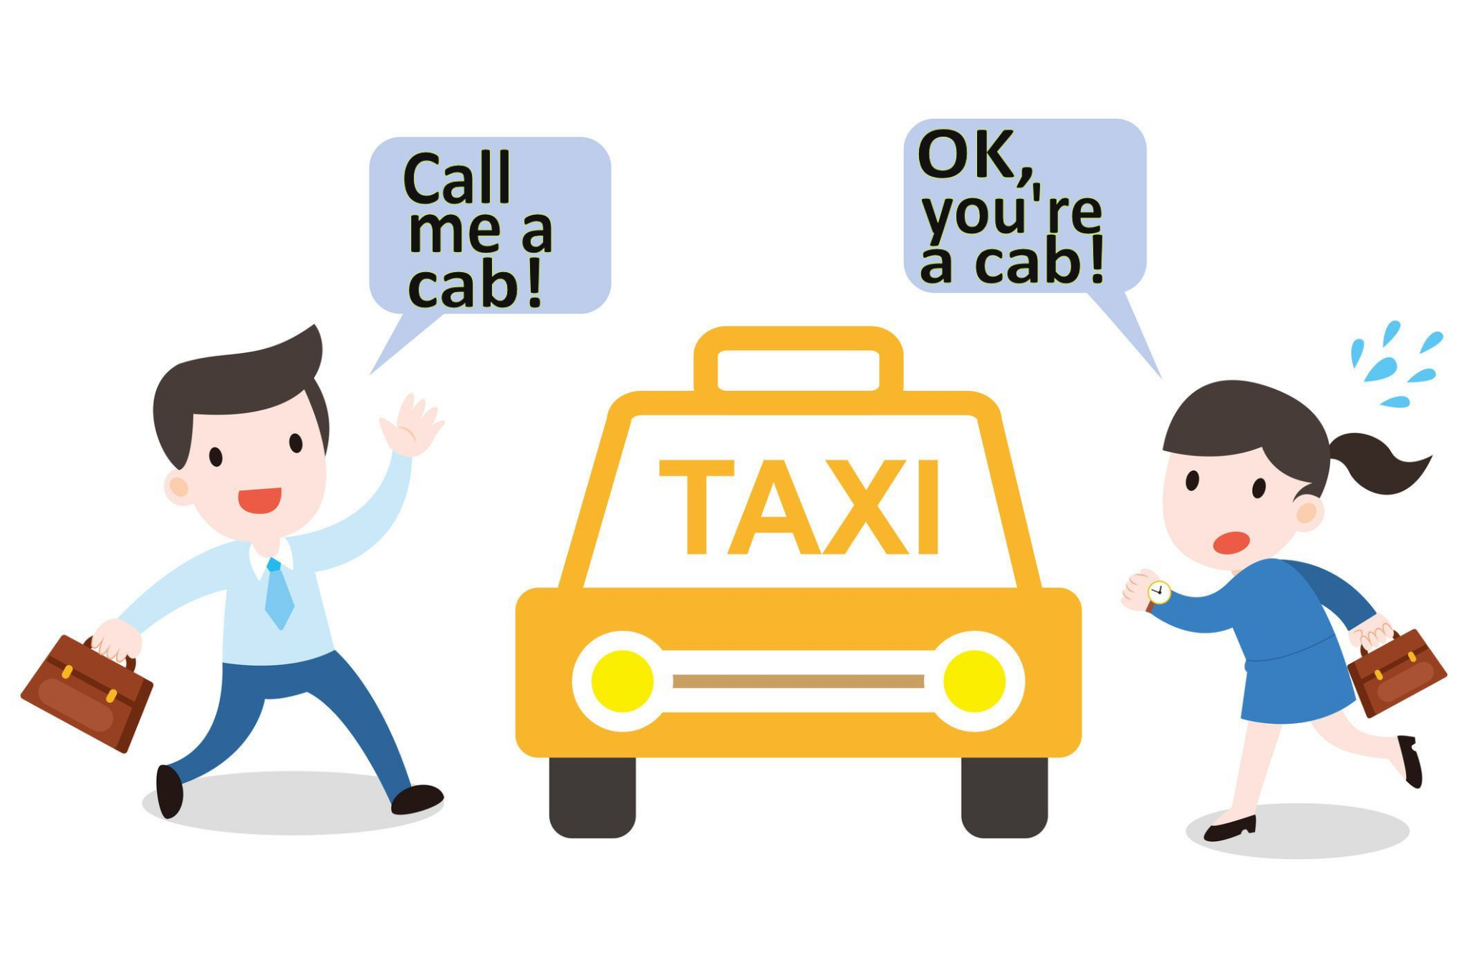
Word Learning
Mapping words to meaning is a difficult task
How do children constrain the hypothesis space?

Slide 27
Word Learning
Mapping words to meaning is a difficult task
How do children constrain the hypothesis space?
  Biases to select referent
    mutual exclusivity bias, whole-object assumption, ...

Slide 28
Word Learning
Mapping words to meaning is a difficult task
How do children constrain the hypothesis space?
  Biases to select referent
    mutual exclusivity bias, whole-object assumption, ...
  Cross-situational learning

Slide 29
But… words occur in continuous speech
words
meaning

Slide 30
But… words occur in continuous speech
THE CAT IS ON THE TABLE
words
meaning

Slide 31
Word Learning
Mapping words to meaning is a difficult task
How do children constrain the hypothesis space?
  Biases to select referent
    mutual exclusivity bias, whole-object assumption, ...
  Cross-situational learning
  Distributional information from the linguistic input
    Context

Slide 32
Word Learning from distributional cues
THE CAT IS ON THE TABLE
WHERE DOES THE CAT SLEEP?
THE CAT ATE YOUR FOOD!
Children can track distributional information at a very young age (Saffran et al. 1996, Aslin et al. 1998, …)
How can distributional information shape meaning representations?
  Let’s look at Distributional Semantic Models

Slide 33
Distributional Semantic Models

Slide 34
Meaning as use
“The meaning of a word is its use in the language” (Wittgenstein, 1953)
“What people know when they say that they know a word is not how to recite its dictionary definition – they know how to use it” (Miller, 1986)
Notes:
The original idea for these models was representing the meaning of a word based on its usage.

Slide 35
The Distributional Hypothesis
“Difference of meaning correlates with difference of distribution” (Harris, 1954)
“You shall know a word by the company it keeps” (Firth, 1957)

Slide 36
Distributional Semantic Models
Distributional Semantic Models (DSMs) derive semantic representations of words based on the distributional hypothesis
These models are also known as Vector Space Models
Notes:
http://colinglab.humnet.unipi.it/wp-content/uploads/2012/12/annurev-linguistics-030514-125254.pdf

Slide 37
Distributional Semantic Models
The representations have the form of vectors (embeddings)
e.g.
These representations are distributed rather than symbolic
  similar words should have similar representations!
249 | 0 | 365 | 446 | 0 | 0 | 90 | 0 | 2136
Notes:
http://colinglab.humnet.unipi.it/wp-content/uploads/2012/12/annurev-linguistics-030514-125254.pdf

Slide 38
Distributional Semantic Models
The number of words that we consider to be part of the context of another word is a parameter called "window size"
We will now see an example of how we derive word representations in Distributional Semantic Models, for a model with window size = 2
Notes:
http://colinglab.humnet.unipi.it/wp-content/uploads/2012/12/annurev-linguistics-030514-125254.pdf

Slide 39
Distributional Semantic Models
THE CAR TRAVELLED AT HIGH SPEED
Notes:
http://colinglab.humnet.unipi.it/wp-content/uploads/2012/12/annurev-linguistics-030514-125254.pdf

Slide 40
Distributional Semantic Models
THE CAR TRAVELLED AT HIGH SPEED
 | the | car | travelled | at | high | speed | ...
the | 0 | 0 | 0 | 0 | 0 | 0 | 0
car | 0 | 0 | 0 | 0 | 0 | 0 | 0
travelled | 0 | 0 | 0 | 0 | 0 | 0 | 0
at | 0 | 0 | 0 | 0 | 0 | 0 | 0
high | 0 | 0 | 0 | 0 | 0 | 0 | 0
speed | 0 | 0 | 0 | 0 | 0 | 0 | 0
... | 0 | 0 | 0 | 0 | 0 | 0 | 0
Notes:
http://colinglab.humnet.unipi.it/wp-content/uploads/2012/12/annurev-linguistics-030514-125254.pdf

Slide 41
Distributional Semantic Models
THE CAR TRAVELLED AT HIGH SPEED
 | the | car | travelled | at | high | speed | ...
the | 0 | 1 | 1 | 0 | 0 | 0 | 0
car | 0 | 0 | 0 | 0 | 0 | 0 | 0
travelled | 0 | 0 | 0 | 0 | 0 | 0 | 0
at | 0 | 0 | 0 | 0 | 0 | 0 | 0
high | 0 | 0 | 0 | 0 | 0 | 0 | 0
speed | 0 | 0 | 0 | 0 | 0 | 0 | 0
... | 0 | 0 | 0 | 0 | 0 | 0 | 0
Notes:
http://colinglab.humnet.unipi.it/wp-content/uploads/2012/12/annurev-linguistics-030514-125254.pdf

Slide 42
Distributional Semantic Models
THE CAR TRAVELLED AT HIGH SPEED
 | the | car | travelled | at | high | speed | ...
the | 0 | 1 | 1 | 0 | 0 | 0 | 0
car | 1 | 0 | 1 | 1 | 0 | 0 | 0
travelled | 0 | 0 | 0 | 0 | 0 | 0 | 0
at | 0 | 0 | 0 | 0 | 0 | 0 | 0
high | 0 | 0 | 0 | 0 | 0 | 0 | 0
speed | 0 | 0 | 0 | 0 | 0 | 0 | 0
... | 0 | 0 | 0 | 0 | 0 | 0 | 0
Notes:
http://colinglab.humnet.unipi.it/wp-content/uploads/2012/12/annurev-linguistics-030514-125254.pdf

Slide 43
Distributional Semantic Models
THE CAR TRAVELLED AT HIGH SPEED
 | the | car | travelled | at | high | speed | ...
the | 0 | 1 | 1 | 0 | 0 | 0 | 0
car | 1 | 0 | 1 | 1 | 0 | 0 | 0
travelled | 1 | 1 | 0 | 1 | 1 | 0 | 0
at | 0 | 0 | 0 | 0 | 0 | 0 | 0
high | 0 | 0 | 0 | 0 | 0 | 0 | 0
speed | 0 | 0 | 0 | 0 | 0 | 0 | 0
... | 0 | 0 | 0 | 0 | 0 | 0 | 0
Notes:
http://colinglab.humnet.unipi.it/wp-content/uploads/2012/12/annurev-linguistics-030514-125254.pdf

Slide 44
Distributional Semantic Models
THE CAR TRAVELLED AT HIGH SPEED
 | the | car | travelled | at | high | speed | ...
the | 0 | 1 | 1 | 0 | 0 | 0 | 0
car | 1 | 0 | 1 | 1 | 0 | 0 | 0
travelled | 1 | 1 | 0 | 1 | 1 | 0 | 0
at | 0 | 1 | 1 | 0 | 1 | 1 | 0
high | 0 | 0 | 0 | 0 | 0 | 0 | 0
speed | 0 | 0 | 0 | 0 | 0 | 0 | 0
... | 0 | 0 | 0 | 0 | 0 | 0 | 0
Notes:
http://colinglab.humnet.unipi.it/wp-content/uploads/2012/12/annurev-linguistics-030514-125254.pdf

Slide 45
Distributional Semantic Models
THE CAR TRAVELLED AT HIGH SPEED
 | the | car | travelled | at | high | speed | ...
the | 0 | 1 | 1 | 0 | 0 | 0 | 0
car | 1 | 0 | 1 | 1 | 0 | 0 | 0
travelled | 1 | 1 | 0 | 1 | 1 | 0 | 0
at | 0 | 1 | 1 | 0 | 1 | 1 | 0
high | 0 | 0 | 1 | 1 | 0 | 1 | 0
speed | 0 | 0 | 0 | 0 | 0 | 0 | 0
... | 0 | 0 | 0 | 0 | 0 | 0 | 0
Notes:
http://colinglab.humnet.unipi.it/wp-content/uploads/2012/12/annurev-linguistics-030514-125254.pdf

Slide 46
Distributional Semantic Models
THE CAR TRAVELLED AT HIGH SPEED
 | the | car | travelled | at | high | speed | ...
the | 0 | 1 | 1 | 0 | 0 | 0 | 0
car | 1 | 0 | 1 | 1 | 0 | 0 | 0
travelled | 1 | 1 | 0 | 1 | 1 | 0 | 0
at | 0 | 1 | 1 | 0 | 1 | 1 | 0
high | 0 | 0 | 1 | 1 | 0 | 1 | 0
speed | 0 | 0 | 0 | 1 | 1 | 0 | 0
... | 0 | 0 | 0 | 0 | 0 | 0 | 0
Notes:
http://colinglab.humnet.unipi.it/wp-content/uploads/2012/12/annurev-linguistics-030514-125254.pdf

Slide 47
Distributional Semantic Models
 | the | car | travelled | at | high | speed | ...
the | 0 | 1 | 1 | 0 | 0 | 0 | 0
car | 1 | 0 | 1 | 1 | 0 | 0 | 0
travelled | 1 | 1 | 0 | 1 | 1 | 0 | 0
at | 0 | 1 | 1 | 0 | 1 | 1 | 0
high | 0 | 0 | 1 | 1 | 0 | 1 | 0
speed | 0 | 0 | 0 | 1 | 1 | 0 | 0
... | 0 | 0 | 0 | 0 | 0 | 0 | 0
Notes:
http://colinglab.humnet.unipi.it/wp-content/uploads/2012/12/annurev-linguistics-030514-125254.pdf
Each row or column will be a representation for each word. Note that they are identical.

Slide 48
Distributional Semantic Models
THE TRUCK TRAVELLED FAST
 | the | car | travelled | at | high | speed | truck | fast
the | 0 | 1 | 2 | 0 | 0 | 0 | 1 | 0
car | 1 | 0 | 1 | 1 | 0 | 0 | 0 | 0
travelled | 2 | 1 | 0 | 1 | 1 | 0 | 1 | 1
at | 0 | 1 | 1 | 0 | 1 | 1 | 0 | 0
high | 0 | 0 | 1 | 1 | 0 | 1 | 0 | 0
speed | 0 | 0 | 0 | 1 | 1 | 0 | 0 | 0
truck | 1 | 0 | 1 | 0 | 0 | 0 | 0 | 1
fast | 0 | 0 | 1 | 0 | 0 | 0 | 1 | 0
Notes:
http://colinglab.humnet.unipi.it/wp-content/uploads/2012/12/annurev-linguistics-030514-125254.pdf
Car and truck are things that travel. Speed and fast are very related but they have different syntactic categories in these sentence, so speed is further from car than fast from truck.

Slide 49
Distributional Semantic Models
This is a term-term co-occurrence matrix (for a toy example)
The vectors reflect the use of words in real linguistic productions.
Similar vectors for semantically related words!
 | the | car | travelled | at | high | speed | truck | fast
the | 0 | 1 | 2 | 0 | 0 | 0 | 1 | 0
car | 1 | 0 | 1 | 1 | 0 | 0 | 0 | 0
travelled | 2 | 1 | 0 | 1 | 1 | 0 | 1 | 1
at | 0 | 1 | 1 | 0 | 1 | 1 | 0 | 0
high | 0 | 0 | 1 | 1 | 0 | 1 | 0 | 0
speed | 0 | 0 | 0 | 1 | 1 | 0 | 0 | 0
truck | 1 | 0 | 1 | 0 | 0 | 0 | 0 | 1
fast | 0 | 0 | 1 | 0 | 0 | 0 | 1 | 0
Notes:
http://colinglab.humnet.unipi.it/wp-content/uploads/2012/12/annurev-linguistics-030514-125254.pdf
Car and truck are things that travel. Speed and fast are very related but they have different syntactic categories in these sentence, so speed is further from car than fast from truck.

Slide 50
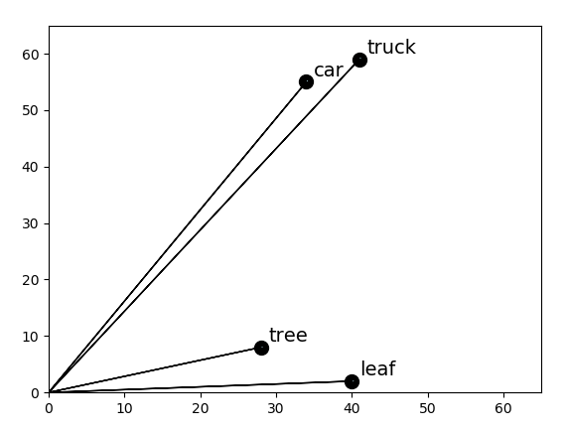
Distributional Semantic Models
We can interpret each position in an n-dimensional vector as a coordinate of a point in n-dimensional vector space
(graph reduced to 2 dimensions)
Thus, these word representations have geometric properties (e.g. distance between words!)
speed
drive

Slide 51
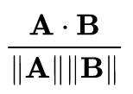
Distributional Semantic Models
Cosine similarity: cosine of the angle of the vectors
cos(Θ) =
The cosine is between [-1, 1].
A cosine similarity of 0 indicates orthogonal vectors (completely unrelated).
speed
drive
Notes:
Why do we look at the angle and not at the distance between the points?
The distance between the points sould reflect the word frequency. Rare words would be very much appart from frequent words, even if they have similar meaning.

Slide 52
Let’s implement this!

